Slide 1
Introduction to Command Line
Jie Li, PhD
UC Davis Bioinformatics Core
10X Workshop
PAG Asia
May 30, 2018

Slide 2
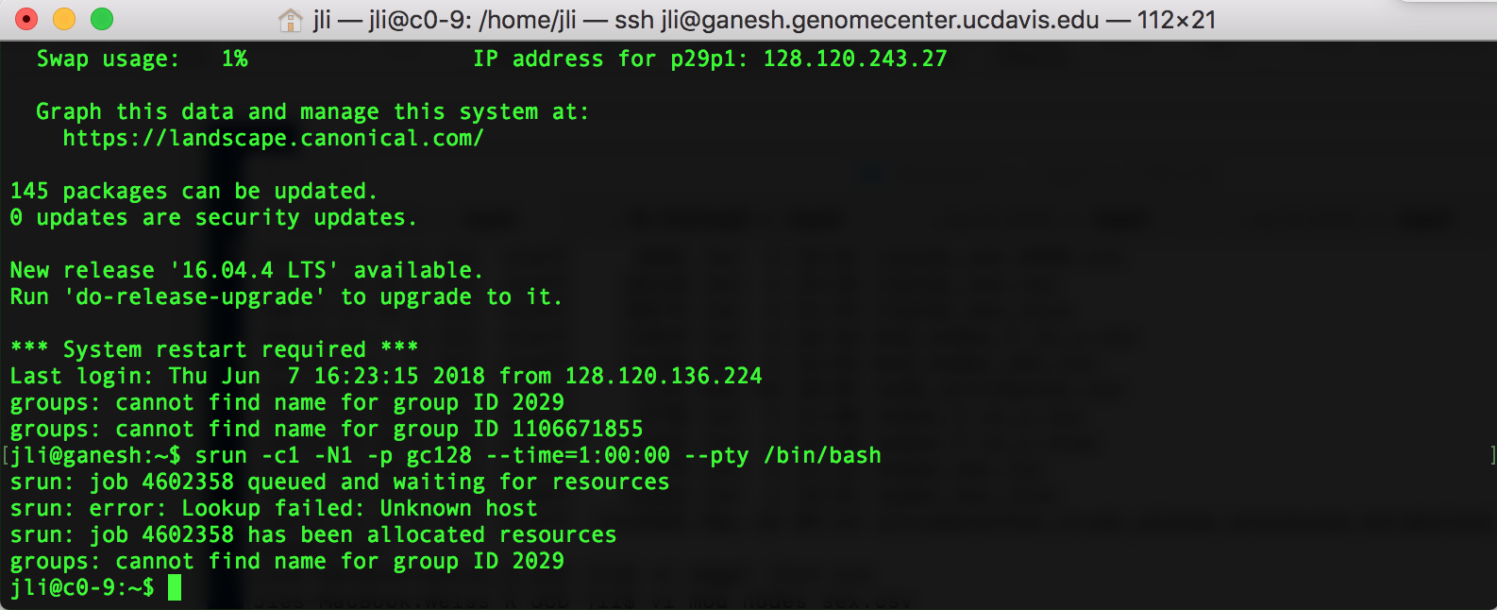
What is command line interface
CLI is a tool into which one can type commands to perform tasks.
The user interface that accepts the typed responses and displays the data on the screen is called a shell: bash, tcsh…
An all-text display

Slide 3
What is command line interface
A prompt is a short text message at the start of the command line on CLI.
Ends with $ in bash shell
Commands are typed after the prompt

Slide 4
What is command line interface
Standard input
Standard output

Slide 5
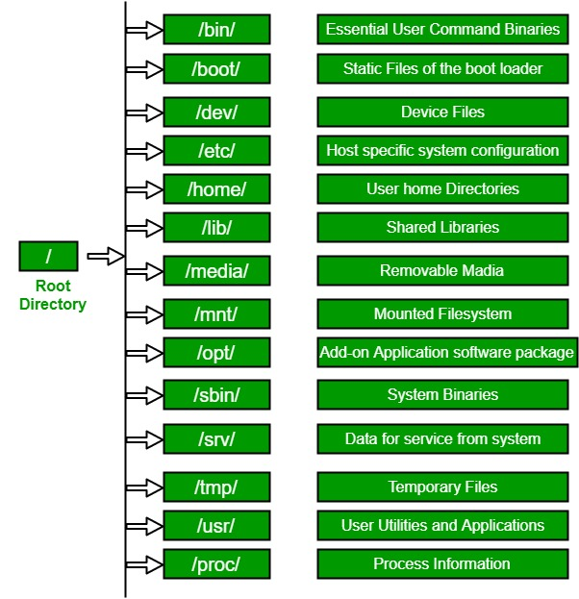
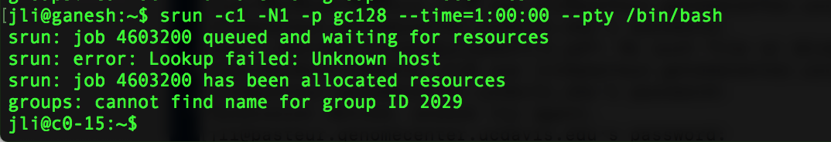
File structure in CLI
Usually, /home is the user accounts reside, ie. user’s home directory.
For example, for a user that has a user name of “jli”: /home/jli
It is the directory that a user is first at after logging into the system.
The tilde (~) represents a user’s home directory.

Slide 6
File structure in CLI (continued…)
Absolute path: always starts with ”/”
/home/jli/test/file1
Relative path: always relative to where we currently are
a single dot (.) refers to the current directory
two dots (..) refers to the directory one level up

Slide 7

Syntax of a command in CLI
a command plus the required parameters/arguments
the separator used in issuing a command is space
argument
command
parameter

Slide 8
Move around in CLI
Command to find out where we currently are
pwd (present working directory)
Command to change to another directory
cd (change directory)
use absolute path: cd /home/jli/test/run1
use relative path: cd ../
without any argument, by default, change to user’s home directory

Slide 9
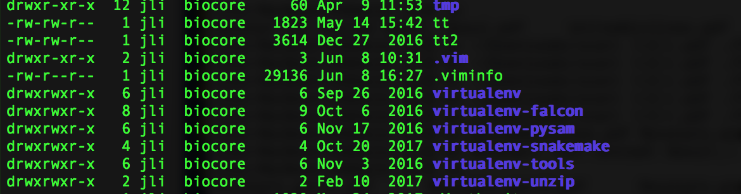
Display files in CLI
Command to display a list of files
ls
without any other parameters, it list all files/directories inside the current directory
may be combined with a path to list a specific file/directory
to show all files/directories and their associated information: ls -al

Slide 10
Move things around in CLI
Command to move something from one place to another
mv (move)
two arguments required:
the file/directory that you want to be moved
the new location
it is also the command to rename things in CLI

Slide 11
Create things in CLI
Command to create a directory
mkdir (make directory)
one argument required:
the directory that you want to create
may create multiple directories at the same time
by default, the directory is created in the current directory, unless an valid path is given
Methods to create a file
text editor, such as vi, vim, Nano, Emacs
other commands, such as echo, cat

Slide 12
Make copies of things in CLI
cp (copy)
two arguments required:
the thing to copy
the place to put the copied
use -r parameter to copy a directory

Slide 13
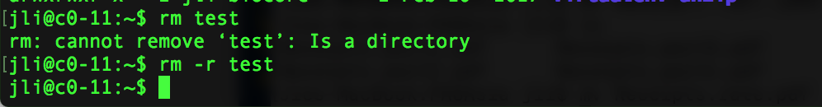
Remove things in CLI
rm (remove)
by default, it only removes a file
in order to remove a directory, use -r parameter
NEVER EVER use the following command, unless you really mean it
rm -rf *

Slide 14
Move things to/from a remote location in CLI
Between two remote unix based locations
scp (secure copy)
wget
curl
rsync
On Windows machines
WinSCP
Filezilla
many others

Slide 15
The mission of the Bioinformatics Core facility is to facilitate outstanding omics- scale research through these activities:
Data Analysis
The Bioinformatics Core promotes experimental design, advanced computation and informatics analysis of omics scale datasets that drives research forward.
Research Computing
Maintain and make available high-performance computing hardware and software necessary for todays data-intensive bioinformatic analyses.
Training
The Core helps to educate the next generation of bioinformaticians through highly acclaimed training workshops, seminars and through direct participation in research activities.
Data Analysis
Research Computing
Training
Data Analysis
Research Computing
Training
Data Analysis
Research Computing
Training
Data Analysis
Research Computing
Training
Intelligently analyzing data from genomics, and other projects, to help drive research forward
Helping build high-performance software and hardware bioinformatics solutions
Providing acclaimed training workshops that will equip people with in-demand bioinformatics skills
Intelligently analyzing data from genomics, and other projects, to help drive research forward
Helping build high-performance software and hardware bioinformatics solutions
Providing acclaimed training workshops that will equip people with in-demand bioinformatics skills
Intelligently analyzing data from genomics, and other projects, to help drive research forward
Helping build high-performance software and hardware bioinformatics solutions
Providing acclaimed training workshops that will equip people with in-demand bioinformatics skills
Intelligently analyzing data from genomics, and other projects, to help drive research forward
Helping build high-performance software and hardware bioinformatics solutions
Providing acclaimed training workshops that will equip people with in-demand bioinformatics skills

