Slide 1
Chameleon Predictor
3D Conformational Descriptors for Cyclic Peptide Membrane Permeation
Jorge Carmona · March 2026

Slide 2
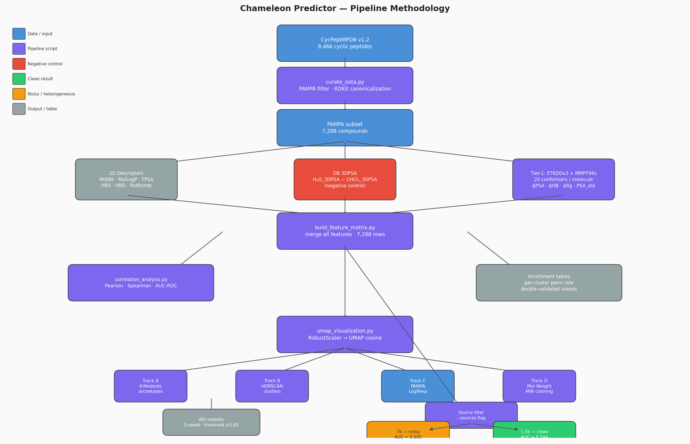
Pipeline Methodology

Slide 3
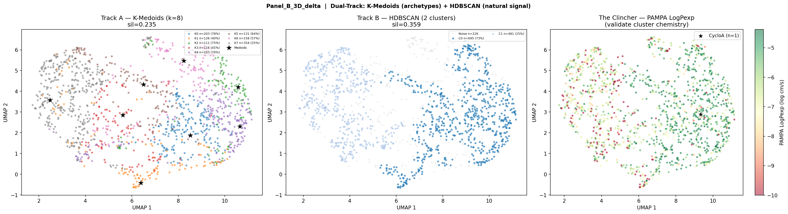
UMAP Panel B — 3D Δ Features (1,502 compounds, Furukawa + Chugai)
AUC = 0.744 on clean homogeneous subset. Two-population structure: chameleonic (high ΔPSA) vs. rigid/polar.

Slide 4
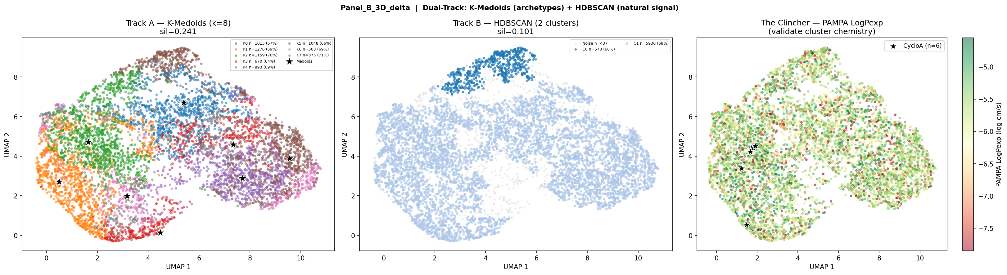
UMAP Panel B — 3D Δ Features (Full 7k)
AUC = 0.505. Two-population structure survives but PAMPA label noise (Townsend/Kelly pooled protocol) washes out the permeability signal.

Slide 5
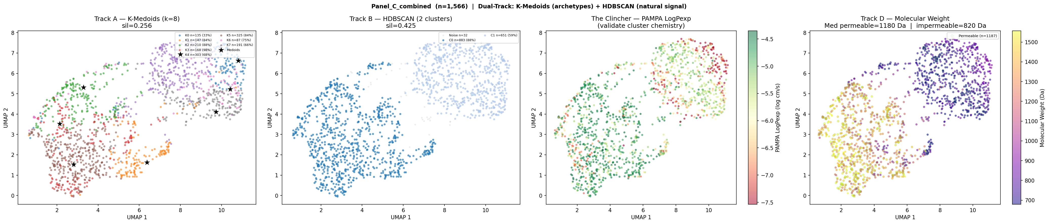
UMAP Panel C + Track D — MW Coloring (1,566 compounds)
Permeable cluster median MW = 1,180 Da vs. impermeable = 820 Da (1.44×). Chameleonic behavior is size-gated: large macrolides only.

Slide 6
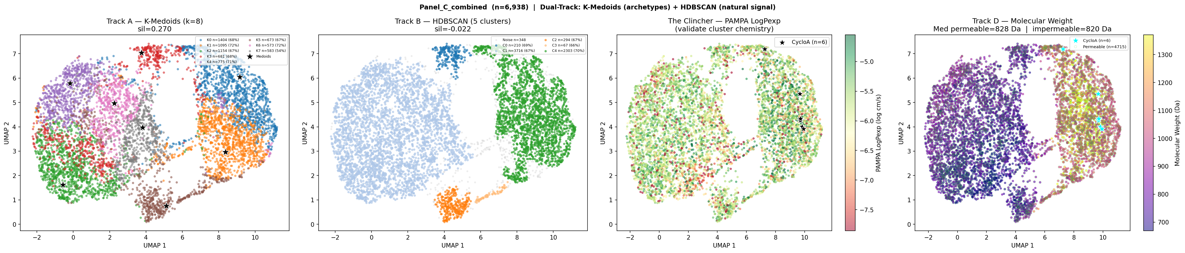
UMAP Panel C + Track D — MW Coloring (Full 7k)
MW gap disappears on full dataset (permeable = impermeable = 820 Da). Cross-source label noise inverts the size-permeability signal.

