Slide 1
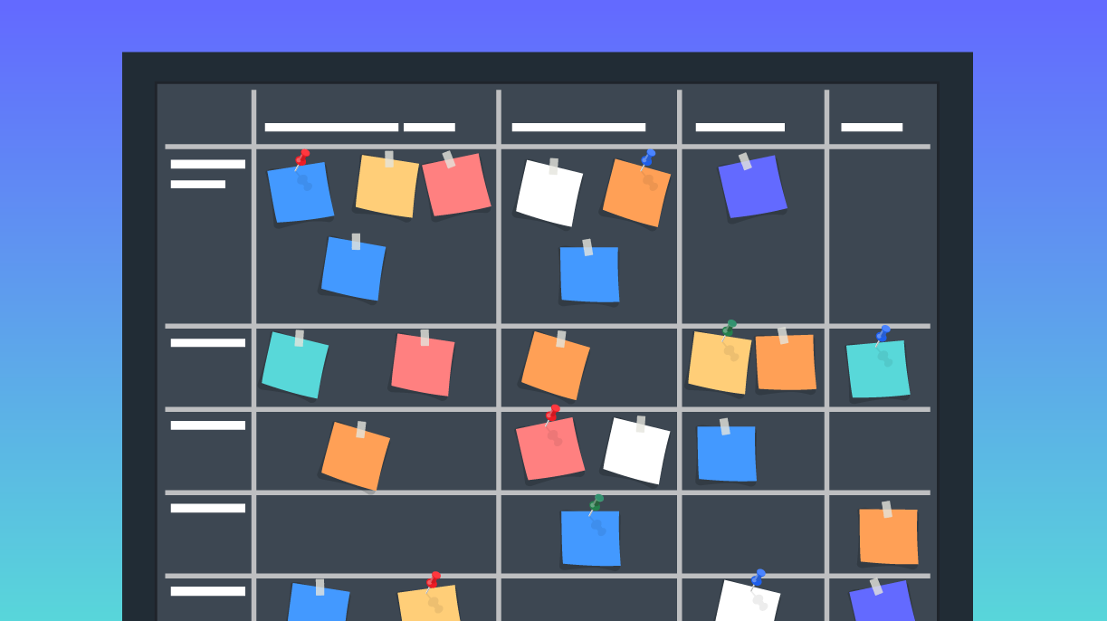
THE BACKLOG: WHAT IS FOR ?
1200618 - Jorge Cunha
1211018 - Pedro Conceição
1211015 - Joana Almeida
1201551 - António Martingo
1200619 - José Lapa

Slide 2
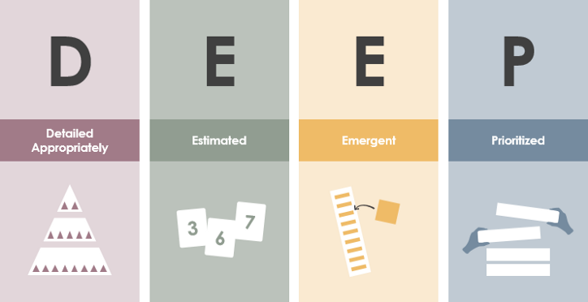
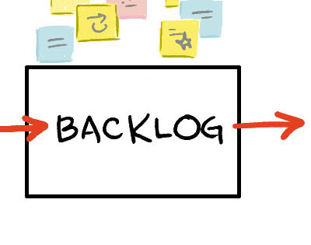
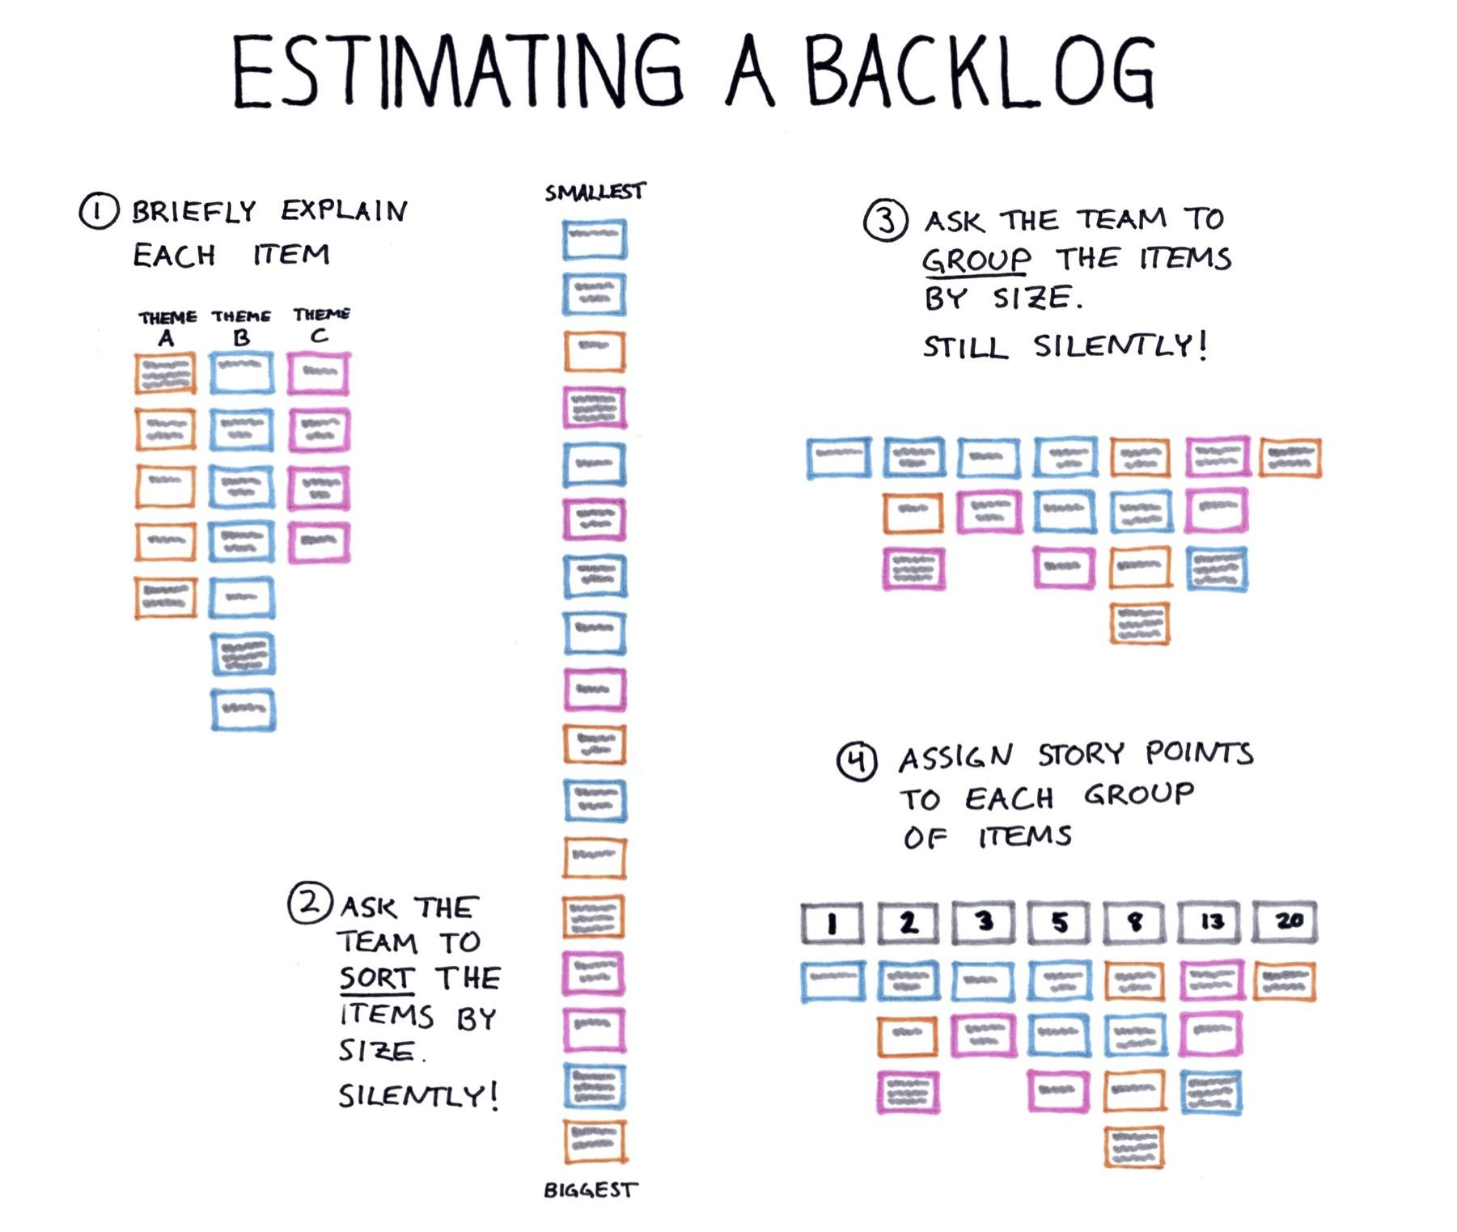
What is a backlog?
A Backlog is a list of tasks;
A product backlog includes creation of user stories, changes of functionalities, and corrections of bugs ;
A key component to backlogs is that its items are ordered by priority;
Helps to provide a single source of truth
A

Slide 3





Makes team discussion easier
On a product backlog not every item is ready to work on.
There are different priorities for different items.
This way, sometimes a team needs to place items or tasks at the bottom of the backlog, to indicate they are not a priority task at the moment.
This makes them a useful tool to facilitate conversations among a team, helps the team discuss how to prioritize work on a product, what conflicts an item might create.

Slide 4



Makes it easier to assign work
A backlog makes the assignment work much easier.
Why ?
The assignments are already there, with their priorities set and the team can just choose who’s the best person to be in charge in each task.

Slide 5

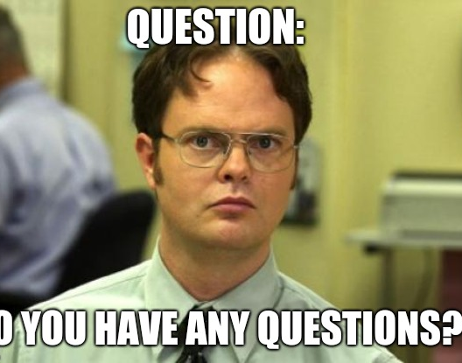
Bibliography:
https://pediaa.com/difference-between-technical-writing-and-literary-writing/
https://www.difference.wiki/technical-writing-vs-literary-writing/

