Slide 1
Topic 2 : Team Building
Luís Moreira - 1200973
Jorge Cunha - 1200618
David Magalhães - 1201237
Tiago Castro - 1201694

Slide 2
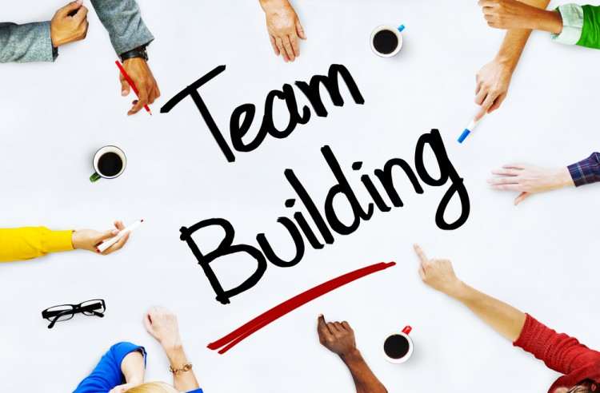
What is Team Building?
Team building is a collective term for various types of activities used to enhance social relations and define roles within teams, often involving collaborative tasks.
How you choose to facilitate team building is your decision but consider the following ways to incorporate it into your workplace.

Slide 3

Definition
The formal definition of team-building includes:
aligning around goals
building effective working relationships
reducing team members' role ambiguity
finding solutions to team problems

Slide 4
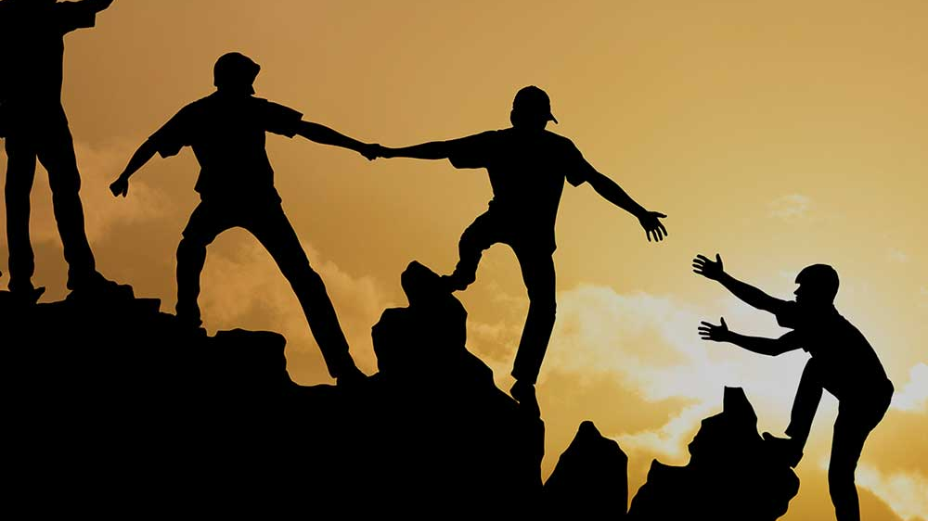
Examples of Team Building Activities
Team Jigsaw - build collaboration, problem solving and communication skills
Tied Together - focus on teamwork, build relationships and communicate clearly
Daredevil - Build communication skills
Many team-building exercises aim to expose and address interpersonal problems within the group.
Over time, these activities are intended to improve performance in a team-based environment.

Slide 5


Team Emblem
This creative team building exercise is great for smaller teams. Players are divided into small teams where they must work together to create an emblem, flag or shield for their teams. Besides collaboration and creative thinking, this activity is also great for building a stronger sense of team identity and cohesiveness. Plus, it's flexible enough for any situation or group size.
Number of participants: Any
Duration: 30-90 minutes
Objective: Focus on creative thinking, collaboration and fostering a team identity.

Slide 6

Perfect Square
A blindfold game where team members must work together to create a perfect square with a rope while completely blindfolded. Communication skills, collaboration and hilariously out of shape squares ensue.
Number of participants: 4-16 participants
Duration: 30 minutes
Objective: Build communication, leadership and collaboration skills

