Slide 1

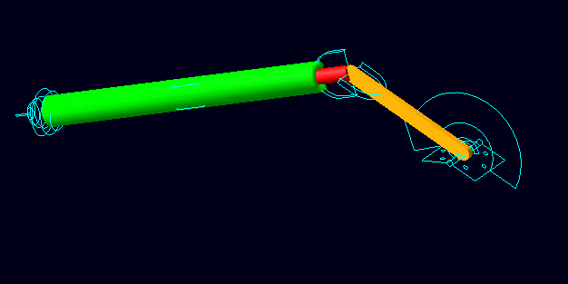
Crank Slider
Estimated time required: 20 min
GUI familiarity level required: Lower
MSC.ADAMS 2005 r2

Slide 2
Topics Covered
In this tutorial, you will learn how to:
Create a revolution
Create a Point-to-Point measure
Create a point measure
Create a measure about an axis
Create an angular velocity measure about an axis
Create an angular acceleration measure about an axis
If you have any difficulties, import the “slider_crank_shortcut.cmd” file and proceed from pg 9
If you have any difficulties, import the “slider_crank.complete.cmd” file and proceed from pg 13

Slide 3
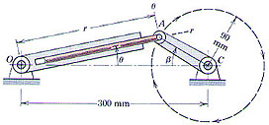
Projectile
Pin A moves in a circle of 90-mm radius as crank AC revolves at a constant rate beta-dot = 60 rad/s. The slotted link rotates about point O as the rod attached to A moves in and out of the slot. For the position beta=30 degrees, determine r-dot, r-double dot, theta-dot, theta-double dot.
This problem asks for the translational speed and acceleration of the slider rod and the angular speed and acceleration
of the slider assembly at a given crank angle of 30 degrees and crank angular velocity of 60 radians per second. To solve
this, we will build an ADAMS model of the crank and slider assembly based on the information given and measure the data
we want using an ADAMS simulation of the
model.
Problem 2/163 from J. L. Meriam and L. G. Kraige, Engineering Mechanics: Volume 2, Dynamics 3rd edition. John Wiley & Sons, Inc.
Copyright © 1992, by John Wiley & Sons, Inc.
This material is used by permission of John Wiley & Sons, Inc.

Slide 4
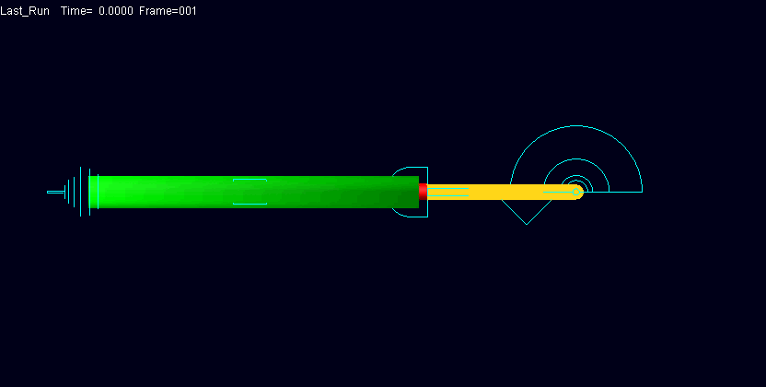
What You Should Accomplish
If you are successful, you should end up with an ADAMS model of a crank slider mechanism

Slide 5
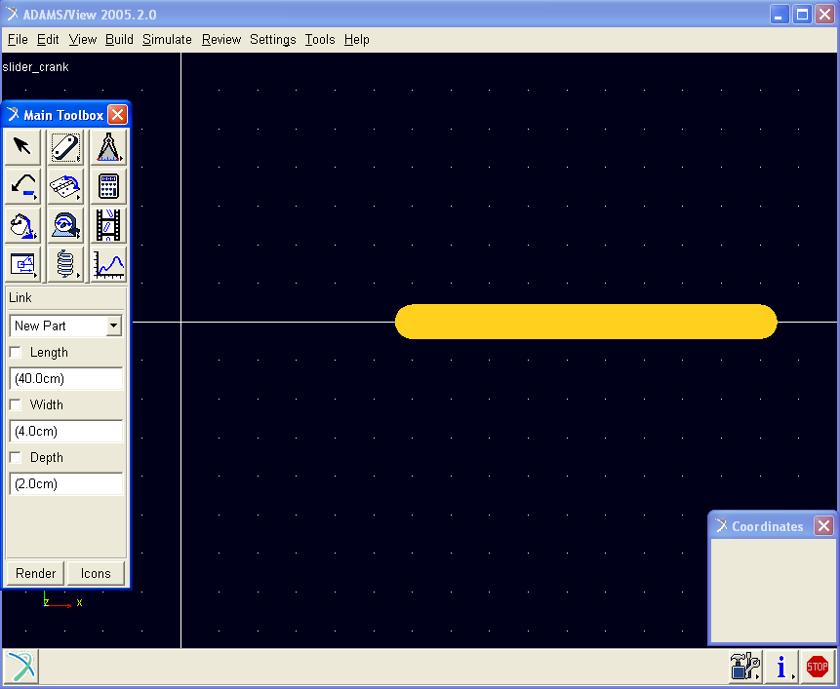
Creating the Model
Start ADAMS.
Create a new model. (Model Name = slider_crank, Units = mmks, Gravity = -y earth)
Resize the working grid, Size = X – 375mm, Y – 250mm, Spacing X – 5mm, Y – 5mm
Open Coordinate Window
Create crank part AC. (link, length = 90-mm, from point (60, 0, 0) to (150, 0, 0)), Rename .slider_crank.crank

Slide 6
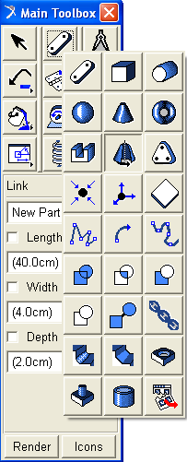
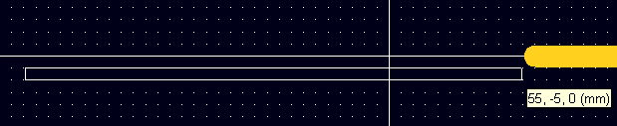
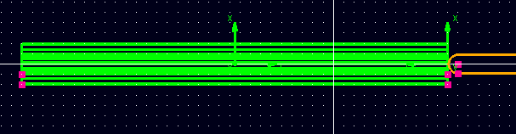
Creating Revolution
Select Revolution from Rigid Body tool stack
Click points:
Right-click to close
Rename .slider_crank.cylinder
55 | 0 | 0
-150 | 0 | 0
55 | -5 | 0
55 | -10 | 0
-150 | -10 | 0
-150 | -5 | 0
55 | -5 | 0

Slide 7
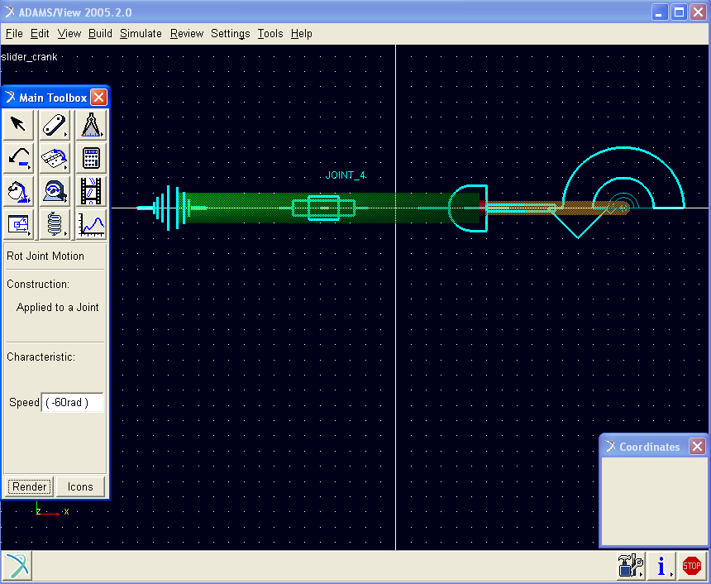
Creating Joints
Create piston part. (cylinder, length = 200 mm, radius = 5 mm, from (60, 0, 0) to (-140, 0, 0)), Rename .slider_crank.piston
Create revolute joints
between crank (link) and ground
Create spherical joint between
revolution and ground,
Create translational joint between
piston and cylinder.
Create Hooke joint between the
link and the cylinder
Add Rotational joint motion to
revolute joint with speed =
-60 rad/s.

Slide 8
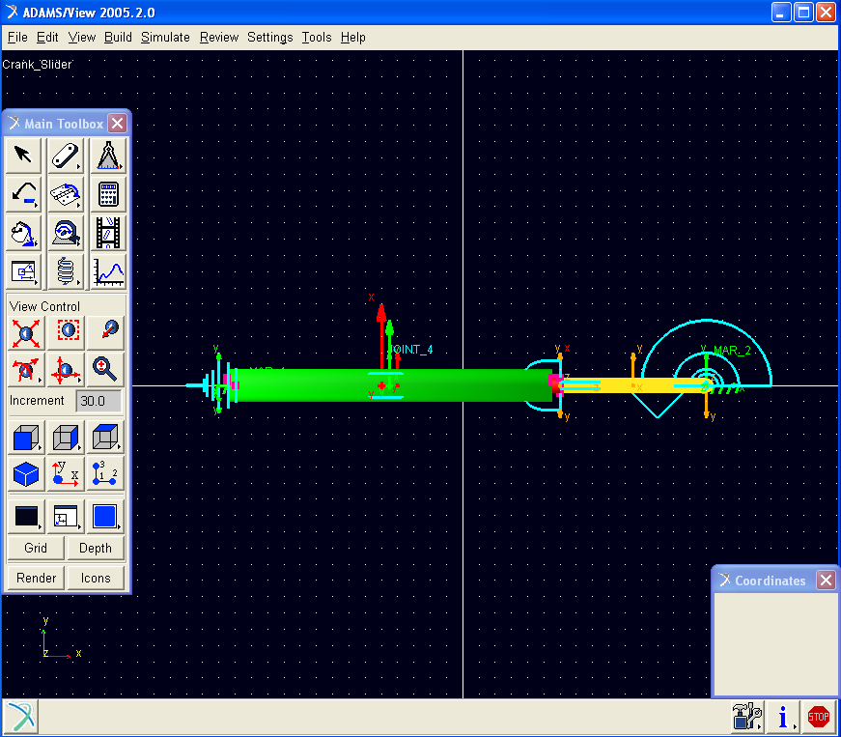
Model
This is what your screen should look like when
your model is complete

Slide 9
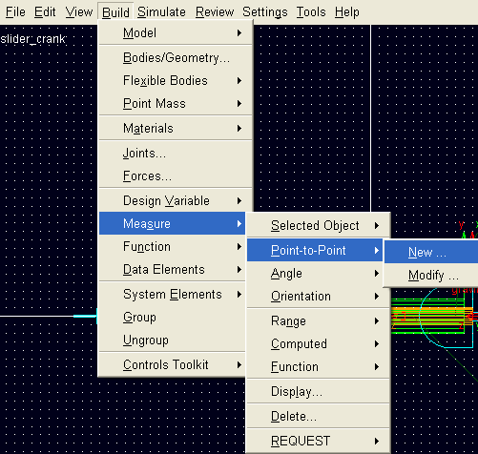
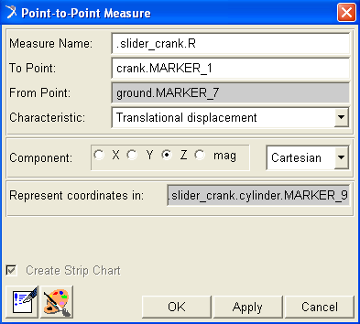
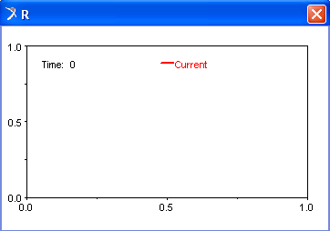
Create Point-to-Point Measure
Click Build menu → Measure → Point-to-Point → New
Enter .slider_crank.R in Measure Name text field
Right-click To Point text field select Marker → Browse → in Database Navigator select slider crank → crank → MARKER_1
Right-click From Point text field select Marker → Browse → in Database Navigator select slider crank → ground → MARKER_7
Select Translational displacement from Characteristic pull down menu
Choose Z Component radio button
Right-click Represent coordinates in text field select Marker → Browse → in Database Navigator select slider crank → cylinder → MARKER_9
Click OK
b
c
d
e
a
f
g
h

Slide 10
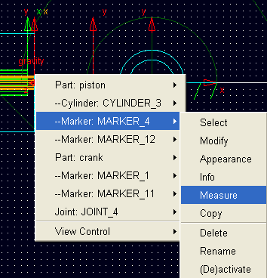
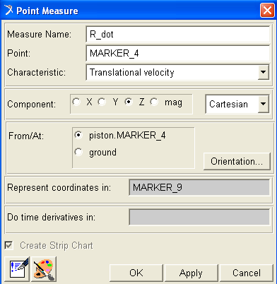
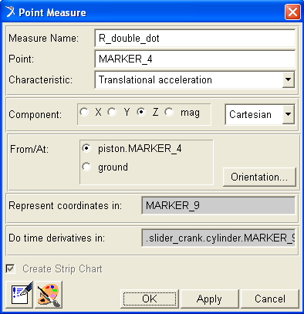
Create Point Measure
Right click piston, select Marker: MARKER_4 → Measure
Enter R_dot from Measure Name
Choose Characteristic as Translational velocity and Z for Component
Select MARKER_9 for Represent coordinates in
Click Apply
Change Measure Name to R_double_dot and select Translational acceleration in Z direction
Choose MARKER_9 from Represent coordinates in and Do time Derivatives in
Click OK
b
f
c
d
a
g
e
h

Slide 11
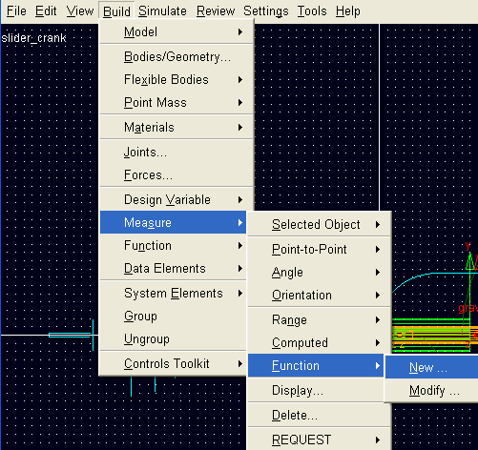
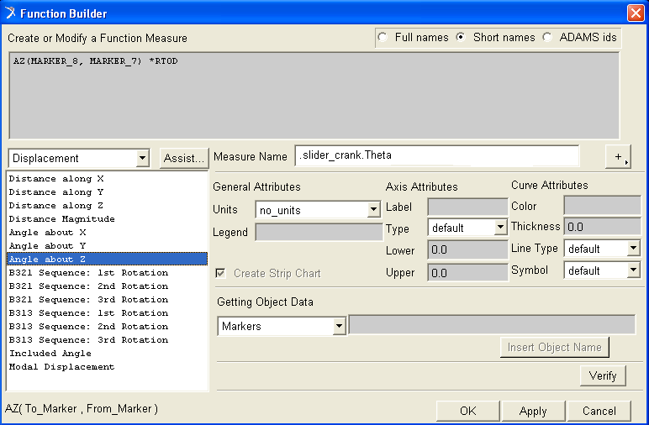
Create Angle About Axis Measure
Click Build menu → Measure → Function → New
Enter .slider_crank.Theta in Measure Name text field
Select Displacement from pull down menu
Select Angle about Z
Choose MARKER_8 as To_Marker
Choose MARKER_7 as From_Marker
Enter *RTOD at the end of the function (i.e. AZ(MARKER_8, MARKER_7) *RTOD)
Click OK
g
c
b
d
a
h

Slide 12
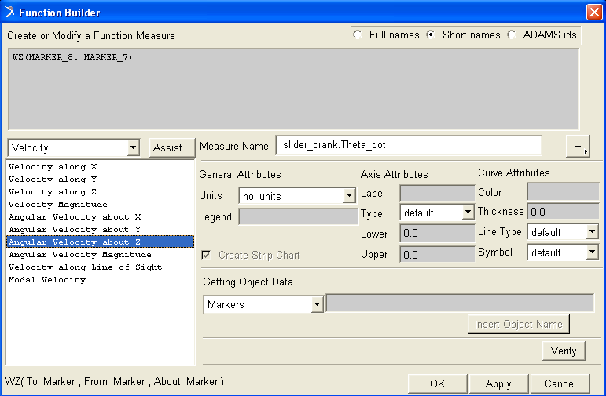
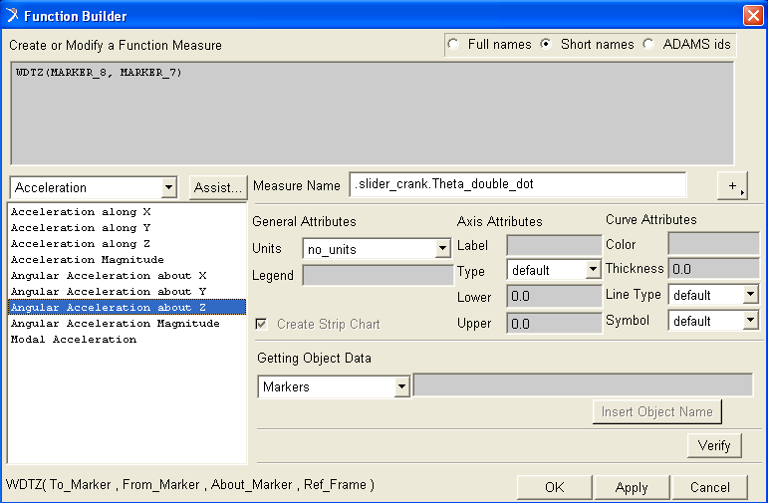
Create Angular Velocity and Acceleration About Axis Measures
Create another measure Angular Velocity about Z, name .slider_crank.Theta_dot from marker MARKER_7 to MARKER_8
Create another measure Angular Acceleration about Z, name .slider_crank.Theta_double_dot from marker MARKER_7 to MARKER_8

Slide 13
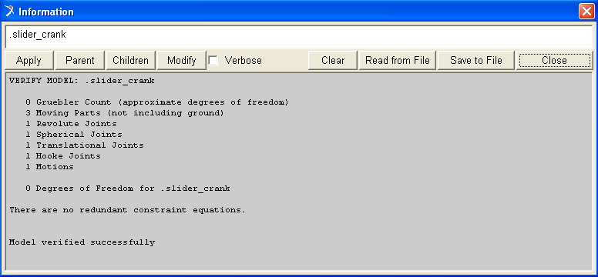
Verify
Verify your model
Run Simulation: Duration = 0.008727 , Step Size = 0.0008727
(30deg ~ 0.008727s)

Slide 14
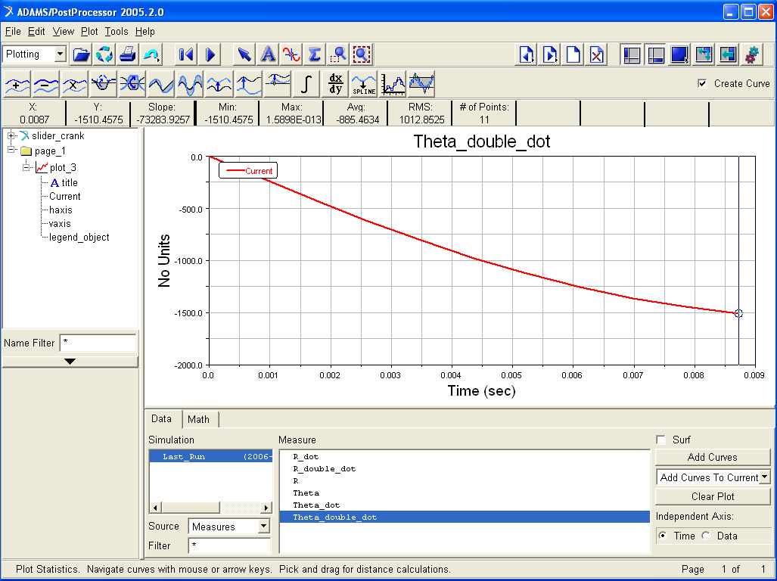
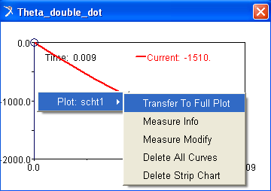
Plot
Right-click in plot window, select Plot: scht1 → Transfer to full plot
Click plot tracking tool, find value for Y when X = 0.0087
To choose another measurement
Select Measures from Source pull down menu
Choose measurement
Click Surf
b
a
e
d
c

Slide 15
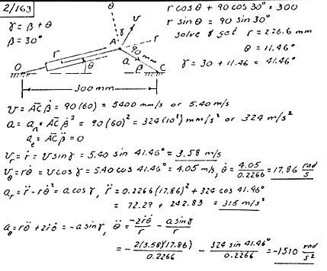





Results
Theoretical Solution
ADAMS solution
R=
R-dot =
R double dot =
Theta =
Theta dot =
r = 2.266m
r-dot = 3.58 m/s,
r-double dot = 316 m/s^2,
Theta = 11.46deg
theta-dot = 17.86 rad/s,
theta-double dot = -1510 rad/s^2
Theta double dot =

Slide 16
Topics Covered
In this tutorial you learned how to:
Create a revolution
Create a Point-to-Point measure
Create a point measure
Create a measure about an axis
Create an angular velocity measure about an axis
Create an angular acceleration measure about an axis

Slide 17
Best Practices
Make sure correct units are set to mmks.
Make sure gravity is on and in the -y direction and set to 9806.15.
Make sure the revolute joints are in the z direction.
Check dimensions of the part to make sure they are correct.
Make sure the measures are set correctly.
Make sure the plot is displaying the correct set of results.
Make sure there are enough output steps to observe the speed and acceleration when beta=30 deg.

