Slide 1



VS
Ironhack Madrid - Data Analytics Part Time - January 2021 - Project Module 1

Slide 2
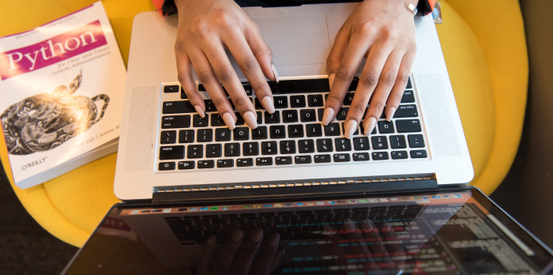
What is the project
Analyze, process and get the information from BiciMAD API to get the BBDD and from datos.madrid.es the datasets of temples in json format.
Requirements: Pandas, requests, geopandas,smtplib, getpass, os, Azure data studio
Final output: an email with a csv file containing the information desired.

Slide 3



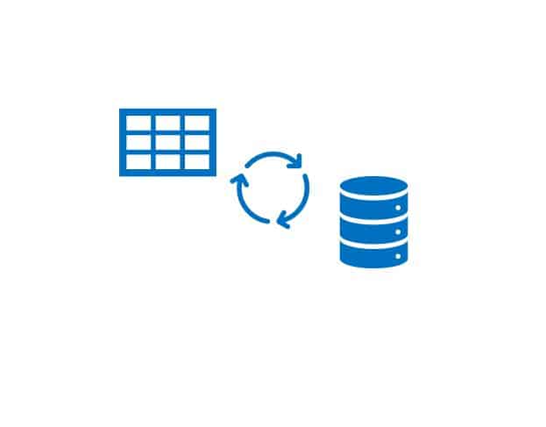
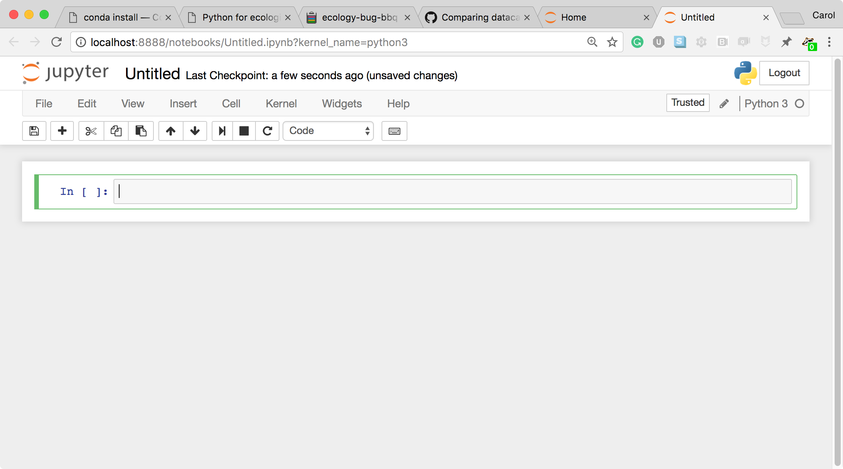
Main points
Parameters:
This was definitely the most difficult part of the project as I had to put into practice everything I learned
LOAD DATA:
It was tough to connect to BiciMAD API as I did not have the skills to do it

Slide 4
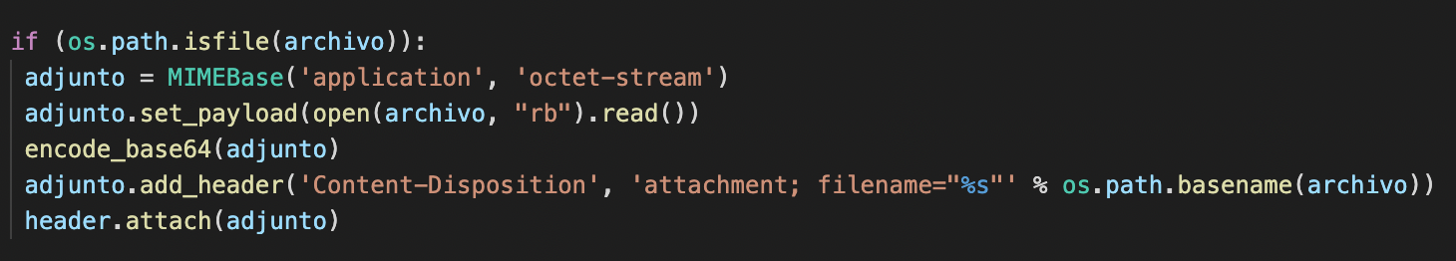
My star function is:

Slide 5
