Slide 1
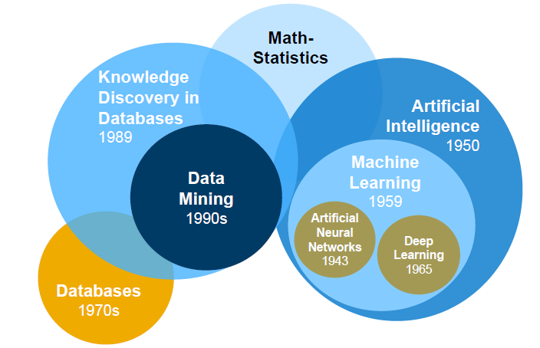
openSAP: Enterprise Machine Learning in a Nutshell

Slide 2
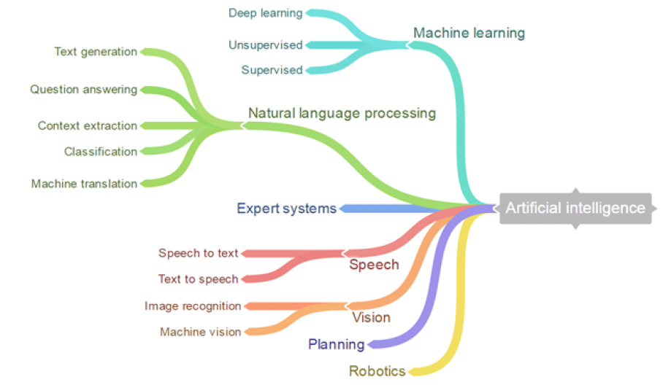
ODTUG 2020: Demystifying Machine Learning and Why You Should Jump on the Bandwagon Now

Slide 3
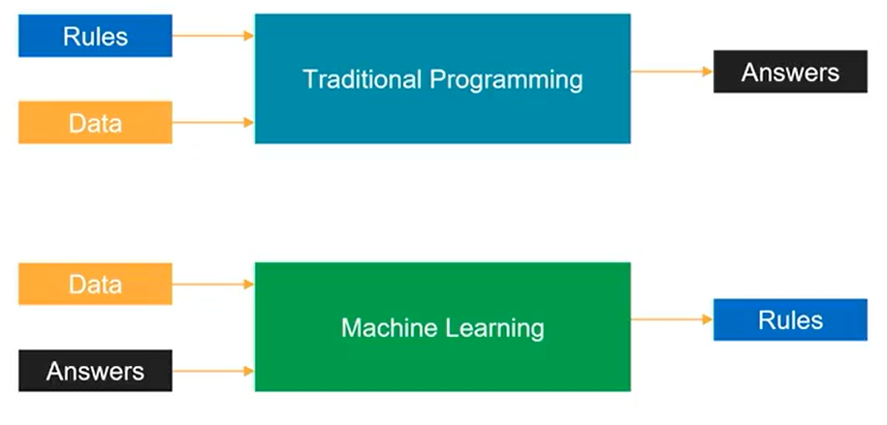
Udacity: Machine Learning Scholarship Program for Microsoft Azure

Slide 4
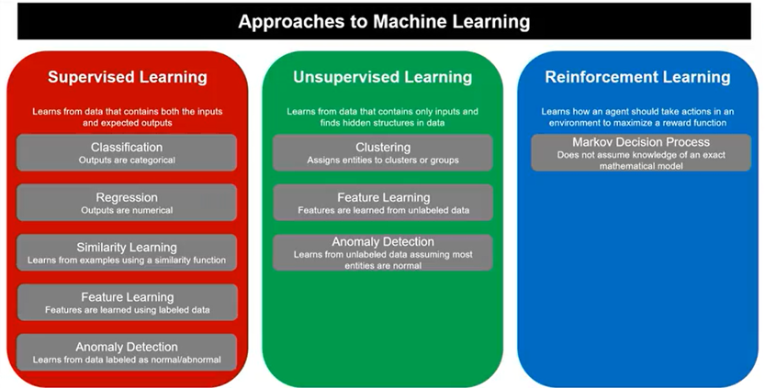
Udacity: Machine Learning Scholarship Program for Microsoft Azure

