Slide 1
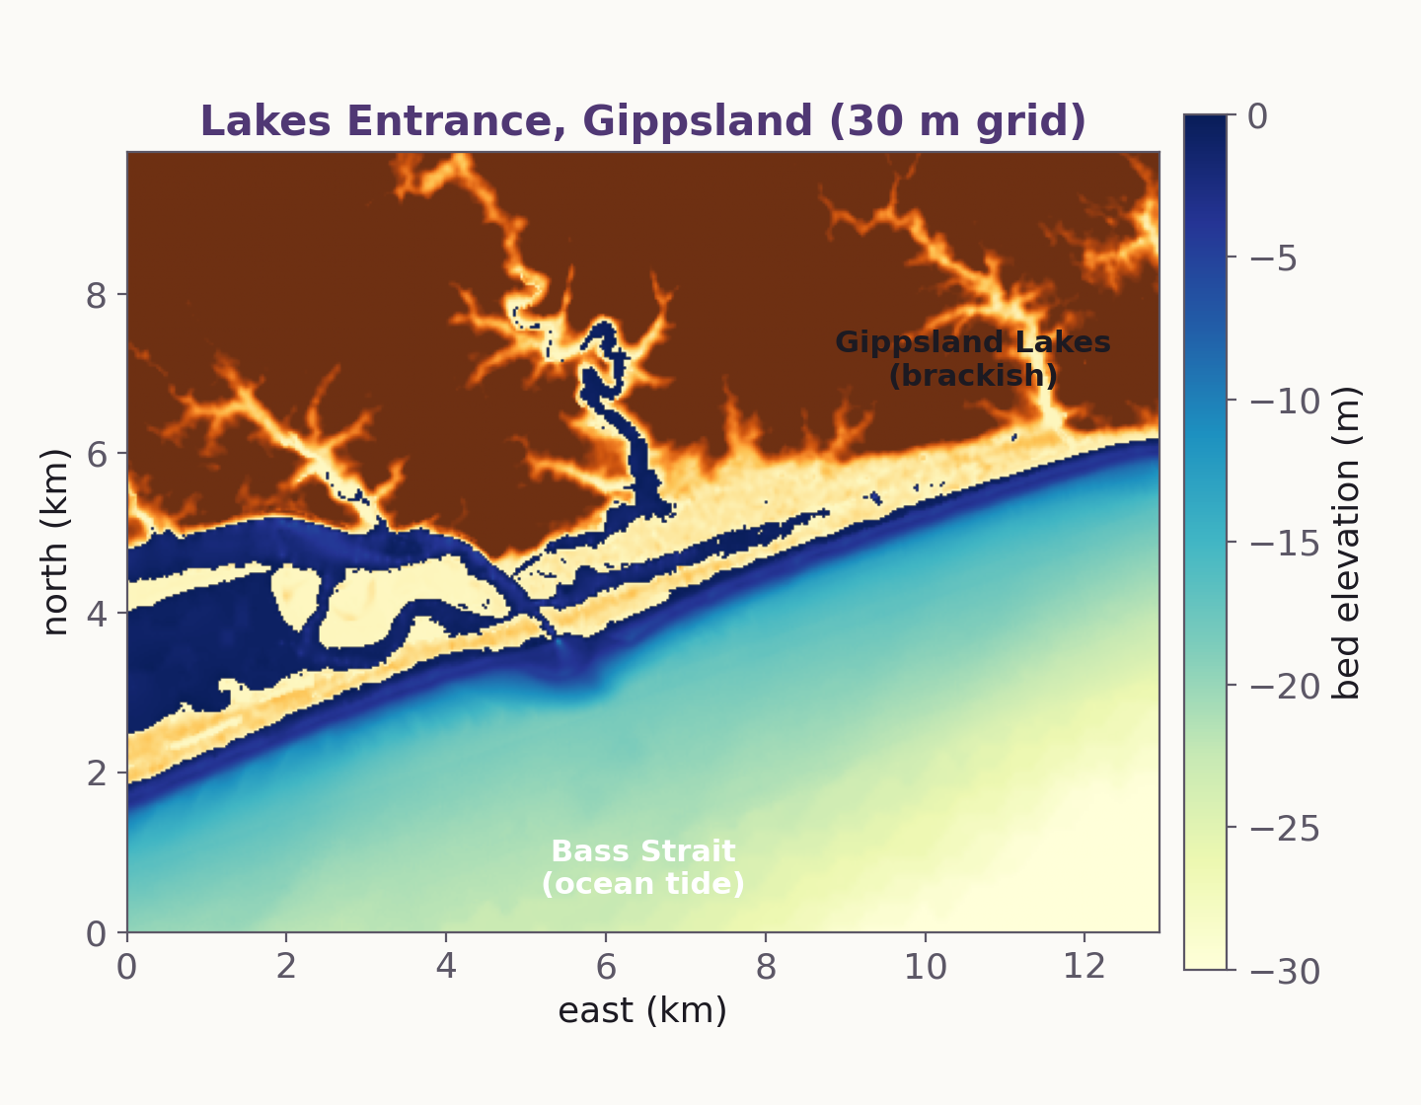
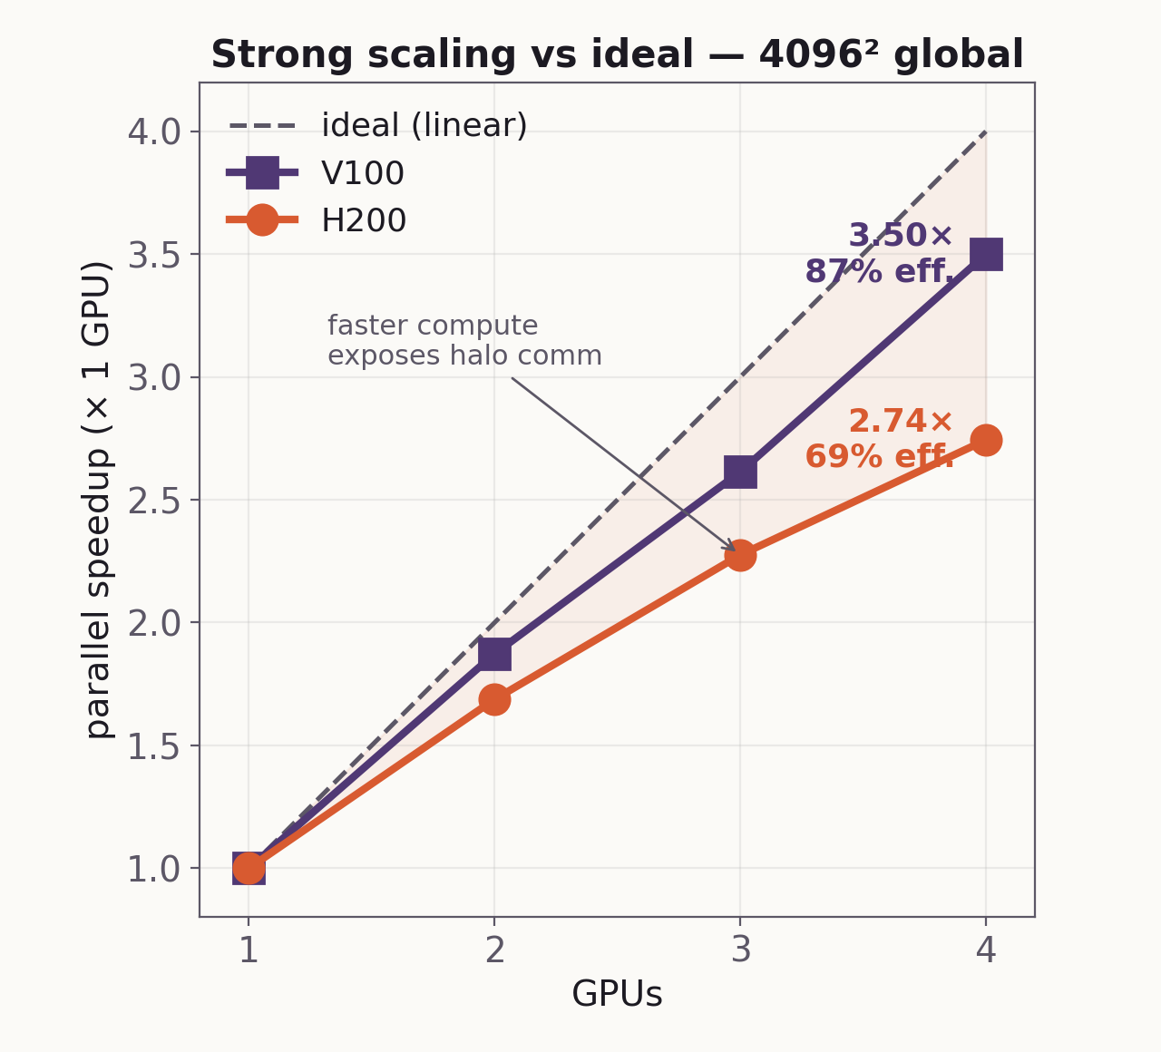
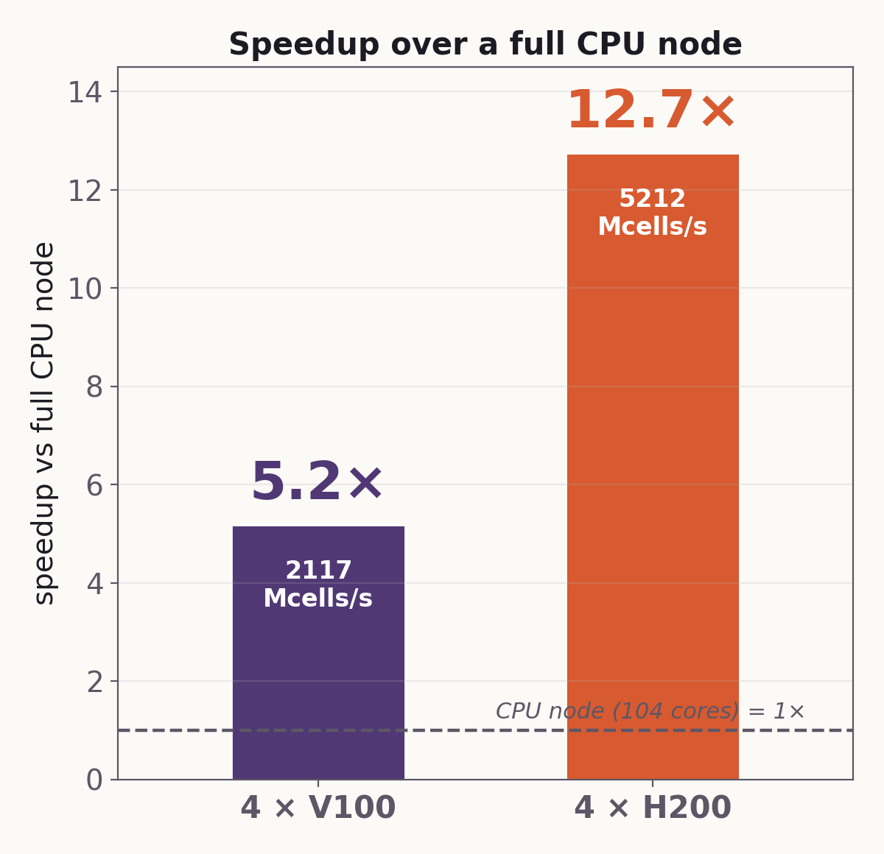
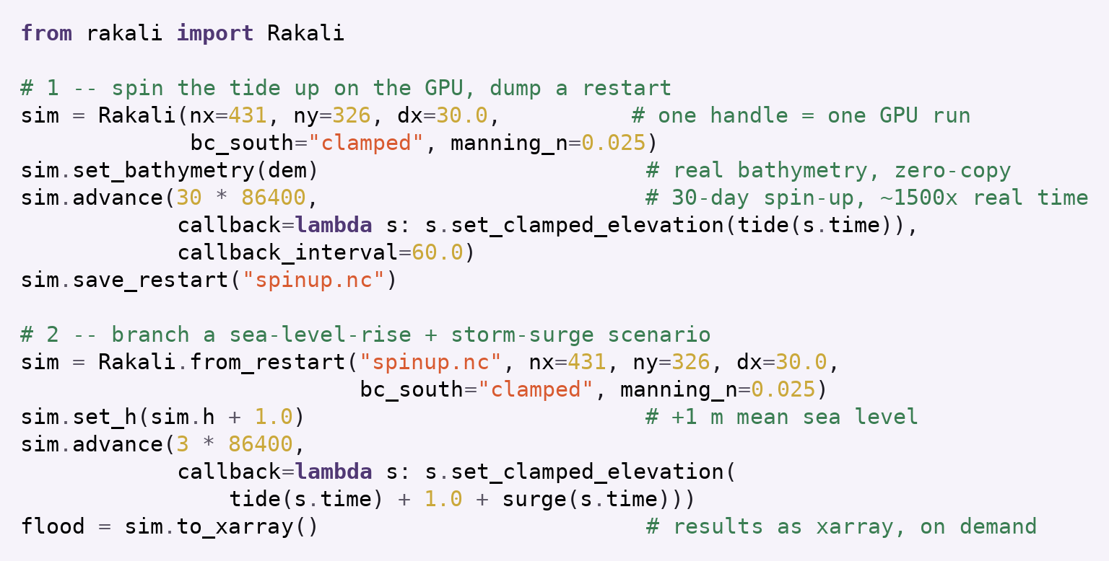
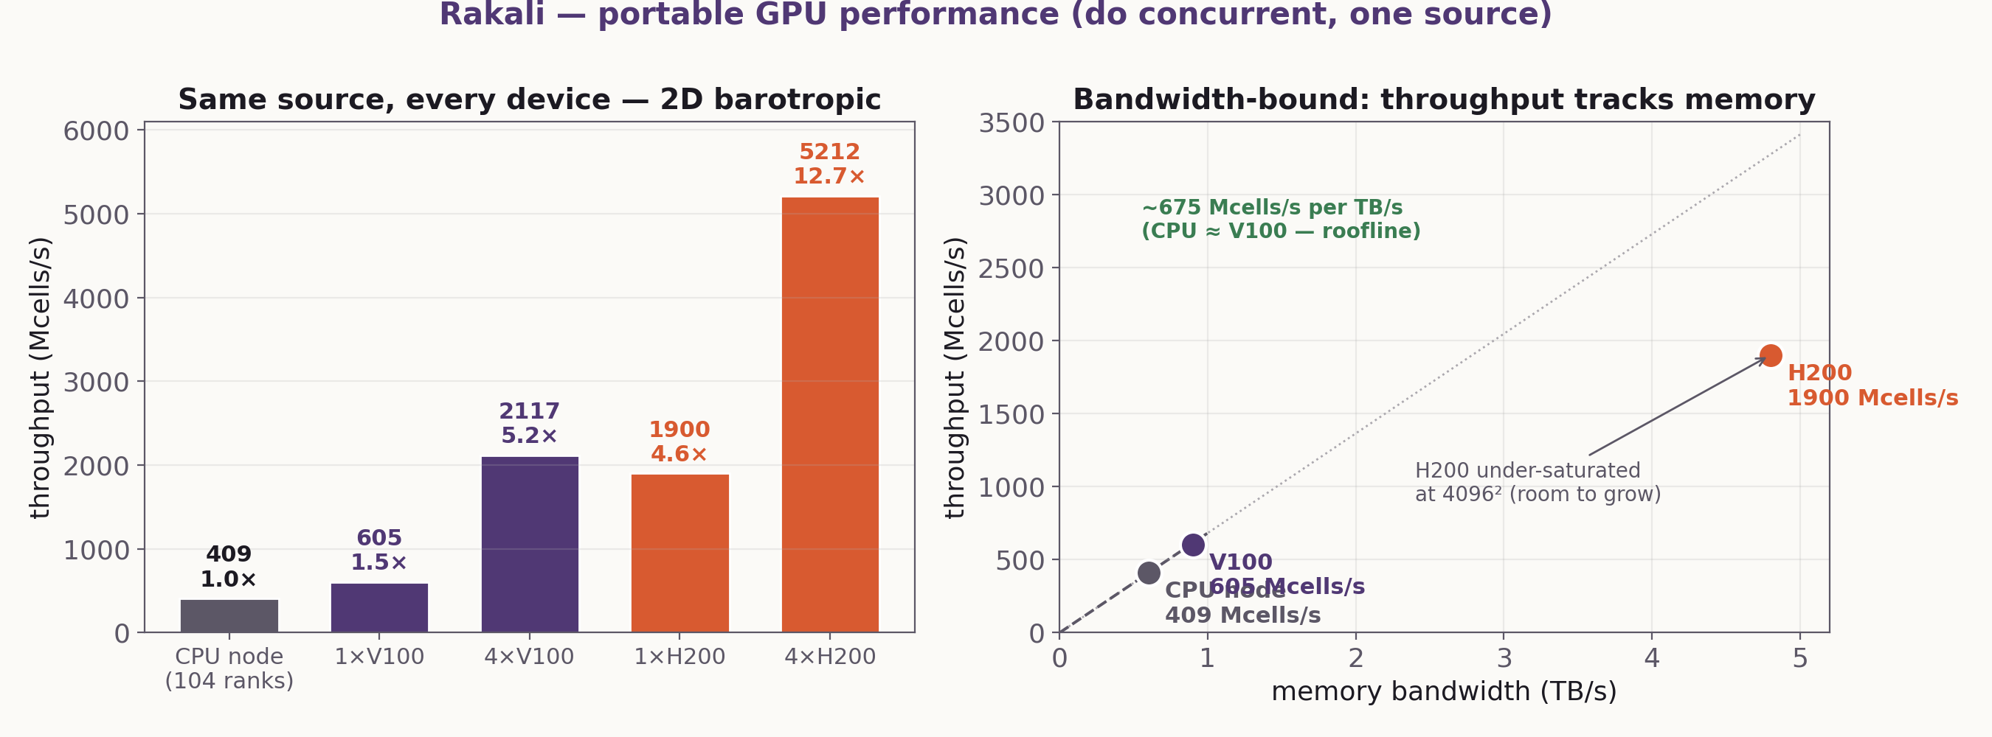
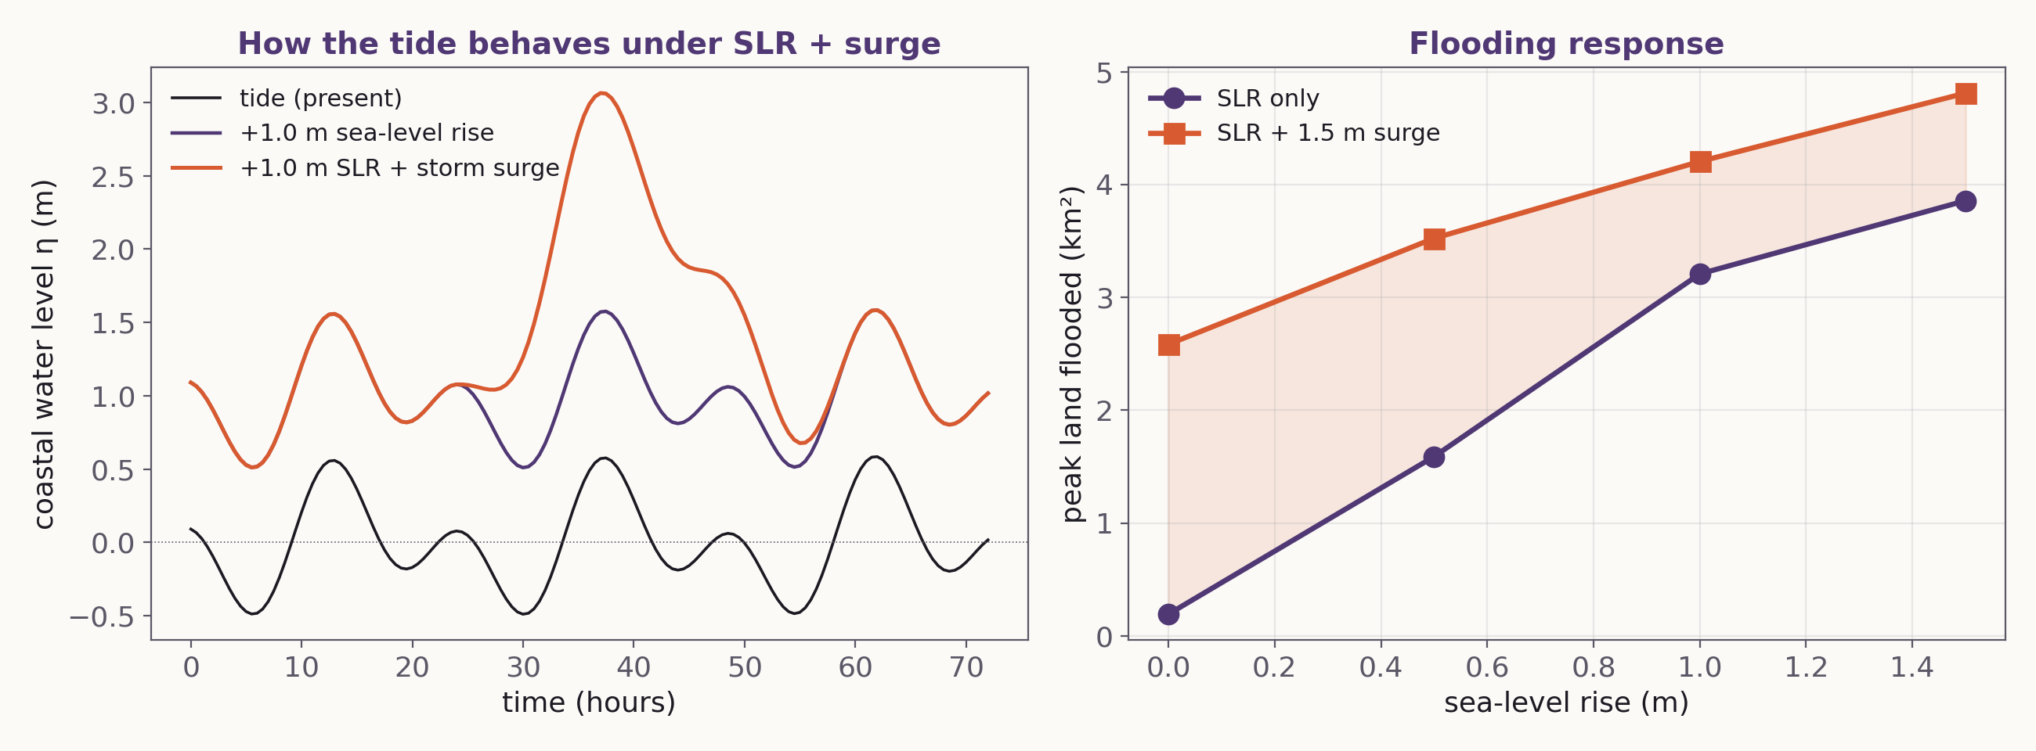
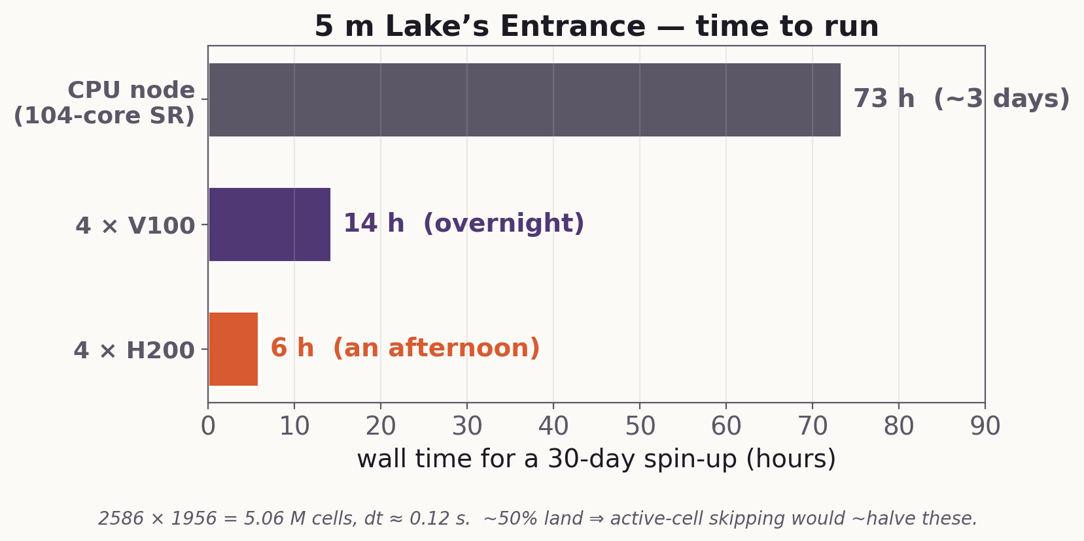
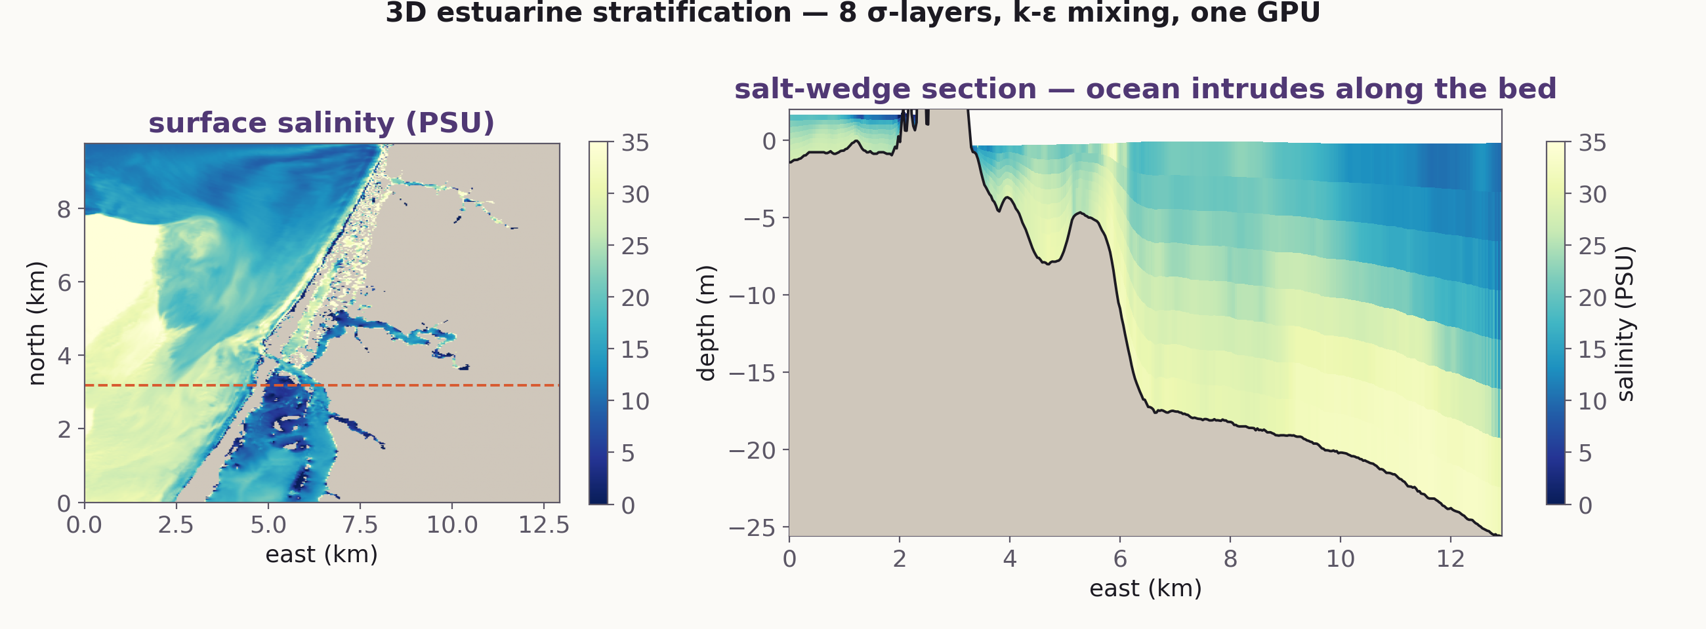
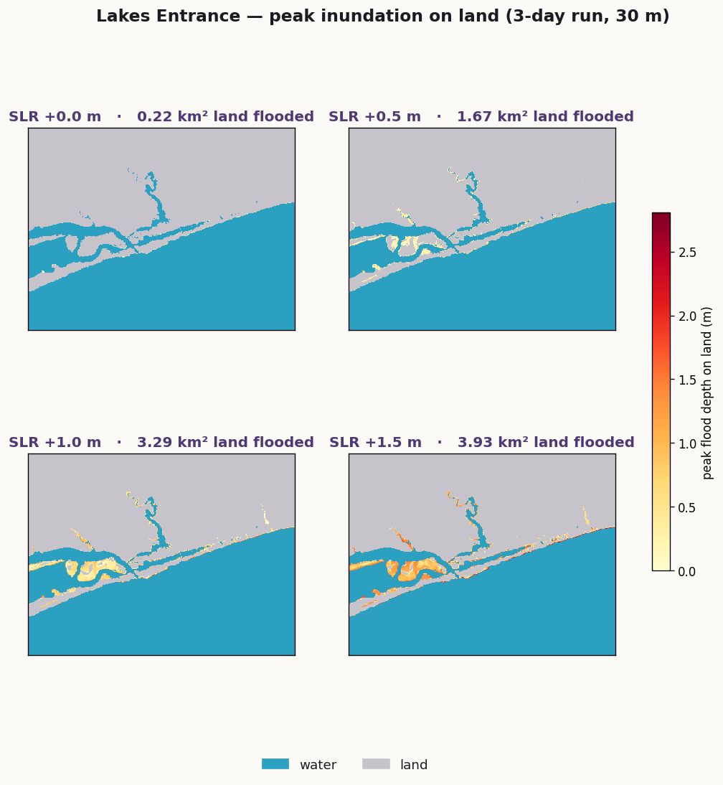
GPU-NATIVE COASTAL & ESTUARINE MODELLING
[CONFERENCE]
[session · date]
jorge.galvezvallejo@anu.edu.au
Rakali: a portable, GPU-first solver for coastal seas
Jorge Luis Gálvez Vallejo · [co-authors] NCI · ANU · [affils]
WHAT IS RAKALI
THE RESULT — LAKE'S ENTRANCE
PERFORMANCE — ONE SOURCE
One solver, every device.
Raise the sea, watch the estuary answer —
in 3D, on one GPU.
Memory-bandwidth-bound: throughput tracks the hardware. One do concurrent source, near roofline on every device.
A single Fortran source on NVIDIA + AMD GPUs and multicore CPUs — do concurrent for compute, OpenACC for data movement. No second code path.
Built for the coast.
Structured Cartesian + unstructured triangular grids; tides, wetting/drying, rivers, real bathymetry — 2D barotropic to 3D multilayer.
Driven from Python.
Opaque-handle iso_c_binding API with zero-copy NumPy views: set bathymetry, force, step, read fields live. MPI automatic.
Run a whole study from a script:
Strong scaling (V100 87% / H200 69% at 4 GPUs) · speedup over a 104-core CPU node (4×H200 = 12.7×).
(a) Lake's Entrance — real 30 m bathymetry; ocean inlet to Bass Strait, brackish Gippsland Lakes.
Throughput vs memory bandwidth — CPU and V100 on the same roofline; H200 has headroom.
Spin up the tide → save a restart → branch a sea-level-rise + surge scenario → read xarray. Solver stays on the GPU.
(b) Coastal water level under tide, +1 m SLR, and +1 m + storm surge (left); peak land flooded vs SLR (right).
A 5 m (5 M-cell) Lake's Entrance: 30-day spin-up overnight on 4×V100, an afternoon on 4×H200.
Conclusions
(c) 3D salt wedge — 8 σ-layers, k-ε mixing: ocean water intrudes along the bed beneath fresher surface water.
Rakali brings GPU-native performance to 3D coastal modelling without sacrificing portability or scriptability. One source runs near memory-roofline on CPU, V100 and H200; 4 GPUs deliver 5–13× a full CPU node at 88% (V100) scaling efficiency. The Lake's Entrance sea-level + surge experiments run fast enough to make scenario exploration routine — driven entirely from Python. [Further physics & validation underway.]
Peak inundation on land across sea-level-rise scenarios (water teal, land grey, flooding warm).
Figures illustrative (interpolated DEM, idealised forcing).
Code + figures: [repo / paper QR]
Jorge L. Gálvez Vallejo · NCI · ANU

Slide 2
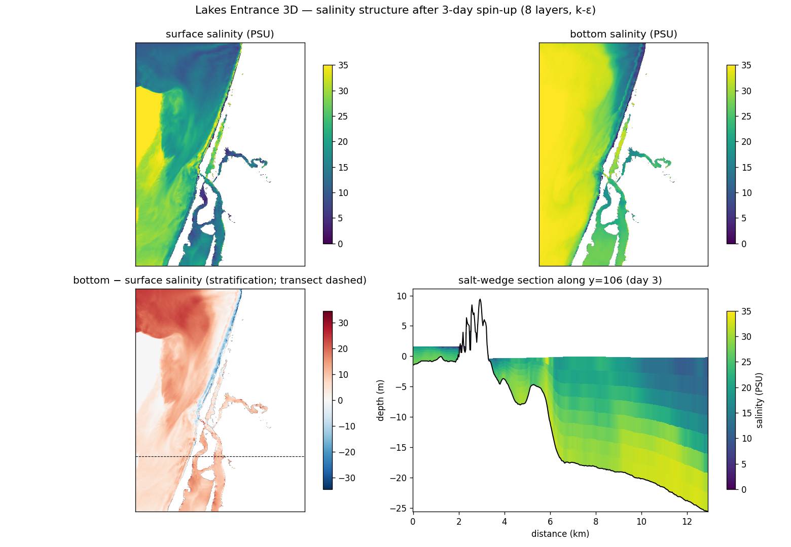
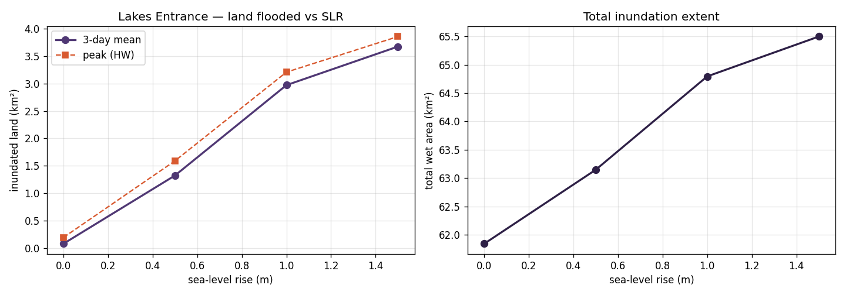
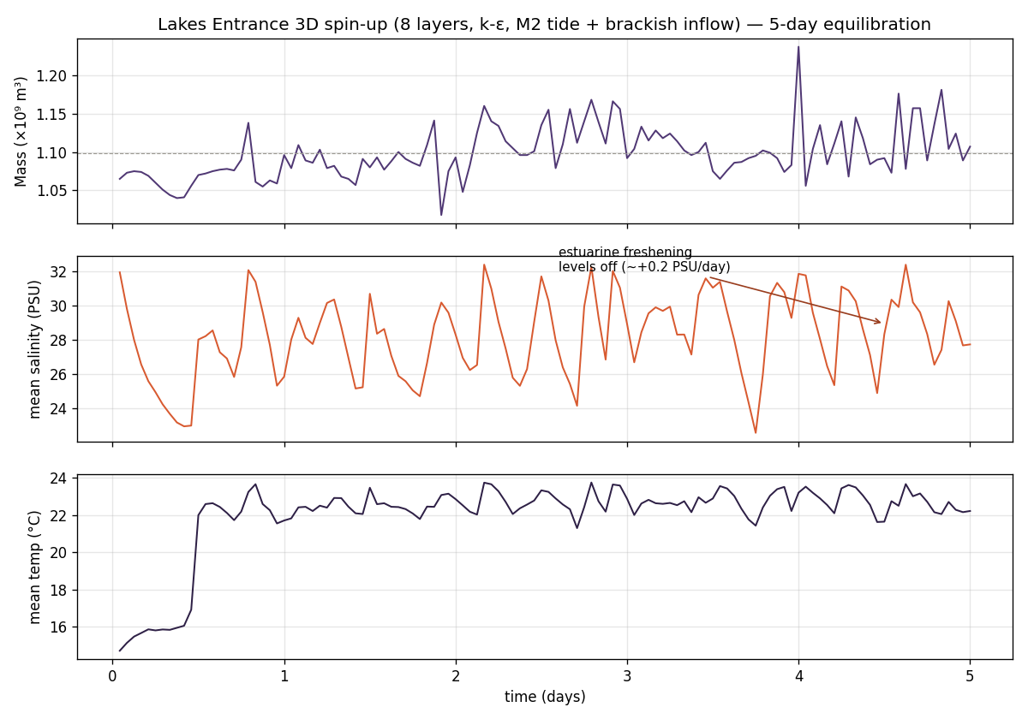
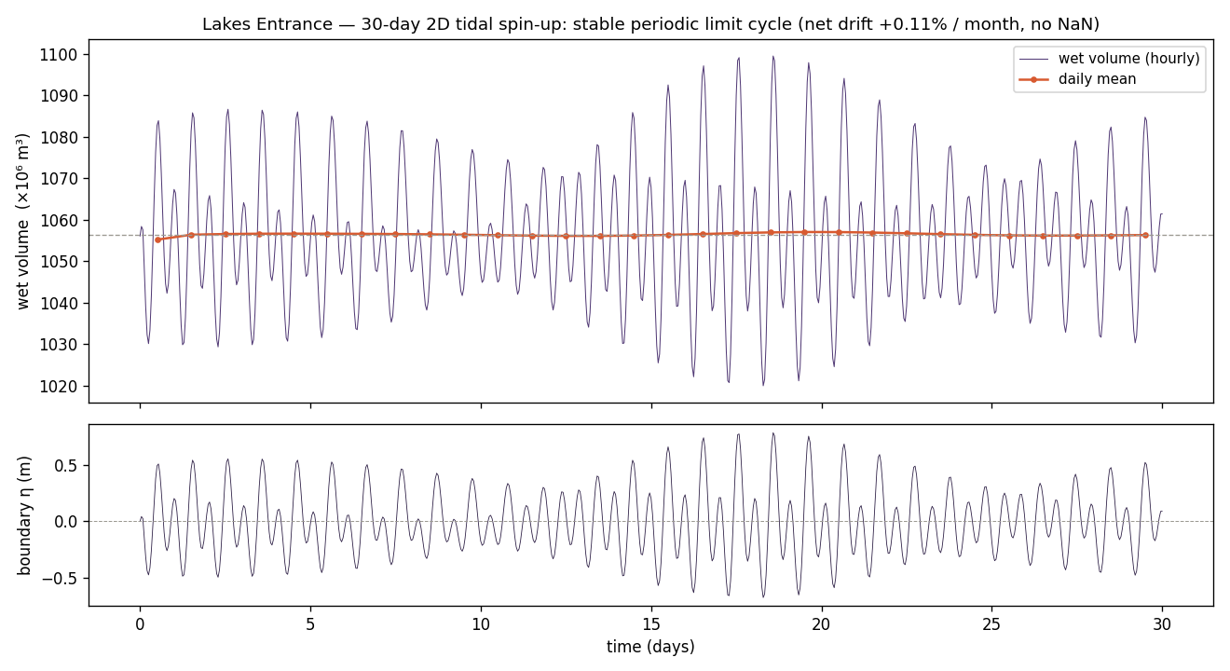
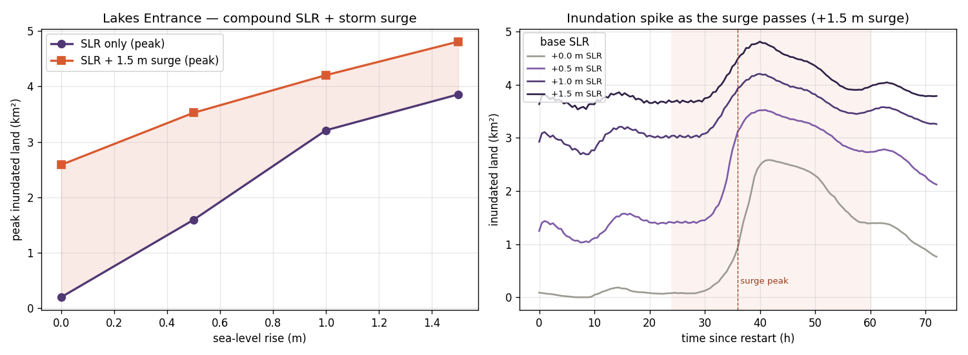

Slide 3

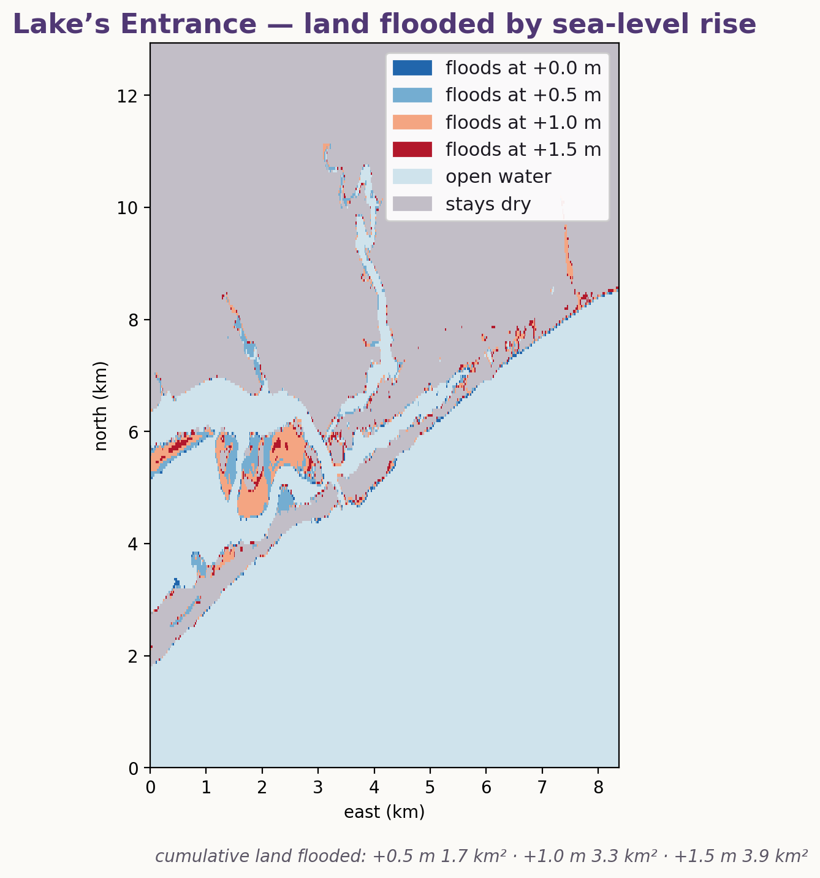
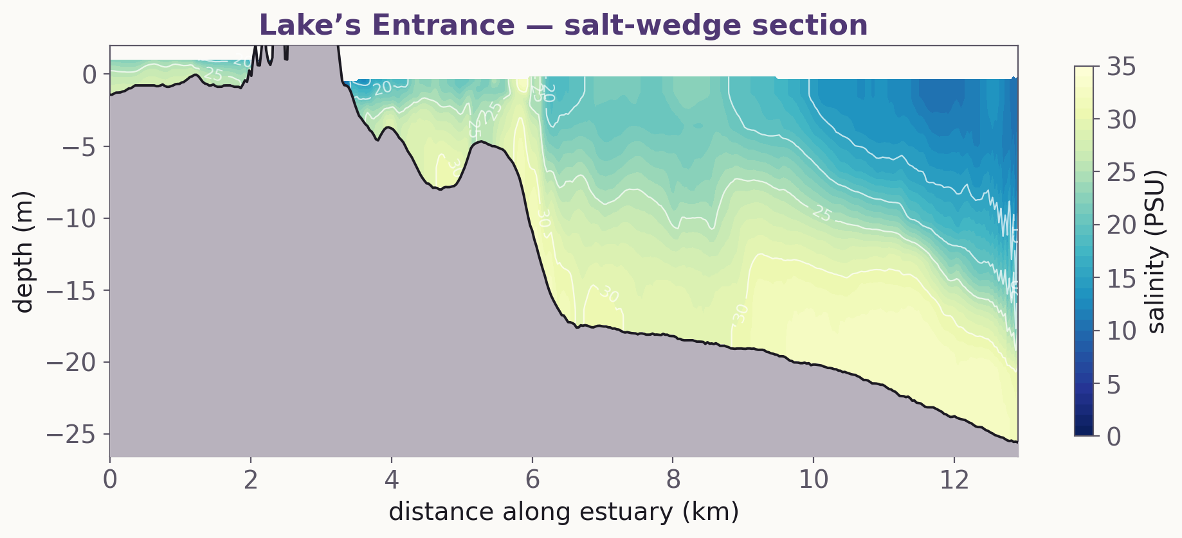

RAKALI
Accelerating Coastal Simulations using GPUs: Flooding hazards from tidal and mean-sea level changes at Lakes Entrance
Jorge Luis Gálvez Vallejo · NCI · ANU
ACOMO
jorge.galvezvallejo@anu.edu.au
What is Rakali?
Modern multi-GPU enabled hydrodynamics platform.
Scalable and portable.
2D Barotropic using structured and unstructured (triangular) grids.
HLL(C) structured fluxes algorithm
KNP central upwind fluxes algorithm
Adaptive and constant time stepping
Strong stability preserving RK2 (more to come!)
Stacked shallow water equations for 3D physics (structured & unstructured)
Vertical mixing (PP, KPP, kappa-epsilon)
Horizontal mixing
Structured grids: Smagorinsky, biharmonic
Unstructured grids: Smagorinsky
Tracers: Salt, Heat, Sediment (advected with PPM)
Generalized Vertical Coordinate support via remap/regrid
Sigma, z*, hybdrid z/sigma
Can execute on CPUs and multi vendor GPUs (NVIDIA, AMD, Intel)
Can be built on your laptop and on a modern HPC system
Mac, Windows, Linux!
Native Python interface
Entire simulation for CPU, GPU, and multi-GPU can be set from python
C-interface makes Rakali callable from other C, C++, and Fortran programs
Can I flood Lakes Entrance?
Usability and Potential
Jorge L. Gálvez Vallejo · NCI · ANU

