Slide 1



How to deal with Police Brutality
Using accountability to prevent police brutality
Natalie Salazar
Lisa Gorton
Abdoulaye Mbenque
Jorge Granda
Avi Severino

Slide 2
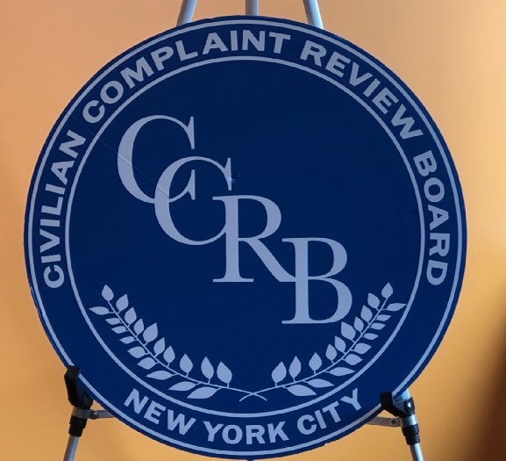
This group set out to focus on the lack of accountability held by the New York Police Department(NYPD) regarding police brutality. Our proposition is to reallocate a portion of the NYPD budget and put it towards properly funding the Civilian Complaint Review Board (CCRB). The CCRB is an independent agency founded in 1993 that is tasked with investigating, mediating, and prosecuting complaints of misconduct on the part of the NYPD.

Slide 3
The problem
Objectionable
Outcomes
Effects
Inadequate Efforts
No Accountability
Problem statement
Direct Effects
At this time, at least 303 NYPD officers that have five or more substantial misconduct allegations against them are still on active duty
A major factor that influences those officers staying in the force is the fact that the final decisions regarding every case is heavily influence by the police commissioner
Use of force may intensified by weak accountability
Police brutality exacerbates inequality and poverty
Police brutality promotes a culture of machismo that rewards aggressive policing
Although the NYPD has an independent agency to overlook complaints received, there is a huge deficit in accountability
Notes:
Problem Statement:
CCRB- community complaint review board
Cut some funding of NYPD and put it towards the CCRB for what they need to operate
How much is the NYPD budget? How much are we putting towards the CCRB
Reallocate funds to CCRB
Specific prosecutors that deal with police brutality (independent prosecutors)

Slide 4
THE CCRB INVESTIGATION PROCESS
Complaints that are received by the CCRB must meet their certain jurisdiction, these complaints must be against NYPD officers only and include FADO (Force, Abuse of Power, Discourtesy, and Offensive Language).
Cases in CCRB jurisdiction are assigned to civilian investigators.
After a case plan is made by the civilian investigator and the officer in question has no history of complaints with the CCRB or the NYPD, both parties will then receive mediation
If there is a history of misconduct complaints, the investigator begins their recommendation which includes: a summary of all complaints made and a recommendation for disposition.
A three-member panel will then vote on the recommendation. If they vote in favor the CCRB, the Administrative Prosecution Unit (APU) will hold a trial at the police department before an administrative law judge.
Even if the APU finds the officer guilty the police commissioner can unilaterally overrule.
Notes:
Complaints that are investigated by the CCRB must include FADO meaning Force, Abuse of Authority, Discourtesy, and Offensive Language and only incidents involving NYPD officers are investigated by the CCRB
The cases that do not fall into jurisdiction of the CCRB are then forwarded to the respective jurisdiction usually being the NYPD IAB.
Of the cases that fall into the CCRB jurisdiction are then assigned to a civilian investigator where they begin their attempt to get in contact with the civilian that had made the complaint. If contact with the civilian complainant is not achieved after five attempts over the phone and two letter attempts the case is then closed. If the investigator gets in contact with the complainant a statement is taken over the phone and an in-person meeting is scheduled where the complainant can bring witnesses that were present. A “case plan” is then created and is submitted to a supervisor investigator.
Once the case plan is created the civilian investigator must get in contact with the officer involved in the complaint, if the investigator fails to identify or get in contact with the officer the case is then closed. If and when the officer is identified the investigator will then collect all documents needed from the NYPD to better assist them in the investigation and a statement will be taken from the officer, their partner, and any other witnesses that were present.
If the officer does not have any history of complaints with the CCRB or NYPD, there was no arrest made, and severe force or abuse of power were not present then the officer will receive “mediation”. This is where the officer and civilian bypass the investigative process and meet one-on-one with a mediator to discuss the incident.
If the officer has some history of misconduct complaints then the civilian investigator then begins their recommendation that includes a summary of all complaints made, an explanation of the circumstances of the case, a credibility of the officers and the civilians, and finally a recommendation for disposition.
These recommendations are reviewed by a three member panel and they will vote on the investigators recommendation.
If the panel votes in agreement with the recommendation then the CCRB Administrative Prosecution Unit (APU) will hold a trial at the police department before an administrative law judge, either the Deputy Commissioner for Trials or an Assistant Deputy Commissioner of Trials.
If an officer is found guilty, the penalty can be a warning and admonishment, loss of vacation days, suspension without pay, dismissal probation, or termination from the NYPD.
The police commissioner retains the authority to decide whether the discipline is imposed, what level of discipline is imposed, and the penalty imposed

Slide 5
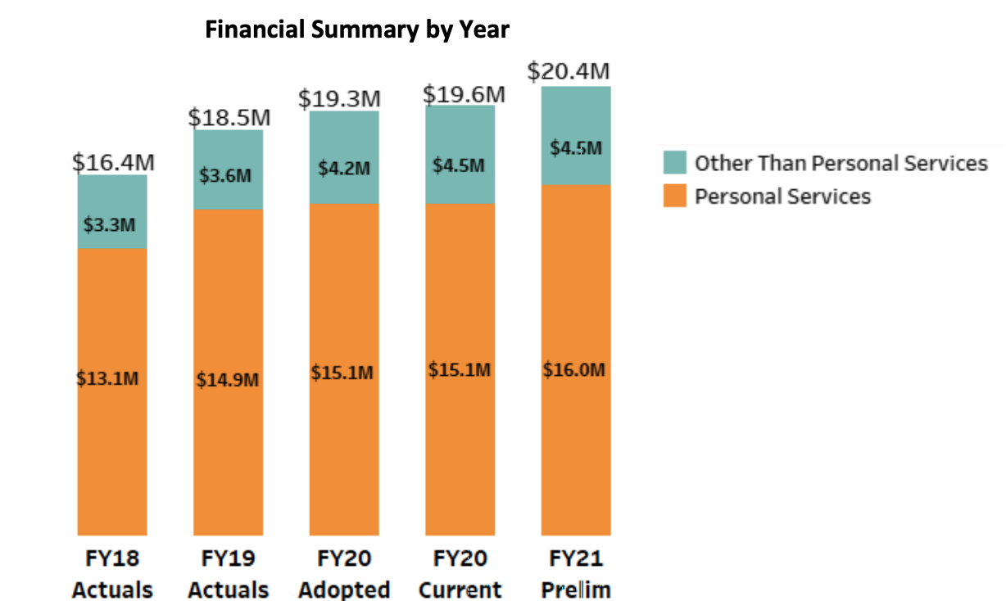
Progression of CCRB’s Funding
Notes:
By defunding the NYPD, we can bolster the CCRB. The mayor cut 1.1million for 2021 The Teal section represents the costs of contractual services, misc. Charges, property equipment, and supplies. The Orange section represents the amount used for salaried and non salaried civilians.

Slide 6
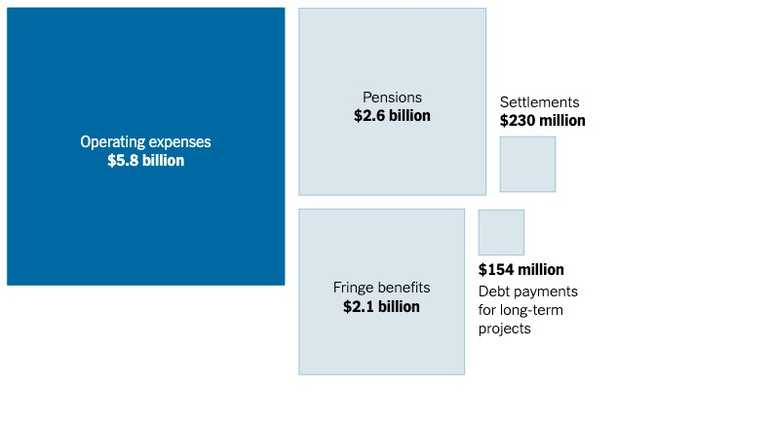
N.Y.P.D. related expenses for 2018
Budget increase
Increase in CCRB Recruitment
Public Interest Prosecutors
Social media group to promote the CCRB and get community members more involved with the process.

Slide 7
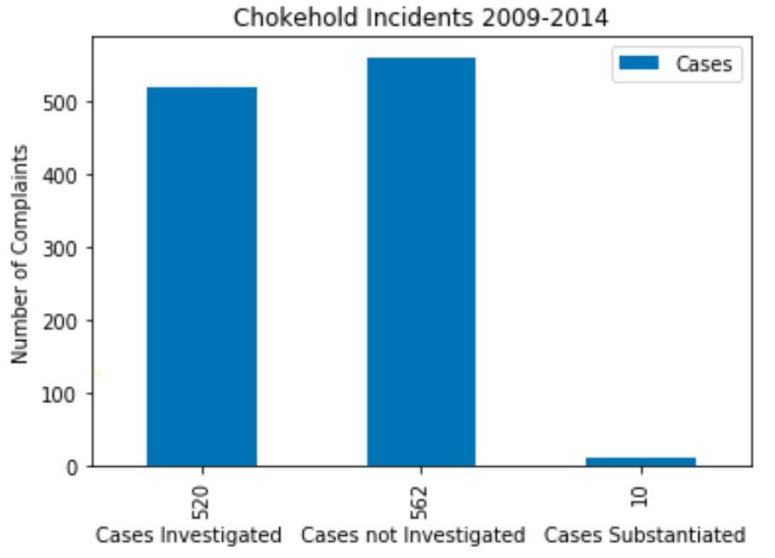
Philip Eure’s study on the city handling complaints of police chokeholds
Philip Eure was the first ever inspector general for the NYPD.
He was appointed in March of 2014
1,082 complaints alleging 1,128 chokeholds
Notes:
The study on the screen shows how the current system fails to serve the public. Philip Eure... According to Eure’s report, between 2009 and 2014 there had been 1,082 complaints of chokeholds by NYPD officers. The CCRB investigated only about half of them. The CCRB substantiated 10. Most of the cases died in the system. CCRB recommended the harshest possible punishment for at least 9 of them. Ray Kelly, the Commissioner at the time, overturn most of them(6). A maximum of five vacation days lost was the strongest sanction

Slide 8
Resources Needed
Allocating more financial and human resources to the CCRB
Increase the CCRB’s number of public prosecutors for its Administrative Prosecution Unit (APU)
Use funds to promote the CCRB and get community members more involved with the process
Full transparency from NYPD officers and commissioner
.

Slide 9
Goals and Objectives
Empowering the Civilian Complaint Review Board (CCRB)
Final rulings will be informed by the CCRB investigation
Rehaul oversight and give power to City Council, unbiased prosecutors and community members
Adequate sanction of police misconducts means removal of officers that engaged in abusive behavior
Community awareness and trust.

Slide 10
Solution
Final revision of resolutions goes to the the City Council
Defund NYPD and reallocate funds to CCRB
Independent Prosecutors that are not politically connected to the Judicial System
It is ideal for the police commissioner not to have the final say on disciplinary matters
Notes:
Give more authority to the CCRB so they can conduct a full unbiased investigation of each complaint.
We found very important to have an Independent police prosecutor’s office that is more removed from local politics
The CCRB recommendation and the independent prosecutor’s resolution must be final.
If there is to be a review of final resolution must lay on the city council.(since it represent the interest of the public)
The Police commissioner is one of the biggest obstacles to reach a satisfactory resolution for complaints. He must be removed from the final decisions.

Slide 11
What does success look like?
Institutional bases of power must be position to monitor the police
Crash the extraordinary hurdles that a complaint must complete before an individual police officer is punished.
The opinion of the city council must carry the most weight concerning individual abuse complaints.
Reach substantive justice in order to improve the outcome of the review system.
Achieve greater openness and transparency.
Notes:
We must have the institutional bases of power position to oversee police actions. If we don’t do this we put our society at risk
Must take down the extraordinary hurdles that a complaint must complete before an individual police officer is punished.
We must see the problems of policing at its roots. The basic nature of the police from inception has been of a tool
for managing inequality and maintaining the status quo
Police reforms that ignore to address this truth are destined to fail.

