Slide 1

G2M Case Study
Virtual Internship
Jorge Alberto Jaramillo Bermudez
Data Science
14 November 2024
México

Slide 2
Background –G2M(cab industry) case study
What is the business problem?
XYZ is a private firm based in the US. Due to the remarkable growth in the cab industry over the last few years and the presence of multiple key players in the market, XYZ is considering an investment in the cab industry. Following their Go-to-Market (G2M) strategy, they aim to thoroughly understand the market before making a final decision.
What are the characteristics of the provided data (data intake report)? What steps did you take to create a relevant dataset?
The analysis is divided into four parts:
Data Understanding
Forecasting profits and the number of rides for each cab type
Identifying the most profitable cab company
Providing recommendations for investment

Slide 3
Data Exploration
Data Overview:
Features: 24 (including 9 derived features)
Timeframe: January 31, 2016, to December 31, 2018
Total Data Points: 355,032
Assumptions:
Data Sources:
Cab_Data.csv
Customer_ID.csv
Transaction_ID.csv
City.csv
Cab_Data.csv
Customer_ID.csv
Transaction_ID.csv
City.csv
USholiday.csv
Final cab data

Slide 4
Data Exploration
Outliers:
Outliers are identified in the "Price_Charged" feature. However, due to the unavailability of trip duration details,
they are not treated as outliers.
Profit Calculation:
Profit for rides is calculated, assuming other factors remain constant.
The calculation utilizes only the "Price_Charged" and "Cost_of_Trip" features.
Users Feature:
The "Users" feature in the city dataset is interpreted as the number of cab users in the city.
It is assumed that this may include users of other cab types as well, encompassing both Yellow and Pink cabs.

Slide 5
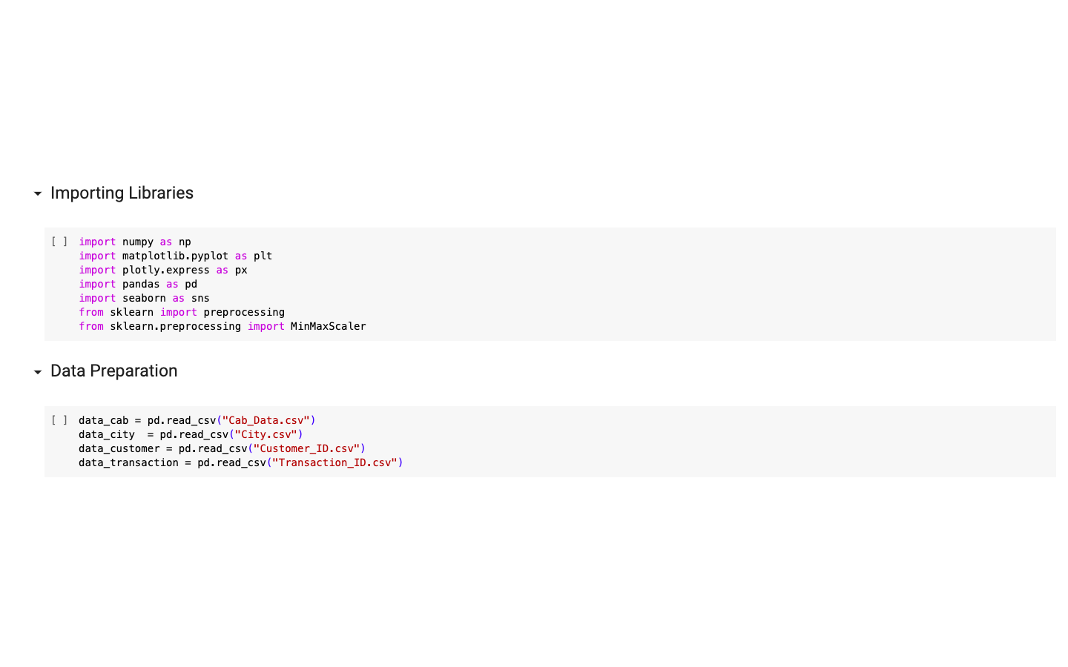
Data Exploration

Slide 6
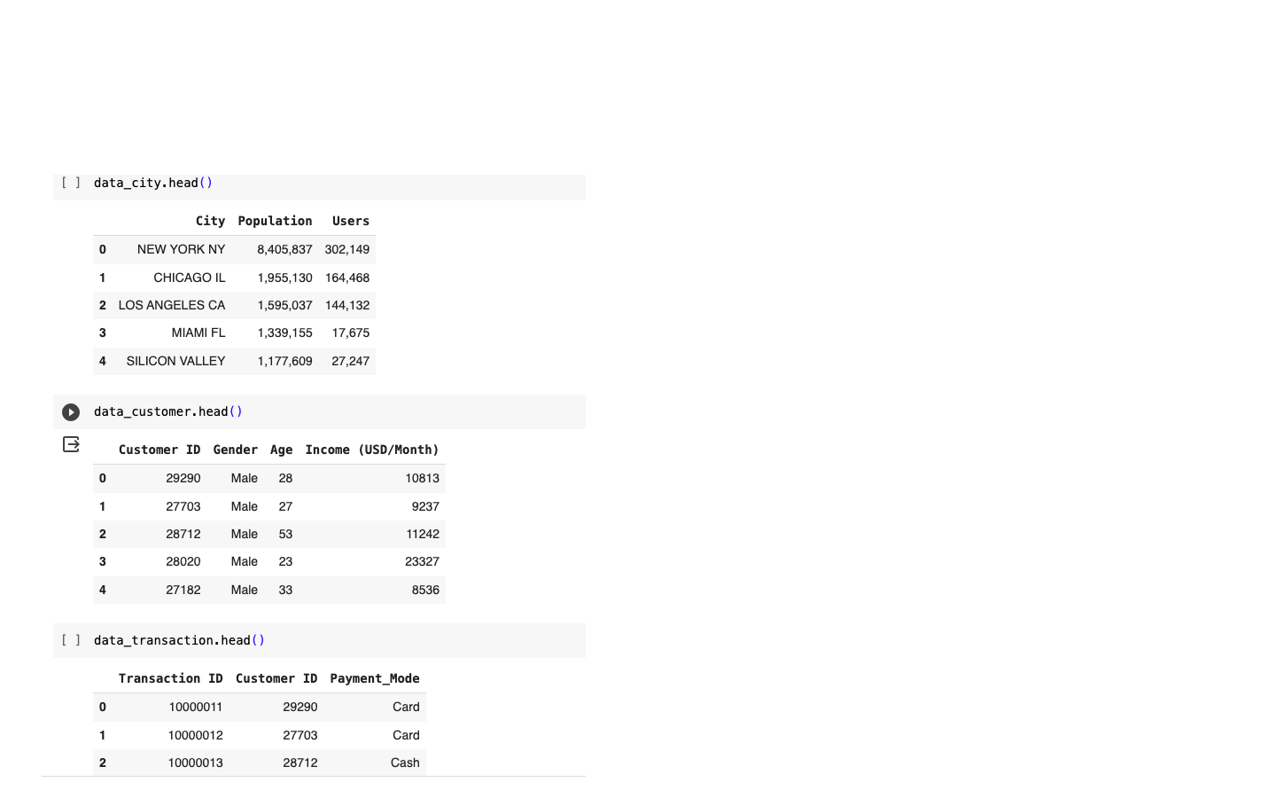
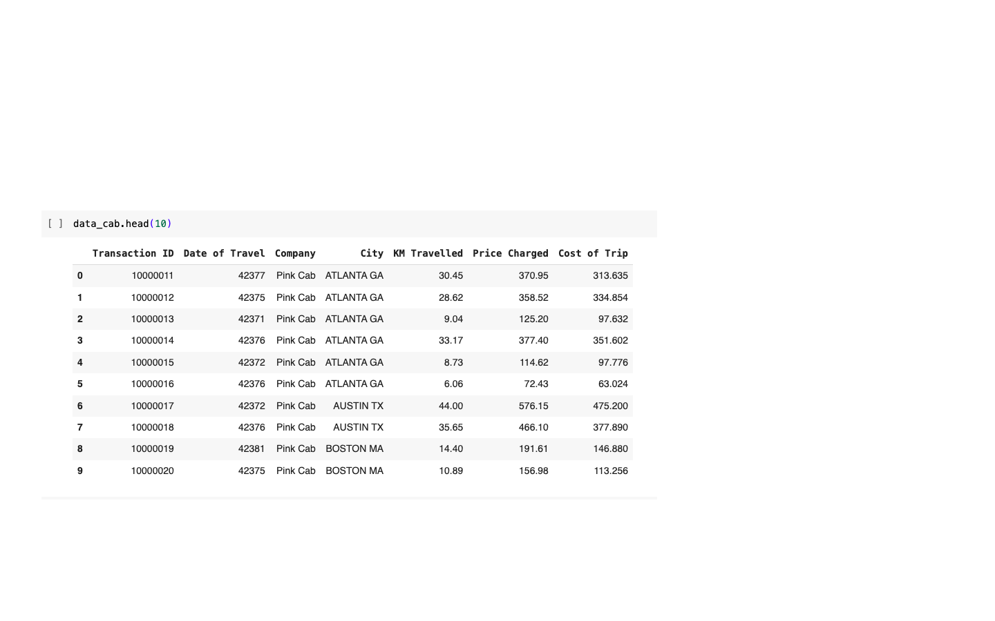
Data Exploration
Similarities :
- Transaction ID
- Customer ID

Slide 7
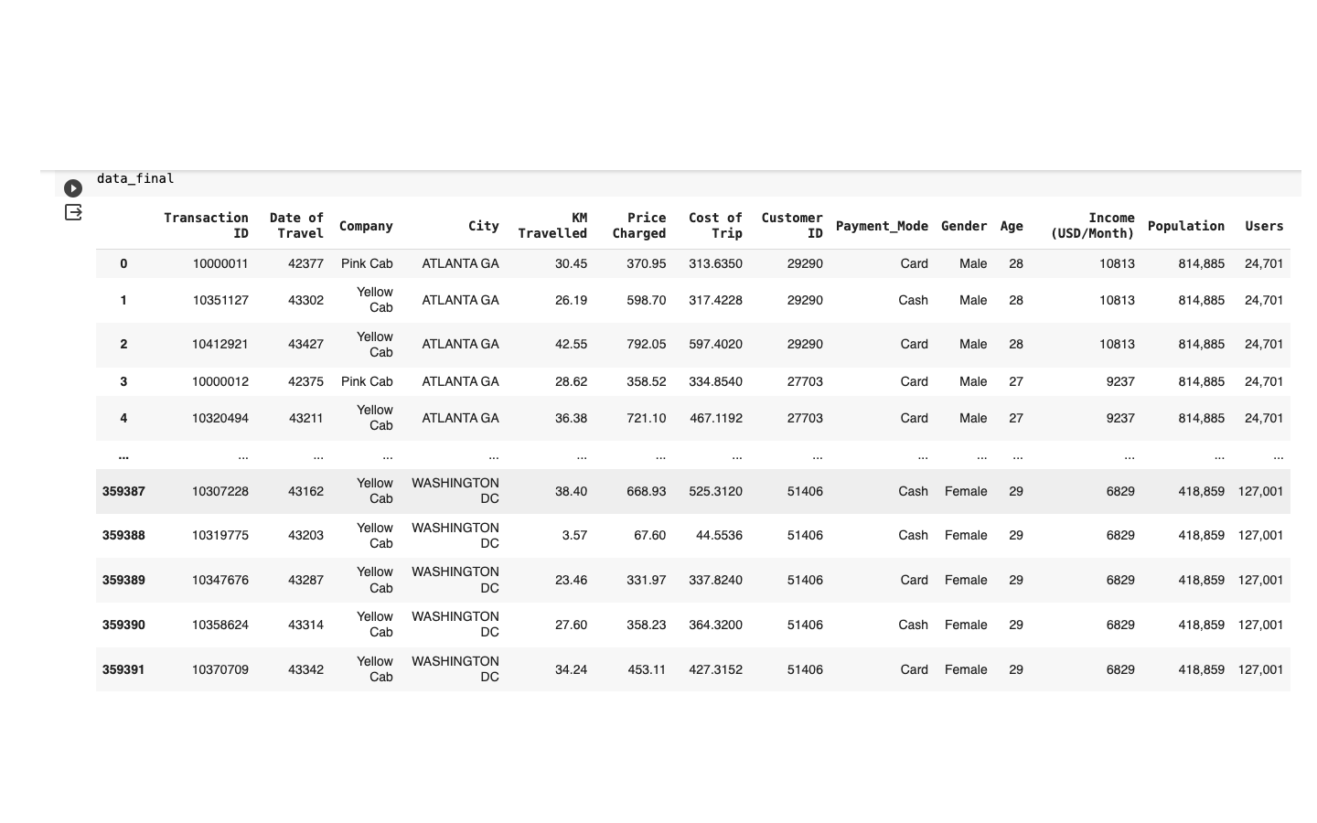
Data Exploration
Merged data = data_final

Slide 8
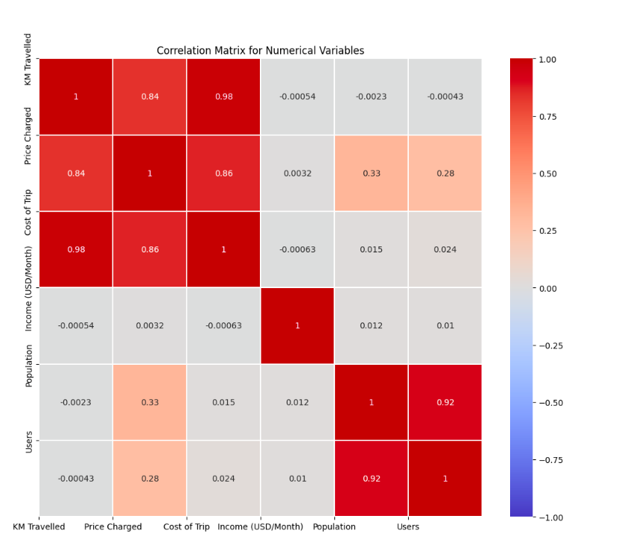
Profit Analysis
Profit Analysis
- KM Travelled and Price Charged:
There is a strong positive correlation of 0.84 between "KM Travelled" and "Price Charged". This suggests that as the distance traveled increases, so does the price charged for the trip.
- KM Travelled and Cost of Trip:
There is a strong positive correlation of 0.98 between "KM Travelled" and "Cost of Trip". This indicates that as the distance traveled increases, the cost of trip also tends to increase.
- Price Charged and Cost of Trip:
"Price Charged" and "Cost of Trip" have a positive correlation of 0.86, suggesting that there is a positive relationship between the price charged and the cost of trip.
- Income (USD/Month) and other variables:
The correlation close to zero between "Income (USD/Month)" and the other variables indicates a weak or non-existent relationship in linear terms.
- Population and Users:
There is a very strong correlation of 0.92 between "Population" and "Users". This could suggest that in more densely populated areas, there are more cab users.

Slide 9
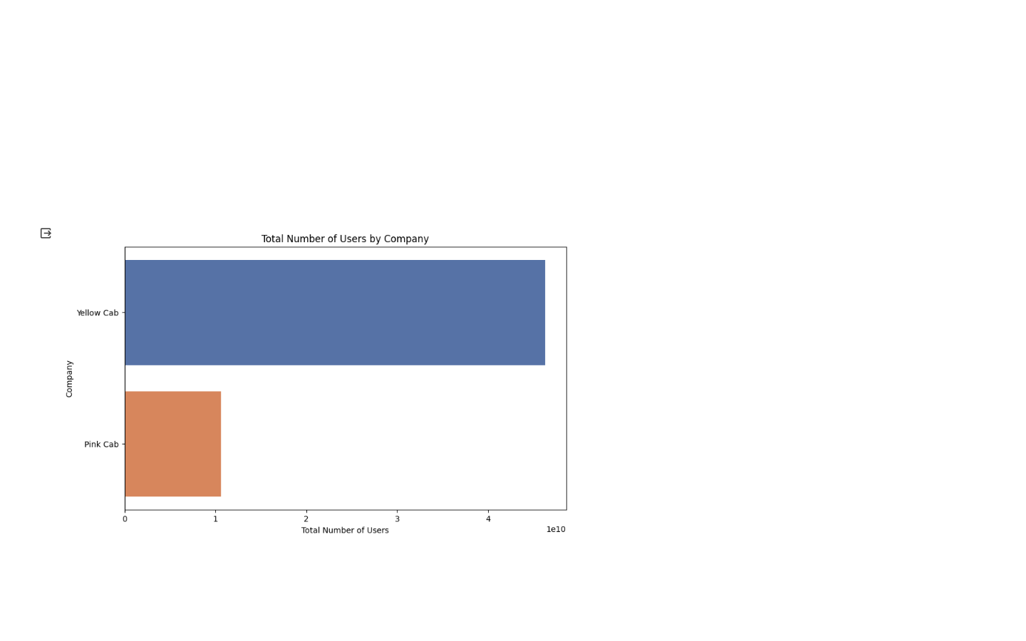
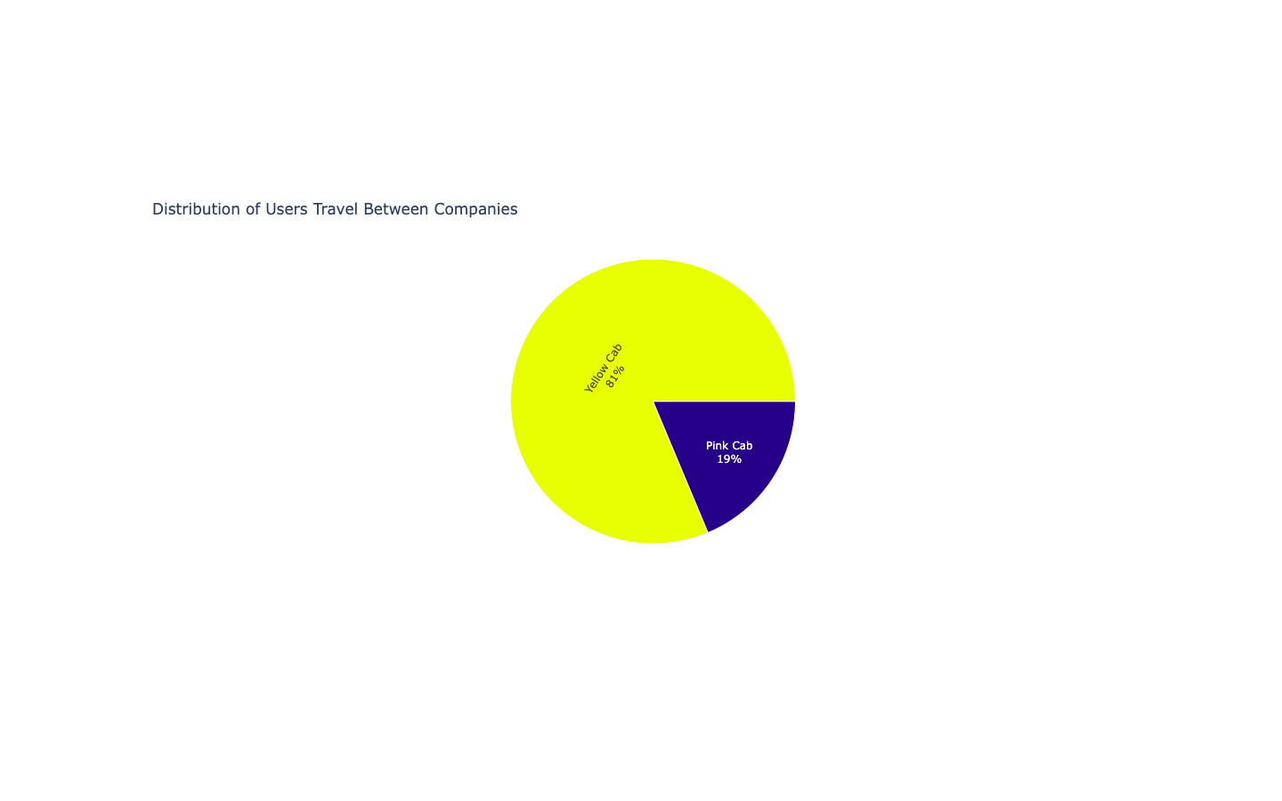
Profit Analysis
Profit Analysis

Slide 10
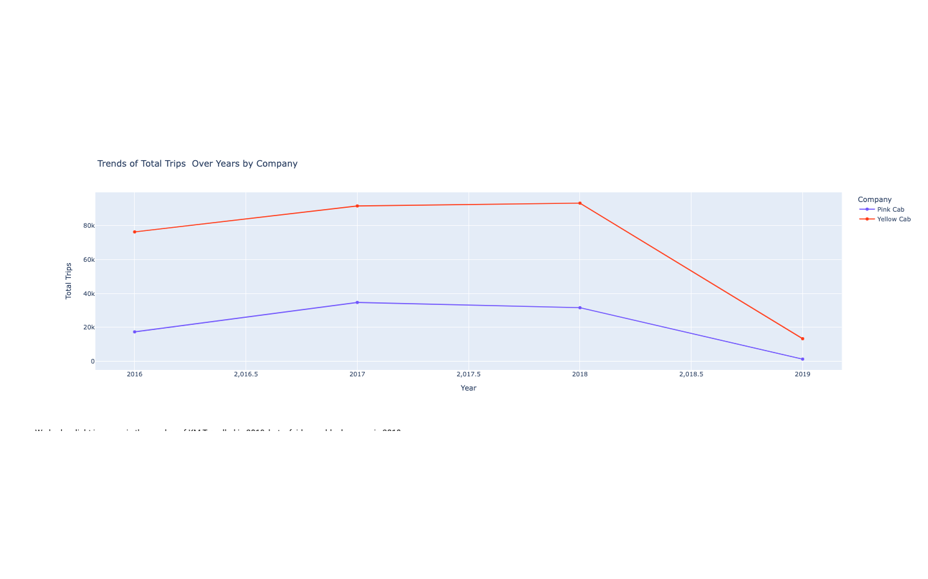
Yearly Profit Analysis

Slide 11
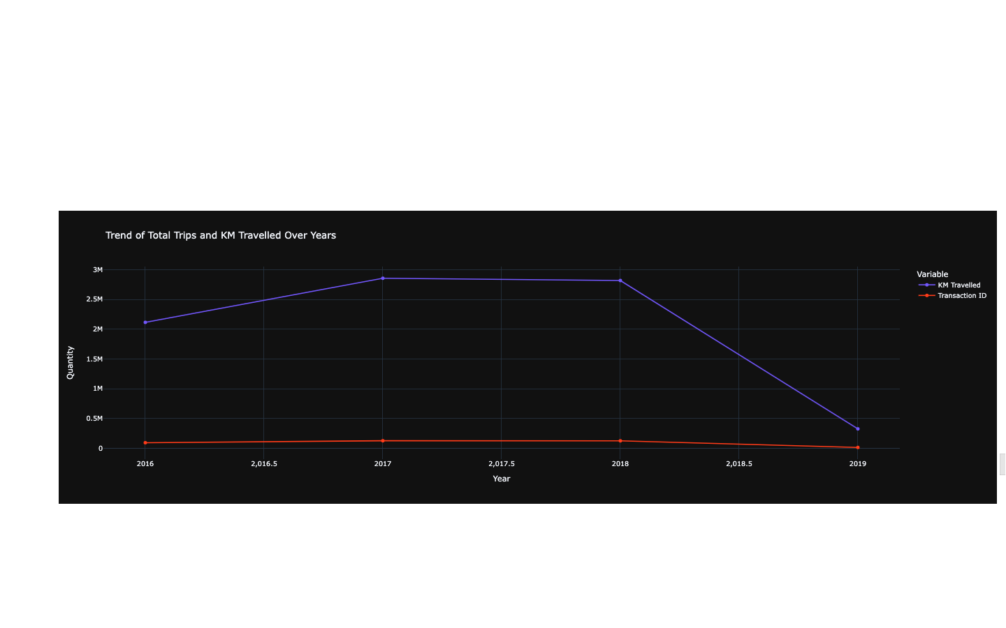
Yearly Profit Analysis

Slide 12
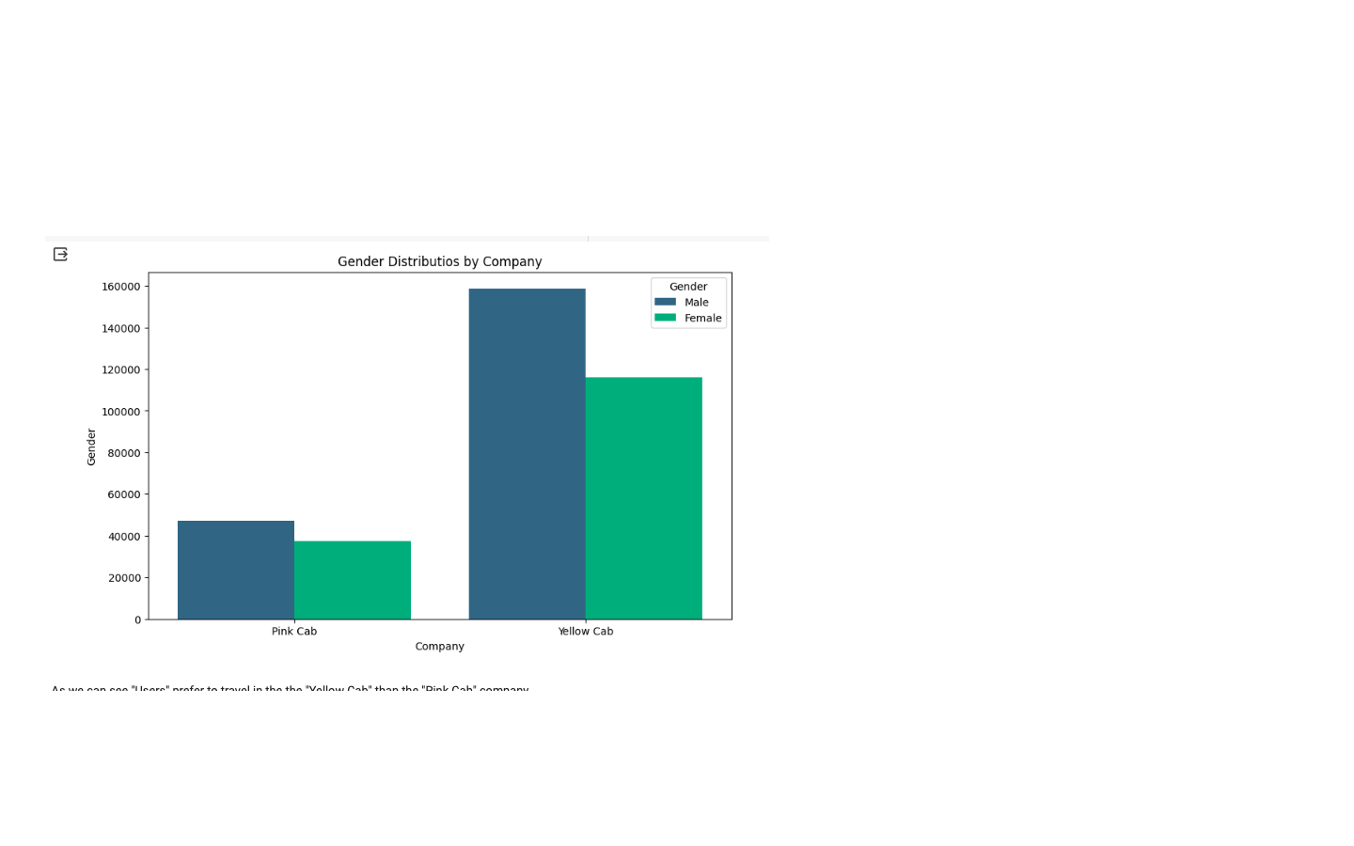
Profit and customer base Analysis Gender wise
There is almost equal distribution of gender in the
Profit and customer base of both the cabs.

Slide 13
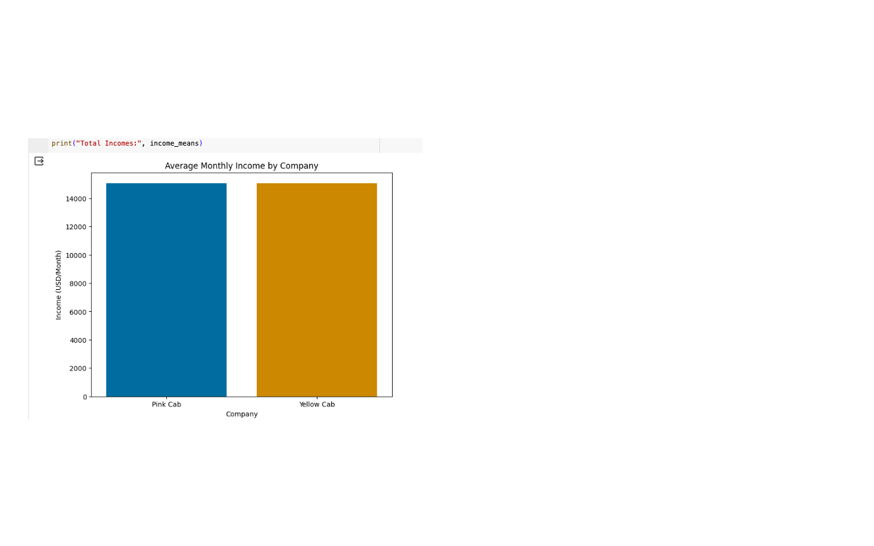
Income Monthly Profit by Company Analysis
Total Incomes: Company Income (USD/Month) Pink Cab :
15059.047137
Yellow Cab : 15045.669817

Slide 14
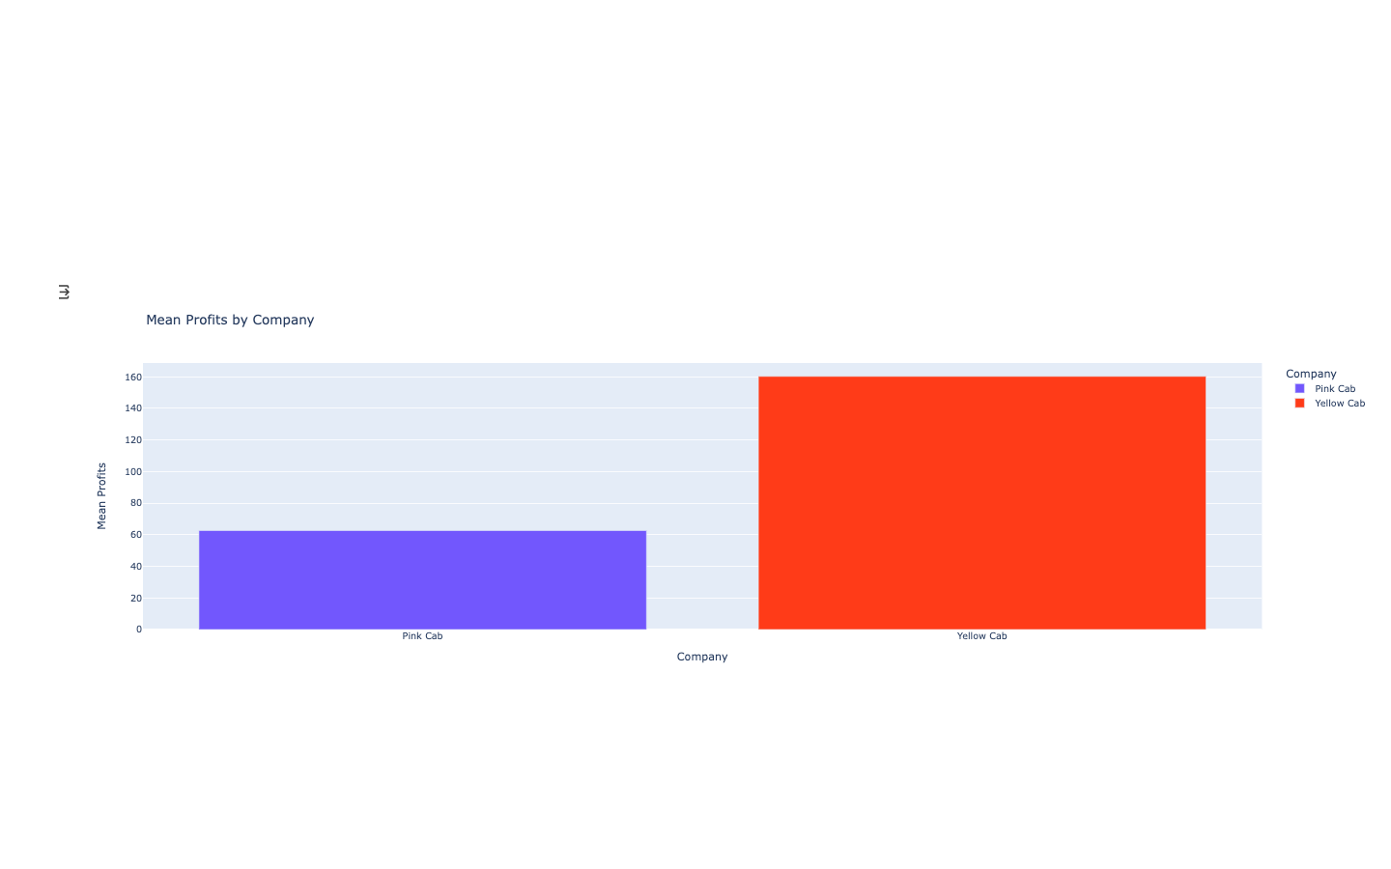
Mean Profits by Company
Company Projected Profit Pink Cab: 62.652174 1 Yellow Cab: 160.259986

Slide 15
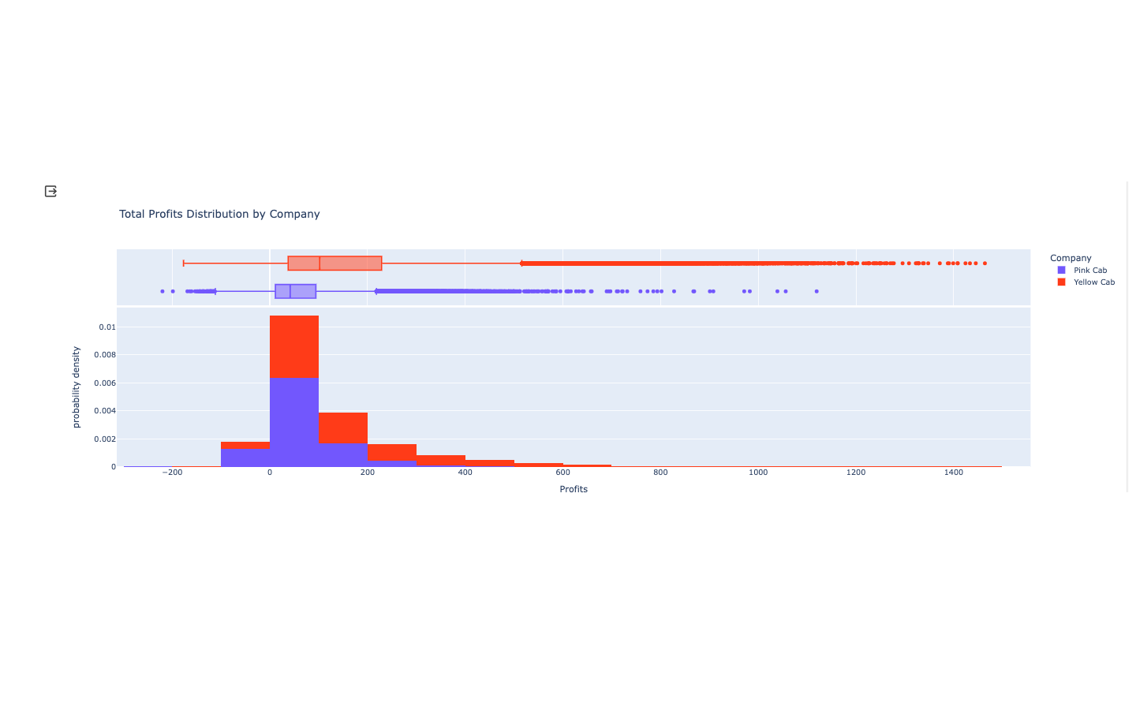
Total Profits Distribution by Company analysis
Company Projected Profit
Pink Cab: 5.307328e+06
Yellow Cab : 4.402037e+07

Slide 16
Conclusions
After conducting Exploratory Data Analysis (EDA), we have clearly identified significant differences between the two taxi companies. It is evident that the company with higher profits is Yellow Cab as compared to Pink Cab, based on the distribution of various factors visualized in the statistics. Considering these findings, it would be advisable to explore investment opportunities in Yellow Cab.

Slide 17
Thank You

