Slide 1
FAIRNESS AND COLLECTIVE DECISION MAKING IN AI
Where does an AI judge people?
Finding warmth and competence inside a language model
Jorge Lastra and Emre Ulu June 2026

Slide 2
WHY THIS MATTERS
Hiring bias could move inside the machine
Companies already use AI to screen job applicants.
Decades of research show that how warm and how competent a name merely sounds predicts who gets a callback. That is documented bias.
If an AI carries the same warmth and competence machinery, automated hiring could repeat that bias at scale, hidden inside a black box.
Our question
Can we find that machinery inside the model, and later show it drives the decision?

Slide 3
THE IDEA
Reading the model's mind
People judge others on two axes: warmth (sincere, trustworthy) and competence (capable, effective). This is the Stereotype Content Model from social psychology.
Does an AI represent these two axes too, as signals we can read?
Probing in plain terms: feed the model a story, pause it partway through its thinking, and read its internal state, which is just a long list of numbers.
A short story
v
Gemma reads it, layer by layer
v
Snapshot at layer 31
Layer 31 is about two thirds through, where abstract ideas are clearest.

Slide 4
HOW WE MEASURE IT
Why we think this is possible
Anthropic recently showed that abstract concepts, even emotions, live inside a model as simple directions that can be read and turned up or down (Sofroniew, Lindsey and colleagues, 2026).
We adopt the same method and point it at warmth and competence.
At layer 31 we read the roughly 3,840 numbers that make up Gemma's internal state, its neurons at that point, and look for the warmth and competence directions among them.
The key bet
If a concept is really in there, it shows up as a direction in those numbers. Finding that direction is what makes the whole study possible.

Slide 5
THE STIMULI
200 short stories that show, never tell
Four kinds: high and low warmth, high and low competence, 50 each (for now).
The behaviour is shown, the trait word is not written. Protagonists have no names and no gender, so we measure behaviour, not identity.
Same situation, two versions: a team meeting under time pressure
HIGH WARMTH
LOW WARMTH
They paused to ask what the quiet teammate was seeing. They made sure the quietest intern's worry went on the board. “We decide together or we don't decide well.”
They announced they already knew the right call. A colleague raised a risk; they kept scrolling. “I don't need everyone comfortable, I need a decision.”

Slide 6
THE METHOD
From stories to a direction
1
2
3
Run each story through Gemma 3 12B and snapshot its internal state at layer 31.
Average the snapshot into one set of numbers per story.
Warmth direction equals average of high warmth minus average of low warmth. Same for competence.
Smoke test first. We ran a small dry run to confirm the pipeline worked, then scaled to the full 200 story set on the cluster.

Slide 7
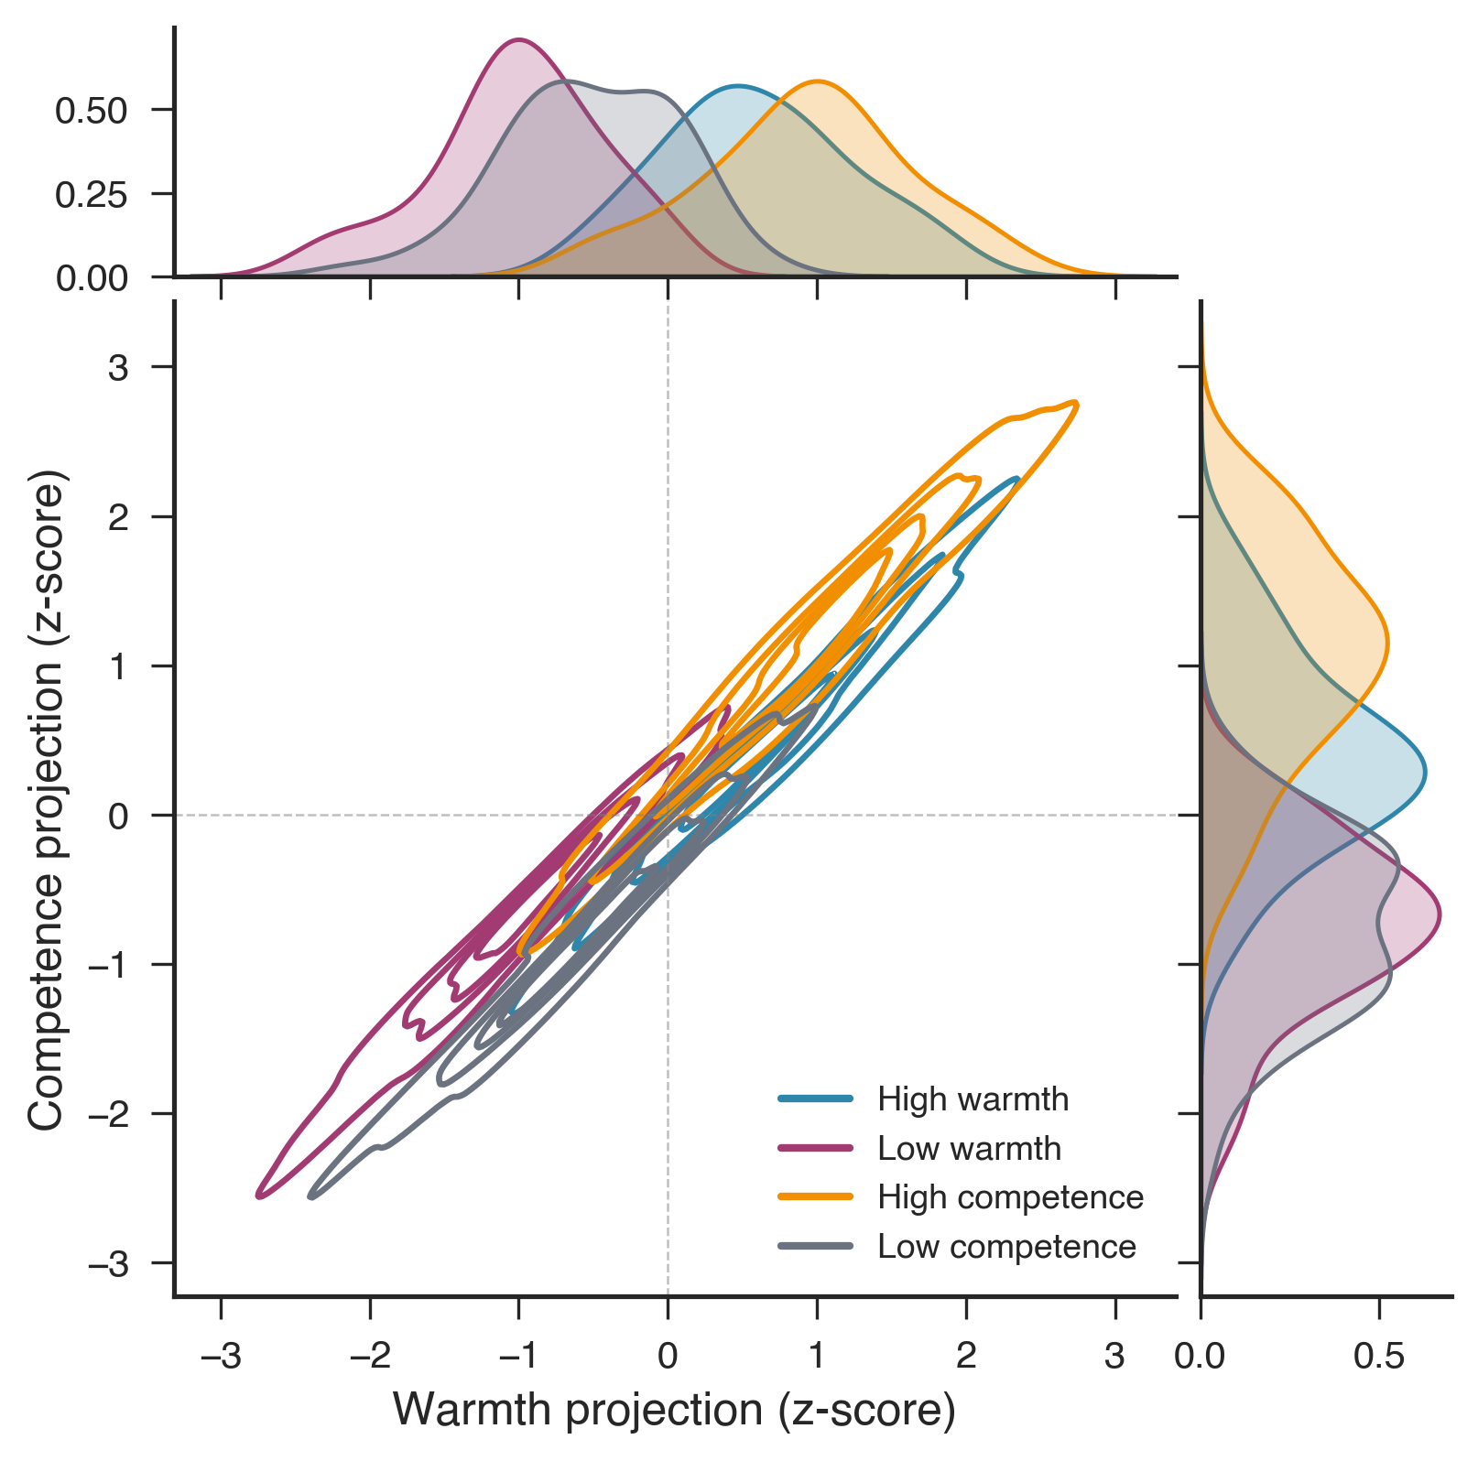
RESULT 1
Four kinds of story, cleanly separated
Each cloud is one kind of story. Warm and cold split left to right; competent and incompetent split top to bottom.
A simple reader told them apart with 100 percent accuracy on stories it had never seen.
Notice the diagonal: good behaviour drifts up and right, bad drifts down and left.

Slide 8
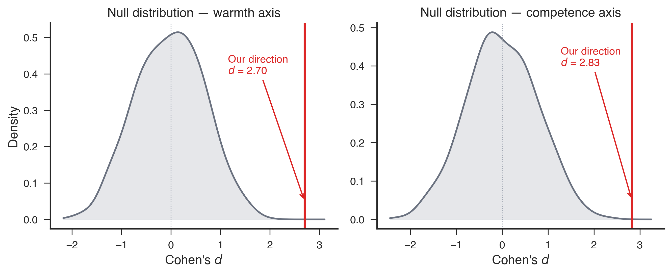
RESULT 2
A real signal, not luck
Could any direction do this? We tried 1000 random ones (grey curve), which all sit near zero.
Our direction (red line) lands far past every one of them. In a space this large, beating all 1000 means we found something genuine.

Slide 9
HONESTY
What we cannot claim yet
Warmth and competence still overlap with plain good versus bad. The simple arrows point about 75 percent the same way.
But a reader trained on warmth is no better than a coin flip at judging competence, and the reverse. So there is warmth specific information. It is not only positivity.
What is next
First, subtract the shared good versus bad component so the two axes stand alone. Then the real test: push the warmth dial up or down and see whether the model's hiring decision changes.

Slide 10
The takeaway
The machinery of social judgment is inside the model, and we can measure it.
This is step one toward spotting and correcting hiring bias before a model is deployed.
The next step: showing it causally drives the decision.

Slide 11
Thank you

