Slide 1
Probing Warmth and Competence
Representations in LLM Hiring Decisions
Emrecan Ulu · Jorge Lastra Cerda
University of Konstanz
Master's Seminar · Fairness and Collective Decision-Making in AI
Notes:
Say nothing — let the slide sit 5 seconds while the audience settles.

Slide 2
AI is now screening job applications, and it discriminates
Applicant
Name
LLM ?
Callback?
All existing audits stop here: they see the output, not the mechanism
50% of US organizations use AI in recruiting (SHRM, 2025)
Behavioral audits show name-driven disparities across race and gender
But they treat the model as a black box: that it discriminates, not how
Notes:
SAY: "We know LLMs discriminate in hiring. But every existing study stops at the output. We wanted to go inside the model and find the mechanism."

Slide 3
A story becomes a hidden activation
HIDDEN ACTIVATION SPACE
STORY
LLM
“The footsteps behind them grew closer.”
words leads
activations
neutral
Concept adapted from Sofroniew, Lindsey et al. (2026)
Notes:
A short story enters the model. Its words are transformed into a high-dimensional activation. We cannot draw thousands of dimensions directly, so we represent that activation as a point and a direction inside an abstract internal space.

Slide 4
A story becomes a hidden activation
HIDDEN ACTIVATION SPACE
STORY
LLM
A very scary story.
words leads
activations
neutral
Concept adapted from Sofroniew, Lindsey et al. (2026)
Notes:
A short story enters the model. Its words are transformed into a high-dimensional activation. We cannot draw thousands of dimensions directly, so we represent that activation as a point and a direction inside an abstract internal space.

Slide 5
A story becomes a hidden activation
HIDDEN ACTIVATION SPACE
STORY
LLM
A very scary story.
words leads
activations
neutral
Concept adapted from Sofroniew, Lindsey et al. (2026)
Notes:
A short story enters the model. Its words are transformed into a high-dimensional activation. We cannot draw thousands of dimensions directly, so we represent that activation as a point and a direction inside an abstract internal space.

Slide 6
A story becomes a hidden activation
HIDDEN ACTIVATION SPACE
STORY
LLM
A very scary story.
words leads
activations
hidden activation
neutral
Text becomes a location in the model’s internal space.
Concept adapted from Sofroniew, Lindsey et al. (2026)
Notes:
A short story enters the model. Its words are transformed into a high-dimensional activation. We cannot draw thousands of dimensions directly, so we represent that activation as a point and a direction inside an abstract internal space.

Slide 7
Emotion concepts become directions
HIDDEN ACTIVATION SPACE
projection marks
STORY
LLM
A very scary story.
strong alignment
words leads
activations
neutral
hidden activation
Concept adapted from Sofroniew, Lindsey et al. (2026)
Notes:
Anthropic showed that abstract emotion concepts can be recovered as linear directions in this space. We can compare the model’s current activation with directions such as joy, fear, and sadness. In this example, the story aligns most strongly with fear. This does not mean the model feels fear; it means the model represents the concept in a measurable way. If emotions form directions, social concepts such as warmth and competence may form directions too.

Slide 8
Emotion concepts become directions
HIDDEN ACTIVATION SPACE
projection marks
STORY
LLM
A very scary story.
strong alignment
words leads
activations
fear
neutral
hidden activation
Concept adapted from Sofroniew, Lindsey et al. (2026)
Notes:
Anthropic showed that abstract emotion concepts can be recovered as linear directions in this space. We can compare the model’s current activation with directions such as joy, fear, and sadness. In this example, the story aligns most strongly with fear. This does not mean the model feels fear; it means the model represents the concept in a measurable way. If emotions form directions, social concepts such as warmth and competence may form directions too.

Slide 9
Emotion concepts become directions
HIDDEN ACTIVATION SPACE
joy
projection marks
STORY
LLM
A very fun story.
strong alignment
words leads
activations
fear
neutral
hidden activation
Concept adapted from Sofroniew, Lindsey et al. (2026)
Notes:
Anthropic showed that abstract emotion concepts can be recovered as linear directions in this space. We can compare the model’s current activation with directions such as joy, fear, and sadness. In this example, the story aligns most strongly with fear. This does not mean the model feels fear; it means the model represents the concept in a measurable way. If emotions form directions, social concepts such as warmth and competence may form directions too.

Slide 10
Emotion concepts become directions
HIDDEN ACTIVATION SPACE
joy
projection marks
STORY
LLM
A very sad story.
strong alignment
words leads
activations
fear
neutral
hidden activation
sadness
If emotion concepts form directions, could warmth and competence do the same?
Concept adapted from Sofroniew, Lindsey et al. (2026)
Notes:
Anthropic showed that abstract emotion concepts can be recovered as linear directions in this space. We can compare the model’s current activation with directions such as joy, fear, and sadness. In this example, the story aligns most strongly with fear. This does not mean the model feels fear; it means the model represents the concept in a measurable way. If emotions form directions, social concepts such as warmth and competence may form directions too.

Slide 11
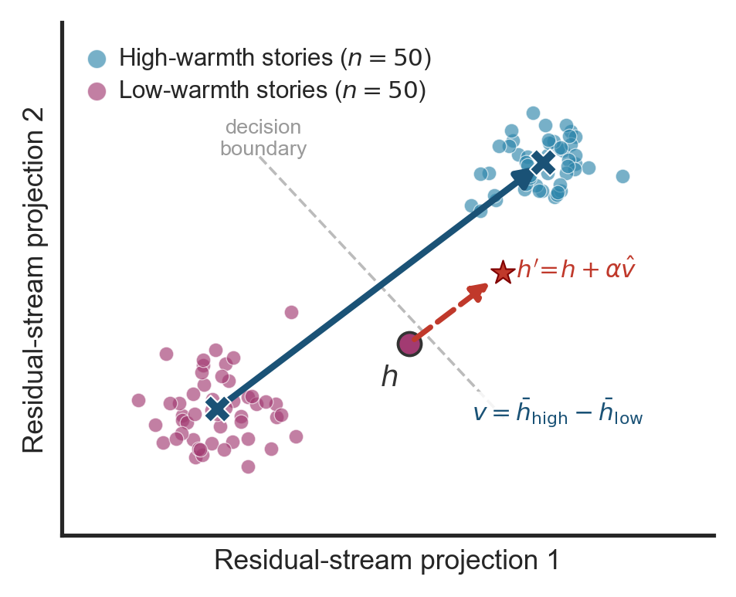
What if social perception is encoded as geometry inside the model?
200 short stories · nameless protagonist · 4 conditions:
High Warmth
Low Warmth
High Competence
Low Competence
Nameless, gender-neutral protagonist in every story, so the vector encodes behaviour, not demographic identity.
Mean difference between high and low conditions gives the direction vector v
If the direction generalizes to new topics never seen during training, the representation is not an artifact of the training stimuli.
Fig: Concept direction geometry (schematic)
Notes:
SAY: "We ran stories through the model, took internal activations at one layer, and computed the mean difference between conditions. That gives us a direction vector for warmth. We then test whether it generalizes to entirely new topics the model has never seen."

Slide 12
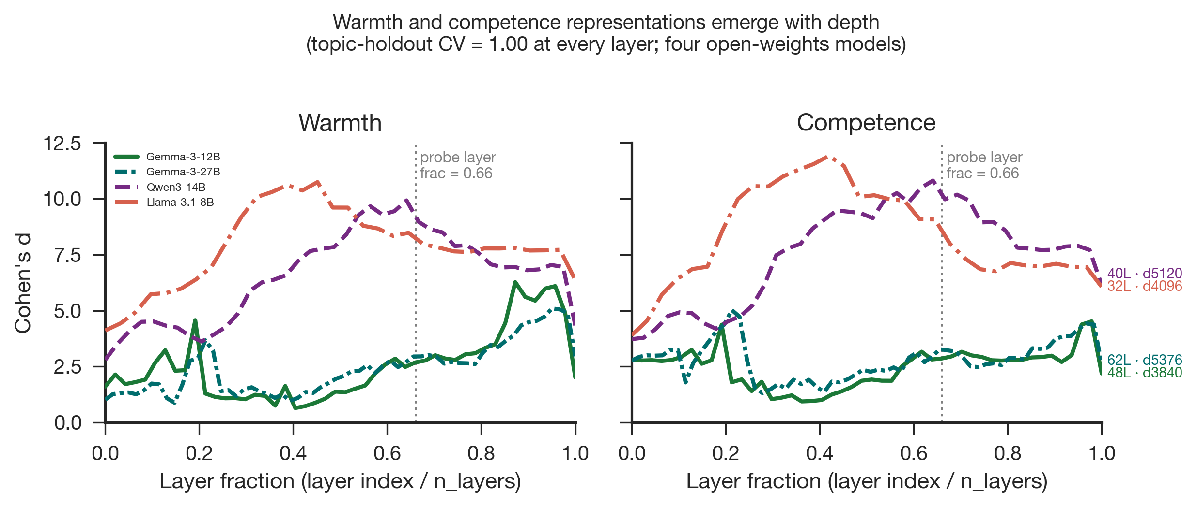
Finding 1: Warmth and competence are linearly encoded in all four models
100%
ρ 0.76–0.99
accuracy, including on
entirely new situations
cross-model story agreement
(4 models, 3 companies)
Gemma-3-12B
Gemma-3-27B
Llama-3.1-8B
Qwen3-14B
Fig: Layer emergence, Cohen's d by depth
All four models, trained independently at three different organisations, converge on the same warmth/competence ordering of stories. That convergence is strong evidence this reflects the training data, not a quirk of one architecture.
Notes:
SAY: "The probe generalizes to new topics never seen during training. And four models from three companies all agree on which stories are warm or cold — strong evidence this is in the training data, not one architecture."

Slide 13
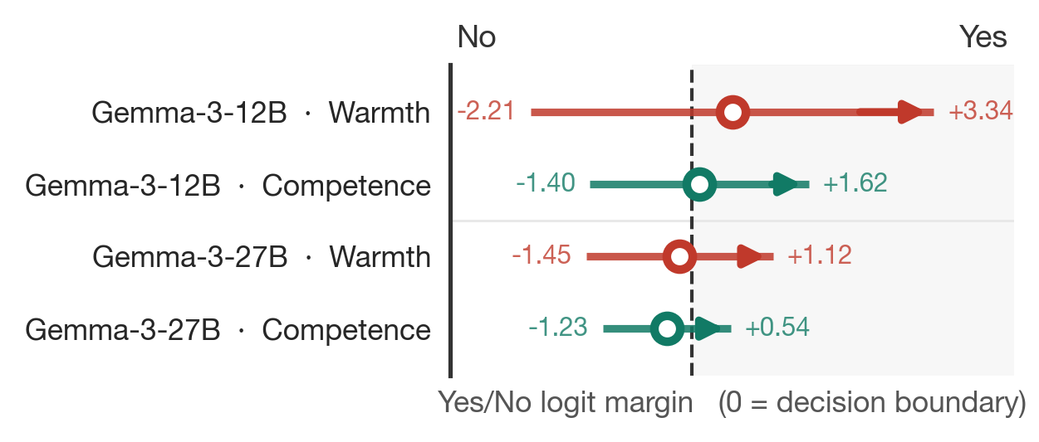
Finding 2: We can steer these directions and flip hiring decisions
Injecting the warmth direction during resume evaluation shifts the callback recommendation, crossing the Yes/No boundary for every name tested.
Caveat: 12B measurement-limited (bf16)
Baseline circle: where each name starts before steering
Fig: Diverging steering, Gemma-3-12B and 27B
Arrow: how far the decision shifts with each push
Dashed line: the Yes / No decision boundary (x = 0)
27B: a small push works; a larger push reverses the effect, suggesting a narrow causal window
Notes:
SAY: "This is the causal test. We inject the warmth direction directly while the model reads a resume. Every single name crosses the decision boundary. At 27B the effect reverses at higher strength — the causal pathway is fragile at larger scale."

Slide 14
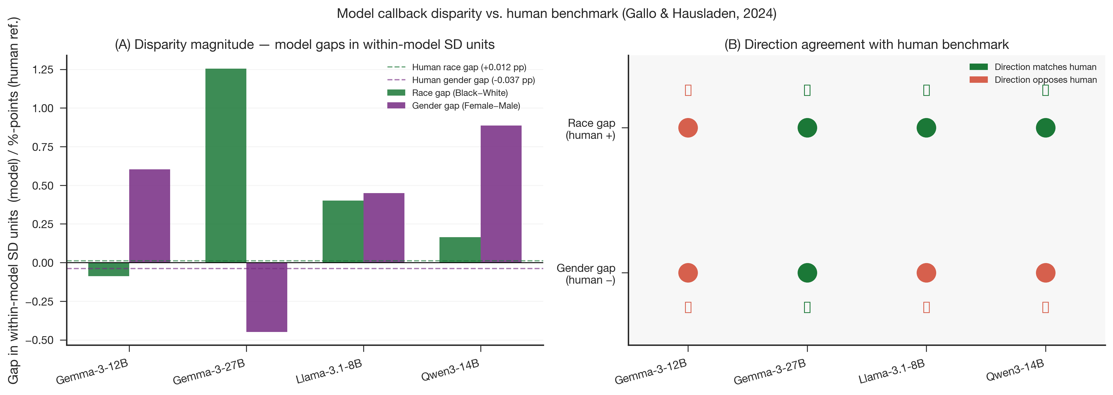
Finding 3: Model disparities run opposite to the human benchmark
Human benchmark (Gallo & Hausladen, 2024):
White names receive more callbacks than Black names
Males receive slightly more callbacks than females
What the models do:
All 3 models with reliable data favor Black-signalling names, opposite the human pattern
Gemma-27B: race gap +1.18 SD, more than 1 SD above White names
Fig: Model disparity vs human benchmark
27B matches human gender direction; Llama and Qwen reverse it
One possible explanation: safety fine-tuning may have overcorrected for racial associations, reversing the gap rather than removing it.
Notes:
REVEAL HUMAN BENCHMARK FIRST, then model results.
SAY: "None of the models reproduce the human racial discrimination pattern. All favor Black-signalling names — the opposite. At 27B the gap is more than 1 SD. The model is not a faithful copy of human prejudice. It is a differently biased system."

Slide 15
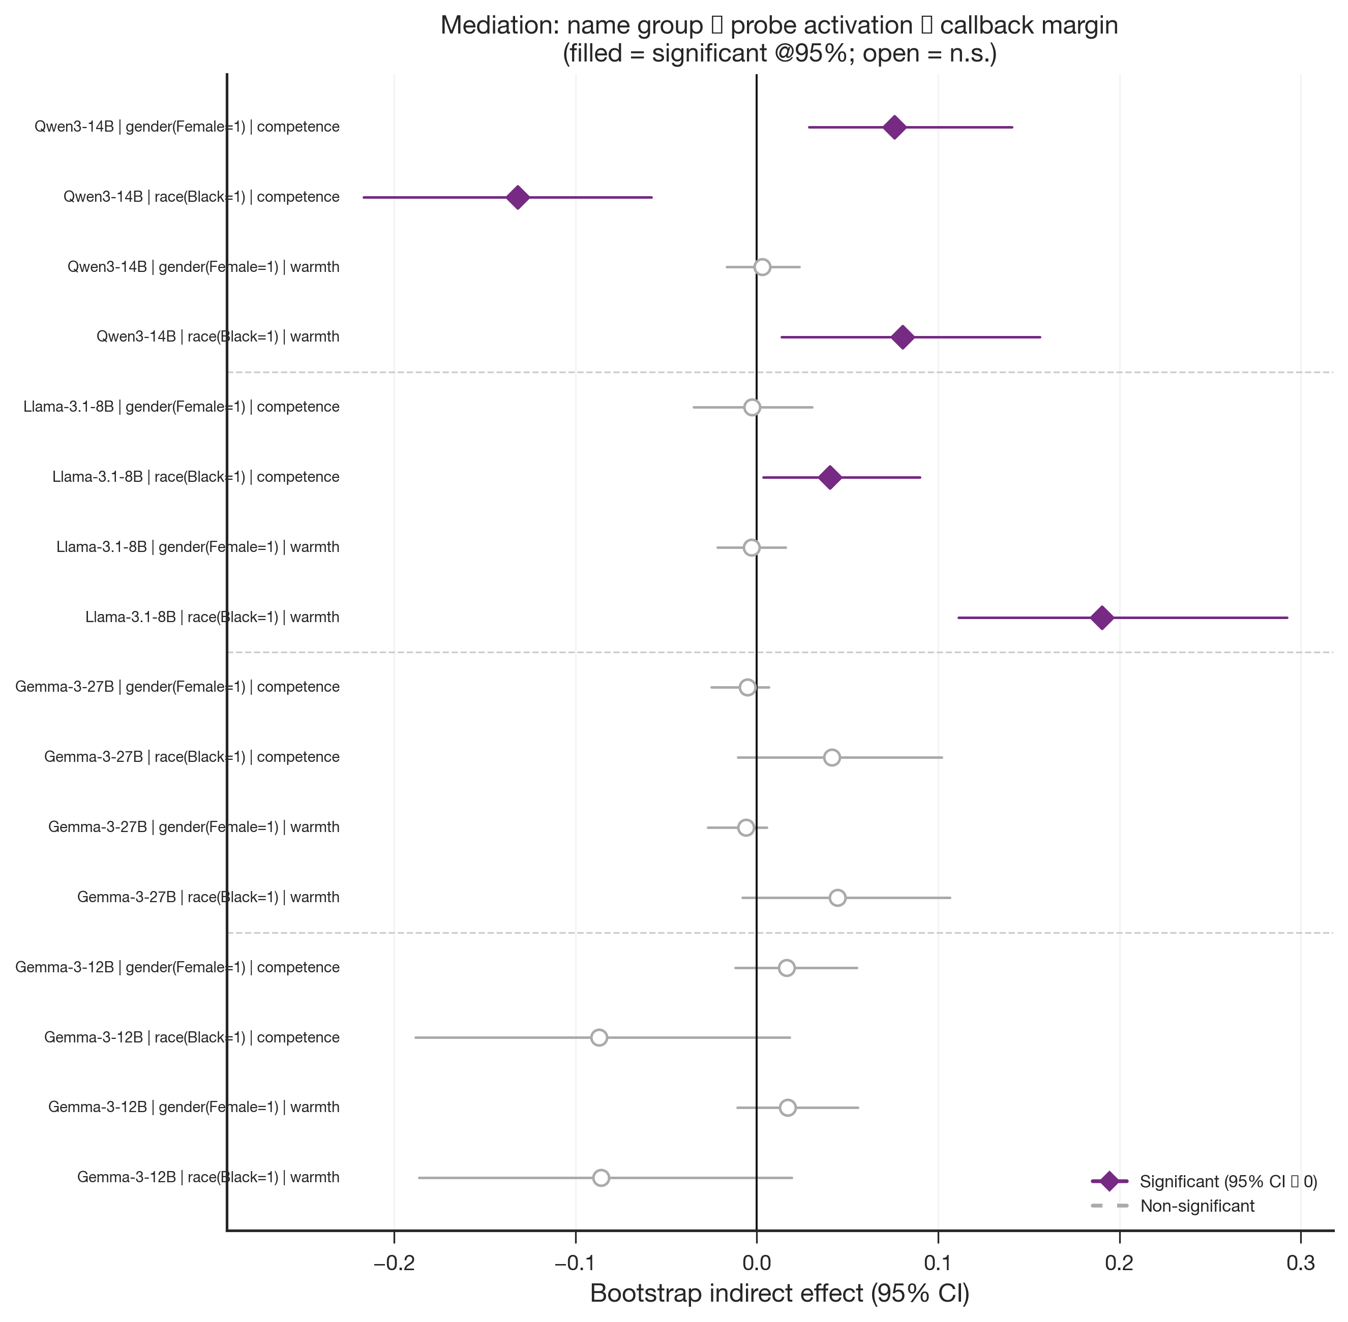
The representation mediates the decision, but not where you would expect
Does the warmth/competence probe score carry the name-group signal into the callback decision?
name group → probe score → callback margin
Significant for Llama (race × warmth). Not significant for Gemma.
Steerability Paradox
Gemma-12B: easiest to steer externally → no significant mediation
Llama-8B: hardest to steer externally → strongest mediation effect
Concept-level steerability and natural causal mediation measure different things.
Fig: Bootstrap mediation forest plot, indirect effects with 95% CI
Notes:
[Optional — use if time allows]
SAY: "The model easiest to steer via direct intervention is not the model where the representation naturally governs the decision. Steering measures causal sensitivity to an external push. Mediation measures whether the natural activation propagates to the outcome."

Slide 16
What this means
The representations are real
01
LLMs encode warmth and competence in a structure consistent with human social perception: linearly separable, causally functional, and consistent across four architectures.
Disparities persist, but point in the opposite direction
02
Name-driven hiring disparities remain. Across the models with reliable data, the racial gap reversed direction compared to the human baseline and grew in magnitude.
You need both probing and behavioral audits
03
Internal representation probing and output-level disparity measurement capture different things. Neither alone is sufficient.
Ulu · Lastra Cerda · University of Konstanz
Notes:
SAY: "The contribution is methodological as well as empirical. We connected mechanistic interpretability to the correspondence study tradition, and the combination reveals something that neither approach would find alone."

