Slide 2

Introduction to D3.js
Eduardo López

Slide 3
Agenda
Data Visualizations
Live Examples
What is D3.js?
Basic Building Blocks
Getting started with D3.js
DOM Manipulation (Selectors)
Binding Data to DOM Elements (D3 States)

Slide 4
Agenda
SVG Elements
Dynamic Data (JSON)
Scales, Range, and Domain
D3 Transitions
D3 Events
Code Walk Through
Summary

Slide 5
Data Visualizations

Slide 6
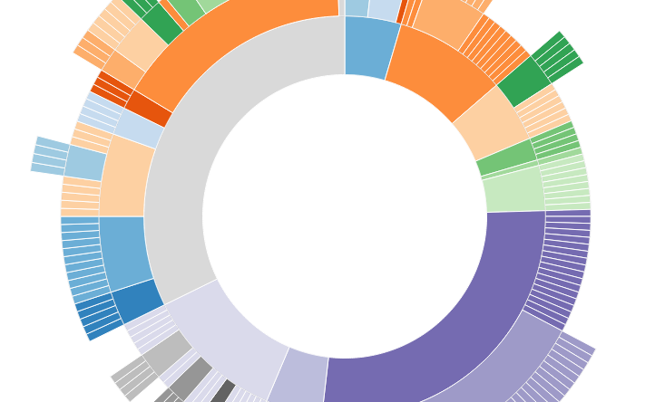
Data Visualizations
A picture is worth 1000 words
Gigantic mounts of data are being generated on a daily basis.
“Data is just like crude. It’s valuable, but if unrefined it cannot really be used.” - Michael Palmer

Slide 7
“The ability to take data—to be able to understand it, to process it, to extract value from it, to visualize it, to communicate it—that’s going to be a hugely important skill in the next decades.”
Hal Varian
Chief Economist, Google

Slide 8
Live Examples

Slide 9
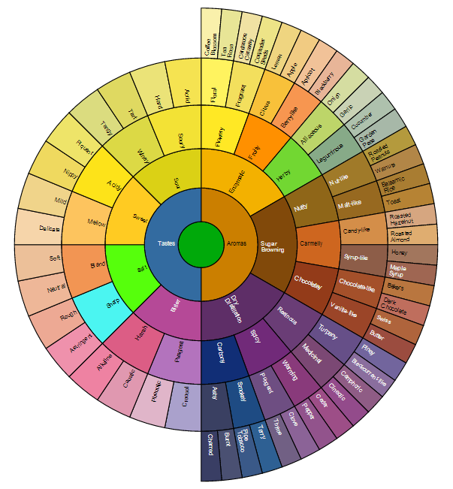
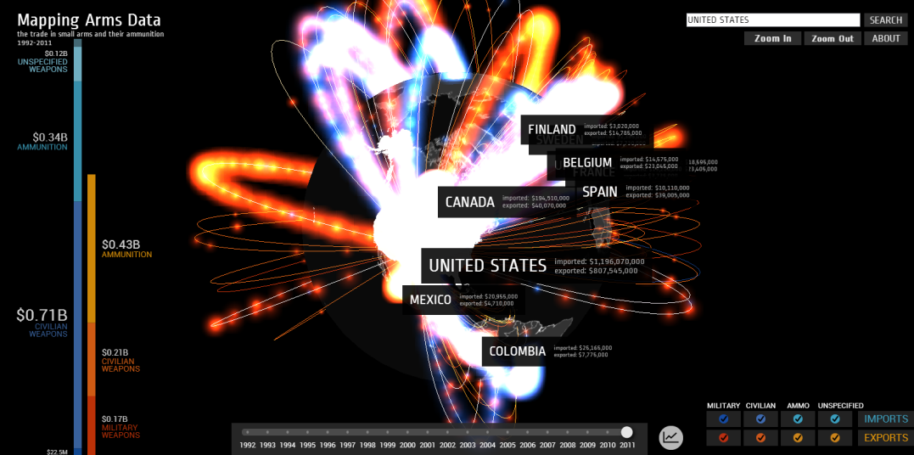
Live Examples

Slide 10
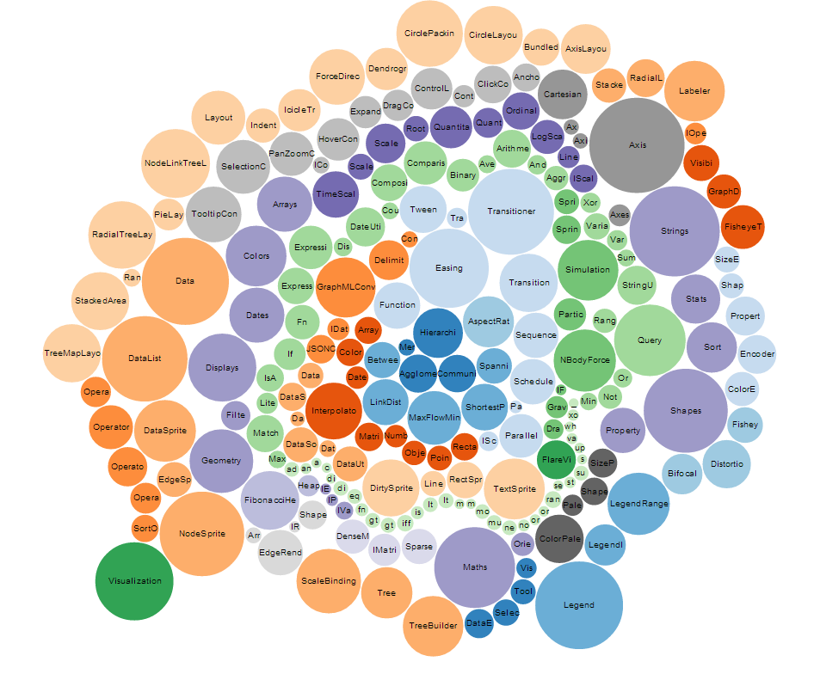
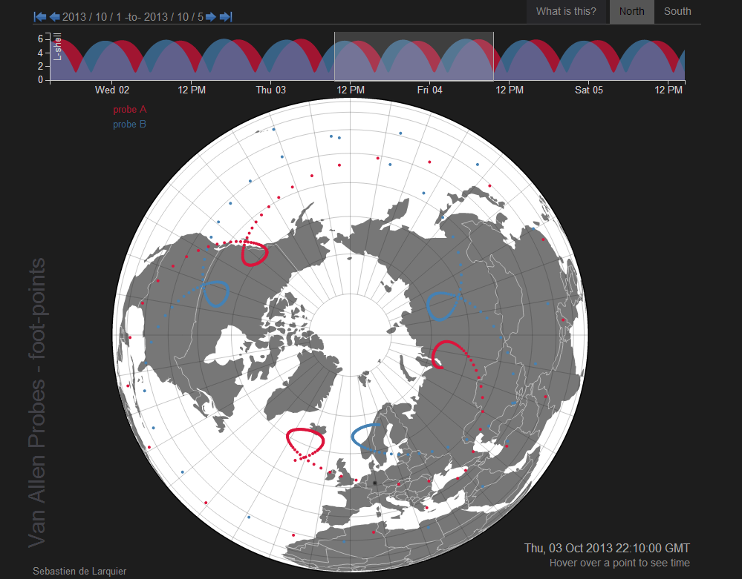
Live Examples

Slide 11
What is D3.js?

Slide 12
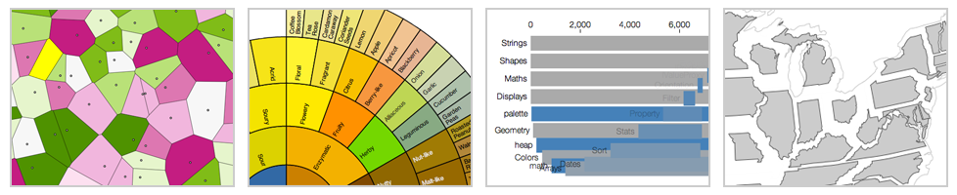
What is D3.js?
Data-Driven Documents
D3.js is a JavaScript library for generating visualizations based on data.
D3 brings data to life using HTML, JavaScript, SVG and CSS.
D3 allows you to bind arbitrary data to a Document Object Model (DOM), and then apply data-driven transformations it.
http://d3js.org/
Notes:
D3.js author works in NYTimes.

Slide 13
What is D3.js?
Advantages
Uses Web Technologies
Easy to debug
Runs fast
Supports large datasets
Dynamic behaviors for interaction and animation
Components and Plug-ins
Documentation
Examples
Large community
Notes:
D3 .js is one of the 10 most active Open Source projects in GitHub

Slide 14



What is D3.js?
Alternatives
Processing.js
Raphael.js
Protovis.js
Paper.js

Slide 15
Basic Building Blocks

Slide 16

Basic Building Blocks
Modern Browsers
Google Chrome (Webkit/Blink)
Firefox (Gecko)
Safari (Webkit)
Opera (Presto/Webkit/Blink)
Internet Explorer (Trident)

Slide 17
Basic Building Blocks
Technologies
SVG
HTML
DOM
CSS
JSON
JavaScript

Slide 18
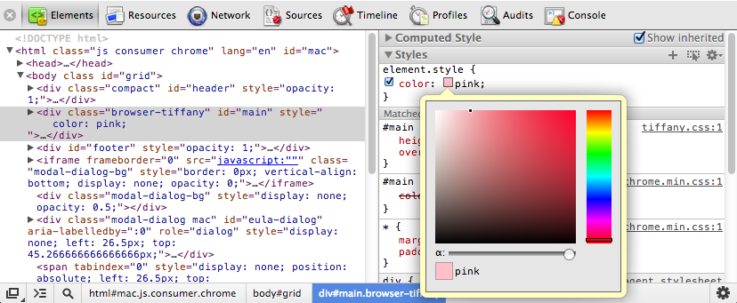

Basic Building Blocks
Web Inspectors
Web Inspector allows you to view the page source, live DOM hierarchy, script debugging, profiling and more.

Slide 19
Getting started with D3.js

Slide 20
Getting started with D3.js
Import the d3.js library:
<script src="d3.v3.min.js"></script>
<script src="http://d3js.org/d3.v3.min.js"></script>
<!DOCTYPE html>
<html>
<head></head>
<body>
<script src="http://d3js.org/d3.v3.min.js"></script>
<script> d3.select("body").append("p").html("Hello World!"); </script>
</body>
</html>

Slide 21
Getting started with D3.js
API Reference
https://github.com/mbostock/d3/wiki/API-Reference

Slide 22

Getting started with D3.js
API Reference
d3 (core)
Selections
Transitions
Working with Arrays
Math
Loading External Resources
String Formatting
Colors
etc.

Slide 23
Getting started with D3.js
API Reference
d3.scales (Scales)
Quantitative
Ordinal

Slide 24
Getting started with D3.js
API Reference
d3.svg (SVG)
Shapes
Axes
Controls

Slide 25
Getting started with D3.js
API Reference
d3.layout (Layouts)
Hierarchy
Partition
Pie
Stack
Tree
Treemap
etc.

Slide 26
Getting started with D3.js
API Reference
d3.behavior (Behaviors)
Drag
Zoom

Slide 27
DOM Manipulation (Selectors)

Slide 28
DOM Manipulation (Selectors)
Selectors
Using JavaScript
var paragraphs = document.getElementsByTagName("p");
for (var i = 0; i < paragraphs.length; i++) {
var paragraph = paragraphs.item(i);
paragraph.style.setProperty("color", "white", null);
}
Using d3.js
d3.selectAll("p").style("color", "white");

Slide 29
DOM Manipulation (Selectors)
Selectors
D3.js select method uses CSS3 selectors to grab DOM elements.
d3.select(“body"); // By tag
d3.select(“#id"); // By id
d3.select(“.class"); // By class
http://www.w3.org/TR/css3-selectors/#selectors
The selection returns an array with elements
var parentElement = d3.select("body");
parentElement;
parentElement.select("p");
Notes:
d3.select("body").append("p").html("Hello");

Slide 30
DOM Manipulation (Selectors)
Dynamic Properties
Styles, attributes, and other properties can be specified as functions of data in D3, not just simple constants.
d3.selectAll("p").style("color", function(d, i) {
return i % 2 ? "#ff0000" : "#0000ff";
});
d = data of each element
i = index of each element
this = current DOM element

Slide 31
Binding Data to DOM Elements (D3 States)

Slide 32
Binding Data to DOM Elements (D3 States)
Data
Data is specified as an array of values, and each value is passed as the first argument (d) to the selection functions.
d3.selectAll("p“)
.data([4, 8, 15, 16, 23, 42])
.style("font-size", function(d) {
return d + "px";
});
Once data has been bound to the document, you can omit the data operator; D3 will retrieve the previously-bound data.
Notes:
With the default join-by-index, the first element in the data array is passed to the first node in the selection, the second element to the second node, and so on.

Slide 33
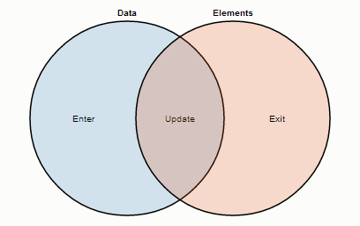
Binding Data to DOM Elements (D3 States)
Enter, Update and Exit selections
This Venn diagram illustrates the data-join.
Data bound to existing elements produce the update (inner) selection.
Unbound data produce the enter selection (left), and unbound elements produce the exit selection (right).

Slide 34
Binding Data to DOM Elements (D3 States)
Enter, Update and Exit selections
You can create/update nodes for incoming data and remove outgoing nodes that are no longer needed.
When data is bound to a selection, each element in the data array is paired with the corresponding node in the selection.
// Update…
var p = d3.select("body").selectAll("p")
.data([4, 8, 15, 16, 23, 42]).html(String);
// Enter…
p.enter().append("p")
.html(String);
// Exit…
p.exit().remove();

Slide 35
Binding Data to DOM Elements (D3 States)
Three Little Circles
http://mbostock.github.io/d3/tutorial/circle.html
Selecting Elements
Binding Data
Creating Elements
Destroying Elements
All Together Now

Slide 36
SVG Elements

Slide 37
SVG Elements
Scalable Vector Graphics
SVG is used to define vector-based graphics for the Web
Vector graphics are not created out of pixels
SVG defines the graphics in XML format
SVG graphics do NOT lose any quality if they are zoomed or resized
Every element and every attribute in SVG files can be animated
Events can be attached to SVG elements

Slide 38
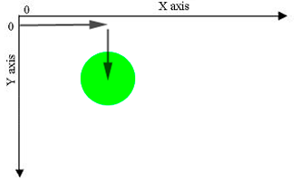
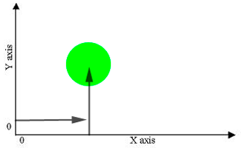
SVG Elements
Mathematical / Graph Coordinate Space
Mathematical Coordinates
Graph Coordinates

Slide 39

SVG Elements
Structure
<svg width="50" height="50">
<circle cx="25" cy="25" r="25" fill="purple" />
</svg>
With d3.js
d3.select("body")
.append("svg")
.attr("width", 50)
.attr("height", 50)
.append("circle")
.attr("cx", 25)
.attr("cy", 25)
.attr("r", 25)
.style("fill", "purple");

Slide 40



SVG Elements
Basic set of shapes
<svg width="50" height="50">
<rect x="0" y="0" width="50" height="50" fill="green" /> </svg>
Rectangle
<svg width="50" height="50">
<circle cx="25" cy="25" r="25" fill="purple" />
</svg>
Circle
<svg width="50" height="50">
<ellipse cx="25" cy="25" rx="15" ry="10" fill="red" /> </svg>
Ellipse

Slide 41



SVG Elements
Basic set of shapes
<svg width="50" height="50">
<line x1="5" y1="5" x2="40" y2="40" stroke="gray"
stroke-width="5" />
</svg>
Straight Line
<svg width="50" height="50">
<polyline fill="none" stroke="blue" stroke-width="2"
points="05,30 15,30 15,20 25,20 25,10 35,10" />
</svg>
Polyline
<svg width="50" height="50">
<polygon fill="yellow" stroke="blue" stroke-width="2“
points="05,30 15,10 25,30" />
</svg>
Polygon

Slide 42
SVG Elements
Grouping SVG elements
SVG group tag: <g>…</g>
Any transformation applied to the SVG Group Element is applied to all of the child elements contained inside.
<svg width="200" height="200">
<g transform="translate(80, 0) scale(...) rotate(...) translate(...) rotate(...)">
...
</g>
</svg>

Slide 43
SVG Elements
Text Element
SVG text tag: <text>…</text>
var circleData = [
{ "cx": 20, "cy": 20, "radius": 20, "color" : "green" },
{ "cx": 70, "cy": 70, "radius": 20, "color" : "purple" }
];
var text = svgContainer.selectAll("text").data(circleData).enter().append("text");
var textLabels = text
.attr("x", function(d) { return d.cx; })
.attr("y", function(d) { return d.cy; })
.text( function (d) { return "( " + d.cx + ", " + d.cy +" )"; })
.attr("font-family", "sans-serif")
.attr("font-size", "20px")
.attr("fill", "red");
(20, 20)
(70, 70)

Slide 44
Dynamic Data (JSON)

Slide 45

Dynamic Data (JSON)
Loading External Data Resources
D3.js has built in functionality to load in the following types of external resources:
XMLHttpRequest (d3.xhr())
Text File (d3.text())
JSON Blob (d3.json())
HTML Document Fragment (d3.html())
XML Document Fragment (d3.xml())
Comma-Separated Values (CSV) file (d3.csv())
Tab-Separated Values (TSV) file (d3.tsv())

Slide 46
Dynamic Data (JSON)
JavaScript Object Notation
{
"success": true,
"circles": [
{
"x_axis": 30,
"y_axis": 30,
"radius": 20,
"color" : "green"
},
{
"x_axis": 60,
"y_axis": 60,
"radius": 20,
"color" : " blue "
}
]
}
d3.json("getCircles.json", function(error, data) {
var circlesData = data.circles;
var svg = d3.select("body")
.append("svg")
.attr("width", 100)
.attr("height", 100);
var circles = svg.selectAll("circle")
.data(circlesData)
.enter().append("circle")
.attr("cx", function(d) { return d.x_axis; })
.attr("cy", function(d) { return d.y_axis; })
.attr("r", function(d) { return d.radius; })
.style("fill", function(d) { return d.color; });
});

Slide 47
Scales, Range and Domain

Slide 48
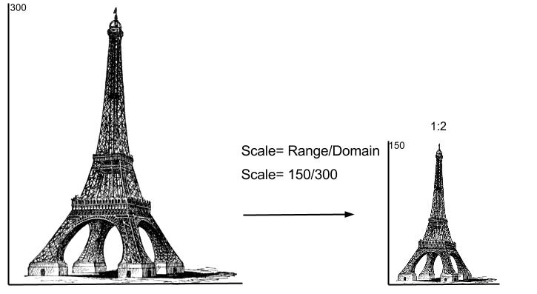
Scales, Range and Domain
Scaling Eiffel Tower

Slide 49
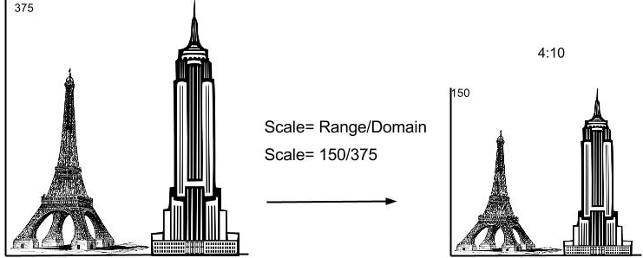
Scales, Range and
Eiffel Tower vs. The Empire State

Slide 50
Scales, Range and Domain
Scales
Scales transform a number in a certain interval (called the domain) into a number in another interval (called the range)
Scales are functions that map from an input domain to an output range (Mike Bostock’s definition).
Ordinal scales have a discrete domain, such as a set of names or categories.
Quantitative scales have a continuous domain, such as a set of real numbers, or dates.

Slide 51
Scales, Range and Domain
Scales
Linear scale is the most common scale, and a good default choice to map a continuous input domain to a continuous output range.
d3.scale.linear() Constructs a new linear scale with the default domain [0,1] and the default range [0,1].

Slide 52
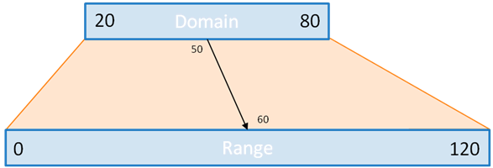
Scales, Range and Domain
Scales: The main idea
Let’s suppose you know your data is always over 20 and always below 80.
You would like to plot it, say, in a bar chart, which can be only 120 pixels tall.
You could, obviously, do the math:
.attr("height", function(d) {return (d-20)*2;})

Slide 53
Scales, Range and Domain
Scales: The main idea
But what if you suddenly have more or less space? or your data changes? you’d have to go back to the entrails of your code and make the change. This is very error prone. So instead, you can use a scale:
There are tons of possibility with scales…
var y=d3.scale.linear().domain(20,80).range(0,120);
...
.attr("height", y)

Slide 54
Scales, Range and Domain
Range and Domain
Range is the amount of pixels you wish to cover with the scale.
Domain is the start and end of your dataset.
Domain
var linearScale = d3.scale.linear()
.domain([0,10000])
.range([0,100]);
var data = [0, 1000, 3000, 2000, 5000, 4000, 7000, 6000, 9000, 8000, 10000];
var minData = d3.min(data); //0
var maxData = d3.max(data); //10000
0
…
10000
Range
0
…
100

Slide 55
Scales, Range and Domain
Axes
D3.js axis component displays reference lines for D3.js scales automatically.
D3.js figures out for you how to draw the vertical and horizontal axis lines, axis ticks, the correct spacing of axis ticks to make the axis visually appealing and many other things.
//Create the SVG Viewport
var svgContainer = d3.select("body").append("svg").attr("width", 400).attr("height", 100);
//Create the Scale we will use for the Axis
var axisScale = d3.scale.linear().domain([0, 100]).range([0, 400]);
//Create the Axis
var xAxis = d3.svg.axis().scale(axisScale).orient("bottom");
//Create an SVG group Element for the Axis elements and call the xAxis function
var xAxisGroup = svgContainer.append("g").call(xAxis);

Slide 56
D3 Transitions

Slide 57
D3 Transitions
Transitions
Transitions gradually interpolate styles and attributes over time.
Tweening can be controlled via easing functions such as “elastic”, “cubic-in-out” and “linear”.
Creating Animations and Transitions With D3
d3.selectAll("circle")
.transition()
.duration(750)
.delay( function(d, i) { return i * 10; })
.attr("r", function(d) { return d * 2; });

Slide 58
D3 Events

Slide 59

D3 Events
Events
A function can be executed when an event occurs, like when a user clicks on an HTML/SVG element.
Types of Events:
Window Event (eg. onload)
Form Events (eg. onsubmit)
Keyboard Events (eg. onkeypress)
Mouse Events (eg. onclick)
Media Events (eg. onerror)
Touch Events (eg. ontouch)

Slide 60

D3 Events
Binding events to elements
var enterCircles = circles.enter().append("g")
.attr("class", "circle")
.attr("id", function(d) { return d.id; })
.attr("opacity", 0)
.on("click", onNodeClick)
.on("mouseover", onNodeMouseOver)
.on("mousemove", onNodeMouseMove)
.on("mouseout", onNodeMouseOut);
function onNodeClick(d) {
var event = d3.event,
positionX = event.pageX,
positionY = event.pageY;
var circle = d3.select(this)
.attr("cx", positionX)
.attr("cy", positionY)
.attr("r", function(d) { return d.radius; });
.style("fill", "blue");
}

Slide 61
Code Walk Through

Slide 62
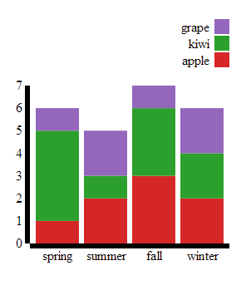
Code Walk Through

Slide 63
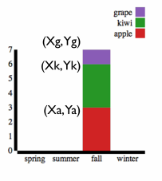

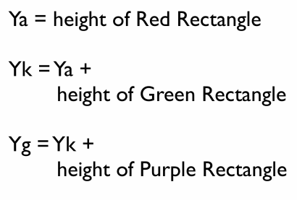
Code Walk Through

Slide 64
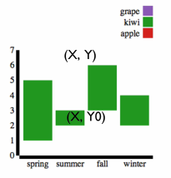
Code Walk Through
D3.layout.stack()(layers)
Layers = [ […], […], […] ]
Layer = [ {…}, {…}, {…} ]
Object = { “”x:…, “y”: …, … }
Notes:
layer_1 = [ {“x”:1, “y”: 2}, {“x”:1, “y”: 2} ];
layer_2 = [ {“x”:1, “y”: 4}, {“x”:4, “y”: 15} ];
layers = [ layer_1, layer_2]; d3.layoutstack()(layers);

Slide 65
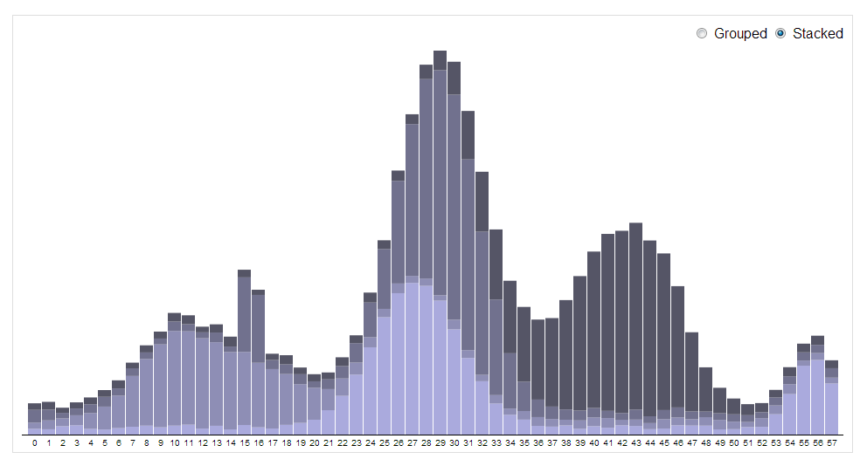
Code Walk Through

Slide 66
Summary

Slide 67
Summary
Data Visualizations
Live Examples
What is D3.js?
Basic Building Blocks
Getting started with D3.js
DOM Manipulation (Selectors)
Binding Data to DOM Elements (D3 States)

Slide 68
Summary
SVG Elements
Dynamic Data (JSON)
Scales, Range, and Domain
D3 Transitions
D3 Events
Code Walk Through
Summary

Slide 69
Links
https://github.com/mbostock/d3/wiki/Gallery
http://blog.visual.ly/why-d3-js-is-so-great-for-data-visualization/
http://bost.ocks.org/mike/join/
http://selection.datavisualization.ch/
http://chimera.labs.oreilly.com/books/1230000000345/ch07.html
http://www.jeromecukier.net/blog/2011/08/11/d3-scales-and-color/
https://www.dashingd3js.com/table-of-contents
http://pothibo.com/2013/09/d3-js-how-to-handle-dynamic-json-data/

Slide 70
Links
http://www.w3schools.com/json/
https://developer.mozilla.org/en-US/docs/JSON
http://www.w3schools.com/svg/
https://developer.mozilla.org/en-US/docs/Web/SVG
http://developers.google.com/chrome-developer-tools/

Slide 71
Q&A

