Slide 1
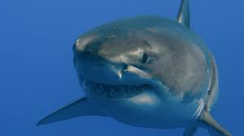
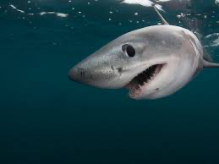

BabyShark
Name
Department Course Number Section Time Location
DATE
Members:
Jorge Rodrigues
Rao Fu
Michele Montalvo
Modris Opelts

Slide 2
Project Overview
Name
Department Course Number Section Time Location
DATE
Business Case
Question
International Water Sports Centers (offering services like diving, surfing, and water-skiing) are vulnerable to shark attacks. They hold responsibilities to customers’ safety and they need to distribute more life-saving resources during the peak months when shark attacks happen most frequently.
In which months should the International Water Sports Centers in major water sports destinations assign more lifeguards at the beaches?
Hypothesis 1: The Water Sports Centers should hire more lifeguards in Summer.
Hypothesis 2: The Water Sports Centers in the North Hemisphere should hire more lifeguards in July, August whereas the ones in the South Hemisphere should hire more in December and January.

Slide 3
Project Overview
Name
Department Course Number Section Time Location
DATE
The original dataset contained entries regarding shark attacks around the world, most of the data came in inconsistent formats;
Data cleaning methods we mainly used: “Fillna, Apply, Drop Duplication, Drop Columns, Lambda, Grouping.” helped us to preserve the integrity of the data and lose as little as possible;
After Data Cleaning, we fixated on “Months” to conduct analysis. We used ‘Histograms, Aggregations, Boxplot’ to reveal the relationships between months and shark attacks;

Slide 4
Challenges
Name
Department Course Number Section Time Location
DATE
Significant Challenges: Formatting issues in variables such as ‘Date, Time, Country’.
Our Fixes: We used Web Scraping to correct the country names(e.g., which could be a State before cleaning);
We used Machine Learning (Random Forest) to predict what Sex were the NA values. ( Used Country, activity and Age);
We converted Time into 4 digits and convert (6<=Hour<12 :Morning; 12<=Hour<18 :Afternoon; 18<=Hour<21 :Evening; rest: Night)

Slide 5
Exploratory Data
Name
Department Course Number Section Time Location
DATE
Global
Country
Histogram: Shark attacks scattered to each months → peak: July
Group Gender, Fatalities by months → peak: July;
Box Plot: Fatalities scattered to each months → July;
Fixated on Top 10 most shark attack countries (AU, US, IN, NZ,SA);
Histogram on specific countries and shark attacks per month;

Slide 6
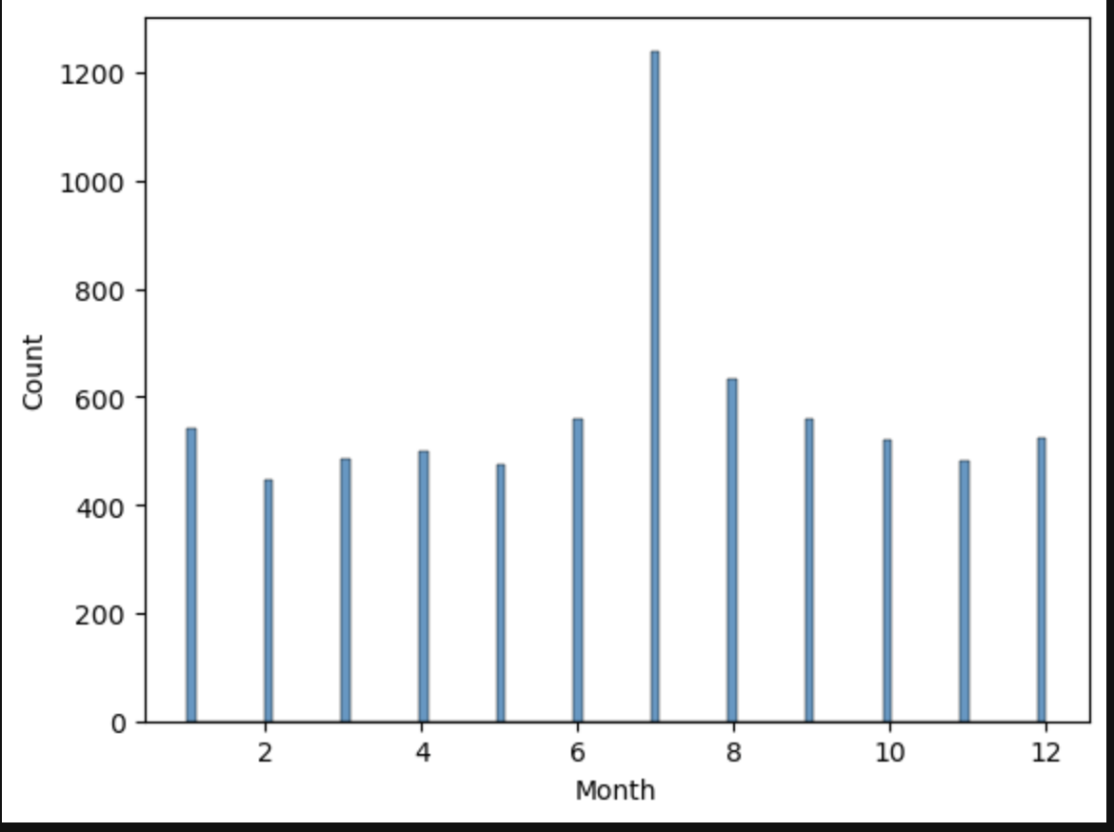
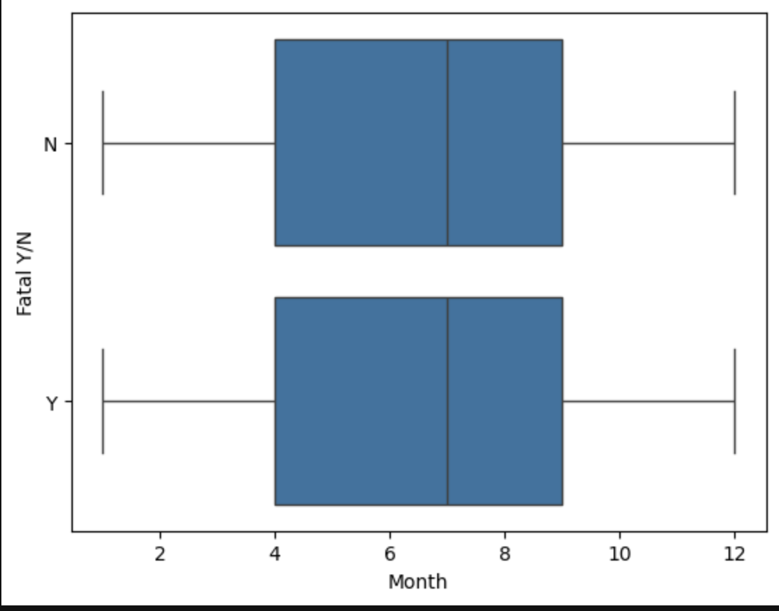
Insights
Name
Department Course Number Section Time Location
DATE
Our findings showed that the month of july generally has the highest propensity for shark attacks.

Slide 7
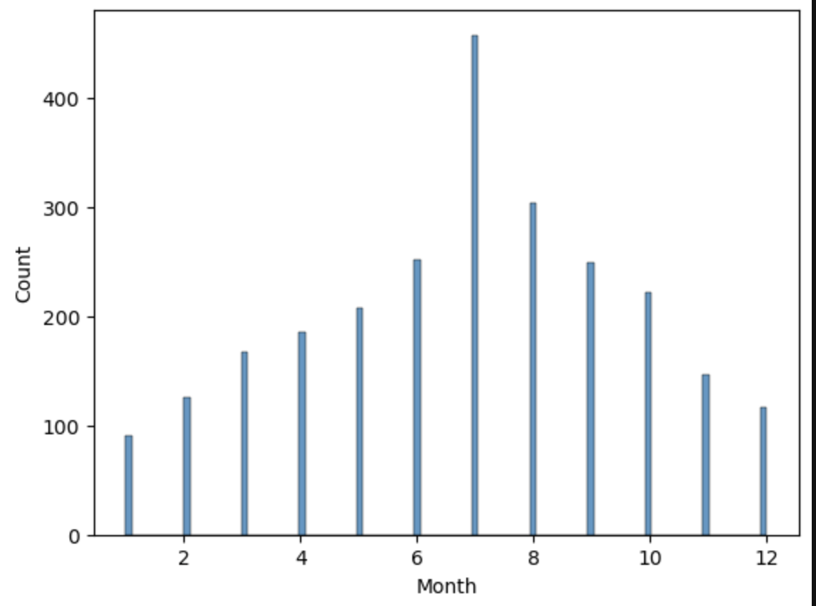
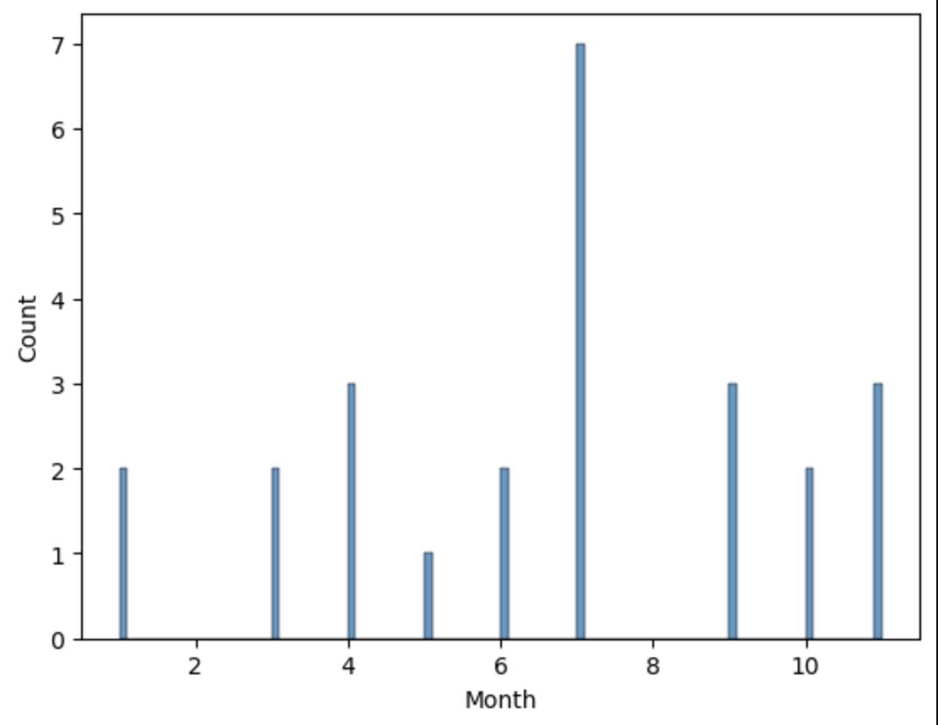
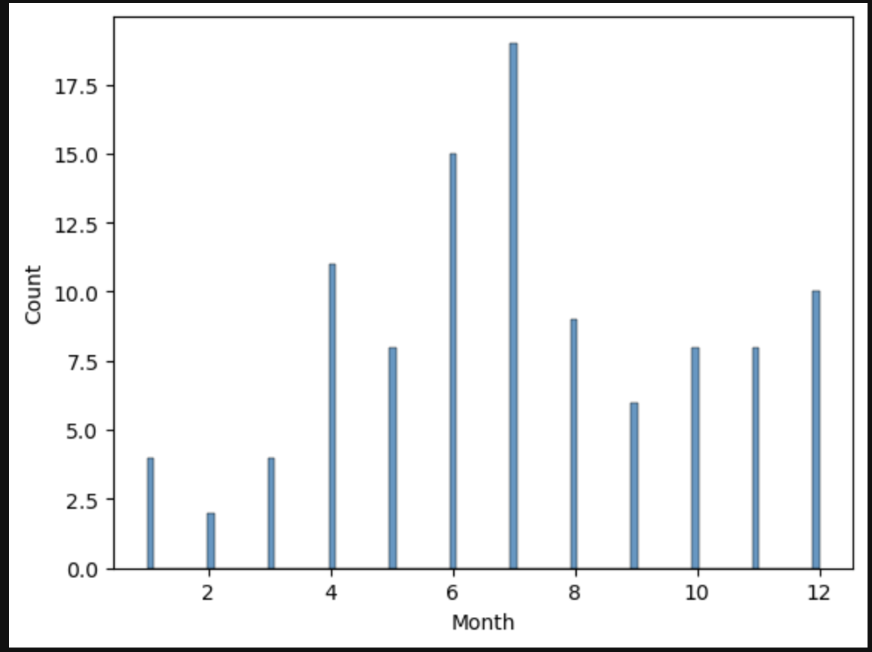
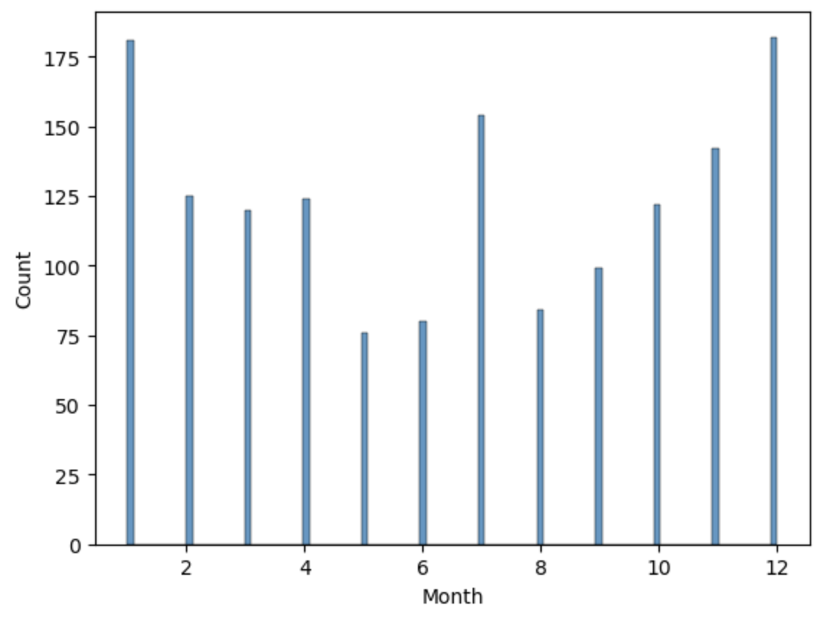
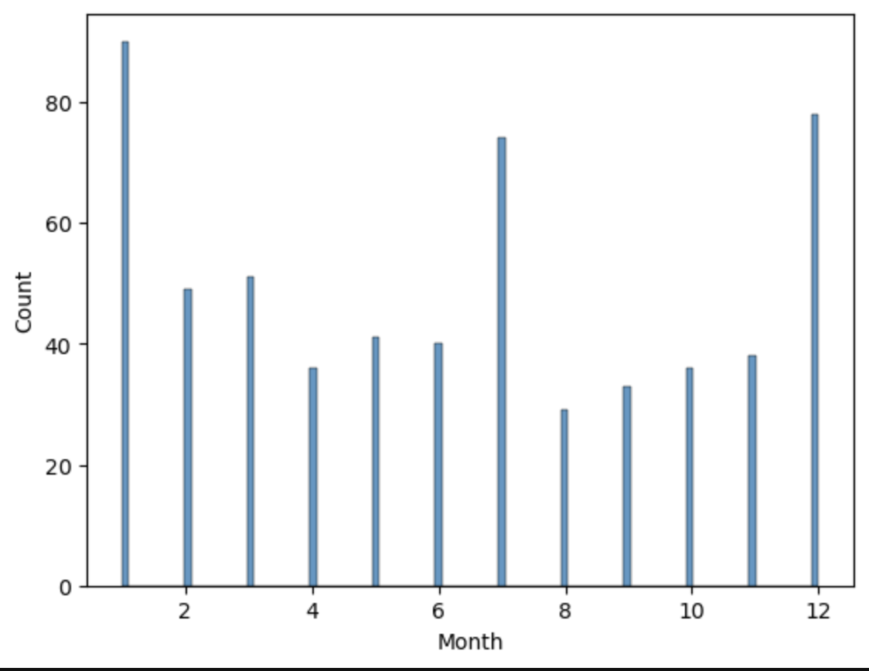
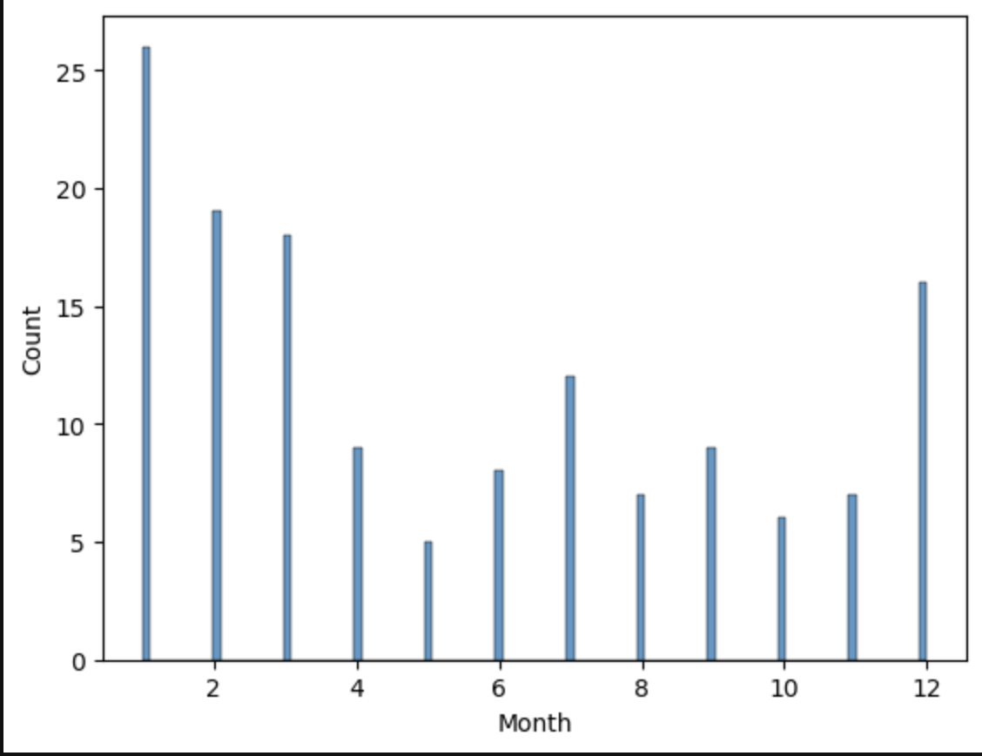
Insights
Name
Department Course Number Section Time Location
DATE
Among the most popular water sports destinations, countries in the North Hemisphere have significantly more shark attacks in July whereas countries in the South Hemisphere have the highest chance of shark attacks in January with some occurrences in July as well.
USA
Indonesia
México
Australia
South Africa
South Africa

Slide 8
Conclusions
Name
Department Course Number Section Time Location
DATE
Among the most popular water sports destinations, countries in the North Hemisphere have significantly more shark attacks in July whereas countries in the South Hemisphere have the highest chance of shark attacks in January with some occurrences in July as well.
USA
Indonesia
México
Australia
South Africa
New Zealand

Slide 9
Conclusions
Major Obstacles
Name
Department Course Number Section Time Location
DATE
Water sports center in the North Hemisphere are advised to assign more life-saving resources in Summer, especially in July;
Water sports center in the South hemisphere are advised to assign more life-saving resources in Summer, especially in January but they should not overlook July.
Date was tricky to standardize due to the different formats that needed to be fixed and found with Regex. Creating web scraping to search countries.
Come up with Hypothesis & Research Question

Slide 10
Name
Department Course Number Section Time Location
DATE
Thank you! and beware of sharks

