Slide 1
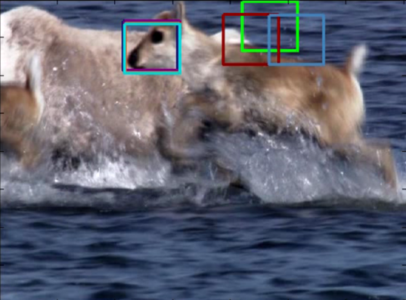
Object
Background
Patches and features extraction
Trackers estimates
Appearance classifier
Appearance scores

Slide 2
__
__
__
__
Patch extraction
Features extraction
Hog Vector

