Slide 1
LD6053 · UG COMPUTING PROJECT
From Public Funding to Sponsor-Capable Career Pathways
A Medallion Data Pipeline Using Token-Based Fuzzy Matching, Unsupervised Nearest-Neighbour
Matching with TF-IDF and Cosine Distance, and Power BI
Python · Medallion
SQL Server · Views
Unsupervised ML
Power BI · DSS
Jorge Tomas Chabrillon | Student ID: 24056316 | Supervisor: Salma Tabjel
BSc (Hons) Computing with Data Science and Big Data Technology
Academic grounding: Nguyen & Cheng (2025); Cvetkov-Iliev et al. (2022); Souha et al. (2025).

Slide 2
OVERVIEW
Presentation route
Problem definition → system design → implementation evidence → evaluation
1 · Problem and research focus
Why fragmented public evidence creates a career-intelligence and data-integration problem.
2 · Method, design and implementation
Medallion architecture, entity-resolution workflow, SQL reporting layer and technical testing.
3 · Findings and dashboard
Current bounded-run evidence and the implemented four-page Power BI dashboard.
4 · Evaluation and reflection
Direct answers to the research questions, limitations, contribution and live demonstration.
The presentation follows the project lifecycle from problem definition to evidence-based evaluation.
Academic framing: Nguyen & Cheng (2025); Cvetkov-Iliev et al. (2022); Souha et al. (2025).
LD6053 · UG Computing Project
Jorge Tomas Chabrillon

Slide 3
INTRODUCTION
The problem and the research gap
Fragmented evidence
Inconsistent organisations
Risk of overclaiming
Contracts Finder, Gateway to Research and the Sponsor Register are separate public sources in different formats and with different purposes.
Legal suffixes, punctuation, abbreviations and spelling differences make exact linkage unreliable.
Funding activity and sponsor status are useful signals, but neither proves vacancies, employer interest or willingness to sponsor.
Research gap
Existing employability, public-funding, entity-resolution and dashboard studies address parts of the problem in isolation. This project combines them into one traceable computing artefact for sponsor-capable career exploration.
Design principle: evidence for further research — not a job recommendation.
Nguyen & Cheng (2025); Wang et al. (2025); Srhoj & Dragojevic (2024); Cvetkov-Iliev et al. (2022).
LD6053 · UG Computing Project
Jorge Tomas Chabrillon

Slide 4
RESEARCH FOCUS
Aim and answerable research questions
Aim: to design, implement and evaluate a Python medallion pipeline, SQL Server layer and Power BI dashboard that integrate public-funding and Sponsor Register data for international-graduate career intelligence.
RQ1 · Data engineering
RQ2 · Entity resolution
RQ3 · Decision support
To what extent does a Bronze–Silver–Gold pipeline support reproducible extraction, transformation, traceability and SQL-ready integration across JSON, XML and CSV public sources?
How does the hybrid workflow combining TF-IDF/Nearest-Neighbour similarity and token-based fuzzy matching classify organisation links by method agreement, confidence thresholds and dashboard eligibility?
How effectively do SQL Server views and Power BI present accepted funding–sponsorship links as traceable, filterable opportunity signals?
Evaluation scope: technical behaviour, reconciliation and rule outcomes. Human-labelled precision and participant usability are outside this study.
Nguyen & Cheng (2025); Cvetkov-Iliev et al. (2022); Souha et al. (2025).
LD6053 · UG Computing Project
Jorge Tomas Chabrillon

Slide 5
ACADEMIC JUSTIFICATION
Literature translated into design decisions
Literature theme
What it supports
Project response
Employability barriers
Information asymmetry and weak student networks justify a career-intelligence aid.
The dashboard consolidates public evidence for employer research.
Public funding
Procurement and research funding show activity but do not prove recruitment.
Funding is labelled as a cautious opportunity signal.
Entity resolution
Name variation makes exact matching alone unreliable; matching outcomes must remain inspectable.
Names are cleaned, exact matches are separated, and non-exact candidates receive two different similarity scores.
Hybrid entity resolution
Candidate retrieval plus a second similarity check can improve transparency and reduce the risk of accepting one weak signal.
The fuzzy and TF-IDF/Nearest-Neighbour routes are compared; disagreement and weak results remain excluded.
Decision support
DSS combines structured data, logic and a user interface.
SQL views and Power BI expose evidence, filters and disclaimers.
Han et al. (2022); Nguyen & Cheng (2025); Cvetkov-Iliev et al. (2022); Sharifi & Ahmadzadeh (2025); Souha et al. (2025).
LD6053 · UG Computing Project
Jorge Tomas Chabrillon

Slide 6
DESIGN
End-to-end system architecture
Contracts Finder
OCDS JSON API
Gateway to Research
BRONZE Raw evidence
SILVER Cleaned data
GOLD Matched data
SQL Server
Power BI
XML API
Sponsor dimension Gold evidence tables Comparison + audit Reporting views
Overview Contracts Finder GtR Data Quality
Sponsor Register
CSV reference data
Career evidence
Accepted links become inspectable dashboard records.
SQL reporting model
One sponsor record can link to many contract or research records. MatchComparison keeps accepted and excluded matching evidence, while DataLoadAudit records each pipeline run. SQL views prepare the reporting data for Power BI, and dated Bronze and Silver files remain in Google Drive.
Souha et al. (2025); Cvetkov-Iliev et al. (2022).
LD6053 · UG Computing Project
Jorge Tomas Chabrillon

Slide 7
IMPLEMENTATION EVIDENCE
Controlled bounded run: data moved through each stage
Source
Bronze
Silver
Compared organisations
Accepted unique organisations
Dashboard evidence rows
Contracts Finder
277
→
277
→
222
→
53
→
80
Gateway to Research
250
→
250
→
141
→
81
→
175
Interpretation
255 dashboard evidence rows is higher than 134 accepted organisations because one accepted organisation can be linked to multiple contracts or research projects.
Project evidence: validated 10 August 2026 snapshot using a 90-day evidence window. Academic context: Cvetkov-Iliev et al. (2022); Sharifi & Ahmadzadeh (2025).
LD6053 · UG Computing Project
Jorge Tomas Chabrillon

Slide 8
ALGORITHM DESIGN
Hybrid matching and conservative acceptance logic
1. Clean organisation name
2. Exact check
If not exact
If not exact
FUZZY SCORE ROUTE
Exact
ML ROUTE · unsupervised
Candidate shortlist
Text representation
TF-IDF + Nearest Neighbours reduce the Sponsor Register
to 25 likely names. This is only a speed step.
TF-IDF character n-grams convert each cleaned organisation name into a numerical vector.
Rule-based fuzzy scoring
Nearest-candidate retrieval
TheFuzz token_sort_ratio compares the shortlisted names and returns the fuzzy candidate and fuzzy score.
Cosine distance + Nearest Neighbours return the closest sponsor and the ML similarity score.
COMPARE + DECISION RULES
EXACT
NON-EXACT
OTHERWISE
Accepted at 100
Same sponsor + fuzzy ≥ 90 + ML ≥ 75
Excluded; retained for audit
ML boundary: Nearest Neighbours is used for the fuzzy shortlist and for the separate ML candidate.
TF-IDF represents text; cosine measures distance; token_sort_ratio and the acceptance thresholds are rule-based.
Sharifi & Ahmadzadeh (2025); Cvetkov-Iliev et al. (2022); scikit-learn implementation documentation.
LD6053 · UG Computing Project
Jorge Tomas Chabrillon

Slide 9
JUSTIFICATION AND EVALUATION
Method selection and technical testing
Python / Colab
Relational SQL Server
Power BI Desktop
Supports API requests, XML/JSON/CSV parsing, matching logic, dated outputs, runtime logging and SQL upload in one reproducible environment.
Tables, constraints, audit evidence and stable reporting views support integrity and reusable reporting.
Provides filterable evidence tables for a non-technical audience, backed by the SQL reporting views.
Why this ML method?
Why not supervised models?
Testing completed
The task is nearest-candidate retrieval for short organisation names, not outcome prediction. Nearest Neighbours works without labelled examples and makes every selected candidate inspectable.
Random Forest, SVM or neural classifiers would require trustworthy match/non-match labels and a train/test evaluation. Those labels did not exist, so supervised performance claims would be artificial.
Component: APIs, parsing, cleaning, dates, duplicates, scores and rules. Integration: API → files → comparison → SQL. System: SQL reconciliation, Power BI pages, filters and disclaimer.
Evaluation boundary
Measured: method agreement, exclusions, runtime, SQL reconciliation and dashboard behaviour. Not measured: labelled accuracy, precision, recall or participant usability.
Sharifi & Ahmadzadeh (2025); Cvetkov-Iliev et al. (2022). Project testing evidence: runtime log, SQL views and Power BI pages.
LD6053 · UG Computing Project
Jorge Tomas Chabrillon

Slide 10
RESULTS
Validation snapshot · 10 August 2026
255
80
175
134
0
Accepted funding evidence rows
Contracts Finder evidence rows
GtR evidence rows
Accepted unique organisations
Missing matching scores
Controlled acceptance picture
Automated validation outcomes
Contracts Finder: 222 organisations compared, 53 accepted and 169 excluded. Gateway to Research: 141 compared, 81 accepted and 60 excluded.
The workflow accepted 134 organisations and retained 229 excluded organisations for audit. Contracts Finder method agreement was 40.54%, while Gateway to Research agreement was 69.50%. Agreement is not accuracy.
Runtime evidence scope
Source-status handling
All 18 logged stages succeeded. The runtime log covers timed pipeline stages only; it excludes package installation, Drive mounting, manual checking and Power BI refresh.
V30 requested ACTIVE GtR projects, so the validated GtR Bronze snapshot contains ACTIVE records only. Contracts Finder uses awarded-contract evidence, so completed procurement can still provide a valid activity signal.
Project evidence: validated 10 August 2026 V30 outputs, SQL checks and Power BI views. Academic context: Cvetkov-Iliev et al. (2022); Sharifi & Ahmadzadeh (2025).
LD6053 · UG Computing Project
Jorge Tomas Chabrillon

Slide 11
RESULTS
Why use both methods? Controlled method-level evidence
363
155
189
188
134
Compared organisations
Fuzzy threshold passes
TF-IDF threshold passes
Same sponsor selected
Finally accepted
Source
Compared
Fuzzy
TF-IDF
Same
Accepted
Contracts Finder
222
69
96
90
53
Gateway to Research
141
86
93
98
81
Combined
363
155
189
188
134
Fuzzy passes
TF-IDF passes
HYBRID DECISION
Rule-based token comparison. Qualifying threshold: 90. Strong at visible wording and word-order variation.
TF-IDF vectors + cosine distance + Nearest Neighbours. Qualifying threshold: 75. Strong at retrieving the nearest character-pattern match.
Exact names are accepted directly. Non-exact matches require both routes to select the same sponsor and pass thresholds. Uncertain cases are excluded.
Interpretation: 188 comparisons selected the same sponsor, but only 134 also met all acceptance rules
Validated 10 August 2026 comparison evidence. Agreement is not accuracy; excluded cases remain auditable.
LD6053 · UG Computing Project
Jorge Tomas Chabrillon

Slide 12
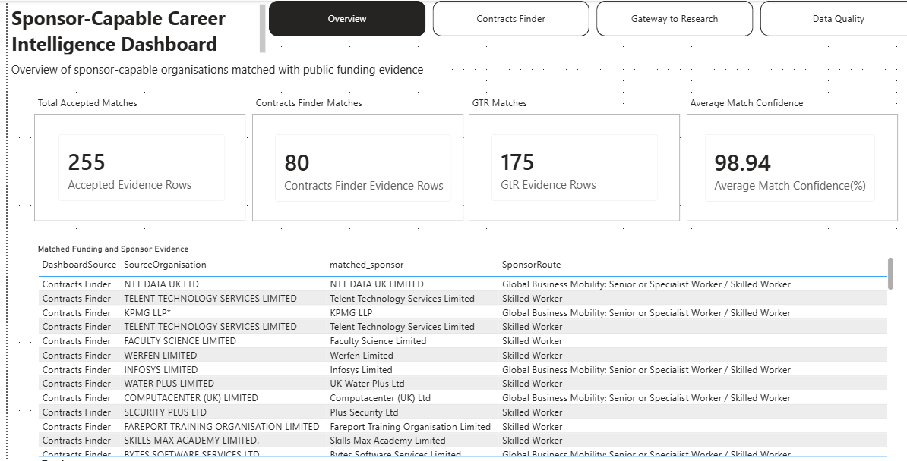
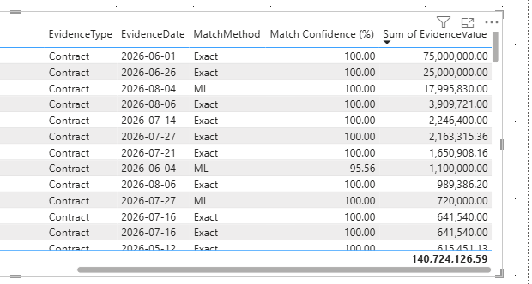
DASHBOARD AND DEMONSTRATION
Power BI dashboard: implemented overview evidence
Overview page purpose
Combines accepted Contracts Finder and GtR evidence and provides the main entry point for employer research.
What the values mean
Cards count accepted evidence rows, not unique organisations. Each row preserves source organisation, matched sponsor, sponsor route and funding evidence.
How to interpret it
Funding and sponsor status are research signals only. In the dashboard, “ML” is the SQL label for accepted non-exact hybrid matches; match confidence is not verified accuracy.
Operational Power BI screenshot.
The controlled evaluation figures are reported separately on the results slides.
LD6053 · UG Computing Project
Jorge Tomas Chabrillon

Slide 13
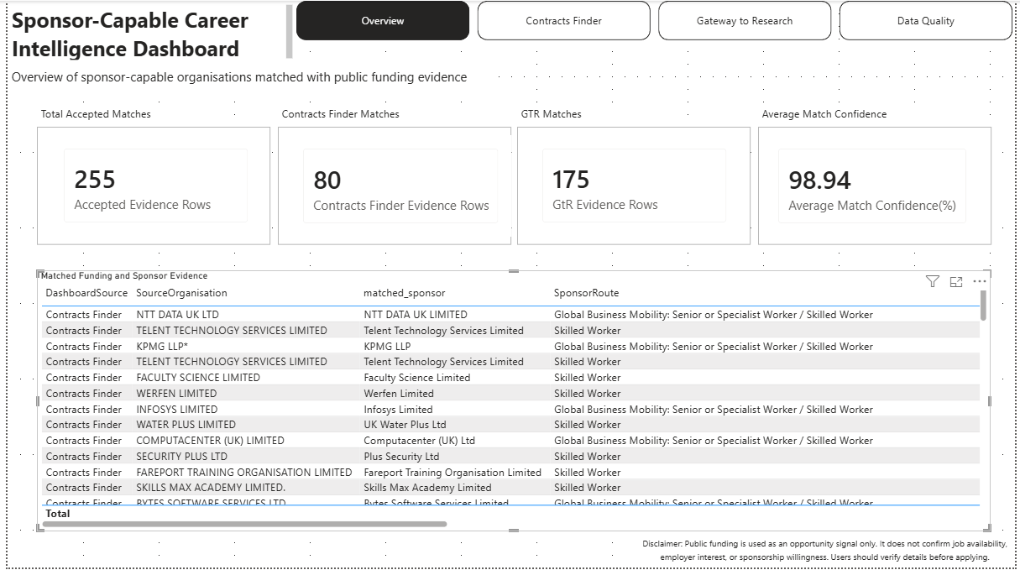
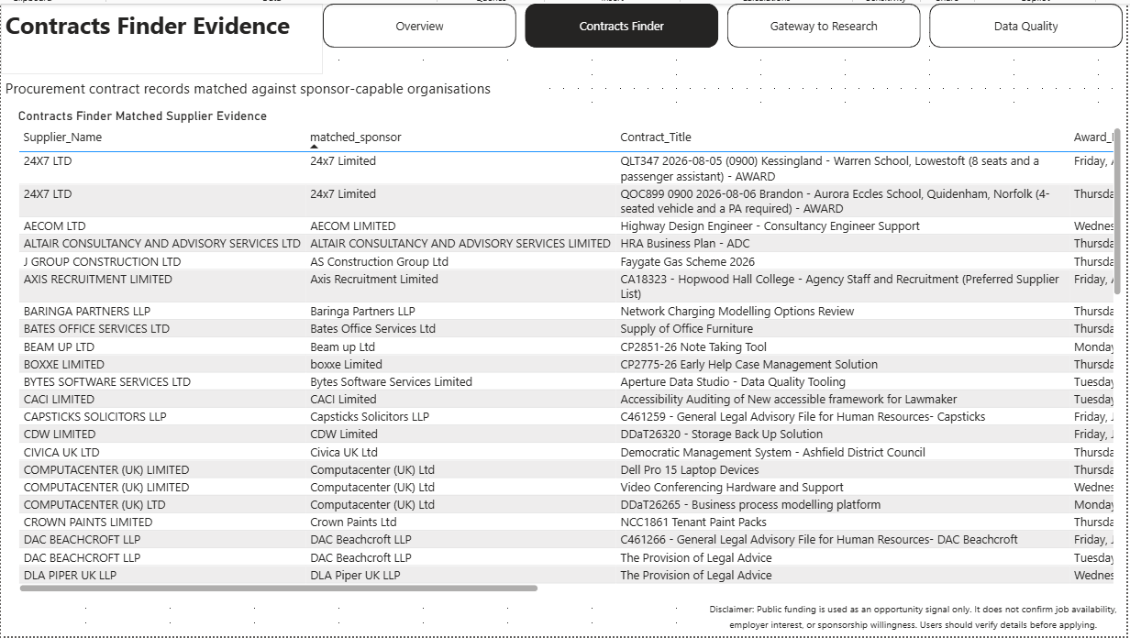
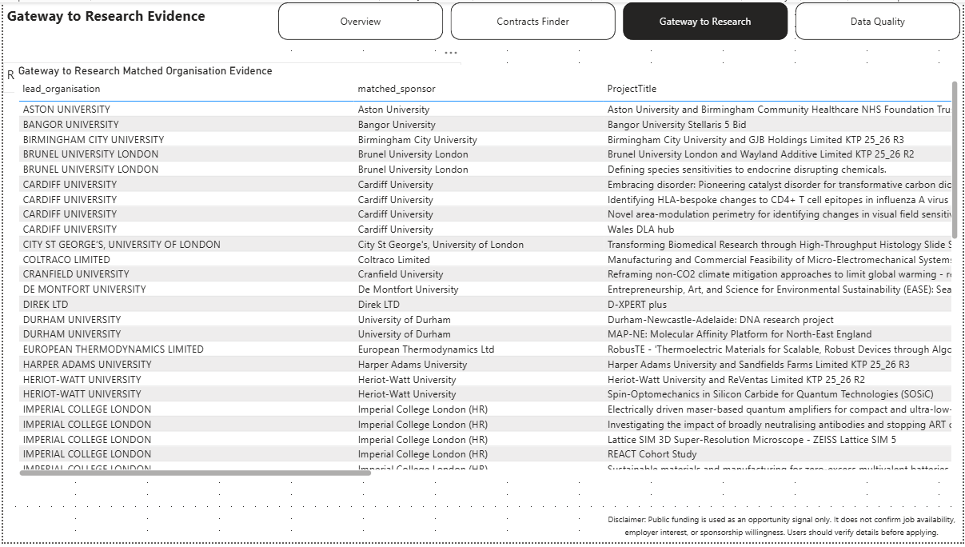
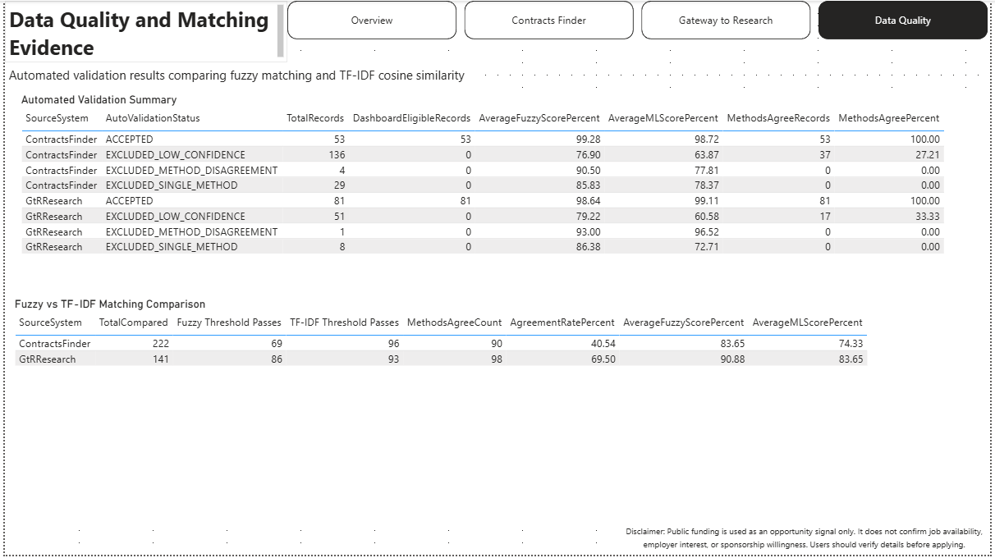
DASHBOARD AND DEMONSTRATION
Implemented Power BI evidence pages
Contracts Finder
Overview
Combined accepted evidence
Headline counts Organisation and sponsor context
Award evidence only
Contract value/date Supplier, route and town
Gateway to Research
Data Quality
ACTIVE research evidence
Project title/start date Lead organisation and sponsor
Evaluation and audit
Fuzzy vs TF-IDF candidates Agreement, exclusions
and thresholds
Primarily technical audit; supports user trust
Validated 10 August snapshot. Future pipeline runs can update the values, while the page purposes and matching rules remain unchanged.
LD6053 · UG Computing Project
Jorge Tomas Chabrillon

Slide 14
CONCLUSION
Evaluation, contribution and reflection
Contribution
Main limitations
Professional relevance
A reproducible pipeline that joins public-funding evidence to sponsor capability while keeping uncertainty visible.
No labelled ground truth or participant usability study; API scope is bounded; funding does not prove recruitment.
Extended my SQL/business-analysis background into Power BI, reproducible data engineering and transparent entity resolution.
RQ1 · Data engineering
The Bronze–Silver–Gold pipeline supported reproducible extraction, transformation, traceability and SQL-ready integration across JSON, XML and CSV, evidenced by dated files, cleaning outputs, runtime logs and SQL reconciliation.
RQ2 · Entity resolution
The hybrid workflow classified organisation links by comparing fuzzy and TF-IDF/Nearest-Neighbour results, then using method agreement and confidence thresholds to make threshold-qualified links dashboard-eligible and exclude uncertain cases.
RQ3 · Decision support
SQL Server views and the four-page Power BI dashboard presented dashboard-eligible funding–sponsorship evidence as traceable and filterable opportunity signals, while keeping source evidence and matching-quality evidence clearly separated.
LD6053 · UG Computing Project
Jorge Tomas Chabrillon

Slide 15
REFERENCES
Selected references
Cvetkov-Iliev, A., Allauzen, A. and Varoquaux, G. (2022) “Analytics on Non-Normalized Data Sources: More Learning, Rather Than More Cleaning”, IEEE Access, 10, pp. 42420–42431.
Eberhard, K. (2023) “The effects of visualization on judgment and decision-making: a systematic literature review”, Management Review Quarterly, 73, pp. 167–214.
Han, Y., Gulanowski, D. and Sears, G.J. (2022) “International student graduates’ workforce integration: A systematic review”, International Journal of Intercultural Relations, 86, pp. 163–189.
Nguyen, H. and Cheng, M. (2025) “Understanding international students’ agency in developing employability”, British Educational Research Journal.
Sharifi, M. and Ahmadzadeh, D. (2025) “Transformer-Gather, Fuzzy-Reconsider: A Scalable Hybrid Framework for Entity Resolution”, arXiv:2509.17470v2.
Souha, A. et al. (2025) “A DSL-Driven Solution and Code Generation for Accelerated Tourism Decision Support System Development”, IEEE Access, 13, pp. 101558–101574.
Srhoj, S. and Dragojevic, M. (2024) “The effects of public procurement on supplier job creation”, Economics, 18.
Wang, F. et al. (2025) “Employability of international postgraduate taught students in the UK: a systematic literature review using PRISMA”, British Journal of Guidance & Counselling.
Questions and live demonstration
LD6053 · UG Computing Project
Jorge Tomas Chabrillon

