Slide 1
Best neighborhood to locate an office in Bratislava
Based on Foursquare data

Slide 2
Index
Introduction
Data Cleaning
10 most common venue categories per neighborhood
Methodology
Hierarchical Clustering method
K-Means Clustering method
Examining Clusters
Results and discussion
Conclusion

Slide 3
Introduction
Bratislava is currently the house of the back office of some of the biggest IT and professional service companies in the world.
These companies would find added value if they create a good working environment for their employees.
The goal of the study is to make a ranking of the neighborhoods in Bratislava based on the frequency of bus and tram stops, outdoor, food and shop & service venues included in the Foursquare database.

Slide 4
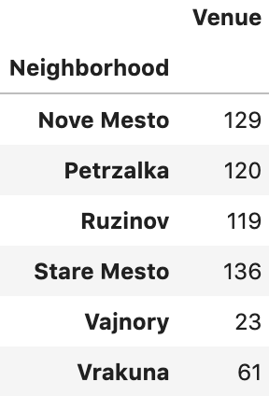
Data cleaning
We need:
the coordinates from each neighborhood, taken manually from Wikipedia and transformed to decimal format, and
location and further information on venues, taken from the Foursquare API.
Once we have the neighborhoods with business centers, we retrieve all the venues under the categories mentioned before and created a table of venue category frequencies.

Slide 5
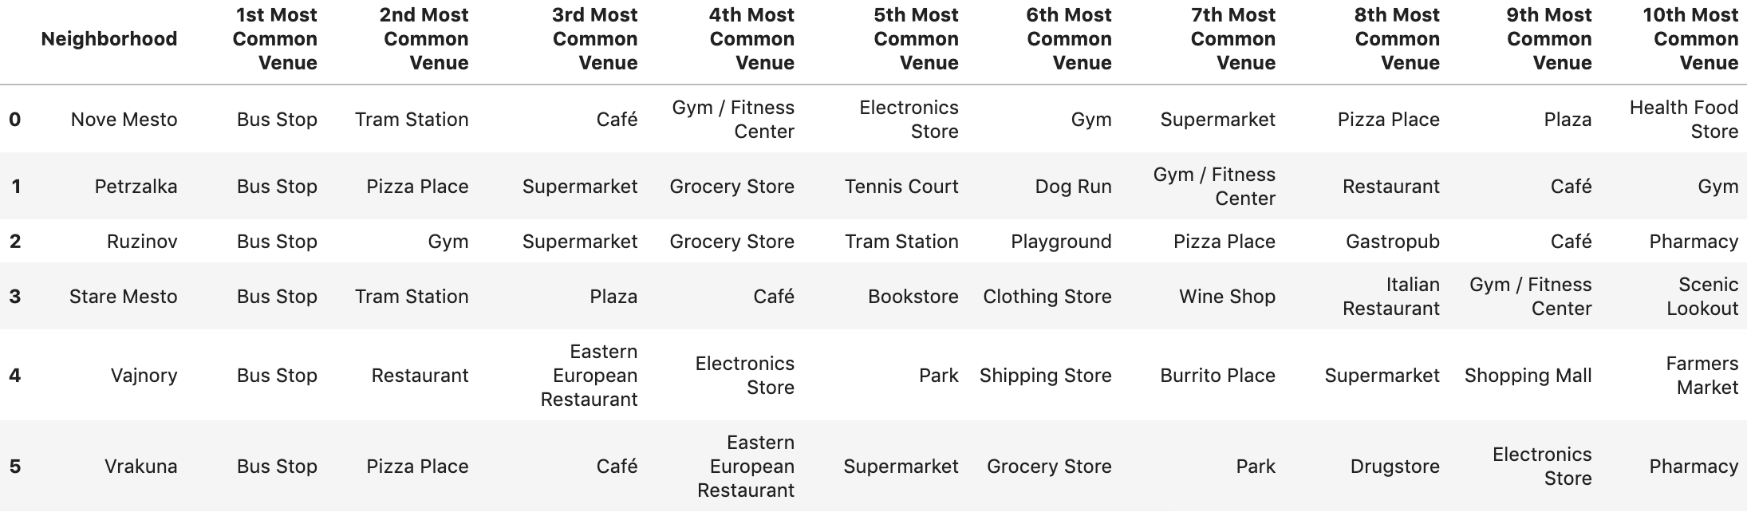
10 most common venue categories per neighborhood

Slide 6
10 most common venue categories per neighborhood
Although the nature of the venues inside each category differs, the split of the top 10 venues is more or less the same in the first 4 neighborhoods.
Vajnory and Vrakuna show a different trend.
Nonetheless, the variety inside each category has to be higher in Nove Mesto, Petrzalka, Ruzinov and Stare Mesto, which more than double the amount of total venues of the other two locations.

Slide 7
Methodology
The table of frequencies was calculated as the amount of venues per category in each neighborhood over the total number of venues in that neighborhood. This means that it is not taking into consideration the differences in total venues between neighborhoods.
However, the results consider this fact in their reasoning.
The analysis will be focused on splitting our list of neighborhoods into smaller clusters that have similar characteristics (or similar venue categories frequencies).
For this purpose, two clustering methods will be used.

Slide 8
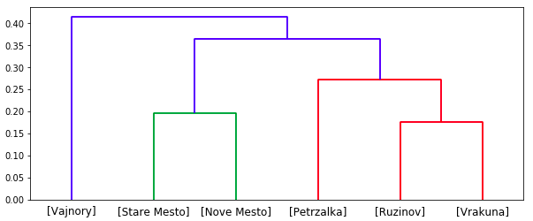
Hierarchical clustering method
Vajnory, with the lowest amount of venues (23), is alone in the first cluster.
Stare Mesto and Nove Mesto, which form the city center of Bratislava, are in the second cluster.
Petrzalka on southern side of the Danube and Ruzinov and Vrakuna on the Eastern part of the city, are in the third cluster.

Slide 9
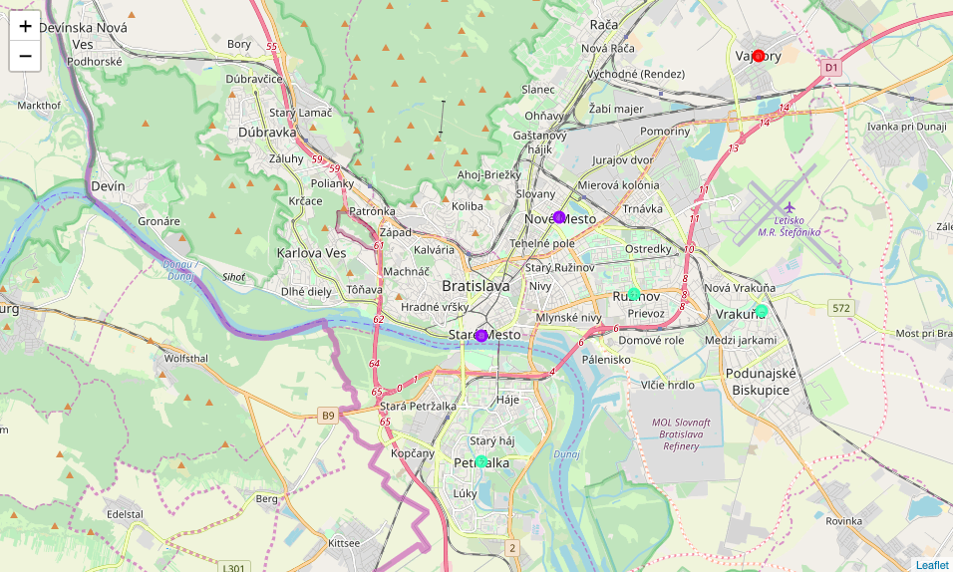
K-Means clustering method
Providing as input the same number of clusters used by the Hierarchical clustering method, the clusters created by this method are exactly the same.
They are split by colors in the map on the right side.

Slide 10
Examining clusters: Vajnory, countryside neighborhood
The lack of variety of venues and their nature explain why Vajnory was included in a separate cluster.
A clear example of this is that it is the only location which contains farmers markets among its most common venues.

Slide 11
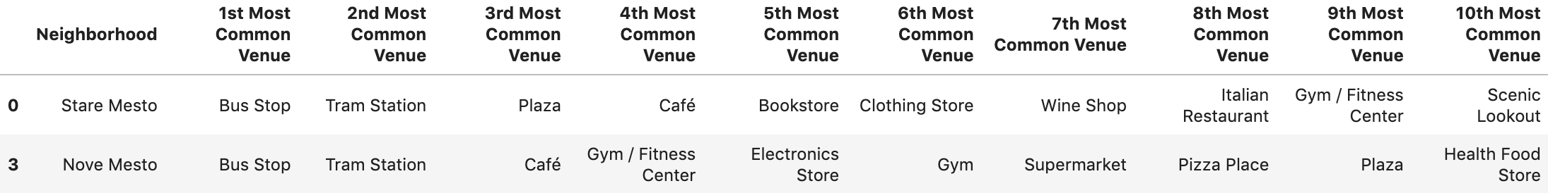
Examining clusters: City center neighborhoods
Stare Mesto and Nove Mesto have in common that bus and tram stops are their most common venues. Cafés and plazas are also between their most common venues.
Stare Mesto shows scenic lookout venues among its top 10 venues, demonstrating that it is the tourist part of the city. This also means more people on the streets, more noise and higher prices in all shops and restaurants.
Both show a broad offer of gyms and other stores that could be visited by workers in their spare time.

Slide 12
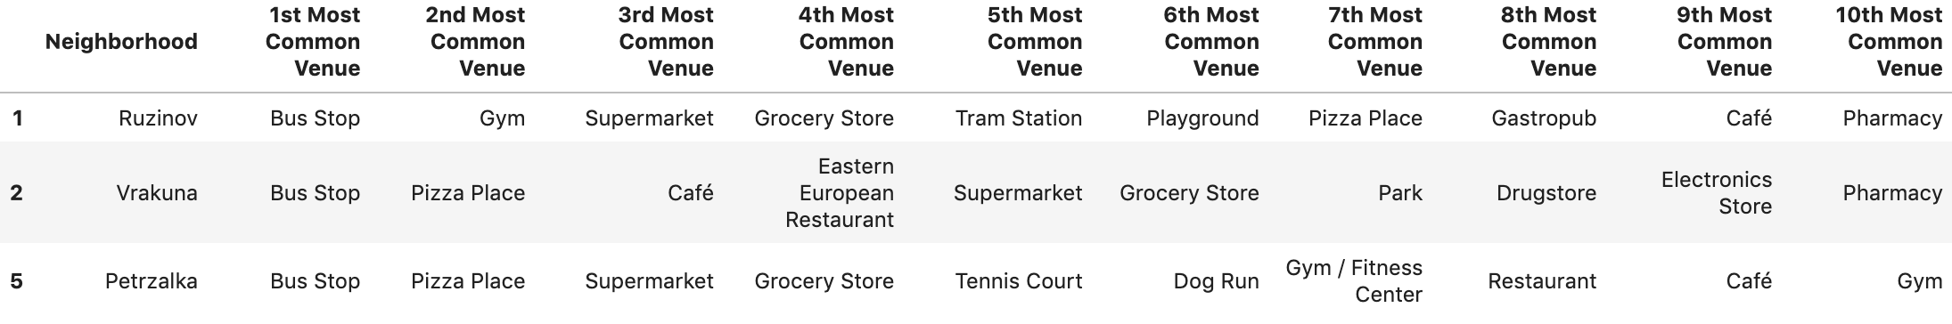
Examining clusters: dormitory suburbs
All of them share the same kind of venues in their surroundings. That could explain why they are together in one cluster.
Their first most common venue is bus stops, but Vrakuna and Petrzalka do not have tram stops around their territory.
Fast-food pizza places are the second most common venue in Vrakuna and Petrzalka.
They all have supermarkets and grocery stores in their top 6 venues.

Slide 13
Results and discussion
Vajnory is discarded as suitable location, as a countryside location is not the most appropriate for an office. It does not have a proper variety of restaurants and other venues, and it is far from the city center by any mean of transportation.
The second neighborhood being excluded is Vrakuna. It would be complicated to find a block of offices where it is more frequent to see single family homes than blocks of flats.
Due to the lack of tram, meaning worse communication with the city center, Petrzalka would also be excluded. There are long term projects to build tram lines in this location, but it is not ready for new business centers (excluding the territory located on the Danube riverside, in front of Stare Mesto).
Therefore, from the analysis provided by this report, the top 3 neighborhoods to locate an office would be Ruzinov, Stare Mesto and Nove Mesto.

Slide 14
Results and discussion
Stare Mesto is the tourist zone of the city, with several restaurants and varied cafés. It is the neighborhood with the biggest amount of venues. However, in tourist periods, it is always crowded. This fact makes it to lose points. I would not recommend this neighborhood for an office, but of course its surroundings.
Ruzinov is the only dormitory suburb that could be a good location due to its good connections to the city center, and the fact that it is close to residential zones. This could be a good point for workers.
Therefore, from the results of this report, Nove Mesto would be the best location for the office:
It has the same variety of venues than Stare Mesto, but at lower prices.
Together with Stare Mesto, it is the best communicated with bus and tram with all other neighborhoods, which would reduce the commuting time for workers.
Close to the old town and with good communications with it, which makes it easier workers to visit its shops and cafés.
Other venues like gyms and supermarkets in the surroundings of the office, highly valued by the average worker.
Plazas among their most common venues, with outdoor and some green spaces for the spare time.

Slide 15
Conclusions
Purpose of this project was to identify the best locations to open an office in Bratislava, based on the variety of food, shop and service and outdoor venues and the frequency of bus/tram stops existing in the surroundings of those locations.
Recommended zones should therefore be considered only as a starting point for more detailed analysis which could eventually result in a location which fulfills the requirements in terms of variety of venues but also in terms of all other relevant conditions for the stakeholder.

