Slide 1
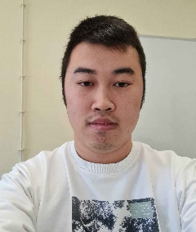
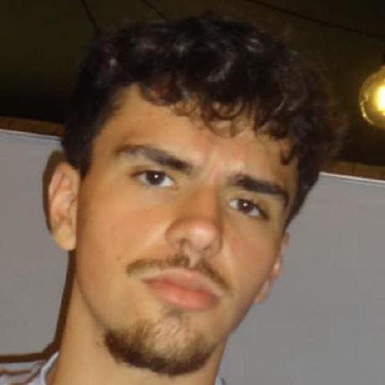
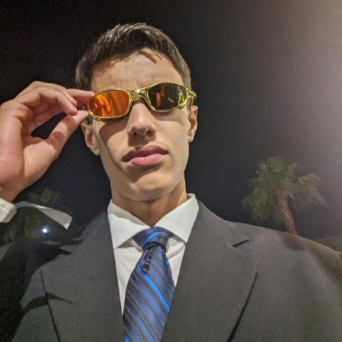
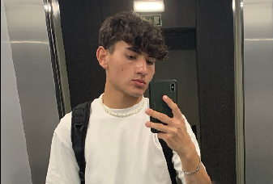
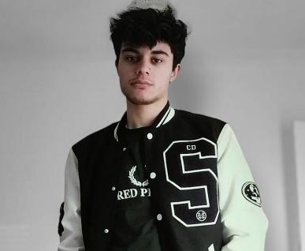
Class 2Dx2DM Group 131 SPRINT 1
LAPR3 2024_2025
Group members:
Romeu Xu (1230444) | Francisco Santos (1230564) | Emanuel Almeida (1230839) | Jorge Rodriguez (1231274) | Paulo Mendes (1231498)

Slide 2
Sprint planning – Sprint 1
Planned Start Date: 30/09/2024 Real Start Date: 3/10/2024
Planned Finished Date: 23/10/2024 Real Finish Date: 26/10/2024
SPRINT BACKLOG
Number of stories | 19
Number of bugs | 3
Number of tasks | 26
Number of Management Tasks (Scrum) | 16
Number of team members | Planned: 5 Actual: 5
Total planned estimation vs execution | Planned hours: 122 Executed hours: 140

Slide 3
Sprint planning BDDAD
Assignment US (as stated on project assignment) | Commited? (Yes / no according to team planning) | Todo | Doing | Testing | Done | Blocked
USEI 01 | Yes |  |  |  | x
USEI 02 | Yes |  |  |  | x
USEI 03 | Yes |  |  |  | x
USEI 04 | Yes |  |  |  | x
USEI 05 | Yes |  |  |  | x
USEI 06 | Yes |  |  |  | x
USEI 07 | Yes |  |  |  | x
USEI 08 | Yes |  |  |  | x
USEI 09 | Yes |  |  |  | x

Slide 4
Sprint planning ESINF
Assignment US (as stated on project assignment) | Commited? (Yes / no according to team planning) | Todo | Doing | Testing | Done | Blocked
USEI 01 | Yes |  |  |  | x
USEI 02 | Yes |  |  |  | x
USEI 03 | Yes |  |  |  | x
USEI 04 | Yes |  |  |  | x
USEI 05 | Yes |  |  |  | x
USEI 06 | Yes |  |  |  | x
USEI 07 | Yes |  |  |  | x

Slide 5
Sprint planning LAPR3
Assignment US (as stated on project assignment) | Commited? (Yes / no according to team planning) | Todo | Doing | Testing | Done | Blocked
USEI 01 | Yes |  |  |  | x
USEI 02 | Yes |  |  |  | x
USEI 03 | Yes |  |  |  | x | x

Slide 6
Work by team member

Slide 7
Work by type

Slide 8
Issues / Assumptions / unanswered questions
Description | Responsible | Date / sprint | Related issue / item in Git
There was a problem with the dataset, it came way later than expected, and it created some organization issues, and it was altered twice. | BD Prof | Sprint 1
It was assumed that each time unit was considered a while loop. | 1231274 | Sprint 1
The lack of starting information, the template for this project was based on a previous one. | ESINF | Sprint1

Slide 9
Daily Meetings
Date | Place / duration | Team member 1 | Team member 2 | Team member 3 | Team member 4 | Team member 5
30/09/2024 | Class / 15 min | x | x | x | x | x
02/10/2024 | Class / 15 min | x | x | x | x | x
04/10/2024 | Class / 15 min | x | x | x | x | x
06/10/2024 | Class / 15 min | x | x | x | x | x
08/10/2024 | Class / 15 min | x | x | x | x | x
10/10/2024 | Class / 15 min | x | x | x | x | x
12/10/2024 | Class / 15 min | x | x | x | x | x
14/10/2024 | Class / 15 min | x | x | x | x | x
16/10/2024 | Class / 15 min | x | x | x | x | x
18/10/2024 | Class / 15 min | x | x | x | x | x
20/10/2024 | Class / 15 min | x | x | x | x | x

Slide 10
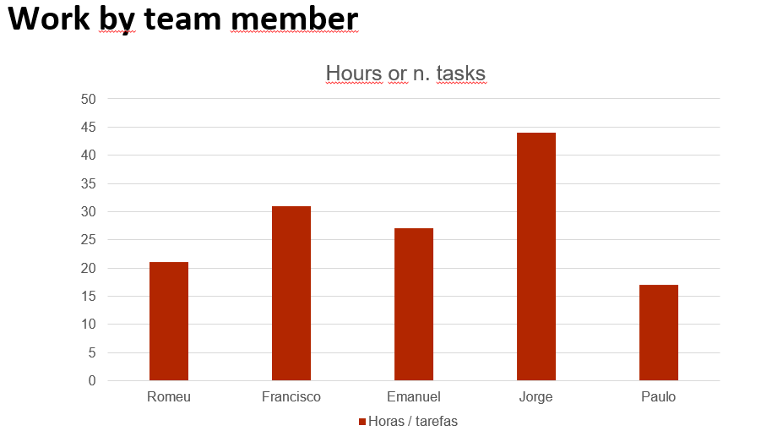
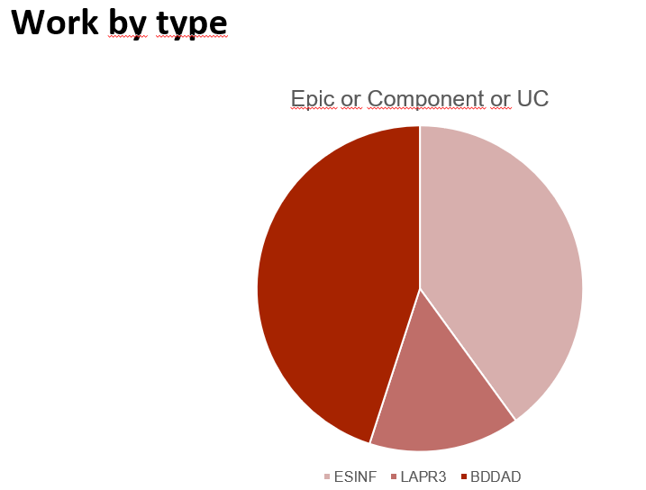
LLM performance assessment (chatGPT or Copilot)
Source file (include file as attachment):
Input (prompt) : make a performance assessment based on these 2 images
make a performance assessment based on these 2 images
Make a performance assessment based on these 2 images. make a performance assessment based on these 2 images

Slide 11
LLM performance assessment
Output file (include file as attachment):
Output (one line per team member):
“Jorge has the highest contribution, with nearly 45 hours/tasks completed. This indicates that Jorge is currently leading in productivity, possibly carrying a larger workload.
Francisco is the second most productive, contributing around 30 hours/tasks.
Emanuel comes close to Francisco with a slightly lower contribution, likely around 25 hours/tasks.
Romeu and Paulo have the lowest contributions, with Romeu slightly above 20 and Paulo below 20. “
Opinion about the output:
Looking at the overall work distribution, it’s clear that Jorge has taken on a significant portion of the tasks or hours, which shows dedication, but it also suggests that there might be an imbalance. Francisco and Emanuel are putting in solid contributions, but they could maybe step it up a bit to lighten Jorge’s load. Meanwhile, Romeu and Paulo are doing their part, but seem to be trailing behind the rest of the team a little bit.
It might be helpful to rebalance the workload slightly so that everyone is contributing more evenly. The key here would be better task distribution and possibly some check-ins to see if people like Paulo and Romeu need extra support or motivation to pick up the pace. Overall, the team is working, but a few adjustments could make things more efficient and less stressful for everyone, especially Jorge.

Slide 12
Sprint Retrospective
Date: 27/10/2024
What went well?
Overall the team was very helpful to each member.
The team was never late.
Participated in a lot of meeting.
What went wrong?
Late introduction of the data base needed for the project.
What we’ve learned?
Leaned a lot about new information structures like map and queues.
We applied DDL and DML.
Learned new concepts about Production Management and Product Engineering

Slide 13
Sprint Retrospective
Date: 27/10/2024
Action items:
Balance Workload Across Team Members
Provide Support for Underperforming Team Members
Focus on High-Priority Projects
Improve Time Management and Prioritization

Slide 14

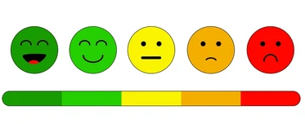
Overall Project perfomance:
Comments: Overall the team performed as expected, all the issues were quickly resolved and everyone contributed for the completion of the project.
- LLM evaluation:

Slide 15


