Slide 1
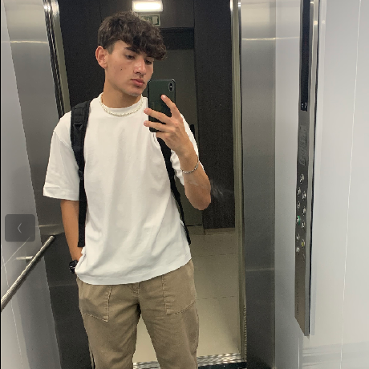
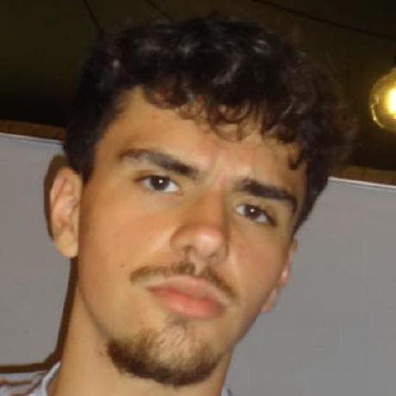

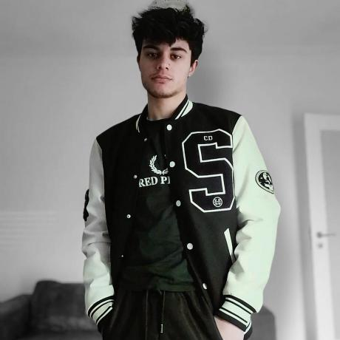
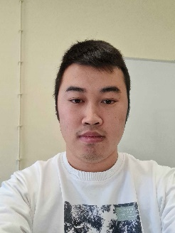
Class 2DM Group 131 SPRINT 3
LAPR3 2024_2025
Group members:
Jorge Ferreira (1231274) | Francisco Santos (1230564) | Emanuel Almeida (1230839) | Paulo Mendes (1231498) | Romeu Xu (1230444)
Foto 1 | Foto 2

Slide 2
Sprint planning – Sprint 3
Planned Start Date: 25 November Real Start Date: 25 of November
Planned Finished Date: 5 of January Real Finish Date: 5 of January
SPRINT BACKLOG
Number of stories: 31
Number of bugs: 0
Number of tasks: 55
Number of Management Tasks (Scrum): 28
Number of team members: 5 | Planned: 5 Actual: 5
Total planned estimation vs execution: | Planned hours: 366h Executed hours: 398h

Slide 3
Sprint planning
Assignment US (as stated on project assignment) | Commited? (Yes / no according to team planning) | Todo | Doing | Testing | Done | Blocked
USAC11 | yes |  |  |  | x
USAC12 | yes |  |  |  | x
USAC13 | yes |  |  |  | x
USAC14 | yes |  |  |  | x
USAC15 | yes |  |  |  | x
USAC16 | yes |  |  |  | x
USAC17 | yes |  |  |  | x
USAC18 | yes |  |  |  | x
USEI17 | yes |  |  |  | x
USEI18 | yes |  |  |  | x
Notes:
Não colocar screenshots! Preencher manualmente os valores.

Slide 4
Sprint planning
Assignment US (as stated on project assignment) | Commited? (Yes / no according to team planning) | Todo | Doing | Testing | Done | Blocked
USEI19 | yes |  |  |  | x
USEI20 | yes |  |  |  | x
USEI21 | yes |  |  |  | x
USEI22 | yes |  |  |  | x
USEI23 | yes |  |  |  | x
USEI24 | yes |  |  |  | x
USBD20 | yes |  |  |  | x
USBD21 | yes |  |  |  | x
USBD22 | yes |  |  |  | x
USBD23 | yes |  |  |  | x
Notes:
Não colocar screenshots! Preencher manualmente os valores.

Slide 5
Sprint planning
Assignment US (as stated on project assignment) | Commited? (Yes / no according to team planning) | Todo | Doing | Testing | Done | Blocked
USBD24 | yes |  |  |  | x
USBD25 | yes |  |  |  | x
USBD26 | yes |  |  |  | x
USBD27 | yes |  |  |  | x
USBD28 | yes |  |  |  | x
USBD29 | yes |  |  |  | x
USFA03 | yes |  |  |  | x
USLP06 | yes |  |  |  | x
USLP07 | yes |  |  |  | x
USLP08 | yes |  |  |  | x
Notes:
Não colocar screenshots! Preencher manualmente os valores.

Slide 6
Work by team member
Notes:
Se compilaram o registo de horas colocar as horas de trabalho, caso contrario utilizar o numero de tarefas ou algo que reflita a distribuição de trabalho.

Slide 7
Work by type

Slide 8
Issues / Assumptions / unanswered questions
Description | Responsible | Date / sprint | Related issue / item in Git
Issue with the understanding of the USLP07 |  | Sprint 3

Slide 9
Daily Meetings
Date | Place / duration | Team member 1 | Team member 2 | Team member 3 | Team member 4 | Team member 5
25/11/2024 | Class / 15 min | x | x | x | x | x
26/11/2024 | Class / 15 min | x | x | x | x | x
27/11/2024 | Class / 15 min | x | x | x | x | x
28/11/2024 | Class / 15 min | x | x | x | x | x
29/11/2024 | Class / 15 min | x | x | x | x | x
30/11/2024 | Home / 15 min | x | x | x | x | x
01/12/2024 | Home / 15 min | x | x | x | x | x
02/12/2024 | Class / 15 min | x | x | x | x | x
03/12/2024 | Class / 15 min | x | x | x | x | x
04/12/2024 | Class / 15 min | x | x | x | x | x
05/12/2024 | Class / 15 min | x | x | x | x | x
Notes:
Podem criar mais páginas se estas não forem suficientes

Slide 10
Daily Meetings
Date | Place / duration | Team member 1 | Team member 2 | Team member 3 | Team member 4 | Team member 5
06/12/2024 | Class / 15 min | x | x | x | x | x
07/12/2024 | Home / 15 min | x | x | x | x | x
08/12/2024 | Home / 15 min | x | x | x | x | x
09/12/2024 | Home / 15 min | x | x | x | x | x
10/12/2024 | Home / 15 min | x | x | x | x | x
11/12/2024 | Home / 15 min | x | x | x | x | x
12/12/2024 | Home / 15 min | x | x | x | x | x
13/12/2024 | Home / 15 min | x | x | x | x | x
14/12/2024 | Home / 15 min | x | x | x | x | x
15/12/2024 | Home / 15 min | x | x | x | x | x
16/12/2024 | Home / 15 min | x | x | x | x | x
Notes:
Podem criar mais páginas se estas não forem suficientes

Slide 11
Daily Meetings
Date | Place / duration | Team member 1 | Team member 2 | Team member 3 | Team member 4 | Team member 5
17/12/2024 | Home / 15 min | x | x | x | x | x
18/12/2024 | Home / 15 min | x | x | x | x | x
19/12/2024 | Home / 15 min | x | x | x | x | x
20/12/2024 | Home / 15 min | x | x | x | x | x
21/12/2024 | Home / 15 min | x | x | x | x | x
22/12/2024 | Home / 15 min | x | x | x | x | x
23/12/2024 | Home / 15 min | x | x | x | x | x
24/12/2024 | Home / 15 min | x | x | x | x | x
25/12/2024 | Home / 15 min | x | x | x | x | x
26/12/2024 | Home / 15 min | x | x | x | x | x
27/12/2024 | Home / 15 min | x | x | x | x | x
Notes:
Podem criar mais páginas se estas não forem suficientes

Slide 12
Daily Meetings
Date | Place / duration | Team member 1 | Team member 2 | Team member 3 | Team member 4 | Team member 5
28/12/2024 | Home / 15 min | x | x | x | x | x
29/12/2024 | Home / 15 min | x | x | x | x | x
30/12/2024 | Home / 15 min | x | x | x | x | x
31/12/2024 | Home / 15 min | x | x | x | x | x
01/01/2025 | Home / 15 min | x | x | x | x | x
02/01/2025 | Home / 15 min | x | x | x | x | x
03/01/2025 | Home / 15 min | x | x | x | x | x
04/01/2025 | Home / 15 min | x | x | x | x | x
05/01/2025 | Home / 15 min | x | x | x | x | x
Notes:
Podem criar mais páginas se estas não forem suficientes

Slide 13
LLM assessment (ChatGPT, Copilot, or other)
Ask LLM to analyze the daily meetings records and summarize an evaluation for each team member and for the overall group performance.
Source file (include file as attachment):
(include the source file for all the prompt as attachment)

Slide 14
LLM performance assessment
Output file:
(include file as attachment)
Output:
Performance: Jorge consistently displayed strong technical skills, steadily progressing through assigned tasks. He efficiently planned, developed, and tested user stories (USEI17, USEI18, and USAC12). Jorge also demonstrated the ability to reflect on lessons learned and adapt planning for subsequent tasks.
Performance: Francisco showed dedication to completing tasks related to ARQCP, ESINF, and BDDAD projects. He effectively transitioned between various project responsibilities and ensured timely completion of deliverables.
Performance: Emanuel contributed significantly by focusing on ESINF user stories and related tasks. While his updates were less detailed, progress was consistent, culminating in successful completion of his responsibilities.
Performance: Romeu worked on ARQCP and ESINF user stories. He encountered some challenges but successfully resolved them and delivered completed tasks by the project’s conclusion.
Performance: Paulo faced health challenges during the project but still contributed to tasks like resolving user stories and updating the relation model. Despite his limited participation, he demonstrated commitment to catching up.

Slide 15
LLM performance assessment
Comment from the team on the LLM assessment:
While it did the job to showcase somewhat of that the team was doing, it does not translate well for what actually the team members did, since that comes from the perception of the people that worked together, over all it did summarize the things that were written in the daily meetings, but the work is not defined by those.
Suggestion of improvement from LLM:
Not much can be said, with the prompt that was given, it did the job really well by summarizing what was written in the daily meetings.
Notes:
No comentário de cada team member, indicar uma percentagem de acerto do LLM de 0-100%

Slide 16


Overall Project performance:
- LLM evaluation:
Overall everyone in the team performed as expected and helped in the completion of the sprint.
Team evaluation: 4
Team feeling:

Slide 17
Sprint Retrospective
Date: 05/01/2025
What went well?
Everyone knew their roles in the team and it helped with the efficiency of our teamwork.
What went wrong?
Time was a somewhat of a problem, but it was still something that the team did overcome.
What we’ve learned?
Every member of the team has their strengths and weaknesses but with the support of the other members all the problems can be solved.

Slide 18
Sprint Retrospective
Date: 05/01/2025
Action items:
Manage better the time.
Ensure that everyone is on the same page in regards of the project

Slide 19


