Slide 1

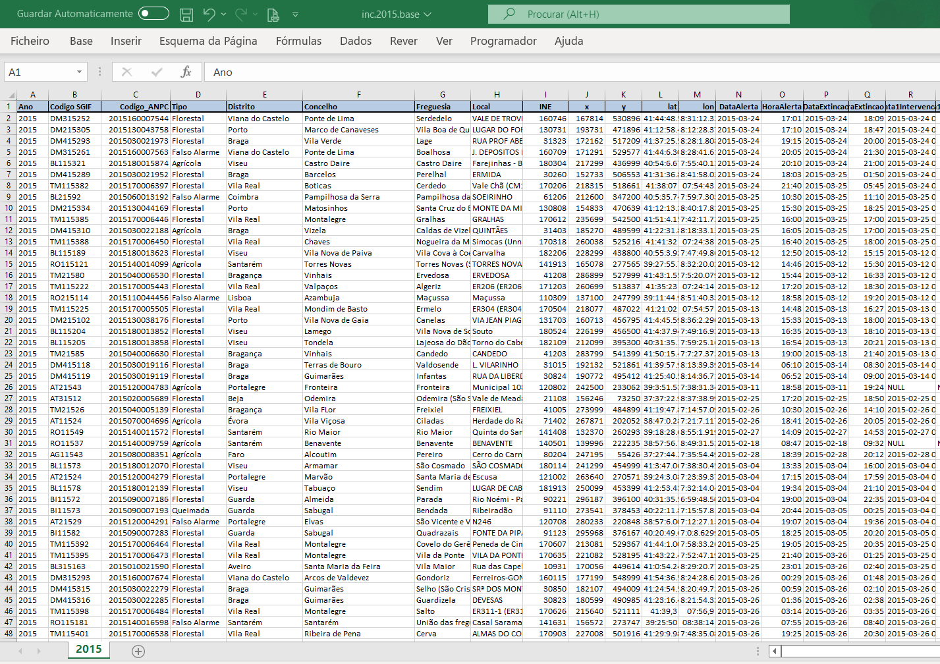
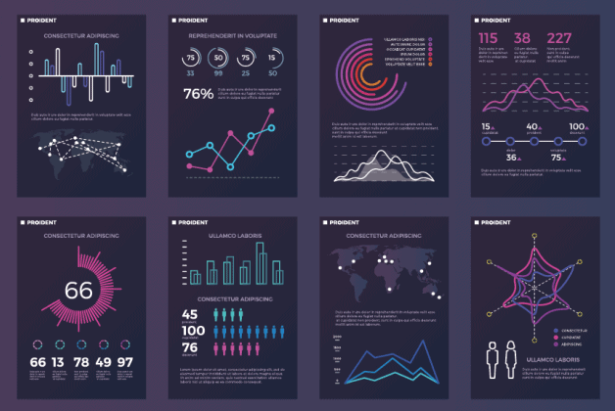
Rural Wildfires – Statistical analysis and inferences 2022/2023 – Data Science Engineering Fundaments – Statistics
Authors:
- João Fragão
- Jorge Vieira
- Tomás Rodrigues

Slide 2
Structure of the project
Methodology for this project: 6 Steps Statistical Investigation
Step 1: Which factors can have an impact on a wider burned area and number of fire occurrences?
Variables of this study:
Type of cause – Qualitative/categorical
Region: Littoral/Interior - Qualitative/categorical
Fire duration - Quantitative
Burned area - Quantitative
Extinction time - Quantitative
Reaction time - Quantitative
Step 2: Getting the data - provided by the Professor

Slide 3
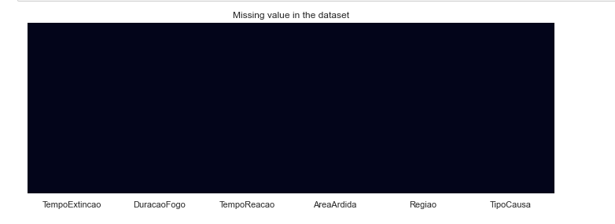
Step 3 – Exploring the data Data cleaning – Null and Error values
After cleaning the data there were no missing values or null values!

Slide 4
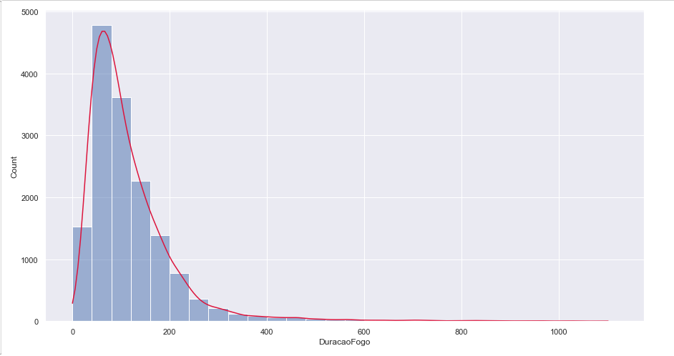
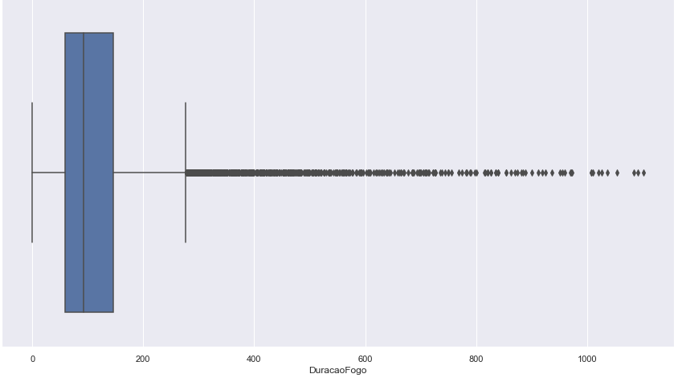
Step 3 – Exploring the data Univariate Analysis – Fire duration
Histogram (Relationship between fire duration and number of occurrences)
Mode fire duration: 80min (over 4500 times)
Follows a right skewed distribution (Mode <Median<Mean)
Boxplot for the Fire duration
Note: Outliers removed
25%: 59
Median(50%): 92
75%: 146
Max: 1102
Count: 15453
Mean: 117,4

Slide 5
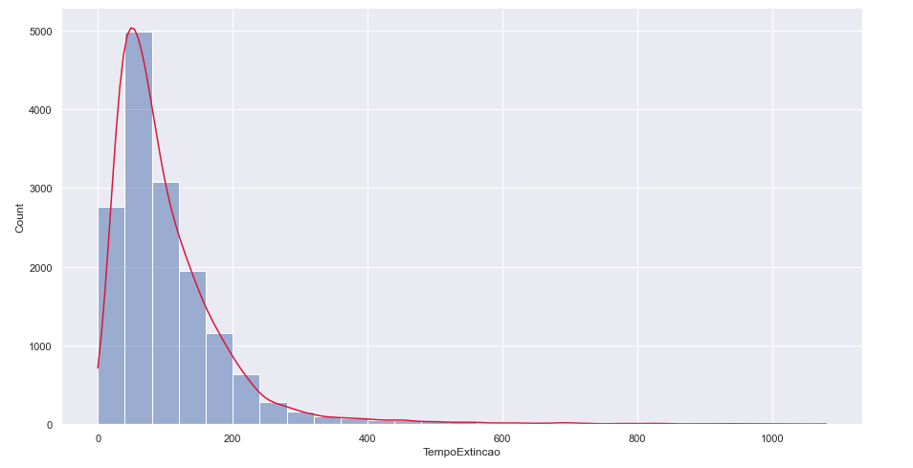
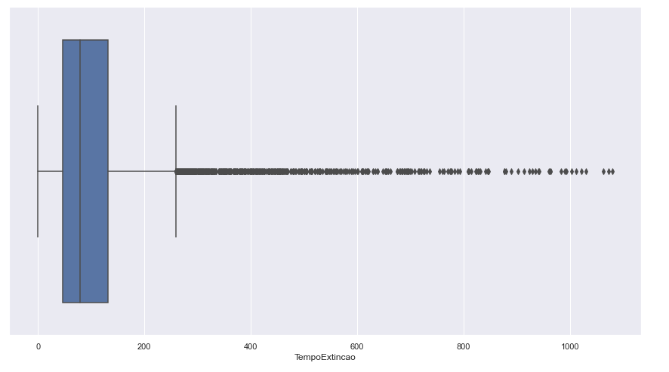
Step 3 – Exploring the data Univariate Analysis – Extinguishing time
Histogram (Relationship between the extinguishing time and number of occurrences)
Mode for the extinguishing time: 80min (over 5000 times)
Follows a right skewed distribution (Mode <Median<Average)
Boxplot for the extinguishing time
Note: Outliers removed
25%: 47
Median(50%): 92
75%: 132
Max: 1080
Count: 15453
Mean:104,4

Slide 6
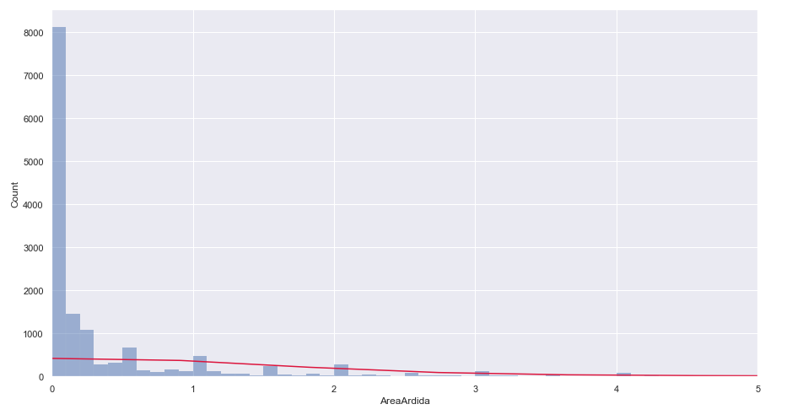
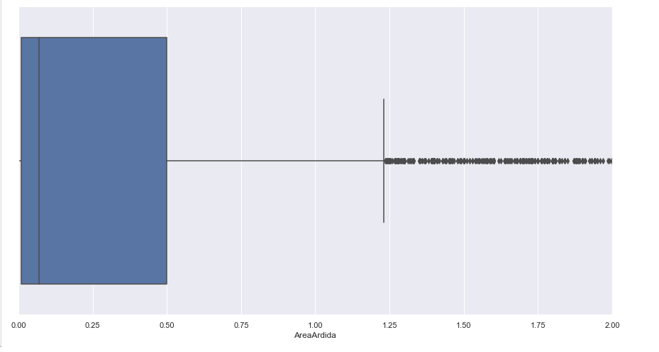
Step 3 – Exploring the data Univariate Analysis – Burned area
Boxplot for the burned area;
Note: Outliers removed
25%: 0,01
Median(50%): 0,07
75%: 0,5
Max: 181,7
Count: 15453
Mean: 1,7
Histogram (Relationship between the burned area and occurrences)
Mode for the burned area: 0,1 acres
Follows a right skewed distribution (Mode <Median<Average)

Slide 7
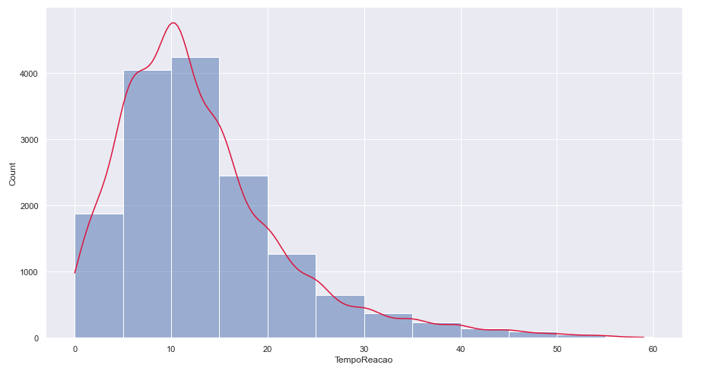
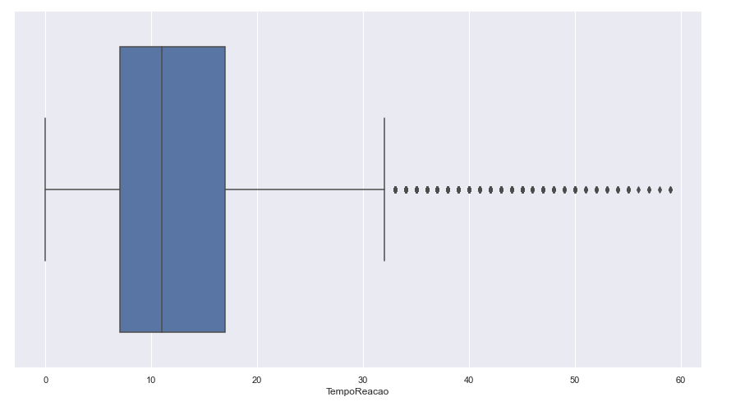
Step 3 – Exploring the data Univariate Analysis – Reaction time
Histogram for the Reaction time;
Mode: 15min;
Follows a right skewed distribution (Mode <Median<Average)
Boxplot for the Reaction time;
Note: Outliers removed
25%: 7min
Median(50%): 11min
75%: 17min
Max: 59min
Count: 15453
Mean: 13min

Slide 8
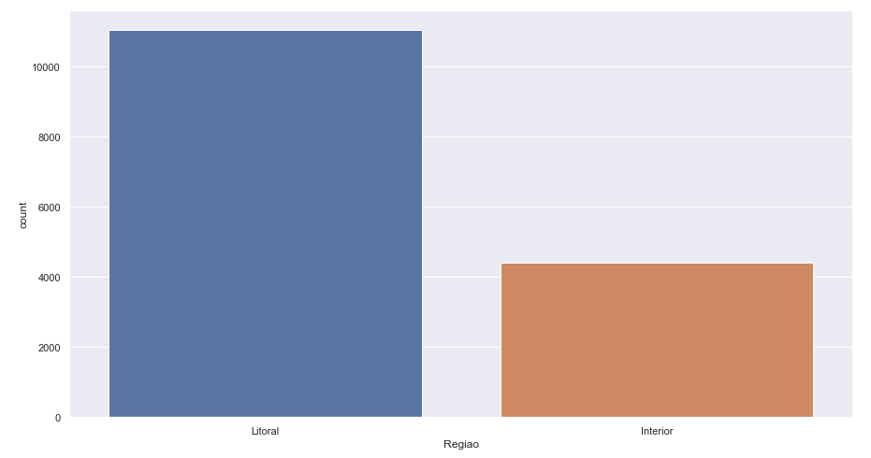
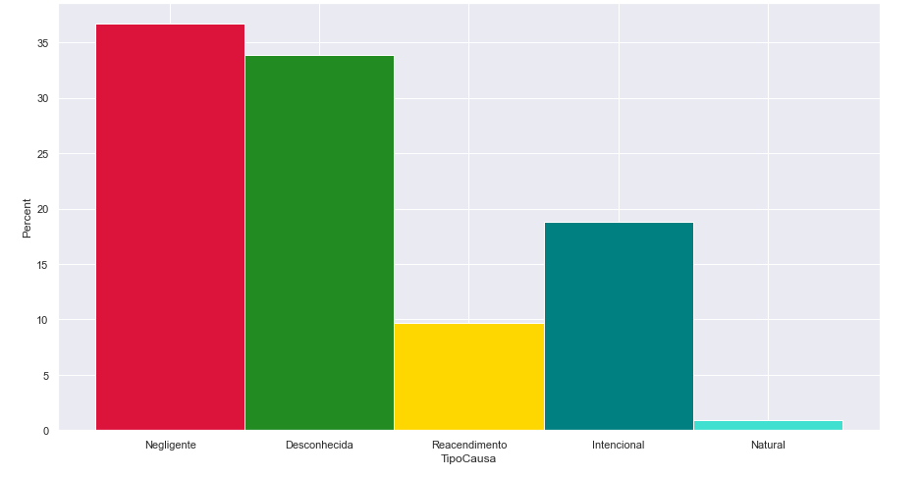
Step 3 – Exploring the data Univariate Analysis – Region and Type cause
Bar chart for the number of occurrences per region;
What stands out? Littoral with many more occurrences (70%/30% Ratio - approx.)
Bar chart for the causes;
Negligence and Unknown causes stand out (70%aprox);
Intentional cause “in between” (almost 20%);
Natural and Reignition are the lowest(10%aprox)

Slide 9
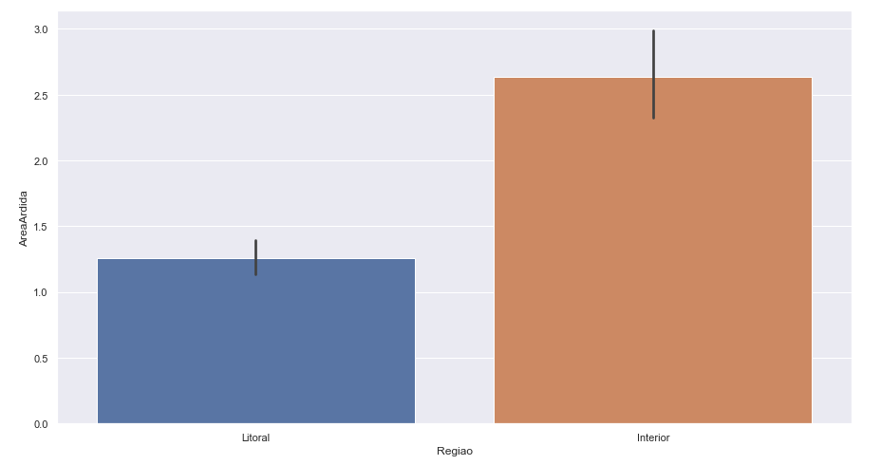
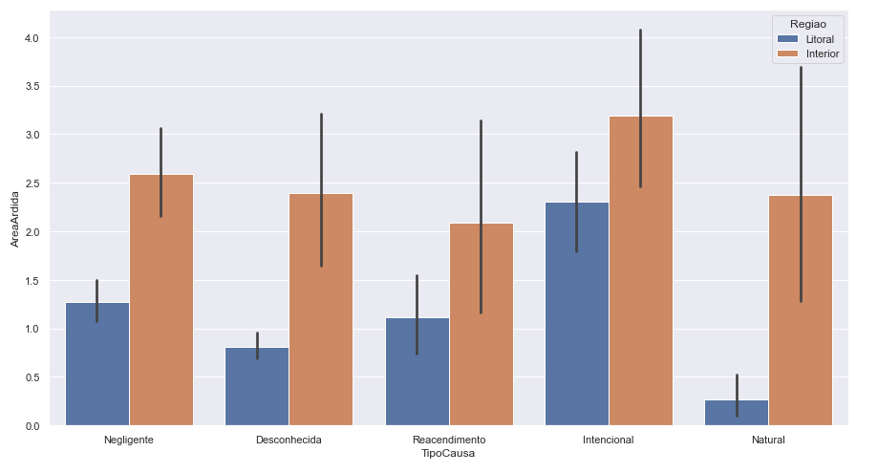
Step 3 – Exploring the data Multivariate Analysis – Region and Type cause
Bar chart for the causes and burned area, split into littoral and interior;
What stands out? The average burned area is higher in the interior than it is on the littoral;
Bar chart for the average burned area per region;
What stands out? Interior with a wider burned area on average.

Slide 10
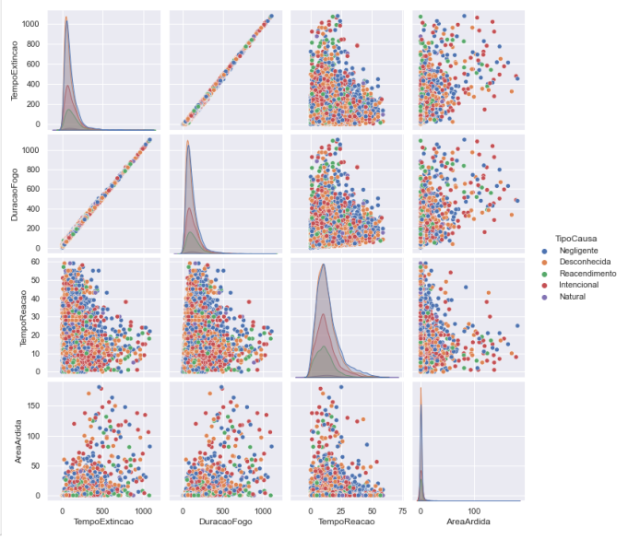
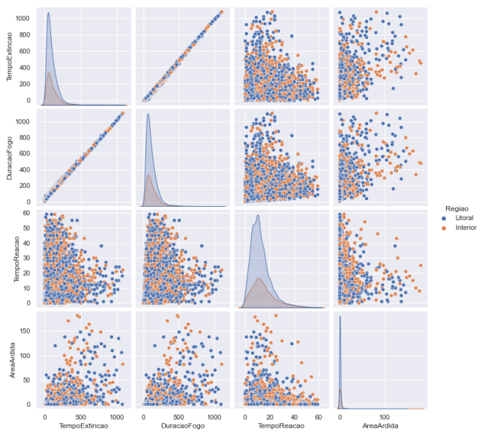
Step 3 – Exploring the data Multivariate Analysis - Correlations
Correlations with type of cause
Correlations with the Regions

Slide 11
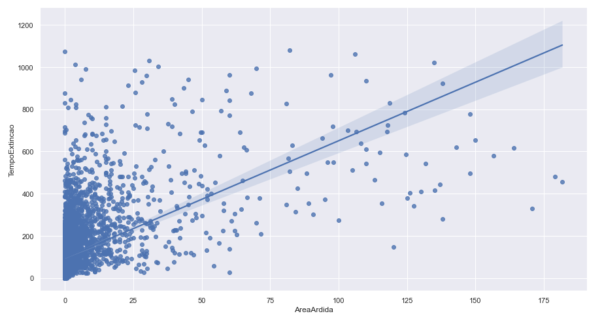
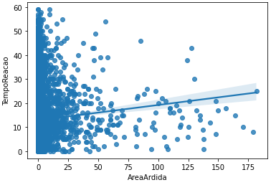
Step 3 – Exploring the data Multivariate Analysis - Correlations
Scatter plot that correlates the burned area and the extinguishing time
Scatter plot that correlates the burned area and the Reaction time

Slide 12
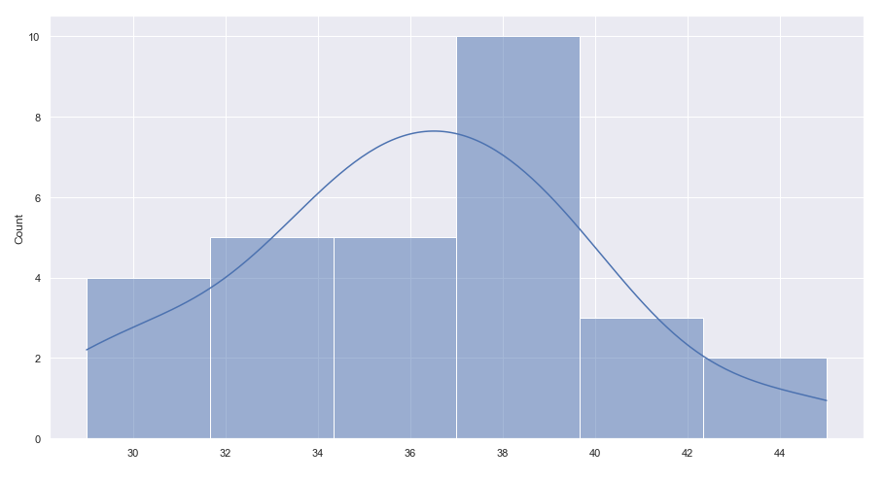
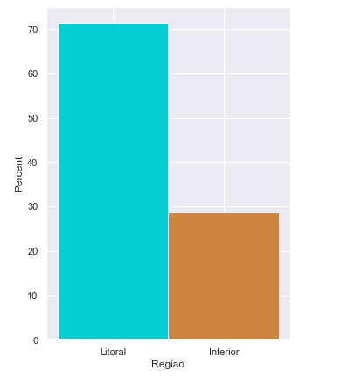

Step 4 – Draw inferences 1st Inference - Can we claim with 99% certainty that more than 71% of the fire outbreaks with an area below 10ha occur on the littoral?
Histogram for the fire outbreak occurrences on the littoral ;
29 samples, 50 rows each sample;
Ho: u ≥ 0,71 vs. H1: u < 0,71;
Confidence interval = ((70,74;74,48)
Conclusion: Since 71% is within the confidence interval, we can claim with 99% certainty that more than 71% of the fire outbreaks with a burned area below 10 ha occur on the littoral.

Slide 13
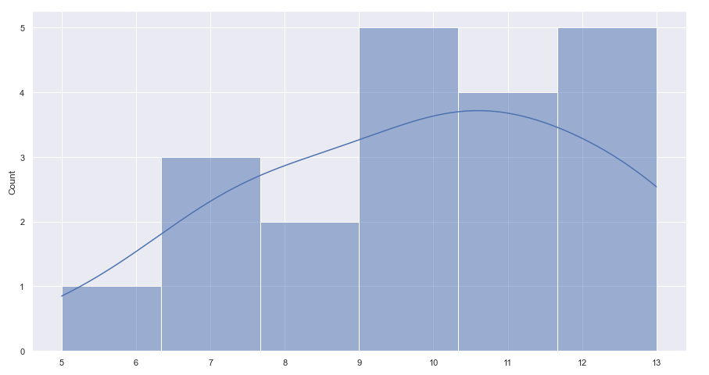

Step 4 – Draw inferences 2nd Inference - Can we claim with 99% certainty that more than 35% of the fires with a burned area above 100ha have an intentional cause behind?
Histogram for the number of occurrences intentionally out of 30 rows 20 samples;
Ho: u ≥ 0,35 vs. H1: u < 0,35
Confidence interval = (34,8;37,2)
Conclusion: Since 35% is within the confidence interval, we have evidence to state that more than 35% of the fires with a burned area above 100ha have an intentional cause behind.

Slide 14
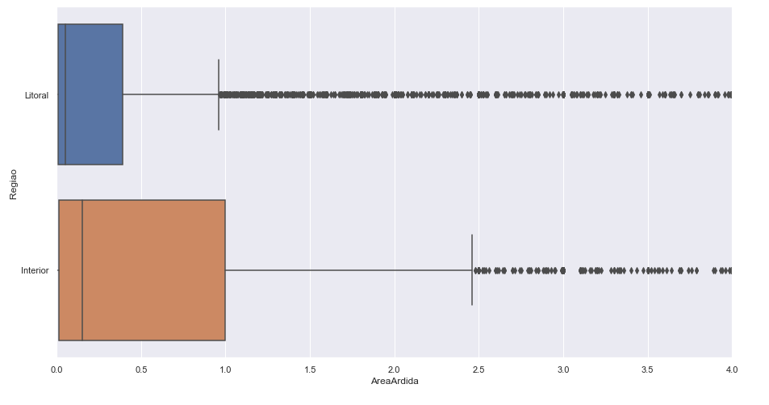
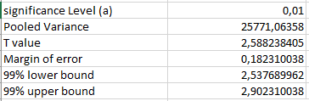
Step 4 – Draw inferences 3rd Inference - Can we claim with 99% certainty that the mean difference of the burned area in the interior is superior to the burned area on the coast ?
Boxplot for the burned area, both on the littoral and in the interior;
𝐻0: 𝜇1≥ 𝜇2 𝐻0: 𝜇1 - 𝜇2 ≥ 0
𝐻1: 𝜇1 <𝜇2 𝐻1: 𝜇1 - 𝜇2 <0
Conclusion: The results suggest that there is strong evidence that the Mean difference of the burned area in the interior will be 2,54 to 2,9 (ha) higher than the burned area on the coast.

Slide 15
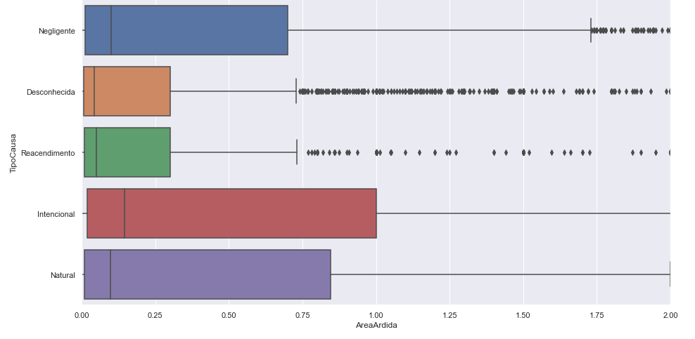
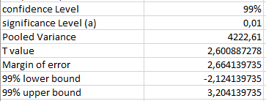

Step 4 – Draw inferences 4th Inference - Can we claim with 99% certainty that the mean difference of the burned area that has a natural cause behind is superior to the one with an intentional cause behind?
Boxplot for the burned area, and the causes behind;
𝐻0: 𝜇1≥ 𝜇2 𝐻0: 𝜇1 - 𝜇2 ≥ 0
𝐻1: 𝜇1 <𝜇2 𝐻1: 𝜇1 - 𝜇2 <0
Conclusion: We cannot claim with 99% certainty that the mean difference of the burned area caused naturally will be higher than the one caused intentionally, since the mean difference can vary from (-2,12; 3,2).

Slide 16
Step 5 – Conclusions (all in all)
More than 70% of the fire outbreaks with a burned area below 10ha occur on the littoral
More than 35% of the fires with a burned area above 100ha have an intentional cause behind
The interior has wider burned areas than the littoral, on average. 2,54 to 2,9 ha more

Slide 17
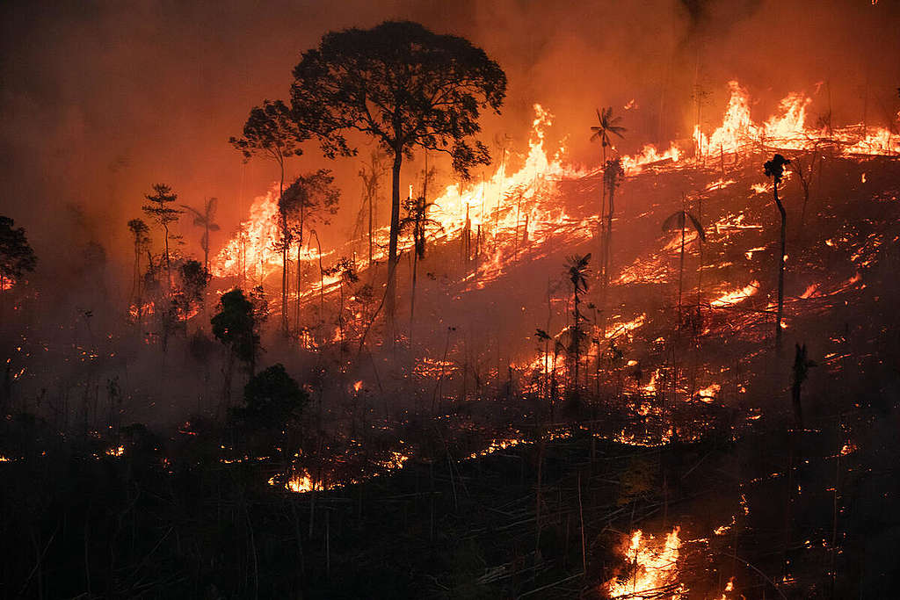
Step 6 – Look back and ahead
Project had a small scale, couldn’t study all variables
Results could be different if we considered outliers
Other interesting variables that could be studied?
Humidity, wind, temperature, vegetation density, terrain slope, proximity to fire department,…
Other interesting studies? Evolution through the years (2022-2025)

Slide 18
END

