Slide 1
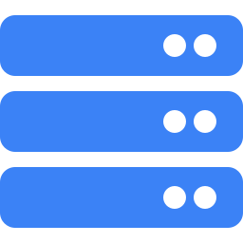
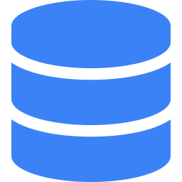

Fullstack Web App
Spring Boot + JavaScript + PostgreSQL
DATA1700 — Webutvikling

Slide 2

How it all fits together
Browser
(HTML + JS)
Controller
(API layer)
Repository
(DB layer)
Database
(PostgreSQL)
The browser sends HTTP requests (GET, POST, PUT, DELETE) to the controller.
The controller calls the repository, which runs SQL against the database.
Data flows back as JSON.

Slide 3
Model
The data container
What is it?
A plain Java class (POJO) that represents one row in the database.
What does it have?
Fields that match table columns
A constructor
Getters and setters
No logic, no annotations, no dependencies.
Movies.java
class Movies {
Long id;
String name;
int age_limit;
String type;
String director;
// + constructor
// + getters & setters

Slide 4
Repository
The database layer
What does it do?
Runs SQL queries using JdbcTemplate.
It is the only class that touches the database.
Key concepts:
@Repository tells Spring to manage it
JdbcTemplate runs SQL safely (with ?)
RowMapper converts rows to objects
One method per CRUD operation
CRUD Operations
getAllMovies()
→ SELECT * FROM movies
addMovie(movie)
→ INSERT INTO movies ...
deleteMovie(id)
→ DELETE FROM movies ...
updateMovie(movie)
→ UPDATE movies SET ...

Slide 5
Controller
The API layer
What does it do?
Receives HTTP requests, calls the repository, and returns JSON. No SQL, no business logic.
Key annotations:
@RestController = returns JSON
@RequestMapping sets the base URL
@GetMapping, @PostMapping, etc.
@RequestBody = JSON → Java object
HTTP → Java method
GET /api/movies
→ getAllMovies()
POST /api/movies
→ add(movie)
DELETE /api/movies/{id}
→ delete(id)
PUT /api/movies/{id}
→ update(id, movie)

Slide 6
Frontend
HTML + JavaScript
HTML
Provides the static structure.
An empty <tbody> that JS fills
Buttons: Load Movies, + Add Movie
Uses Bootstrap for styling
The HTML page has no data.
JavaScript populates it dynamically.
JavaScript (fetch)
Calls the API and updates the page.
fetch("api/movies") for GET
fetch(url, {method: "POST", body})
JSON.stringify() to send data
response.json() to read data
Spring auto-converts JSON ↔ Java objects.

Slide 7
The flow, summarized
1
User clicks a button in the browser
2
JavaScript sends an HTTP request (fetch)
3
Controller receives it, calls the repository
4
Repository runs SQL, returns data
5
Controller sends JSON back to the browser
6
JavaScript updates the page with the response
Each layer has one job. Keep them separated.

