Slide 1

Triple-to-Text: Converting RDF Triples into Natural Languages via Optimizing an Inverse KL Divergence
Yaoming Zhu, Juncheng Wan, Zhiming Zhou, Liheng Chen
Lin Qiu, Weinan Zhang, Xin Jiang, Yong Yu
Sponsored by Huawei Innovation Research Program

Slide 2
Triple-to-Text
Background & Preliminaries
Knowledge Graphs and RDF triples
SEQ2SEQ
Objective Analysis:
Maximum Likelihood Estimation
KL divergence and inverse KL divergence
T2T Framework
Framework
Algorithm details
Experiments

Slide 3
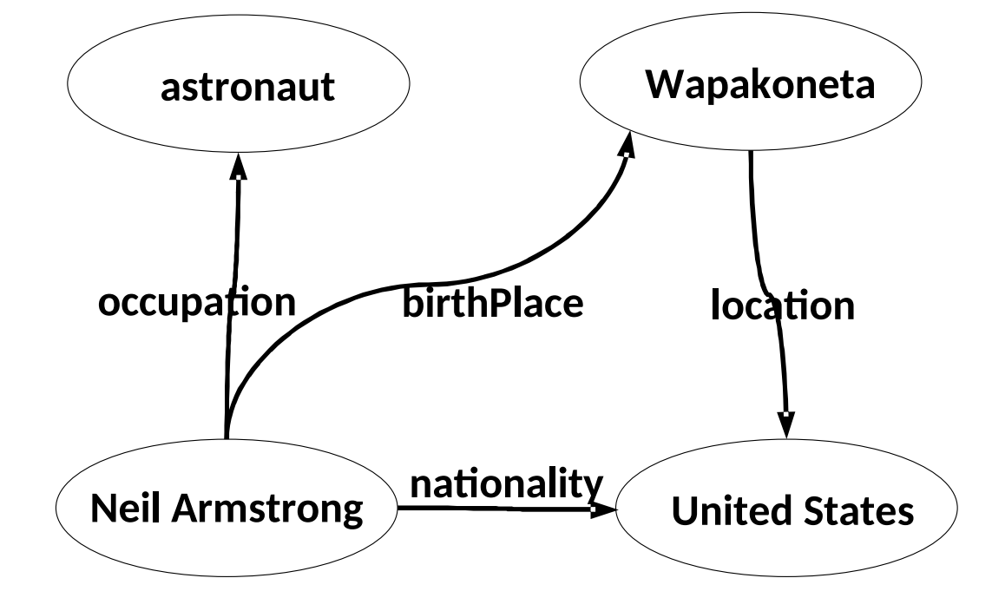
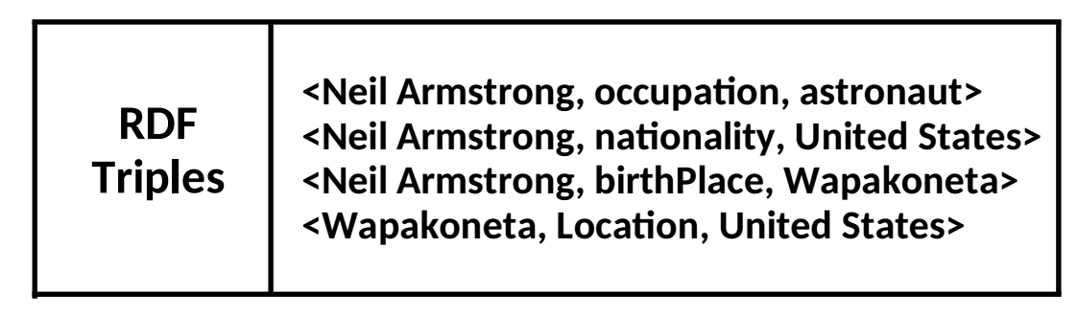
Background & Preliminaries
Knowledge Graphs & Resource Description Frameworks
A knowledge base typically consists of Resource Description Frameworks (RDF)
each RDF datum is a triple consisting of three elements, in the form of (subject, predicate, object)

Slide 4
Background & Preliminaries
Knowledge Graphs & Resource Description Frameworks
A knowledge base typically consists of Resource Description Frameworks (RDF)
each RDF datum is a triple consisting of three elements, in the form of (subject, predicate, object)
Problem and Motivation
Some human interaction interfaces (e.g., DBpedia) deliver knowledge bases in the form of RDF triples in a human-readable way.
Given a knowledge base in the form of RDF triples, our goal is to generate natural language description of the knowledge which are
grammatically correct,
easy to understand,
capable of delivering the information to humans.

Slide 5
Background & Preliminaries
Knowledge Graphs & Resource Description Frameworks
A knowledge base typically consists of Resource Description Frameworks (RDF)
each RDF datum is a triple consisting of three elements, in the form of (subject, predicate, object)
Problem and Motivation
Some human interaction interfaces (e.g., DBpedia) deliver knowledge bases in the form of RDF triples in a human-readable way.
Given a knowledge base in the form of RDF triples, our goal is to generate natural language description of the knowledge which are
We cares more about quality rather than diversity
Neil Armstrong was an American astronaut born in Wapakoneta, a city in the United States

Slide 6

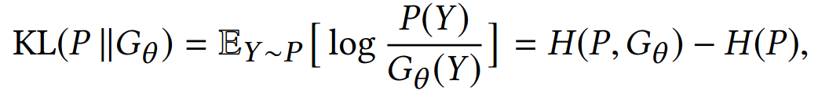
Objective Analysis
Sequence to Sequence Generation
Our work is based on the sequence to sequence framework (SEQ2SEQ).
Standard SEQ2SEQ framework consists of an encoder and a decoder. Both of them are parameterized by RNN.
Maximum Likelihood Estimation
Training neural language models through maximum likelihood estimation (MLE) is most widely used.
P: real data distribution ; G: the estimated probability distribution
It is equivalent to minimizing the Kullback-Leibler (KL) divergence.

Slide 7

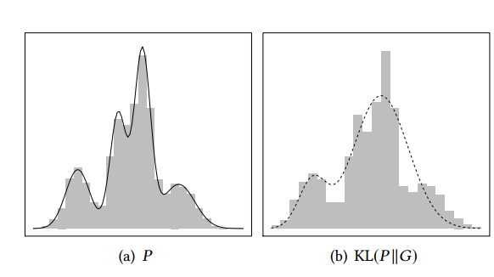
Objective Analysis
Analysis KL divergence
KL divergence between two distributions
given limited capacity of Gθ, it may only be a rough approximation of P (the real distribution is complex).
Arjovsky et al. pointed out by optimizing KL divergence, estimated distribution Gθ is more likely to have a wide coverage and possibly contain samples out of the real distribution P.

Slide 8


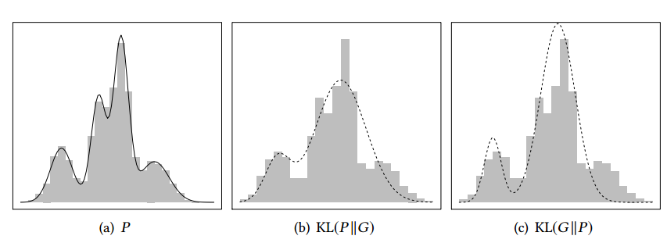
Objective Analysis
Inverse KL divergence
We argue that inverse KL divergence is a better choice in generation tasks.
Minimizing H(Gθ , P), which corresponds to the objective of Turing test (Huszár 2015).
Maximizing H(Gθ ), the self-entropy of the generator. It helps expand the support of Gθ , to avoid disjoint support between P and Gθ .

Slide 9
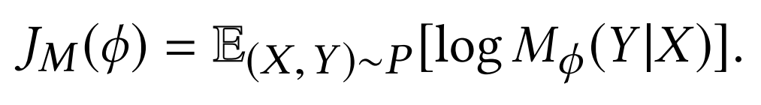
Objective Analysis
We could not directly optimize the inverse KL divergence
P is an empirical distribution and not viable.
we introduce a new module Mϕ, called judger, to approximate target distribution.

Slide 10
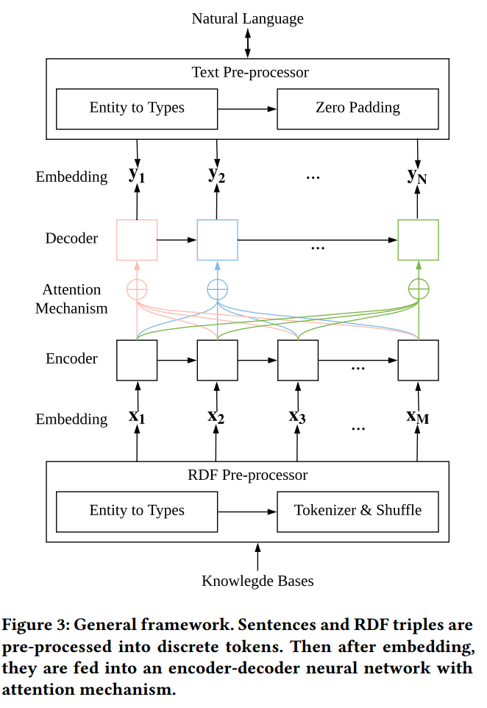
T2T Framework
General Framework
Delexicalizing technique introduced by Trisedya et al.
The pre-process can reduce the size of the vocabulary list,
and improve the generalization capacity of the model.

Slide 11
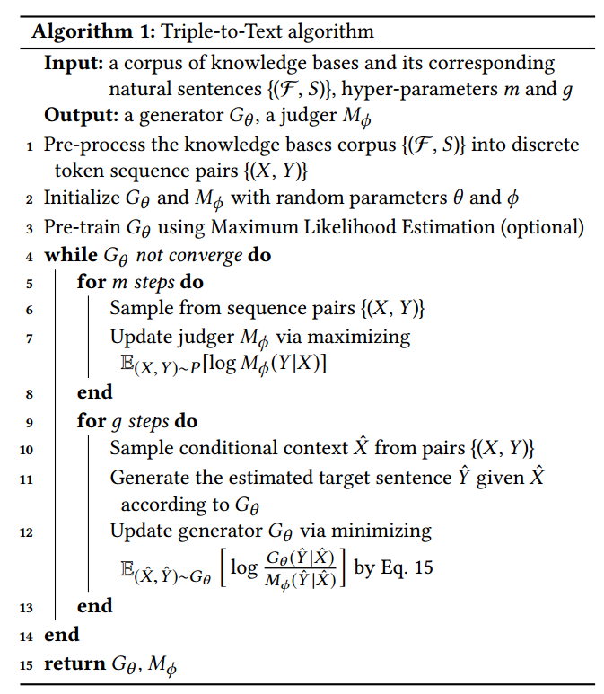
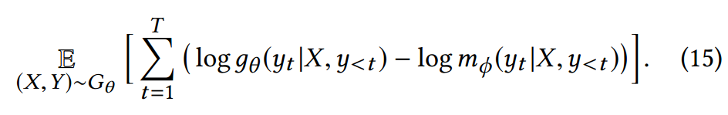
T2T Framework
Algorithm details
The judger and the generator are trained alternately.
This is inspired by curriculum learning.

Slide 12
Experiments
Datasets
WebNLG: extracted from 15 diﬀerent DBPedia categories.
SemEval-2010 Task 8: originally designed for extracting semantic relations between pairs of nominals.
Baidu SKE: a large-scale human annotated Chinese dataset .
Baseline
MLE
CoT (JS divergence)
SeqGAN (RL and GAN based)
Pointer-Generator Network
Neural Wikipedian (NW)

Slide 13
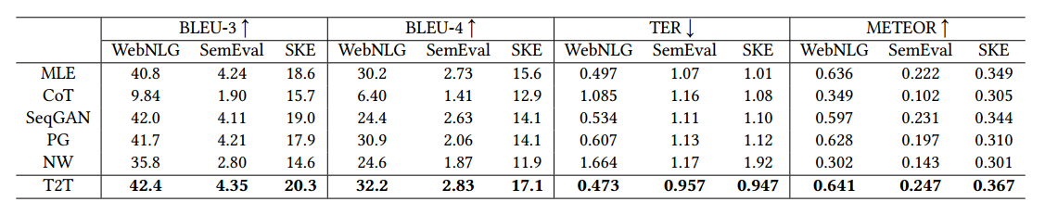
Experiments
Results
Word-based metrics

Slide 14
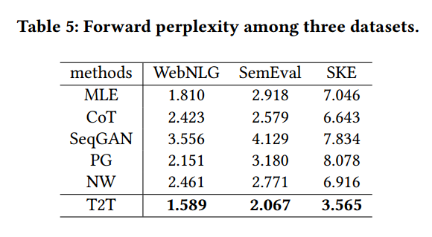
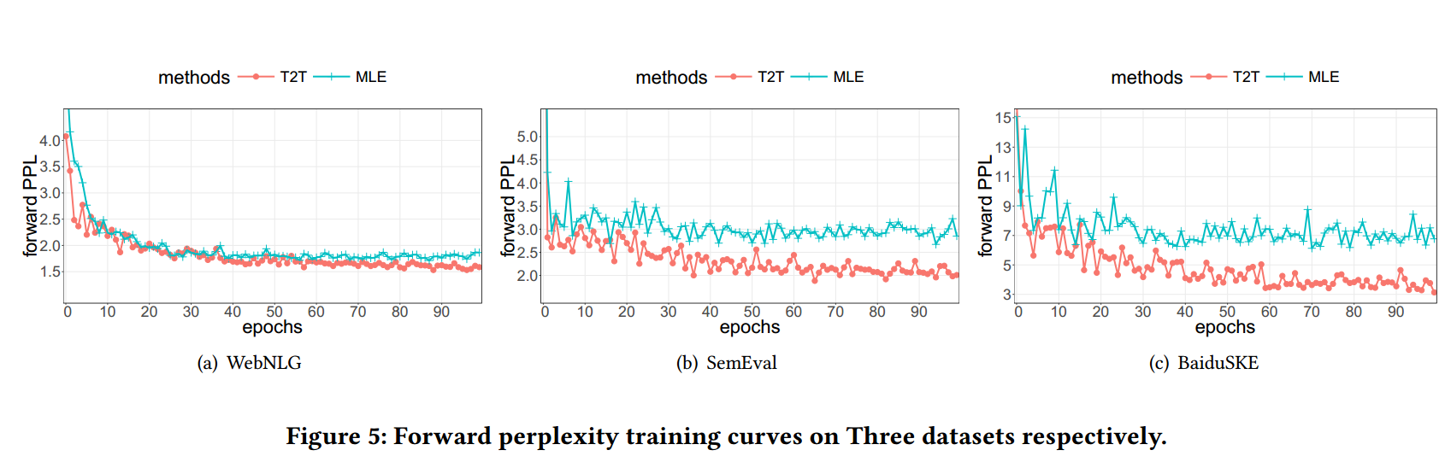
Experiments
Results
Perlexity-based metric
Forward PPL

Slide 15
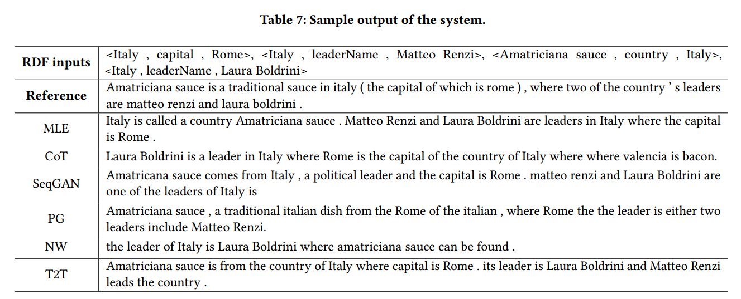
Experiments
Case Study

Slide 16

Thanks！
Contact me:
ymZhu [at] apex.sjtu.edu.cn
Slides:

