Slide 1

It’s an avocado…
Thanks…

Slide 2

WHAT IS IT?!
Data
2015-2018
Represents avocado in Time & Space.
Notes:
Data represents a list of sales of avocados that went on during the period of January 2015 to March 2018.
It has sales in most places in mainland US.

Slide 3

Purpose of Dashboard
Determine purchase trends.
Determine if marketing if effective.

Slide 4
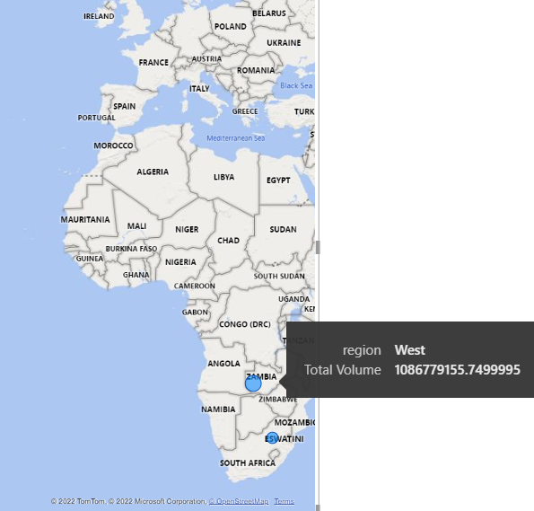
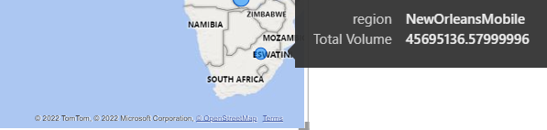
Resolving Region Differences
West
New Orleans (Mobile)
Notes:
When I looked at where it was locating all the current regions, I got a couple all the way off in Zambia & South Africa For some reason. In order to resolve this issue and bring them to their proper place.

Slide 5

City in More than 1 State
San Diego
Notes:
While I was working on this, I couldn’t find anything on cities in more than one state, least of all San Diego which I could only find one city with that name in the US with a google search…
Maybe I just don’t know what I’m looking for though.

Slide 6
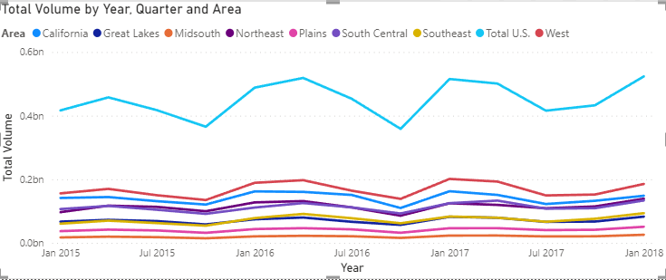
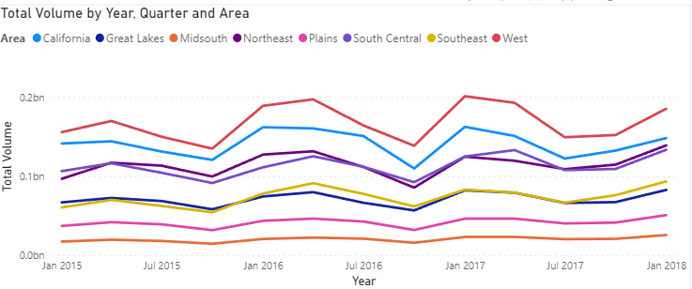
Regions that Imply Metropolitan Areas
Miami Ft Lauderdale
Lebanon
Notes:
Since the map is based on the regions for the which are bigger than states, it doesn’t really factor in too much.
I did, however, have to factor out Lebanon Kansas as that was the placeholder for Total US. I disinclined it from some of the visuals to give a better idea of what the majority of the data actually looked like.

Slide 7
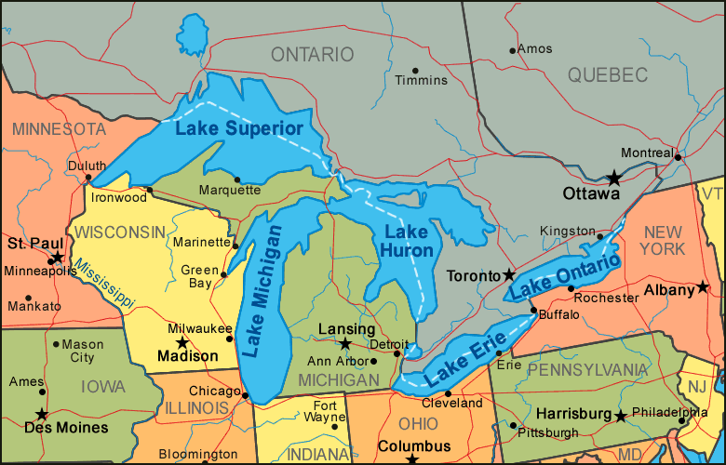
Regions implying Geographic Areas
Great lakes
Notes:
I used a city placed the data where there wasn’t a lot of data so that way it can work as a placeholder for lesser-known stuff.
For Great Lakes, since there wasn’t a lot of data set to and to distinguish it, I set it to Wisconsin

Slide 8

Rebranding
12 Regions
42 Cities.

