Slide 1
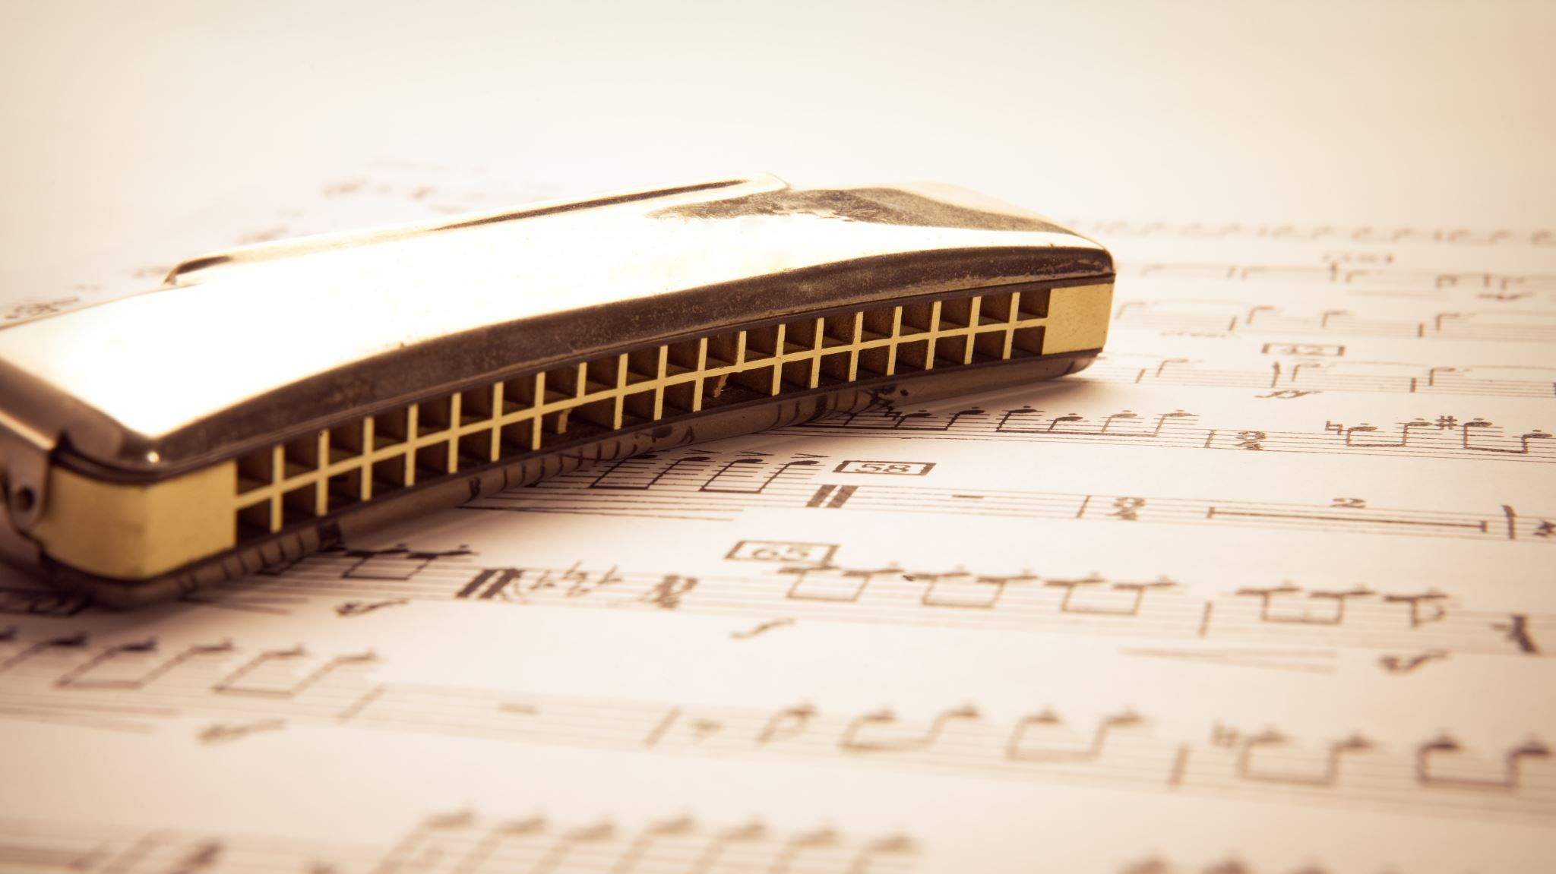
Top Songs of 2021s and 80s

Slide 2

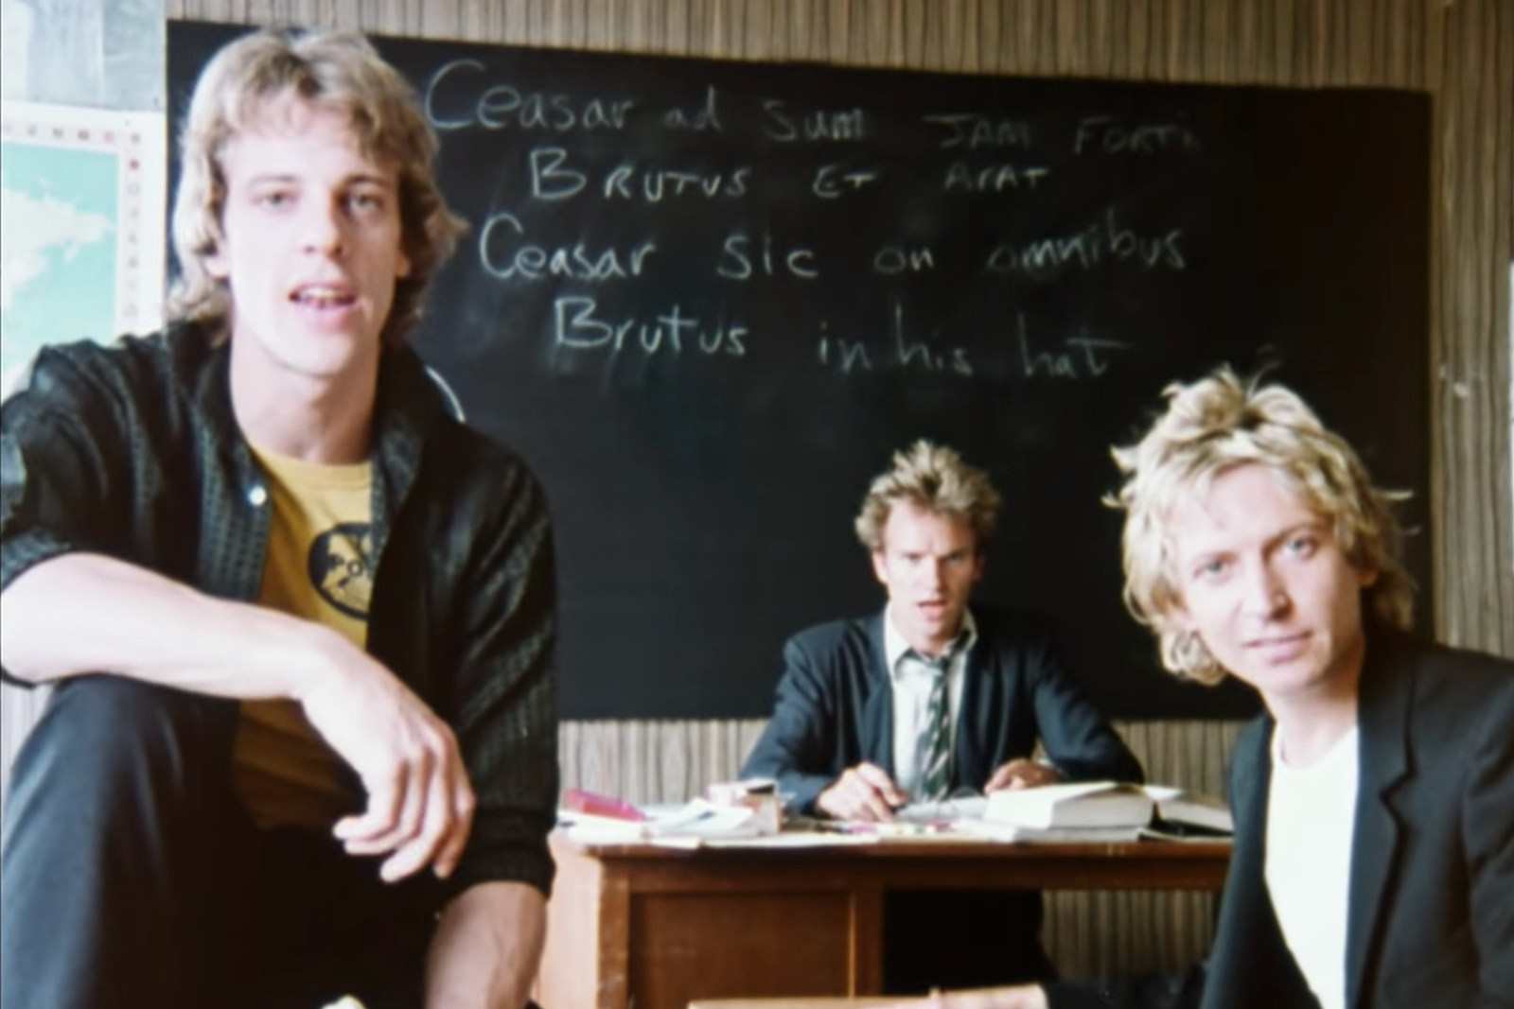
Top Songs from two Generations
Purchases
Ratings
(Needed to be in English)
Olivia Rodrigo’s Driver’s License
The Police’s
Don’t Stand So Close To Me
Notes:
I looked at the purchases and rating of the songs from their respective ages to determine which ones were the most popular.
There was one addendum to that though, because if I were to take songs from different languages other than English, then we’d have 100% unique words that have nothing in common which means that the results would only deflate the results.
I also chose not to include a translation from that song because the translation of a song in another language is subjective as there are occasionally terms that don’t translate well.

Slide 3
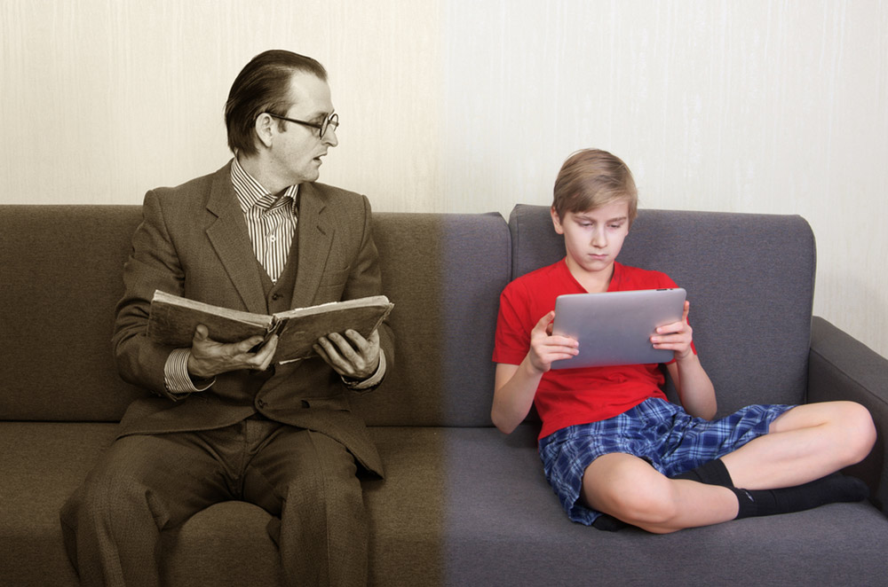
What’s a Generation Gap?
See which words popped out of either generation
Determine any other generational differences
Notes:
It was kind of frustraiting for me because it seemed like it was impossible for me to create a word cloud that used the actual word count of the words in the databases. It was sad for me. :pensivefoe: I at least got the 80s side working fine for whatever reason, but I still don’t feel it worked right for me.

Slide 4

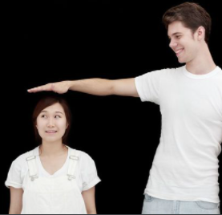

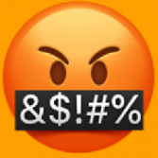
What does this dashboard teach us about your data source
80s songs were shorter?
21s songs have cursing…
They both like ‘Like’
Notes:
While looking at the data I noticed a couple of things.
1st thing I noticed is that 80s songs were shorter and had less varied language. This kind of surprised me considering how often people complain that newer music isn’t as complex as older music which is still probably true, just not necessarily between the most popular music. They had fewer unique words, character, and lengths in general. I only took the top 5 in the 2021s, but I had to take the top 10 in the 80s to meet the requirements.
2nd is a major difference is the amount of swearing. Even in the 80s, the most popular music seemed to be devoid of it, (not saying that the topics are really much better though). It was a pleasant surprise to find that the majority of the 21s didn’t have too much cursing though.
3rd the most popular non-stopword word is the word “like”

