Slide 1
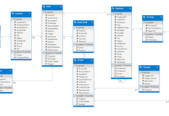
ORM – Entity Framework
Notes:
Links:
https://www.pexels.com/photo/black-sail-ship-on-body-of-water-906982/

Slide 2

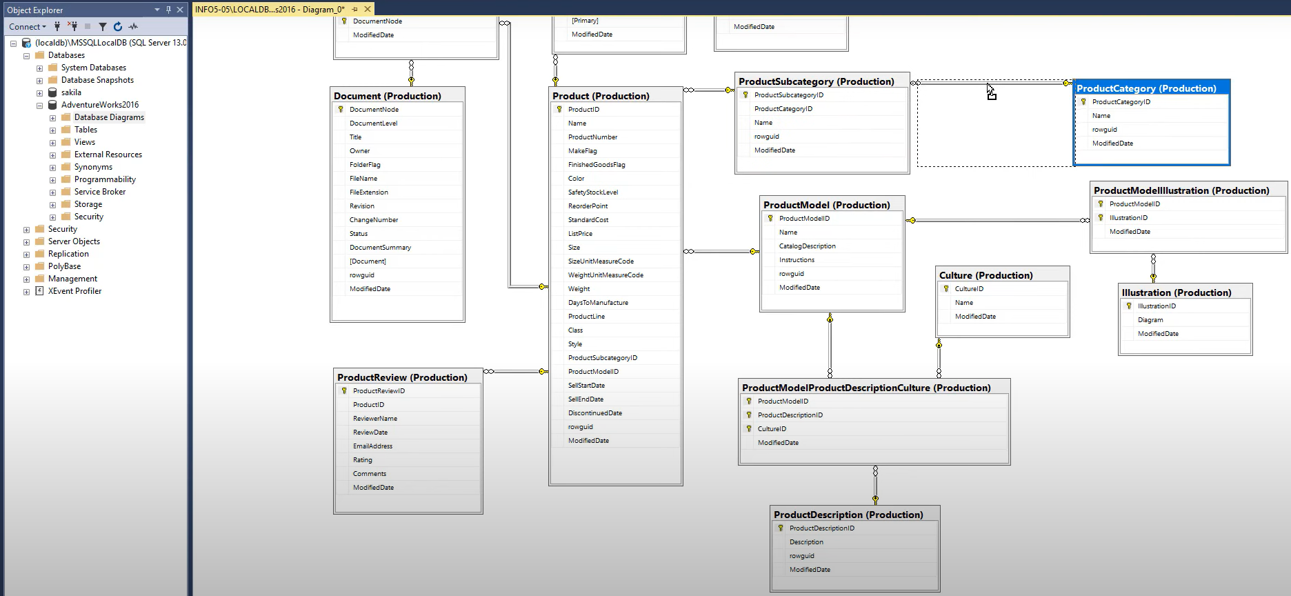
?

Slide 3





Providers
SQL Server
PostgreSQL
SQL Server New Instance
Cosmo DB-Azure
MySql
Oracle DB

Slide 4





Environments
Dev.2
PROD.1
Original DB
QA
Dev.3

Slide 5
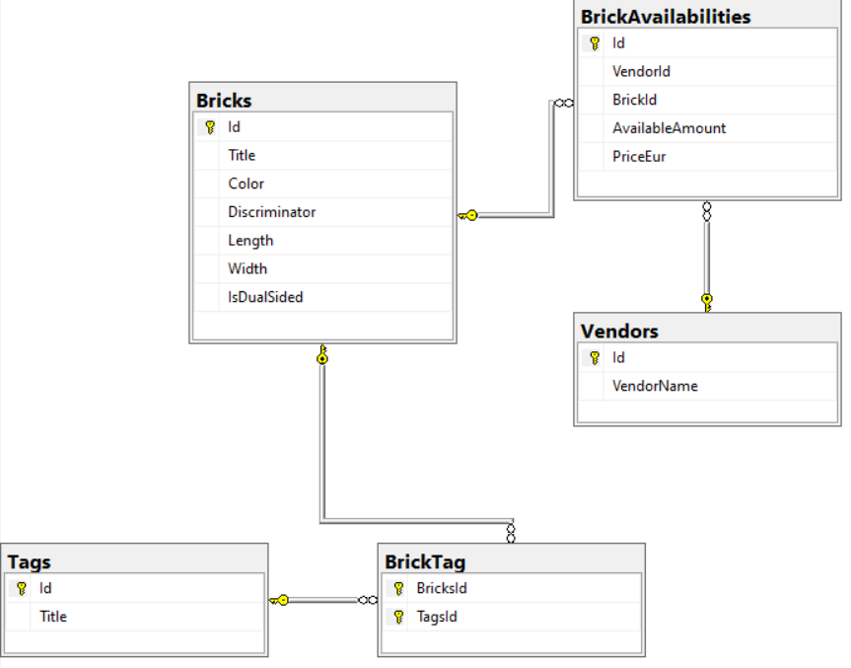
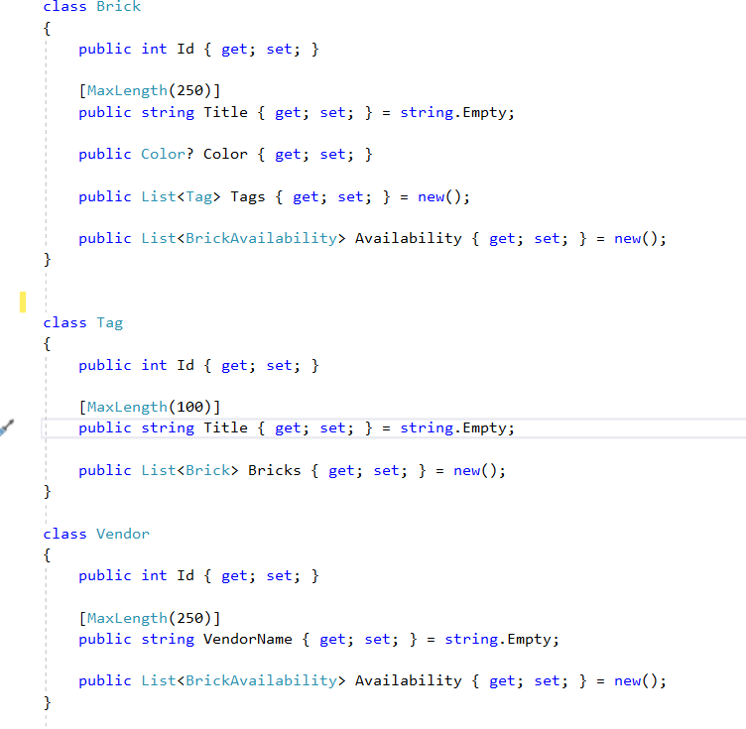
DB Relations vs C# objects & collections
Title Here
You can edit this text for your presentation
Title Here
You can edit this text for your presentation
Notes:
Links:
https://www.pexels.com/photo/delivery-man-wearing-a-face-mask-carrying-boxes-4391478/
https://www.pexels.com/photo/delivery-man-wearing-a-face-mask-carrying-boxes-4391479/
https://www.pexels.com/photo/man-in-a-face-mask-handing-over-a-thermal-bag-to-another-man-4393668/
https://www.pexels.com/photo/man-wearing-a-face-mask-paying-for-pizza-delivery-4393444/

Slide 6
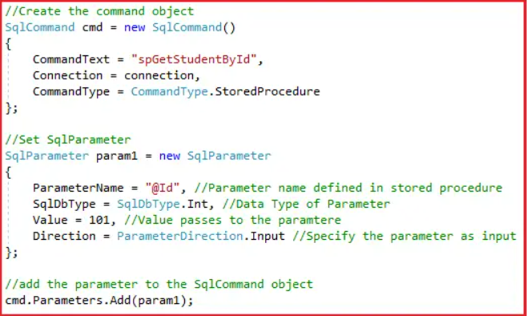
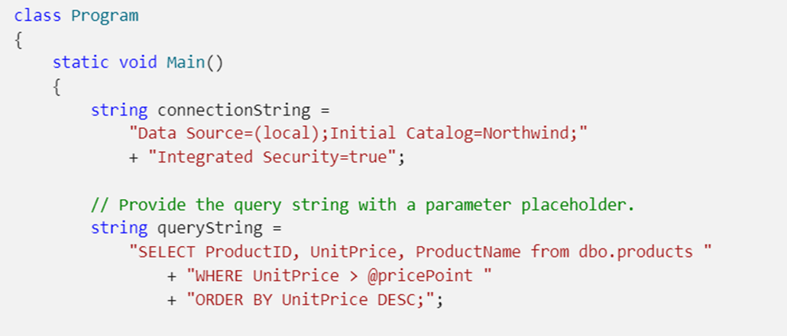
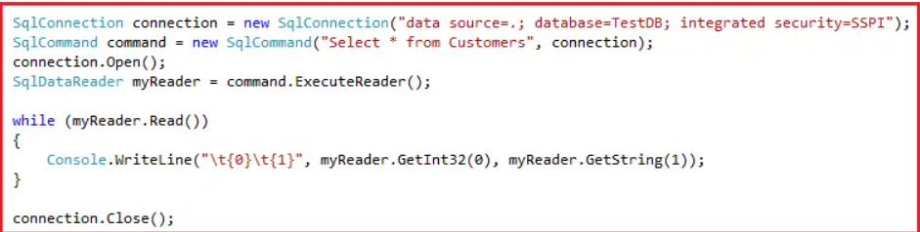
Komunikimi me DB

Slide 7
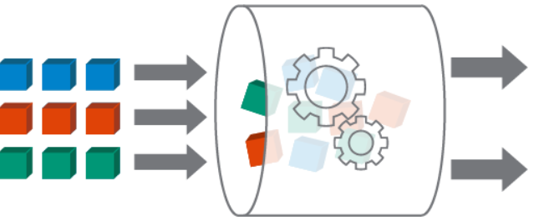
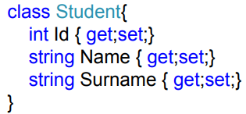
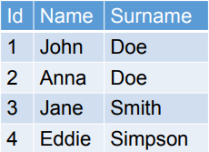
Database Layer
Entity Framework
Rest of the application

Slide 8
Avantazhet e ORM
Përshpejton kohën e zhvillimit të një soft-i
Ul kostot e zhvillimit
Menaxhon logjikën për dizenjim dhe ndërveprim me databazën
Shkruhet më pak kod për leximin apo shkrimin e të dhënave
Tejkalon veshtirësitë që lindin kur përdor databaza të ndryshme

Slide 9
Day 1
Console App with Entity Framework
MVC App with Entity Framework
DbContext & DbSet
Simple Data Modeling
FluentAPI, DataAnnotations, Naming Conventions
Scaffolding an Existing Database
EF Migrations
LINQ

Slide 10
Day 2
Improving our existing model. Diff Techniques we can apply
Model Complex Relationships
Data Seeding
Logging Techniques
Lazy Loading vs Eager Loading
Change Tracker

Slide 11
Day 3
Writing our own SQL queries
Transaction
SqlServerTypeMapper
ModelBuilder in different files
Concurrency Token

Slide 12
Faleminderit!
Notes:
Links:
https://www.pexels.com/photo/black-sail-ship-on-body-of-water-906982/

