Slide 1
527 Data Analytics
February 11, 2016
Pothole Repair Data Analysis
Author: Joris Ekpangbo

Slide 2
Outline
Introduction/ Objectives
Data Processing/ Background
Analysis
Conclusion

Slide 3
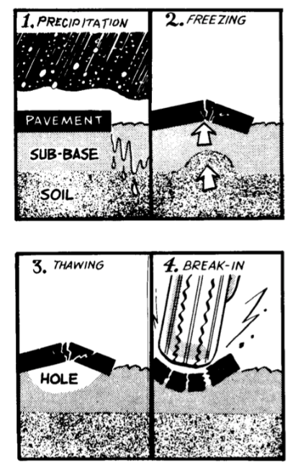
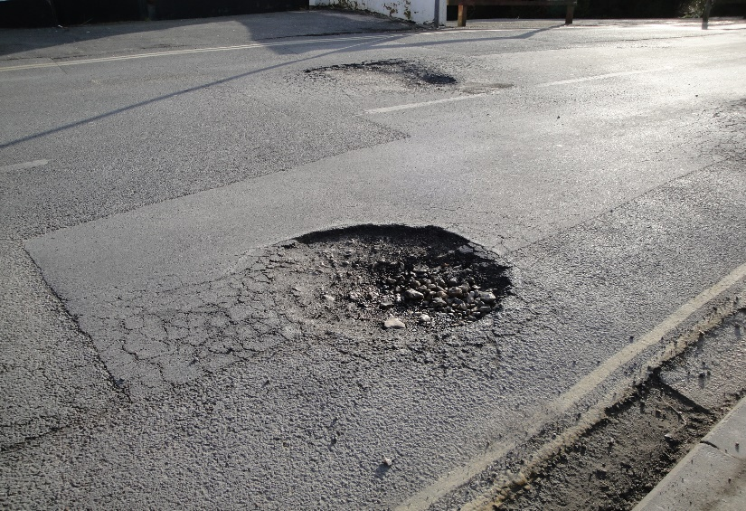
I. Introduction/Objectives
A pothole is a type of failure in an asphalt pavement, caused by the presence of water in the underlying soil structure and the presence of traffic passing over the affected area. Introduction of water to the underlying soil structure first weakens the supporting soil. Traffic then fatigues and breaks the poorly supported asphalt surface in the affected area. Continued traffic action ejects both asphalt and the underlying soil material to create a hole in the pavement.
According to a U.S. Army Corps of Engineers publication, Pothole primer—A public administrator's guide to understanding and managing the pothole problem, (Eaton, et al.), pothole formation requires two factors to be present at the same time: water and traffic. Water weakens the soil beneath the pavement by infiltration; traffic applies the loads that stress the pavement past the breaking point.
figure1:Example of a pothole figure 2: Factors leading to pothole failure

Slide 4
I. Introduction/Objectives (cont.)
Potholes can grow to several feet in width, though they usually only develop to depths of a few inches. If they become large enough, damages to tires, wheels, and vehicle suspensions are liable to occur. Therefore, serious road accidents can occur as a direct result, especially on highways where vehicle speeds are greater. Every year, for each city which roads are covered with potholes like Chicago, the challenge is to repair, to patch as soon as possible them to avoid catastrophes. Last year in New Delhi, the government recorded 11,400 deaths caused by potholes, speed breakers and humps on roads.
The following analysis will be performed on the City of Chicago budget appropriations from 2011 to 2015, the Department of transportation’s pothole repair spending and performance metrics, the 311 service request statistics and the Weather History from 2011 to 2015. The objectives of this analysis will be to:
Determine how much was spent on repairing potholes each year from 2011 to 2015,
Determine how much time was spent on repairing potholes,
Determine what was the average response times each year,
Determine whether the response time is seasonally affected or not (e.g., is the response time faster in the winter?)

Slide 5
II. Data Processing/ Background
Once data has been collected, it should be checked for any inaccuracies and obvious errors that can lead to not only waste of resources and time to collect poor data but also wrong priorities and wrong decisions. Data, in order to be useful, should be RELIABLE, TIMELY, AVAILABLE, ACTIONABLE, COMPARABLE. Consequently, the datasets previously collected must be processed to perform a consistent and accurate analysis.
First, for the Budget Data File Processing, some columns in the excel budget files had to be excluded because they were not pertinent or necessary for the analysis to be performed ( for instance, assuming that ORGANIZATION DESCRIPTION column information is the same as DEPARTMENT DESCRIPTION column information in the excel file, ignoring the duplicate column of information - ORGANIZATION DESCRIPTION improve the quality of the data). This is the set of deleted columns in the excel budget files:
After processing, the Total Target Budget Dataset number of rows is 37038.
Excluded columns of data:
In 2011: | ORGANIZATION CODE | SCHEDULE | DEPARTMENT
In 2012: | ORGANIZATION CODE | SCHEDULE / GRADE | BARGAINING UNIT
In 2013: | ORGANIZATION CODE | SCHEDULE / GRADE | BARGAINING UNIT
In 2014: | ORGANIZATION CODE | ORGANIZATION DESCRIPTION | SCHEDULE / GRADE | BARGAINING UNIT
In 2015: | ORGANIZATION CODE | ORGANIZATION DESCRIPTION | SCHEDULE / GRADE | BARGAINING UNIT

Slide 6
II. Data Processing/ Background (cont.)
Second, for the 311 Metrics File Processing, some columns had also to be excluded because of their inconsistency with the rest of the dataset and some (like YEAR and MONTH) were created to allow the aggregation of data per month, and per year. Since the analysis should be performed on the Annual Budget for Potholes Repair of Chicago from 2011 to 2015 the data collected for 2016 must be excluded. Furthermore, the information needed for the analysis should be on repair activities already completed, not pending (which could be polluting for our dataset). The total row count included after processing is 218312.
1) Created MONTH, YEAR columns.
2) Excluding STATUS=COMPLETED-DUP
3) Excluding YEAR=2016
4) Including MOST RECENT ACTION= COMPLETED or POTHOLE PATCHED only.
Third, for the Performance Metrics File Processing, the columns YEAR and MONTH were likewise created to allow the aggregation of data per month, per year. The total row count included is 468.
1) Created MONTH, YEAR columns.
2) Including all columns and rows.
Finally, for the Weather History Processing:, the columns YEAR and MONTH were created to allow the aggregation of data per month, per year. The total row count include at the end of the data processing is 1918.
1) Created MONTH, YEAR columns
2)Including all columns and rows

Slide 7
III. Analysis
The following analysis will be performed on the Annual Budget for Potholes Repair of Chicago from 2011 to 2015, the Department of transportation’s pothole repair spending and performance metrics, the 311 service request statistics and the Weather History in this city from 2011 to 2015.
The following chart explicitly shows that 52% (more than the half) of the total budgeted amount assigned to Potholes Repair in Chicago City is allocated to Asphalt Laborers salaries payment. And this conjecture is the same for the other years. In other words, the annual potholes repair budget depends heavily on the annual amount of asphalt laborers’ wages.

Slide 8
Spending on repairing potholes from 2011 to 2015
Therefore if the asphalt laborers work longer, more they will get paid and higher the total budgeted amount will be. Assuming bad weather conditions (snow, cold temperatures, wind), the number of potholes needed to be filled will significantly increase. Consequently, the asphalt laborers will work more and longer but with less efficiency because of the bad weather conditions. Which means an increased annual Potholes Repair Budget. To sum up, the Potholes Repair Budget depends heavily on the weather conditions.
This histogram shows that the highest annual budgeted amount assigned to Pothole Repair in Chicago was in 2015 ($13,506,369). This amount is somehow unusual because averagely, this amount is around $7,000,000 which is basically the half of the 2015 budgeted amount. We can assume that this outstanding augmentation is due to bad weather conditions this year. The analysis of the following charts will confirm this assumption.

Slide 9
Annual Number of Potholes filled
The number of 311 calls for potholes repair increase generally in the Winter, precisely in March. The analysis of this histogram shows that more potholes (847,713) were filled in 2014 compared the other years even if the 2014 allocated budget for potholes repair is one of the lowest. On the other hand, even if the City of Chicago 2015 budget appropriation is the highest in the studied dataset, it did not imply an augmentation in the number of potholes filled per year compared to the previous years.

Slide 10
What was the average response times each year?
The pattern of the following chart is exactly the same observed in the annual number of potholes filled histogram. We can easily deduct that the number of potholes needed to be filled determine the work load of the asphalt laborers, which is per se obvious. This histogram also shows us that the Potholes Repair Units were more effective in 2012 (average response days per year is 16.2122642, approximatively 17 days). Knowing that the factors that can prevent Repair Units from doing their job are cold temperatures, rain, snow, ice conditions, we can assume that this effectiveness is due to better weather conditions this year. On the other hand, in 2014 is noticeable the highest average response days 49.578211. The bad weather conditions had probably slowed down the Potholes Repair Units and jeopardized their effectiveness in 2014. Consequently, the average response time depends on weather conditions.

Slide 11
Is the response time seasonally affected?
We made previously an assumption about how the average response days is affected. It is affected by the weather conditions. The following charts illustrate what the weather was like from 2011 to 2015 by plotting the average of the mean temperature per year. We can easily notice that in 2012, the average temperature observed is the highest in our dataset, which can explain why the Potholes Repair Units were more effective: they worked in good weather. On the other hand, in 2014 the average temperature was the coldest and logically the effectiveness of the Repair Units decreased since they worked in cold weather.

Slide 12
Is the response time seasonally affected? (cont.)
In the same fashion, since the following chart illustrate what the average of the mean visibility miles was from 2011 to 2015, we can easily notice that in 2012, the average visibility miles is the highest in our dataset, which mean that the Potholes Repair Units had an acceptable visibility while working. On the other hand, in 2014 the average visibility miles was poor.

Slide 13
Is the response time seasonally affected? (cont.)
Wind Speed can also be prejudicial for Potholes Repair Units. This histogram shows us that the average of the mean WindSpeedMPH from 2011 to 2015 was one of the lowest in 2012. On the other hand, in 2014 the windy city justifies its name by an average of mean WindSpeedMPH reaching 10.1424658 MPH. This fact corroborates also the assumption previously stated: the effectiveness of the Potholes Repair Units depends on the weather conditions.

Slide 14
IV. Conclusion
To wrap up, this analysis allows us to have an Insight on how the Chicago City Annual Potholes Repair Budget varies. The starting point of its variability is the weather conditions.
First, since cold weather and traffic on the roads cause potholes formation, as a matter of fact, the weather conditions determine the annual number of formed potholes in Chicago.
Second, in the same fashion, the annual number of potholes needed to be filled influence the annual work load of asphalt workers and their effectiveness in their work depends again on weather conditions.
Third, the Total Budgeted Amount for Potholes Repair assigned by Chicago City depending heavily on the asphalt workers’ wages which grow proportionally to their work load, we can easily deduct that the Chicago City Annual Potholes Repair Budget depends on weather conditions. In other words, better is the weather, lower will the Annual Potholes Repair Budget be.
These metrics show what the weather was like since January 2016. The average temperature and the average visibility on miles being this low, and the wind speed being this high (i.e. bad weather conditions), we can predict a high Potholes Repair Budget this year.
Average of Mean TemperatureF | Average of Mean VisibilityMiles | Average of Mean Wind SpeedMPH
28.23809524 | 8.69047619 | 10.64285714

