Slide 1
Deep Learning for Biology
Joris Roels

Slide 2
Unsupervised Neural Networks

Slide 3
Overview
Introduction
Autoencoders
Regularizations
Deep K-means clustering

Slide 4
Introduction

Slide 5













Introduction
So far, we have only considered supervised learning
$x_{1}$
$h_{1}$
${\hat{y}}_{1}$
$y_{1}$
$x_{2}$
$h_{2}$
${\hat{y}}_{2}$
$y_{2}$
Loss
$$…$$
$$…$$
$$…$$
$$…$$
$x_{n}$
$h_{m}$
${\hat{y}}_{3}$
$y_{l}$

Slide 6
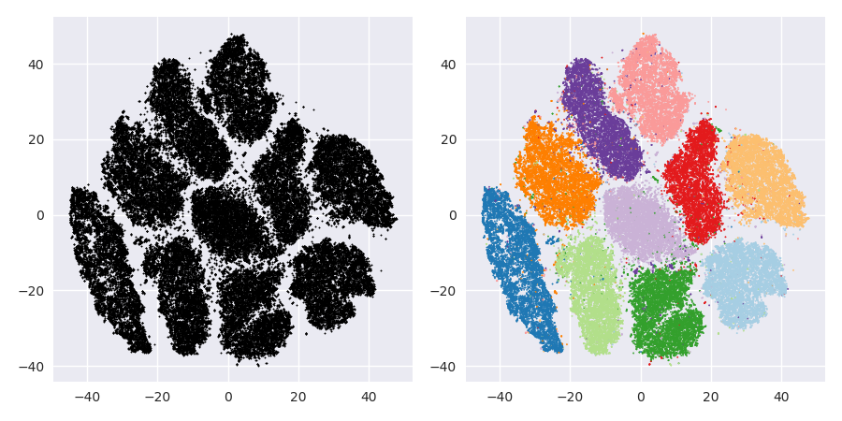
Introduction
What about unsupervised or semi-supervised learning?

Slide 7



Introduction
Labels are sometimes not available or costly
➔ What loss function to use for training?
$x_{1}$
$h_{1}$
${\hat{y}}_{1}$
$y_{1}$
$x_{2}$
$h_{2}$
${\hat{y}}_{2}$
$y_{2}$
Loss
$$…$$
$$…$$
$$…$$
$$…$$
$x_{n}$
$h_{m}$
${\hat{y}}_{3}$
$y_{l}$

Slide 8
Autoencoders

Slide 9




Autoencoder
Special case of an MLP that aims to reconstruct the input
$x_{1}$
$h_{1}$
${\hat{x}}_{1}$
$x_{2}$
$h_{2}$
${\hat{x}}_{2}$
$$…$$
$$…$$
$$…$$
$x_{n}$
$h_{m}$
${\hat{x}}_{n}$

Slide 10




Autoencoder
Loss function:
Mean squared error (MSE)
$$ℒ\left(x,\hat{x}\right)=\frac{1}{n}\sum_{i}{{\left(x_{i}−{\hat{x}}_{i}\right)}^{2}}$$
Mean absolute deviation (MAD)
$$ℒ\left(x,\hat{x}\right)=\frac{1}{n}\sum_{i}{\left|x_{i}−{\hat{x}}_{i}\right|}$$
Special case of an MLP that aims to reconstruct the input
$x_{1}$
$h_{1}$
${\hat{x}}_{1}$
$x_{2}$
$h_{2}$
${\hat{x}}_{2}$
$$…$$
$$…$$
$$…$$
$x_{n}$
$h_{m}$
${\hat{x}}_{n}$

Slide 11

Autoencoder
If $n≤m$, the transformation could be trivial
Either $m<n$ (dimensionality reduction) …
… or additional restrictions (overcomplete autoencoders)
Multiple hidden layers can also improve the representation
Special case of an MLP that aims to reconstruct the input
$x_{1}$
$h_{1}$
${\hat{x}}_{1}$
$x_{2}$
$h_{2}$
${\hat{x}}_{2}$
$$…$$
$$…$$
$$…$$
$x_{n}$
$h_{m}$
${\hat{x}}_{n}$

Slide 12


















Stacked autoencoder
Extracting hierarchical features by considering the hidden layer as inputs ➔ Train each autoencoder separately after each other
$x_{1}$
${\hat{x}}_{1}$
$h_{1}$
$h_{1}$
${\hat{h}}_{1}$
$g_{1}$
$x_{2}$
${\hat{x}}_{2}$
$h_{2}$
$h_{2}$
${\hat{h}}_{2}$
$g_{2}$
$$…$$
$$…$$
$$…$$
$$…$$
$$…$$
$$…$$
$h_{m}$
$h_{m}$
$g_{l}$
${\hat{h}}_{m}$
$x_{n}$
${\hat{x}}_{n}$

Slide 13


















Stacked autoencoder
Extracting hierarchical features by considering the hidden layer as inputs ➔ Train each autoencoder separately after each other
$h_{1}$
${\hat{h}}_{1}$
$g_{1}$
${\hat{g}}_{1}$
$g_{1}$
$f_{1}$
$h_{2}$
${\hat{h}}_{2}$
$g_{2}$
$g_{2}$
$f_{2}$
${\hat{g}}_{2}$
$$…$$
$$…$$
$$…$$
$$…$$
$$…$$
$$…$$
$f_{k}$
$h_{m}$
$g_{l}$
${\hat{h}}_{m}$
$g_{l}$
${\hat{g}}_{l}$

Slide 14




























Stacked autoencoder
Stacking them into each other leads to a hierarchical representation (Lee et.al., 2011)
$x_{1}$
$h_{1}$
${\hat{h}}_{1}$
${\hat{x}}_{1}$
$g_{1}$
${\hat{g}}_{1}$
$f_{1}$
$x_{2}$
${\hat{x}}_{2}$
$h_{2}$
${\hat{g}}_{2}$
${\hat{h}}_{2}$
$g_{2}$
$f_{2}$
$$…$$
$$…$$
$$…$$
$$…$$
$$…$$
$$…$$
$$…$$
$f_{k}$
$h_{m}$
$g_{l}$
${\hat{g}}_{l}$
${\hat{h}}_{m}$
$x_{n}$
${\hat{x}}_{n}$

Slide 15
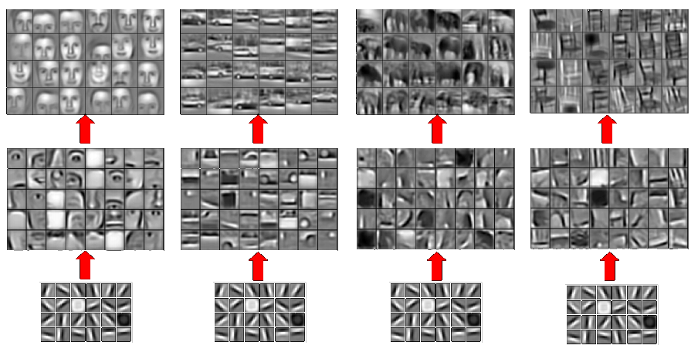



Stacked autoencoder
Stacking them into each other leads to a hierarchical representation (Lee et.al., 2011)
$f_{i}$
$g_{i}$
$h_{i}$

Slide 16
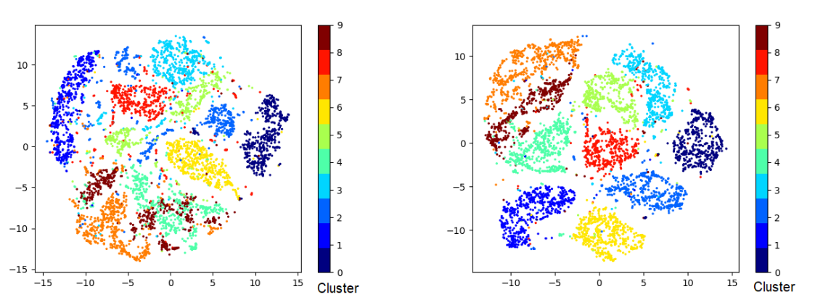




Autoencoder
$x_{1}$
$h_{1}$
${\hat{x}}_{1}$
$x_{2}$
$h_{2}$
${\hat{x}}_{2}$
$$…$$
$$…$$
$$…$$
$x_{n}$
$h_{m}$
${\hat{x}}_{n}$
Apply clustering in the lower-dimensional embedding
Clustering results on the MNIST dataset (t-SNE visualization)
K-means in the input space
K-means in the embedded space

Slide 17
Regularizations

Slide 18

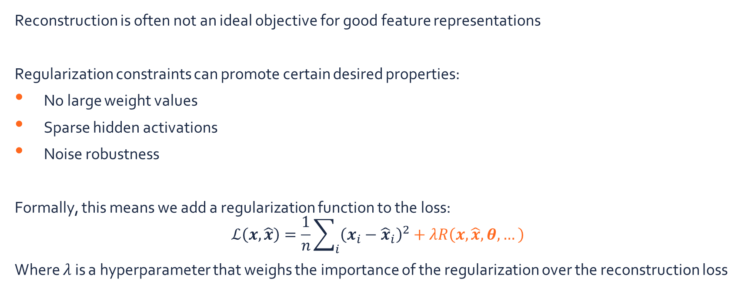


Regularizations
$x_{1}$
$h_{1}$
${\hat{x}}_{1}$
$x_{2}$
$h_{2}$
${\hat{x}}_{2}$
$$…$$
$$…$$
$$…$$
$x_{n}$
$h_{m}$
${\hat{x}}_{n}$
Reconstruction is often not an ideal objective for good feature representations
Regularization constraints can promote certain desired properties:
No large weight values
Sparse hidden activations
Noise robustness
Formally, this means we add a regularization function to the loss:
$$ℒ\left(x,\hat{x}\right)=\frac{1}{n}\sum_{i}{{\left(x_{i}−{\hat{x}}_{i}\right)}^{2}}+λR\left(x,\hat{x},θ,…\right)$$
Where $λ$ is a hyperparameter that weighs the importance of the regularization over the reconstruction loss

Slide 19

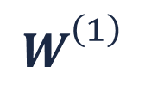


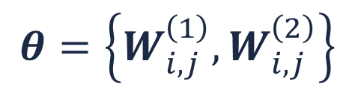






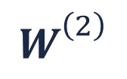


Weight decay
$$θ=\left\{W_{i,j}^{\left(1\right)},W_{i,j}^{\left(2\right)}\right\}$$
Idea: large weight values should not occur too often
Constraint for small weight values
$$R\left(θ\right)=\frac{1}{\left|θ\right|}\sum_{w∈θ}{w^{2}}$$
$$W_{}^{\left(1\right)}$$
$$W_{}^{\left(2\right)}$$
$x_{1}$
${\hat{x}}_{1}$
$h_{1}$
$x_{2}$
${\hat{x}}_{2}$
$h_{2}$
$$…$$
$$…$$
$$…$$
$h_{m}$
$x_{n}$
${\hat{x}}_{n}$

Slide 20
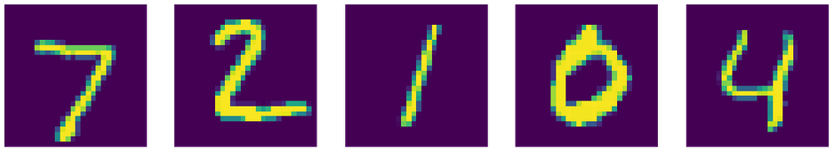
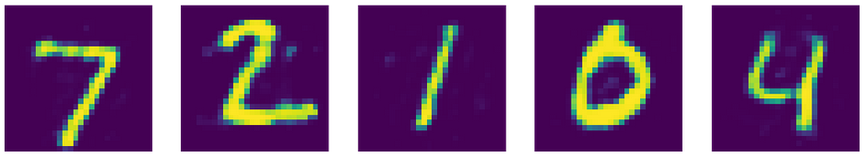
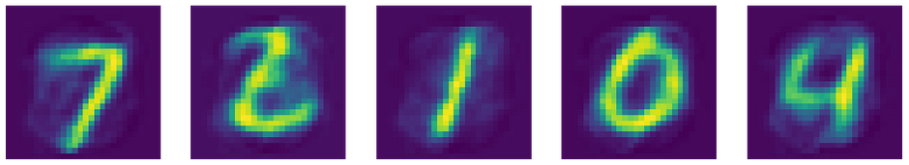
Weight decay
MNIST training samples
Idea: large weight values should not occur too often
Constraint for small weight values
$$R\left(θ\right)=\frac{1}{\left|θ\right|}\sum_{w∈θ}{w^{2}}$$
Reconstructions “vanilla” autoencoder
Reconstructions autoencoder with weight decay

Slide 21
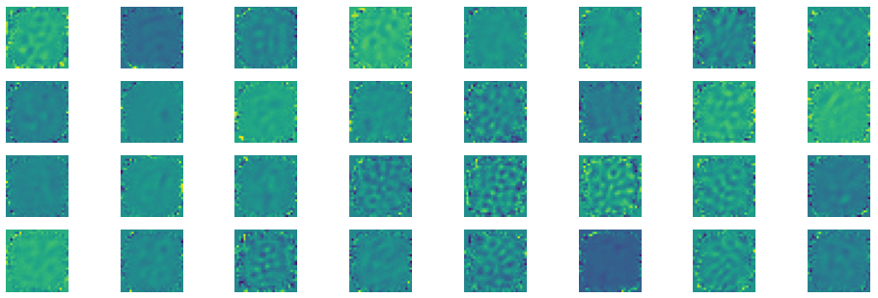
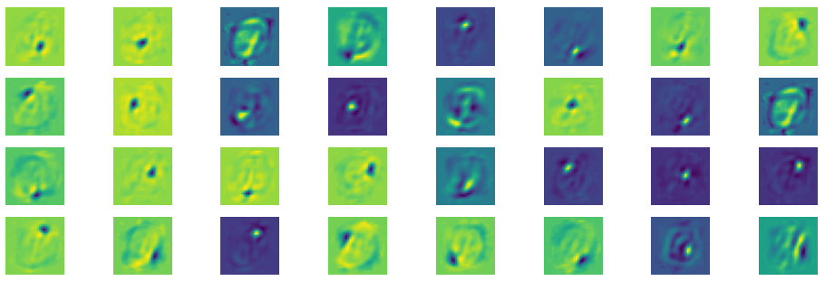
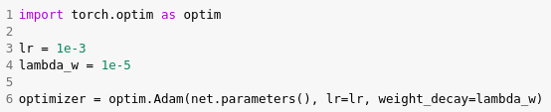
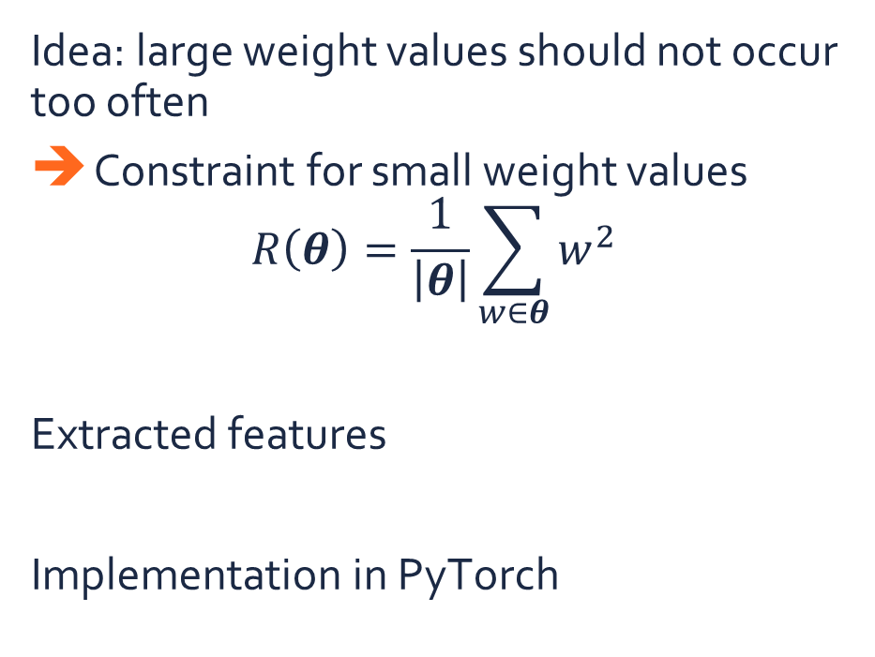
Weight decay
Features “vanilla” autoencoder
Idea: large weight values should not occur too often
Constraint for small weight values
$$R\left(θ\right)=\frac{1}{\left|θ\right|}\sum_{w∈θ}{w^{2}}$$
Extracted features
Implementation in PyTorch
Features autoencoder with weight decay

Slide 22
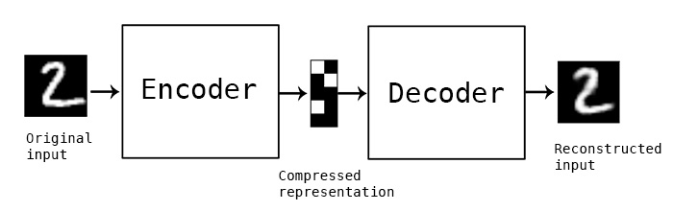
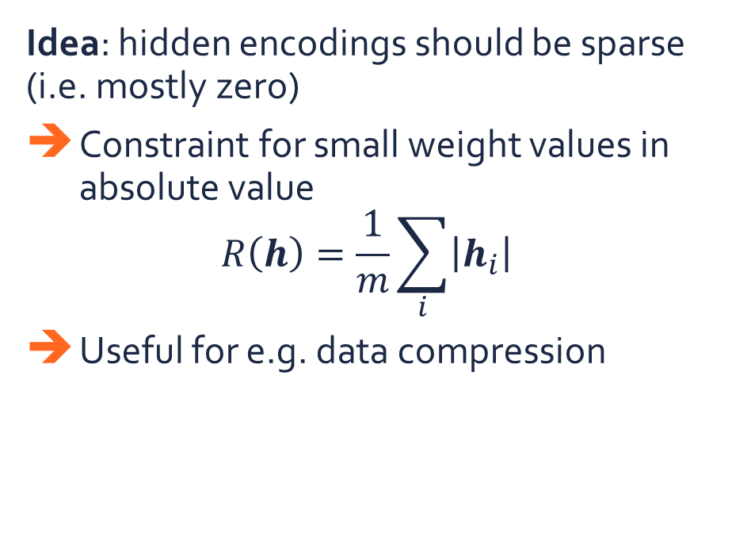
Sparse autoencoders
Idea: hidden encodings should be sparse (i.e. mostly zero)
Constraint for small weight values in absolute value
$$R\left(h\right)=\frac{1}{m}\sum_{i}{\left|h_{i}\right|}$$
Useful for e.g. data compression
$x_{1}$
${\hat{x}}_{1}$
$h_{1}$
$x_{2}$
${\hat{x}}_{2}$
$h_{2}$
$$…$$
$$…$$
$$…$$
$h_{m}$
$x_{n}$
${\hat{x}}_{n}$

Slide 23




Denoising autoencoder
Idea: reconstruction should be robust to noise
Inject noise at the input stage
Goal: reconstruct the noise-free image
Useful for e.g. data restoration
$x_{1}$
$x_{1}$
${\hat{x}}_{1}$
$h_{1}$
$x_{2}$
$0$
${\hat{x}}_{2}$
$h_{2}$
$$…$$
$$…$$
$$…$$
$$…$$
$h_{m}$
$x_{n}$
$x_{n}$
${\hat{x}}_{n}$

Slide 24

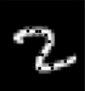


Denoising autoencoder
$$x′$$
$$x$$

Slide 25
Deep K-means clustering

Slide 26
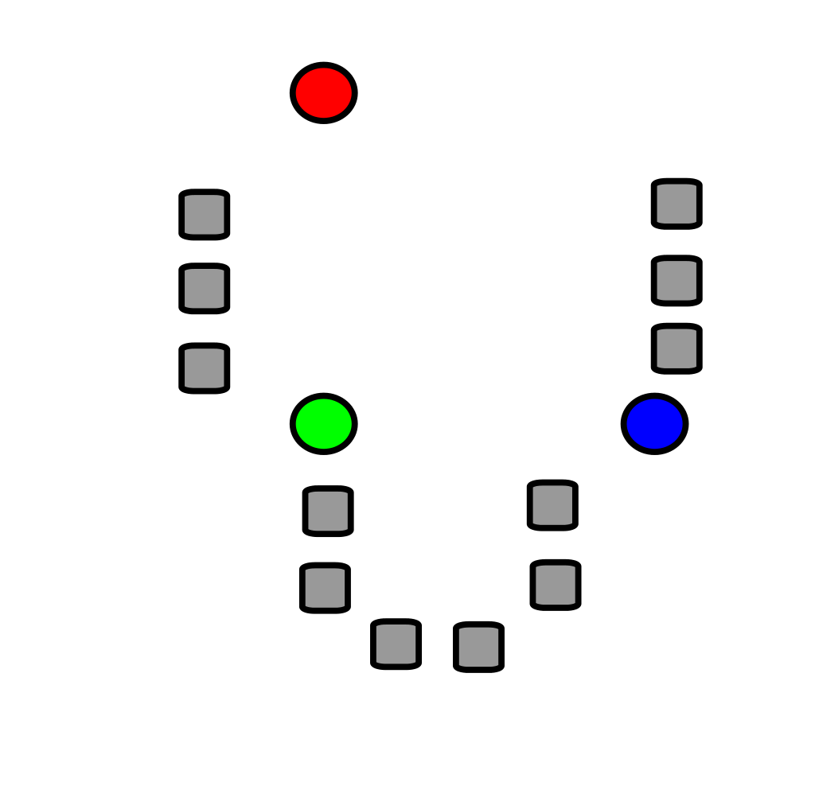
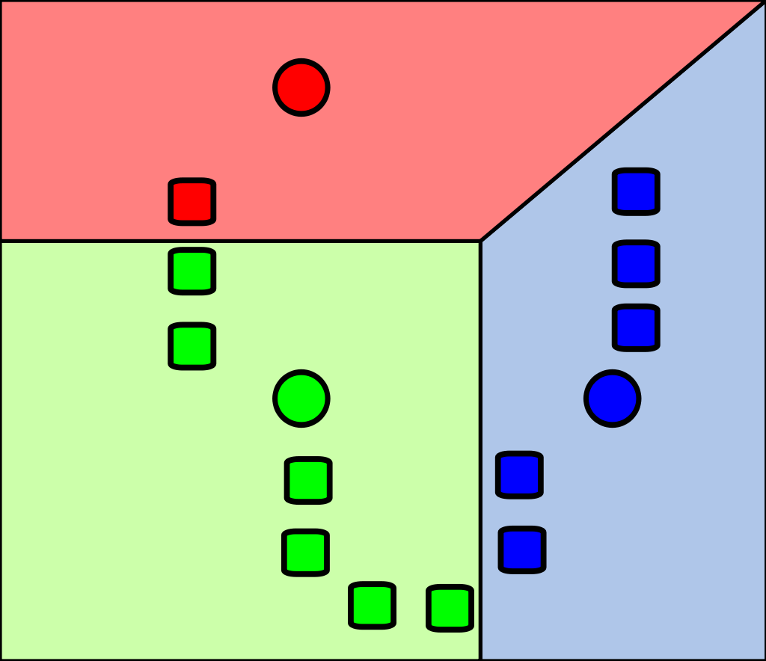
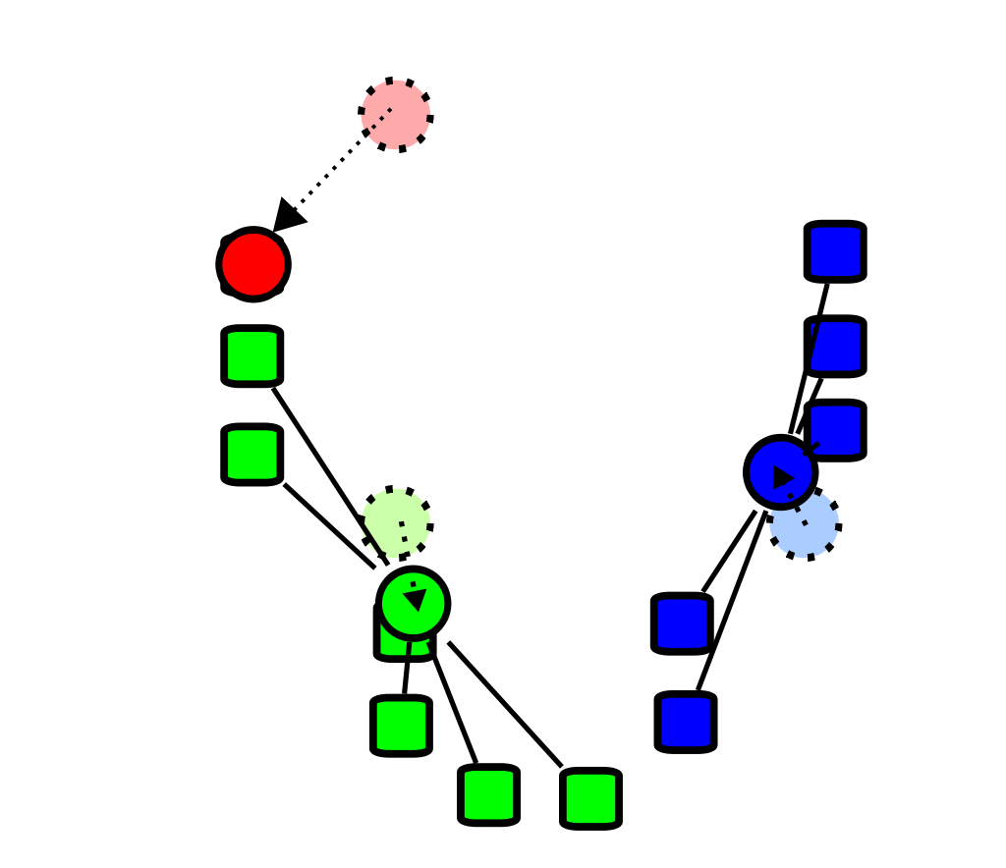
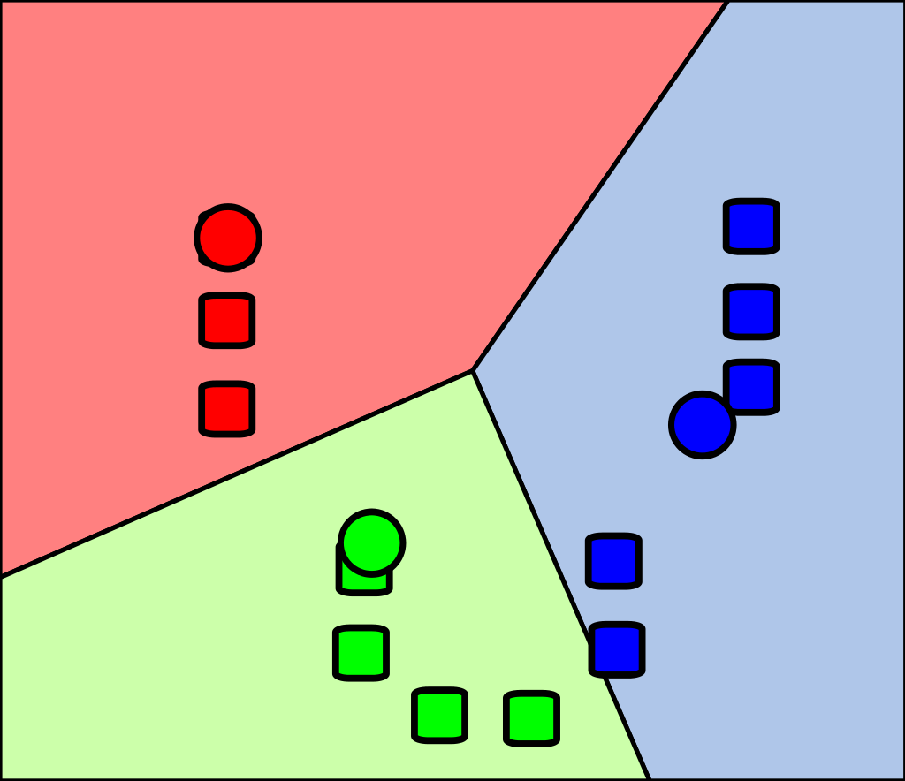
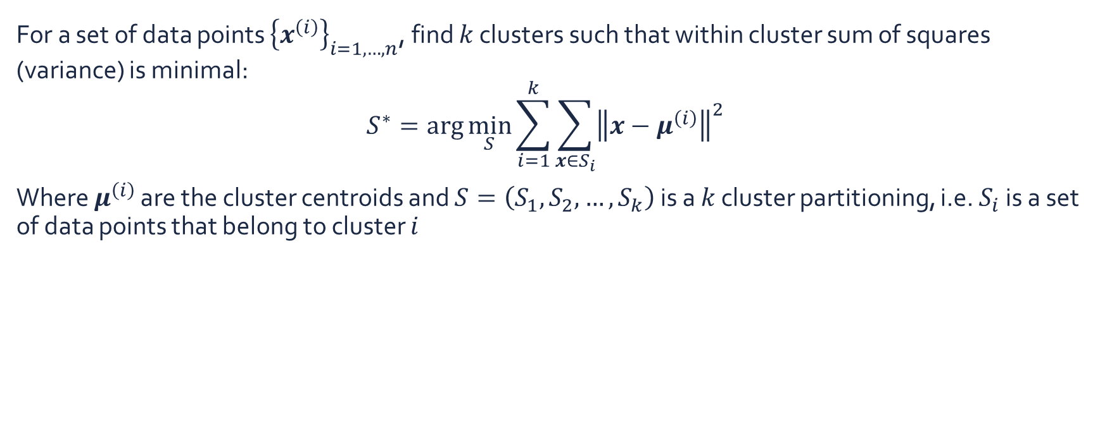
K-means clustering
For a set of data points ${\left\{x^{\left(i\right)}\right\}}_{i=1,…,n}$, find $k$ clusters such that within cluster sum of squares (variance) is minimal:
$$S^{∗}=\arg{\min_{S}{\sum_{i=1}^{k}{\sum_{x∈S_{i}}{{\left\|x−μ^{\left(i\right)}\right\|}^{2}}}}}$$
Where $μ^{\left(i\right)}$ are the cluster centroids and $S=\left(S_{1},S_{2},…,S_{k}\right)$ is a $k$ cluster partitioning, i.e. $S_{i}$ is a set of data points that belong to cluster $i$

Slide 27





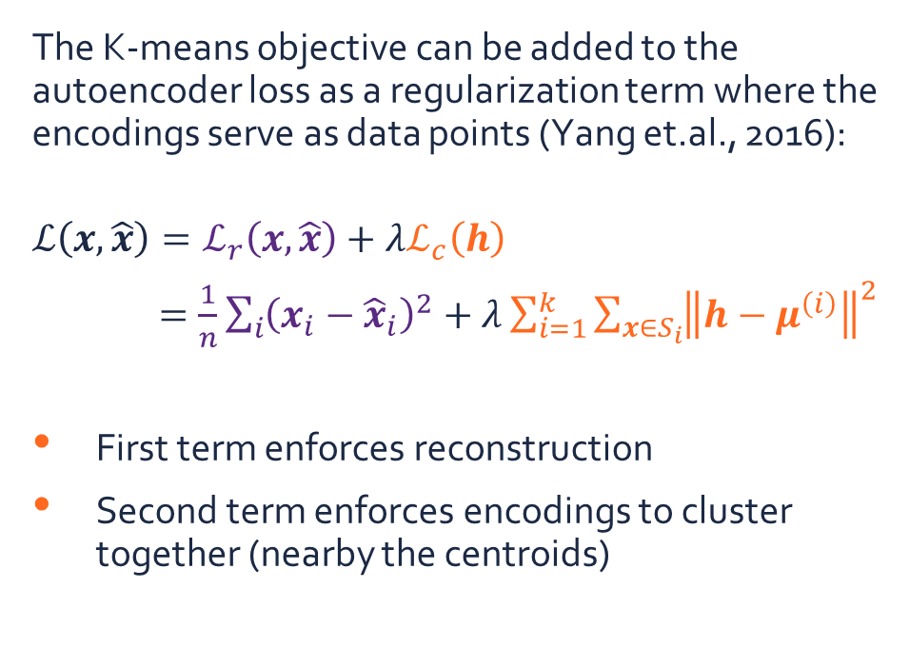








K-means clustering regularization
The K-means objective can be added to the autoencoder loss as a regularization term where the encodings serve as data points (Yang et.al., 2016):
$$ℒ\left(x,\hat{x}\right)=ℒ_{r}\left(x,\hat{x}\right)+λℒ_{c}\left(h\right)$$
$=\frac{1}{n}\sum_{i}{{\left(x_{i}−{\hat{x}}_{i}\right)}^{2}}+λ\sum_{i=1}^{k}{\sum_{x∈S_{i}}{{\left\|h−μ^{\left(i\right)}\right\|}^{2}}}$
First term enforces reconstruction
Second term enforces encodings to cluster together (nearby the centroids)
$x_{1}$
${\hat{x}}_{1}$
$h_{1}$
$x_{2}$
${\hat{x}}_{2}$
$h_{2}$
$$…$$
$$…$$
$$…$$
$h_{m}$
$x_{n}$
${\hat{x}}_{n}$
$$ℒ_{c}\left(h\right)$$
$$ℒ_{r}\left(x,\hat{x}\right)$$

Slide 28
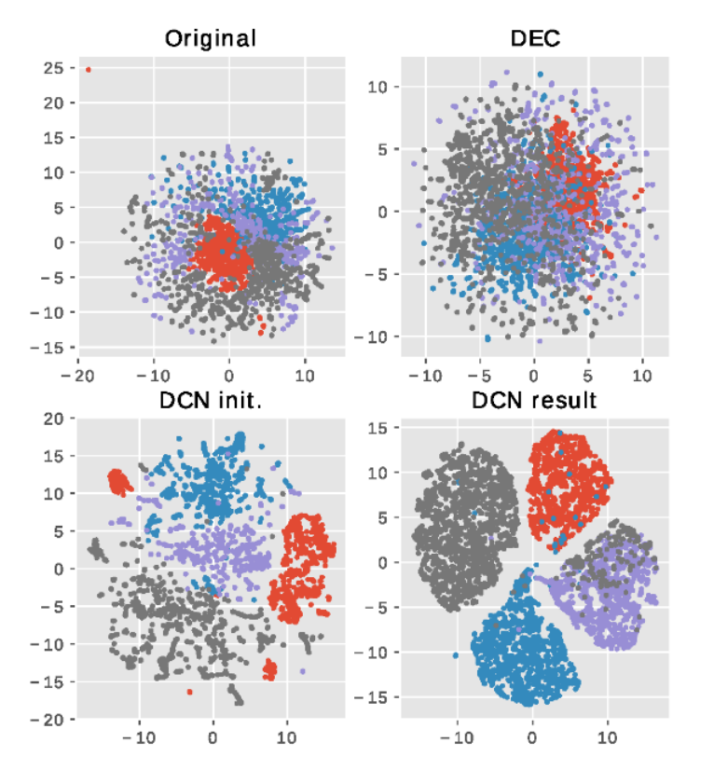
Deep clustering networks
Clustering results on RCV1-v2 dataset
Deep clustering networks (DCN) are able to map the inputs to lower-dimensional embeddings that are densely clustered

Slide 29
Summary
Unsupervised neural networks: (stacked) autoencoders
Reconstruct the input
Additional regularization can improve feature extraction:
Weight decay
Sparsity
Denoising autoencoders
Additional regularization can also improve clustering:
K-means loss
Deep clustering networks
$x_{1}$
${\hat{x}}_{1}$
$h_{1}$
$x_{2}$
${\hat{x}}_{2}$
$h_{2}$
$$…$$
$$…$$
$$…$$
$h_{m}$
$x_{n}$
${\hat{x}}_{n}$

Slide 30
Exercises

Slide 31
Exercises
Download the fifth exercise assignment
Move to your break-out room
Open the notebook in Google Colab:
Go to https://colab.research.google.com
File > Upload notebook (> log in if necessary) > browse to the notebook
Make sure you are using a GPU: Runtime > Change Runtime Type > Select ‘GPU’
Try to solve the exercises
After every exercise we will come back to the main room and discuss the results
The complete solution notebook will be uploaded at the end of the session
Ask questions to the assistants in the break-out room!

Slide 33
References
Lee, H., Grosse, R., Ranganath, R., & Ng, A. Y. (2011). Unsupervised learning of hierarchical representations with convolutional deep belief networks. Communications of the ACM. https://doi.org/10.1145/2001269.2001295
Yang, B., Fu, X., Sidiropoulos, N. D., & Hong, M. (2016). Towards K-means-friendly Spaces: Simultaneous Deep Learning and Clustering. International Conference on Machine Learning, 8, 5888–5901. http://arxiv.org/abs/1610.04794

