Slide 1
Deep Learning for Biology
Joris Roels

Slide 2
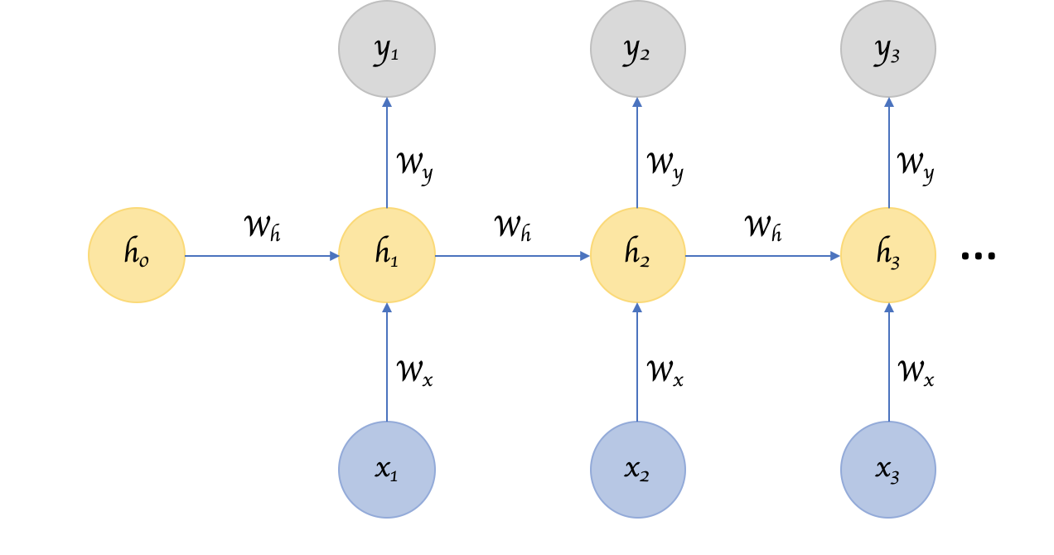
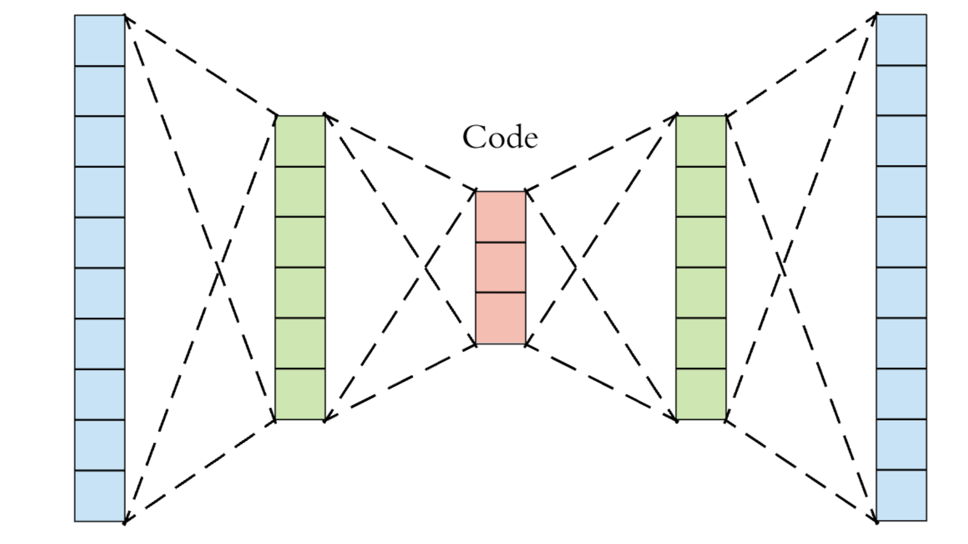
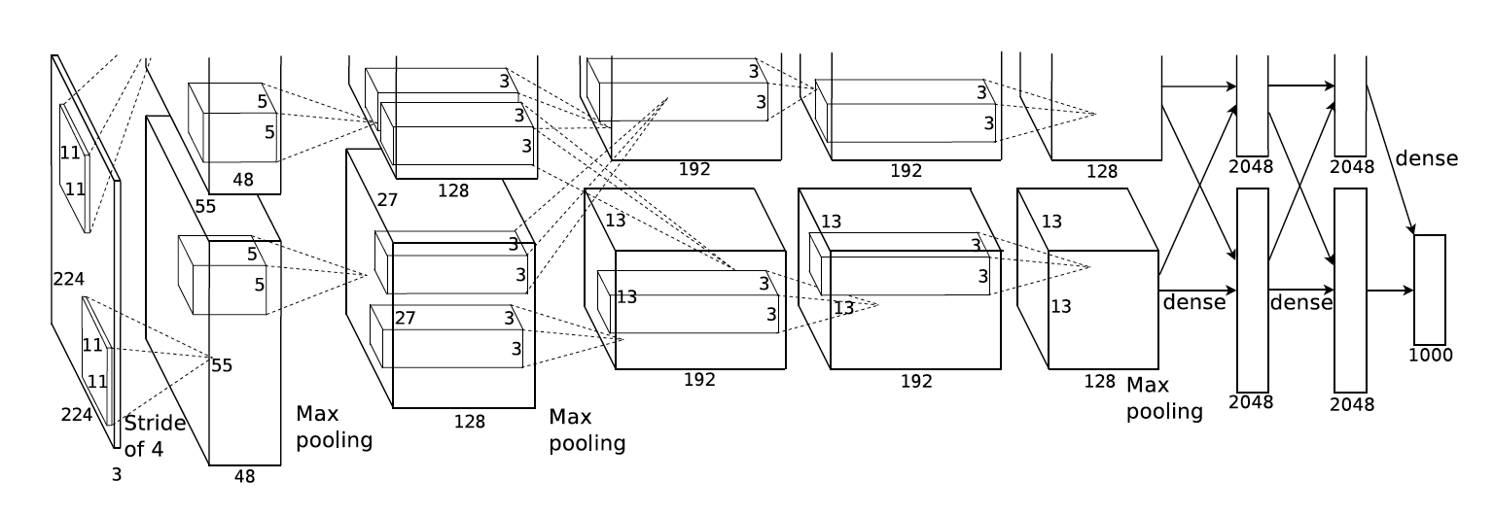
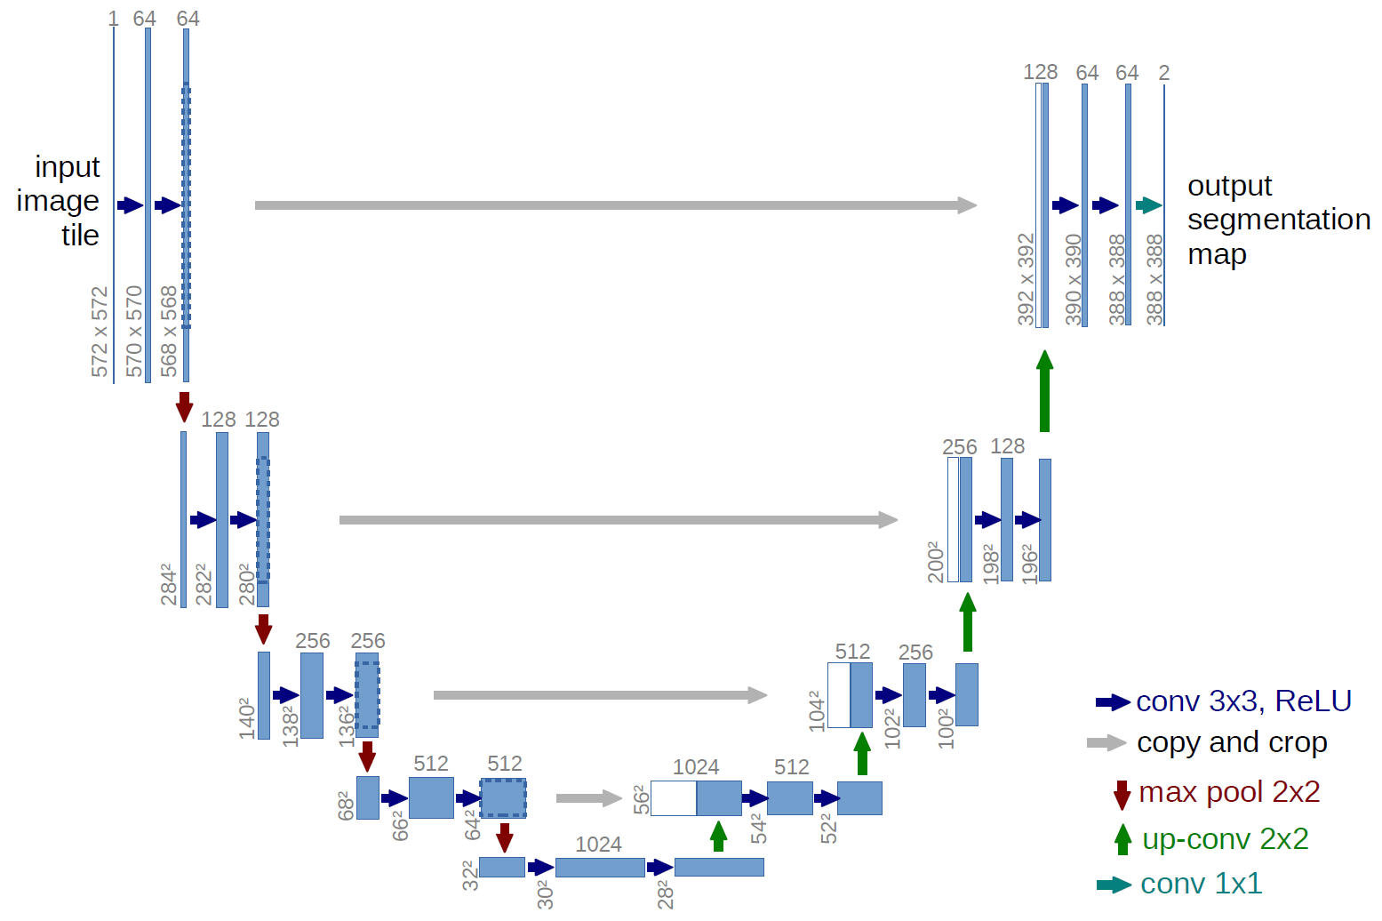
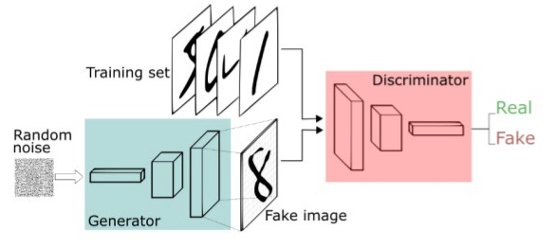
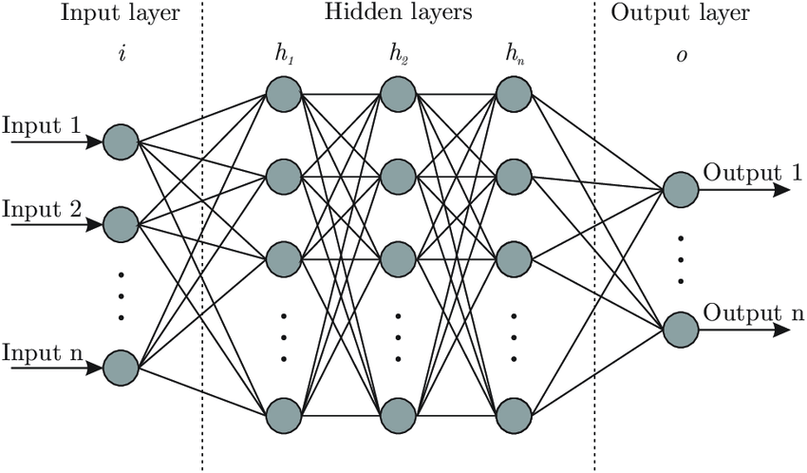
Agenda
Day 1:
Introduction to Deep Learning
Neural Networks
Convolutional Neural Networks for Classification & Segmentation
Day 2:
Recurrent Neural Networks
Autoencoders
Generative Neural Networks

Slide 3
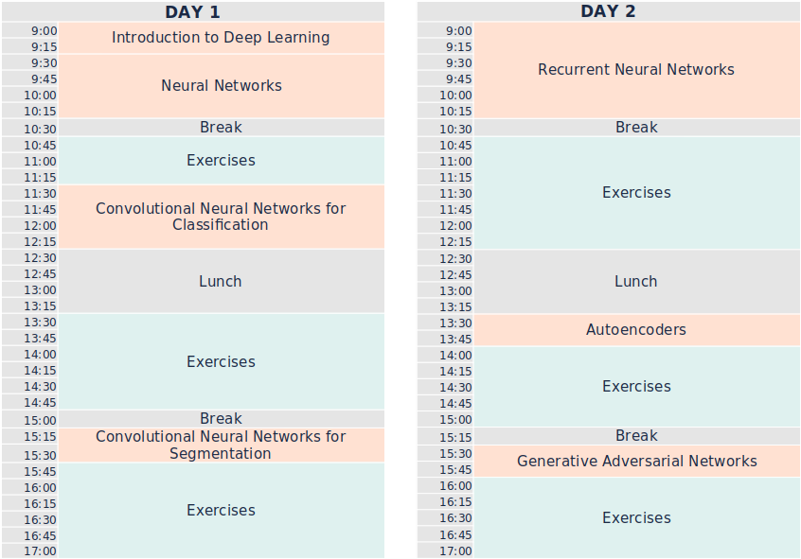

Slide 4
Introduction to Deep Learning

