Slide 1
Deep Learning for Biology
Joris Roels

Slide 2
Conclusion

Slide 3
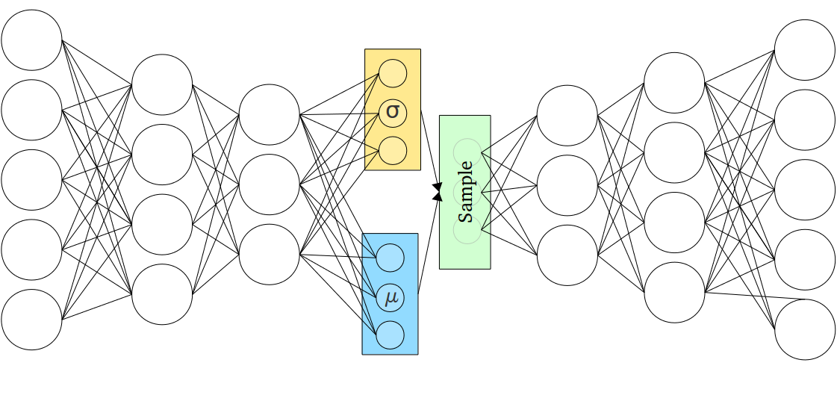
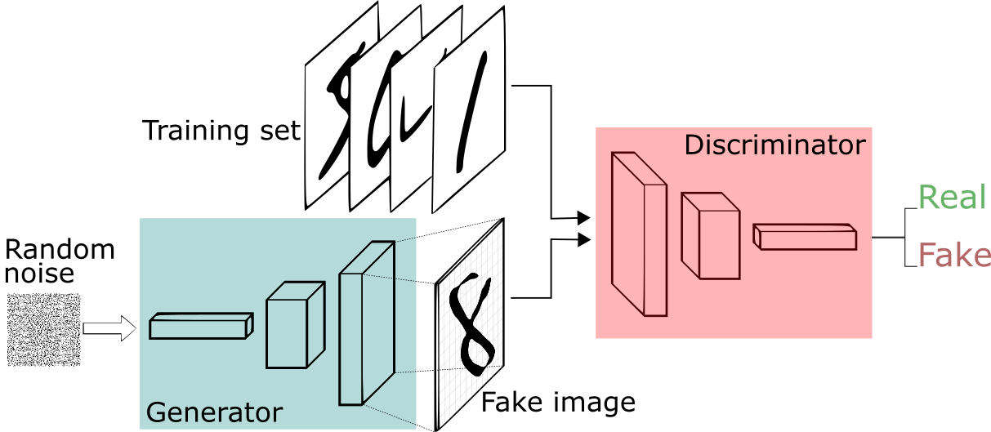
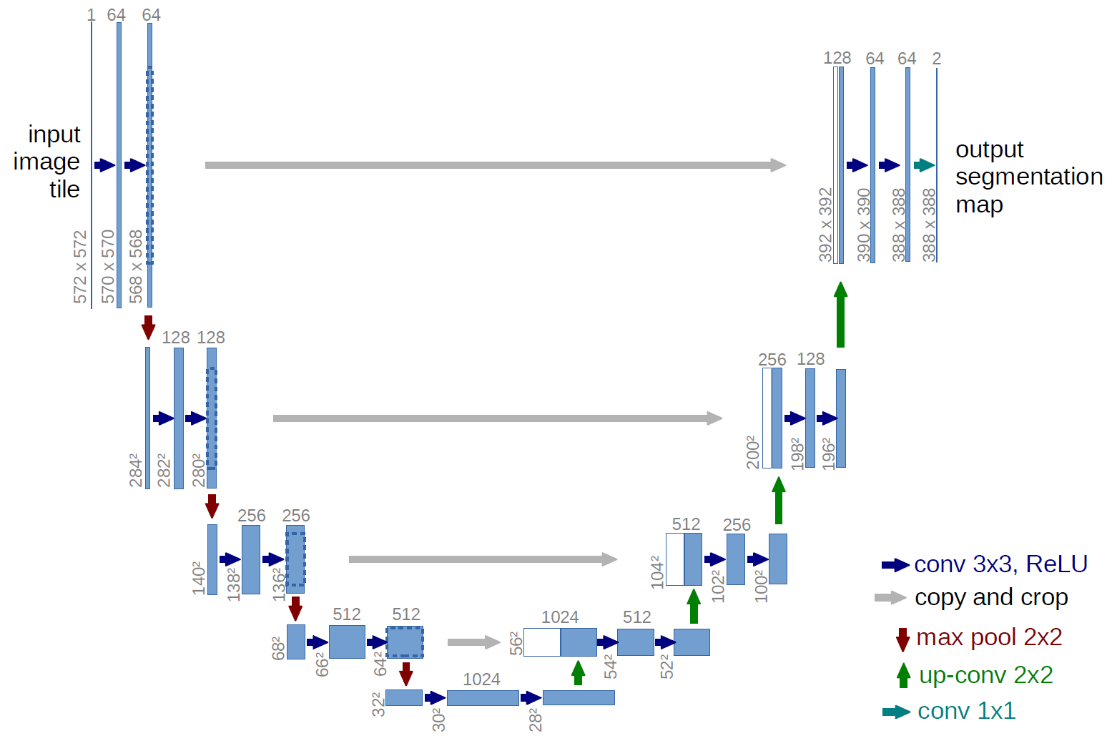
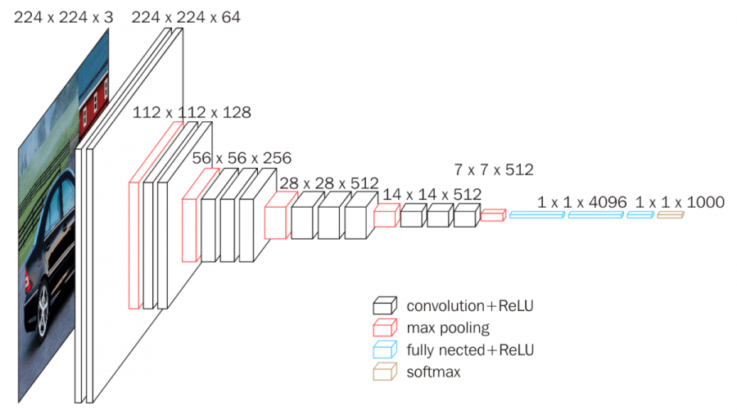
































Deep learning road to solutions
Variational Autoencoder, Generative Adversarial Networks
Sequence
Recurrent Neural Networks, Long Short Term Memory Networks
${\hat{y}}_{t}$
${\hat{y}}_{t}$
$$μ_{x}$$
$c_{t−1}$
$c_{t}$
Sequence or fixed-size data?
$h_{t−1}$
$h_{t}$
Generative
tanh
tanh
$$σ_{x}$$
$$z∼𝒩\left(μ_{x},σ_{x}\right)$$
$h_{t−1}$
$σ$
$σ$
tanh
$σ$
$h_{t}$
Fixed-size
$x_{t}$
$x_{t}$
Discriminative or generative?
Classification or segmentation?
Encoder-Decoder Convolutional Neural Networks
Labeled
Not good enough
➔ Get labels
Labeled or unlabeled data?
Discriminative
Classification
Segmentation
Autoencoders, Deep Clustering Networks
Multi-layer perceptrons, Convolutional Neural Networks
$x_{1}$
${\hat{x}}_{1}$
Unlabeled
$x_{2}$
$h_{1}$
${\hat{x}}_{2}$
$x_{1}$
$h_{1}$
$y_{1}$
$h_{2}$
$x_{2}$
$h_{2}$
$y_{2}$
$$…$$
$$…$$
$$…$$
$h_{m}$
$$…$$
$$…$$
$$…$$
$x_{n}$
${\hat{x}}_{n}$
$x_{n}$
$h_{m}$
$y_{l}$

Slide 4
Deep learning: pros & cons
State-of-the-art performance in most domains
Existing frameworks make implementation relatively easy
Keras
TensorFlow
PyTorch
Large user-community
Code
Data
Pre-trained models
Requires lots of (labeled) data!
Computationally expensive
Typically requires GPU(s)
Training can be time-consuming
Model finetuning requires expertise
Extracted features are hard to interpret
Still lacking some theoretical fundaments

Slide 5
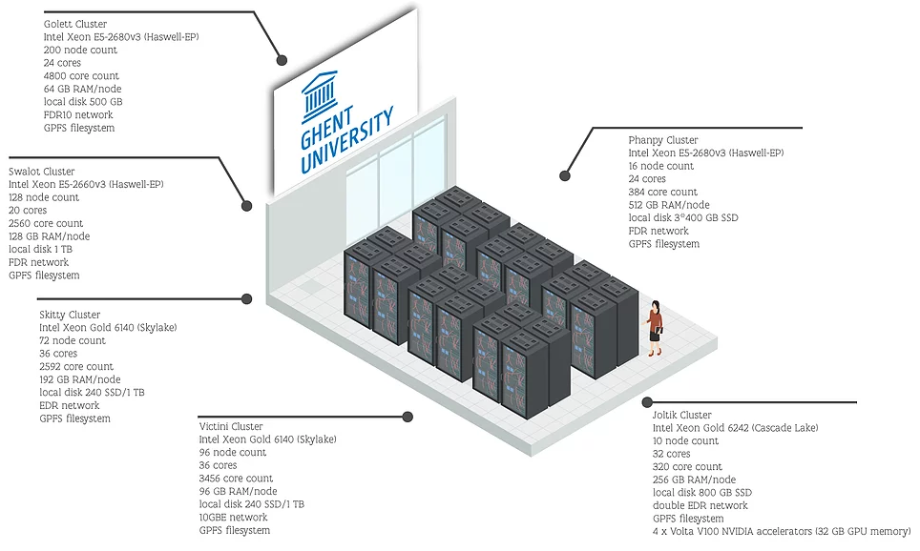
Practical tips
If you want to get started by yourself:
Start simple:
Classical methods (SVM, K-means, PCA, etc.) can perform sufficiently well!
Training a custom neural network:
Start with a small network
Increase the network capacity (wider and/or deeper) to fit the training data
Keep track of overfitting and make the proper adjustments (dropout, data augmentation, batch normalization, etc.)
Need GPU compute resources?
UGent HPC: https://www.ugent.be/hpc/en

Slide 6
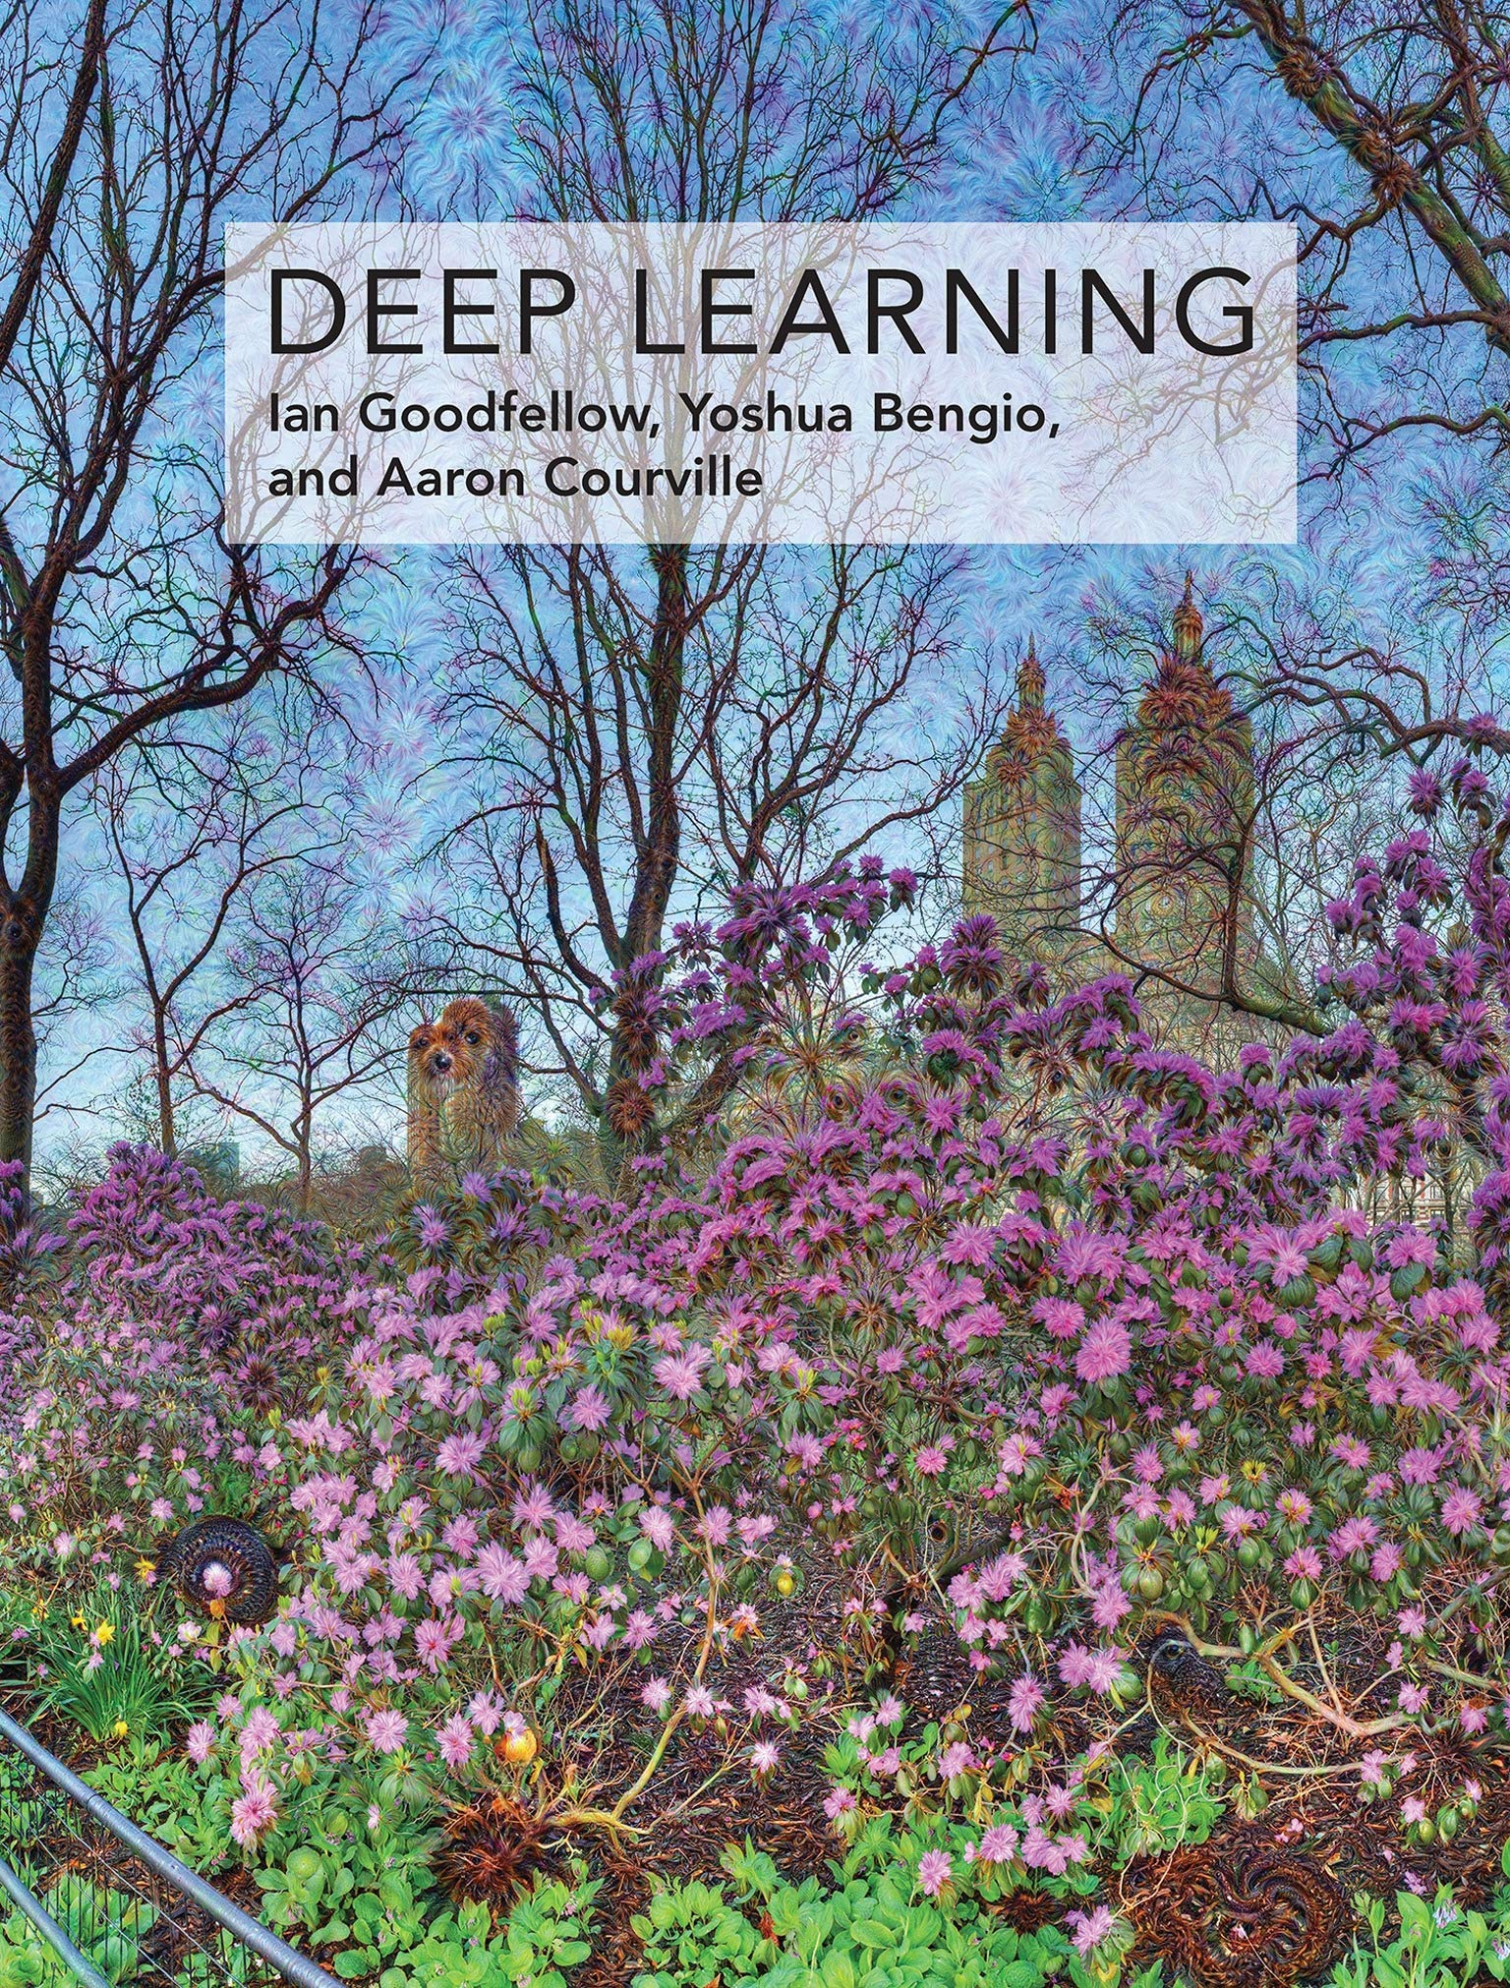
More information
Lots of resources available!
Deep Learning e-book: https://www.deeplearningbook.org/
Practical tutorials in PyTorch: https://pytorch.org/tutorials
Slides and exercises (+ solutions) of this workshop will be online: https://github.com/JorisRoels/deep-learning-biology

Slide 7
Thank you!

