Slide 1











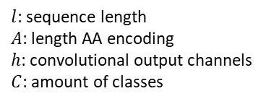



















$x_{1}^{1}$
$x_{1}^{2}$
$$…$$
$x_{1}^{l}$
$h_{1}^{1}$
$h_{1}^{2}$
$$…$$
$h_{1}^{l}$
$x_{2}^{1}$
$x_{2}^{2}$
$$…$$
$x_{2}^{l}$
$h_{2}^{1}$
$h_{2}^{2}$
$$…$$
$h_{2}^{l}$
1D Conv
$$…$$
$$…$$
$$…$$
ReLU
$$…$$
$$…$$
$$…$$
$x_{A}^{1}$
$x_{A}^{2}$
$$…$$
$x_{A}^{l}$
$l$: sequence length
$A$: length AA encoding
$h$: convolutional output channels
$C$: amount of classes
$h_{h}^{1}$
$h_{h}^{2}$
$$…$$
$h_{h}^{l}$
$y_{1}^{1}$
$y_{1}^{2}$
$$…$$
$y_{1}^{l}$
$y_{2}^{1}$
$y_{2}^{2}$
$$…$$
$y_{2}^{l}$
Linear
Linear
LSTM
$$…$$
$$…$$
$$…$$
ReLU
$y_{C}^{1}$
$y_{C}^{2}$
$$…$$
$y_{C}^{l}$

