Slide 1
Week 0
Joris Elfferich

Slide 2
Progressie
Alternatieven afweging authenticatie:
- Smart cards (NFC)
- Biometrisch
- 2FA
Alternatieven opslaan
- Database
- Lokaal
- Blockchain

Slide 3
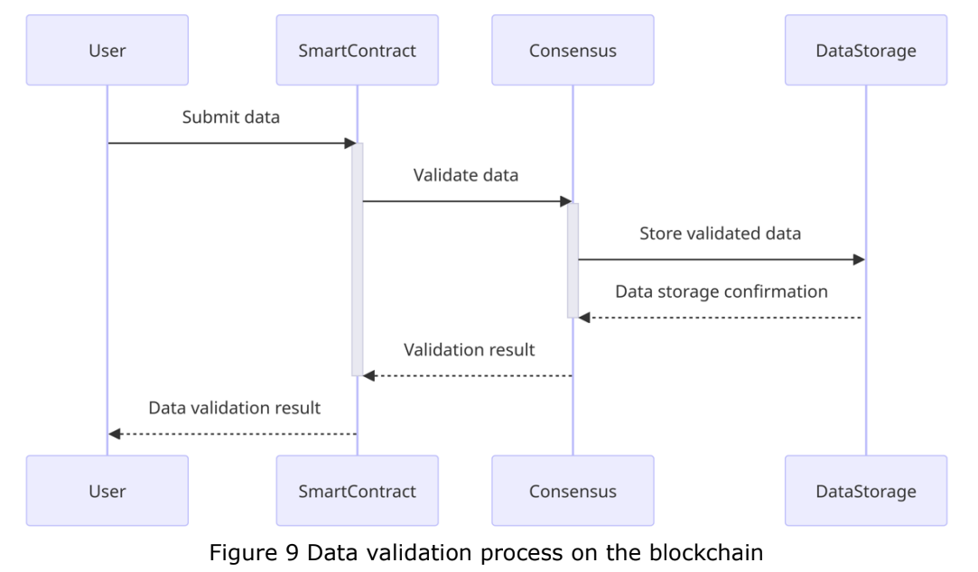
Vragen
“The inventory that relates to the IHM information will be transmitted to every stakeholder. This also makes the data decentralized. A consensus mechanism will be used in this phase so that every alteration of the inventory can be validated by every ledger holder, which is the stakeholder.”
Blockchain alleen toegankelijk via schip?
Hoe authoriseren we de juiste mensen?
Voorbeeld IHM

