Slide 1

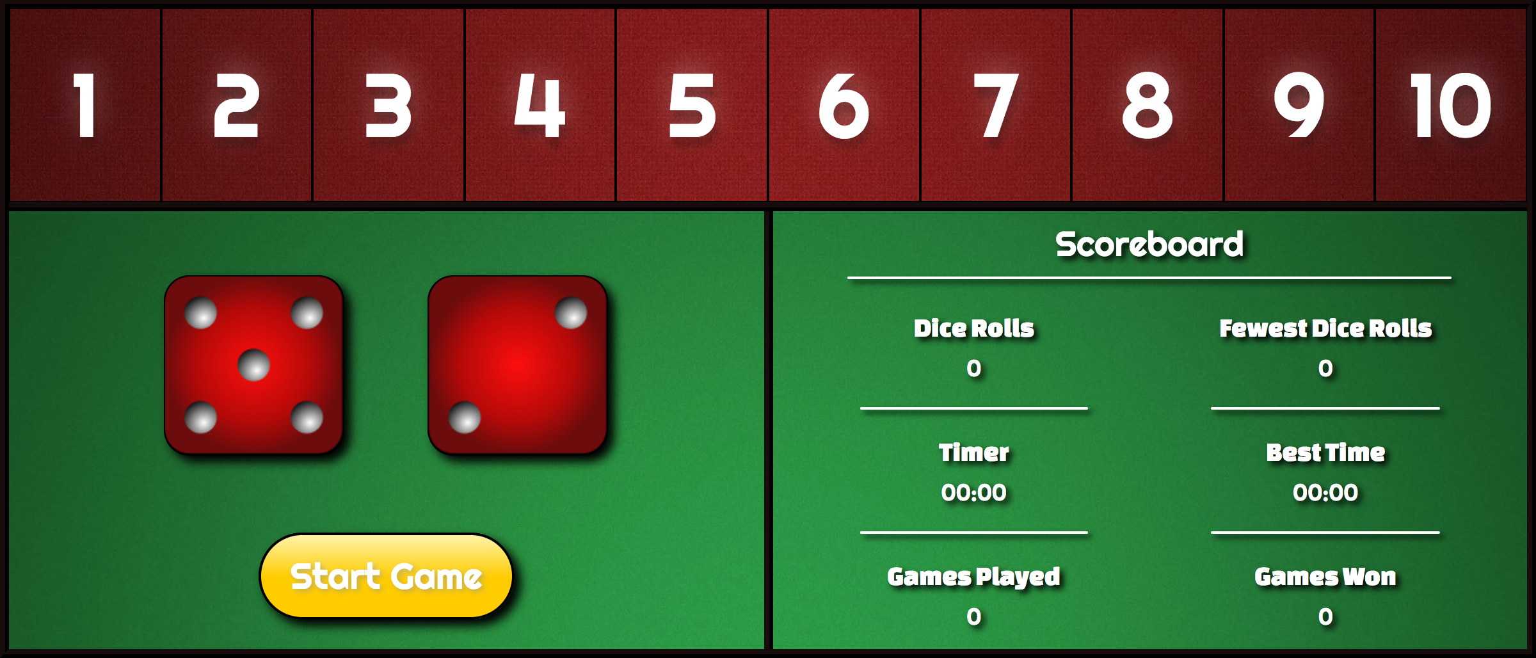
WDI Project 1: Flip The Box
A single page web app
designed by Mark Ledbetter

Slide 2
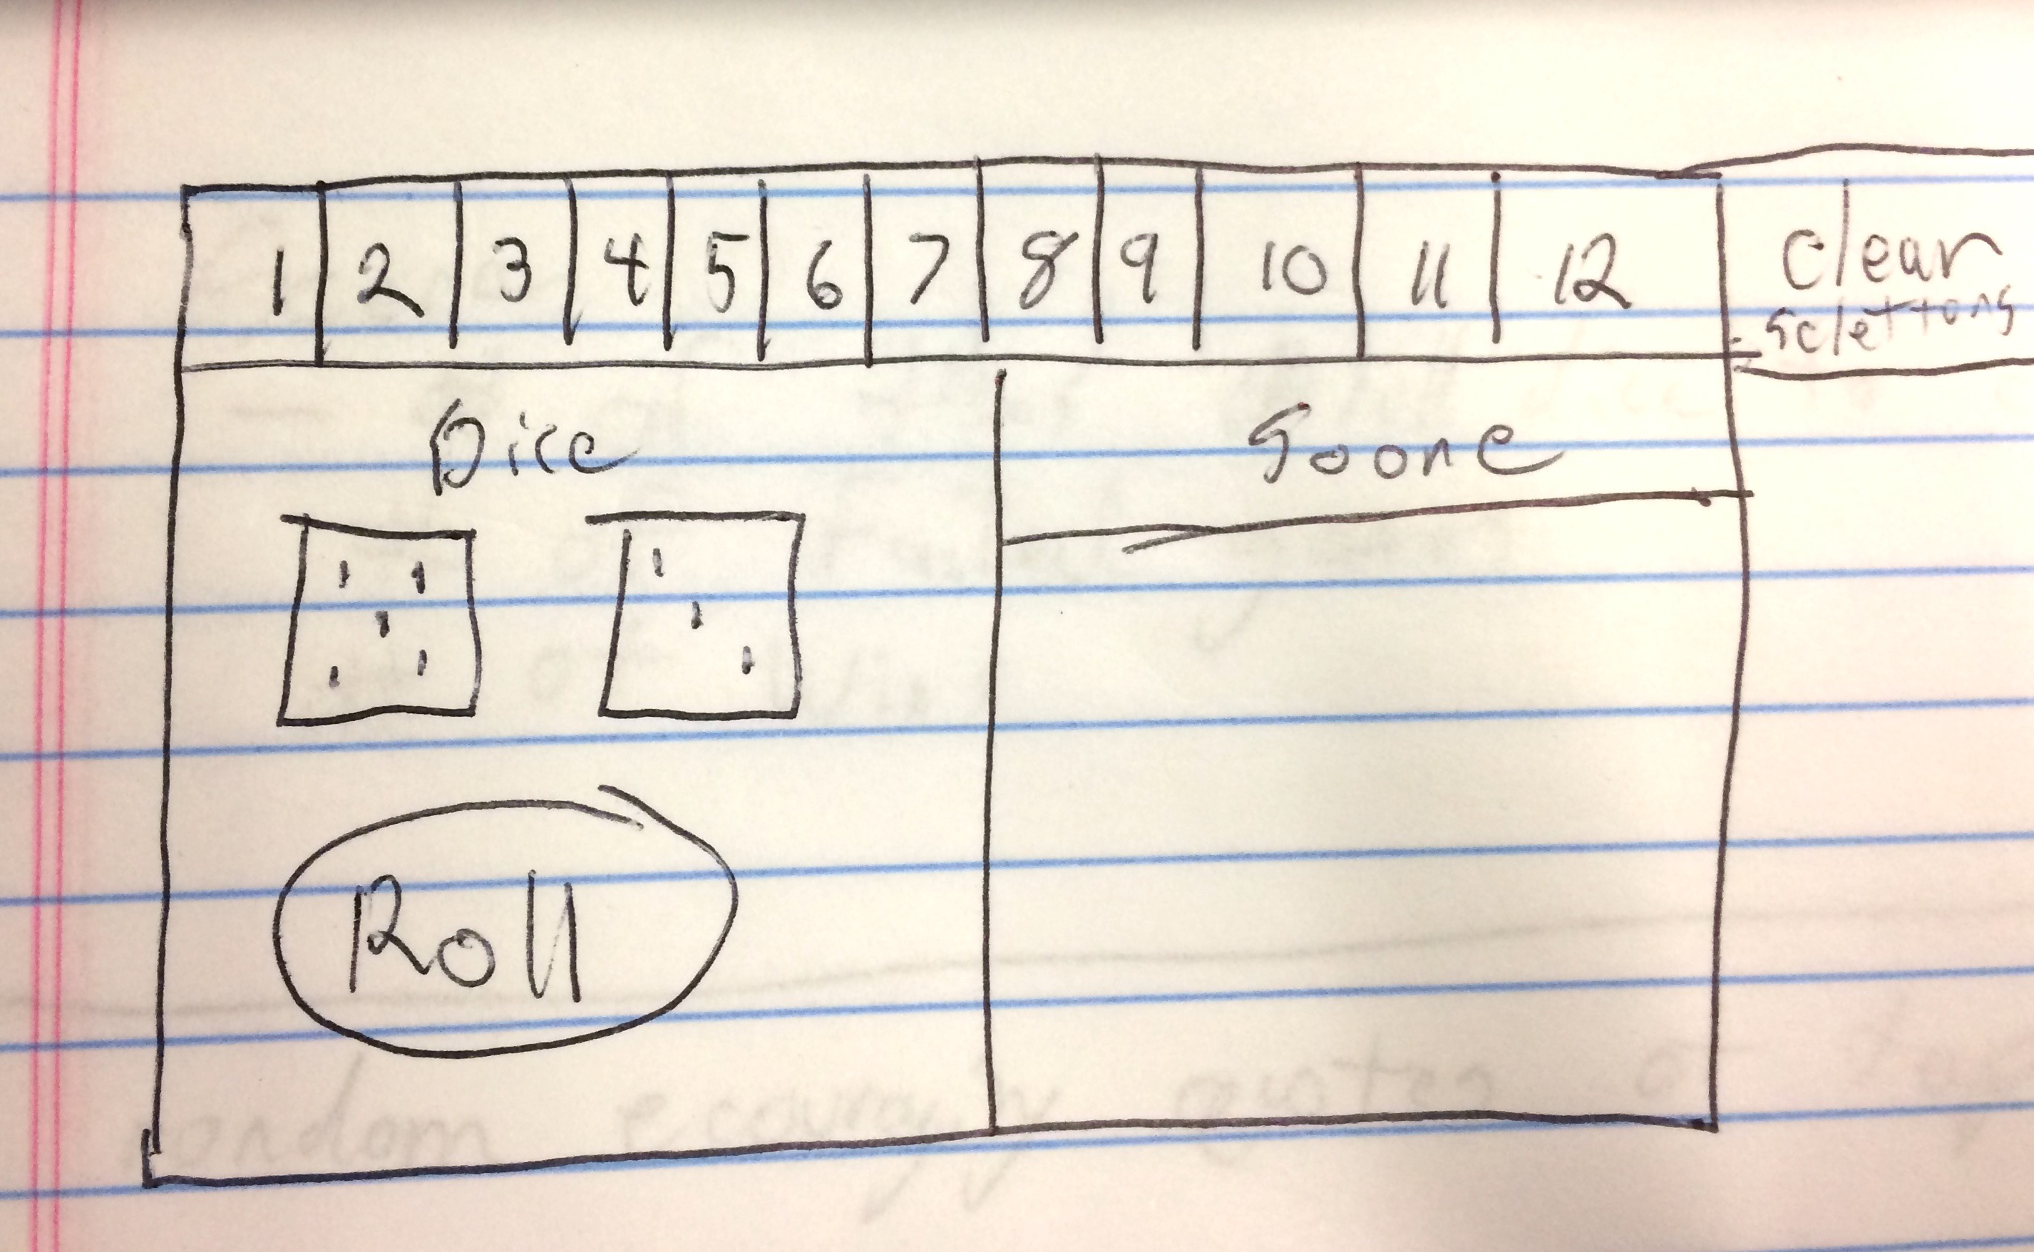
Project Overview
The inspiration for the game came from my childhood. My grandmother had this game and it was one of the few toys she had at her house for my brother and I to play with. So it seemed like a great fit for this project, to take a favorite game from my childhood and modernize it into a web app.
In addition to replicating the functionality of the game, one of my goals was to recreate the look and feel of the game using CSS and flex. Creating a responsive design that also had dimension and animation.
I was able to achieve a lot more functionality that I had originally planned including sound effects, the Scoreboard and custom popups for the alerts and game instructions.

