Slide 1
Introduction to Futter with Spring Security
By Dobri Tsvetkov and Georgi Sotirov

Slide 2
Traditional app development
Numerous platforms and need of different apps
Problems with native app development
Other cross-platform frameworks

Slide 3
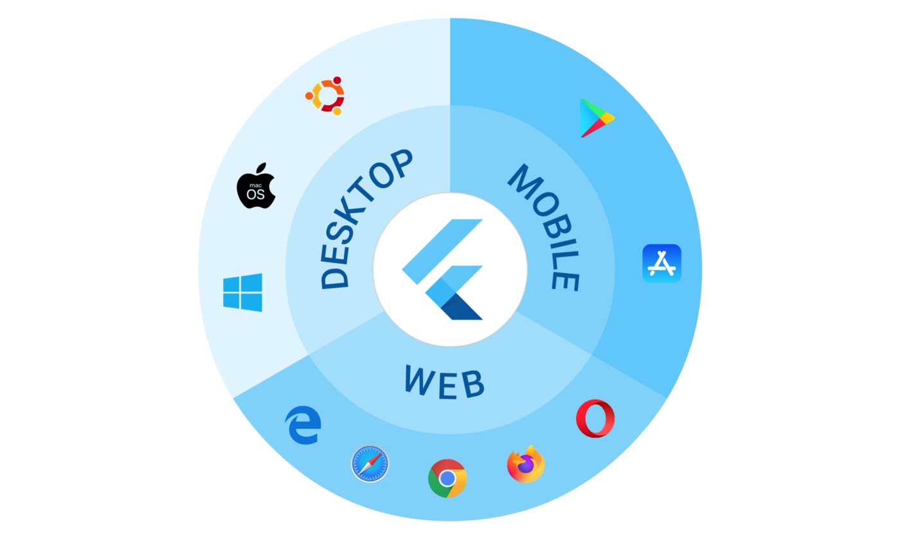
Flutter
Open-source UI software development kit created by Google
Dart - object-oriented, class-based, garbage-collected language with C-style syntax

Slide 4
Demo
DEMO

Slide 5
Thank you!

