Slide 1
Introduction to Futter with Spring Security
By Dobri Tsvetkov and Georgi Sotirov

Slide 2

Why cross platform?
Native is good.
Broad Functionality
Sleek UI
High performance
BUT
Native is expensive!
Slower to develop
More difficult to maintain
Inconsistent across platforms
Notes:
Functionality - Native apps built for a particular operating system have direct access to the device's hardware, such as camera, microphone, and GPS location support.
UI. Mobile engineers develop native apps using native SDKs, which makes the UI look consistent. The interfaces of native apps are designed to work well with a specific platform, which makes them feel like an integrated part of the device and provides a more intuitive user experience.
High performance. The core programming language and APIs used to build native apps make them fast and responsive.

Slide 3
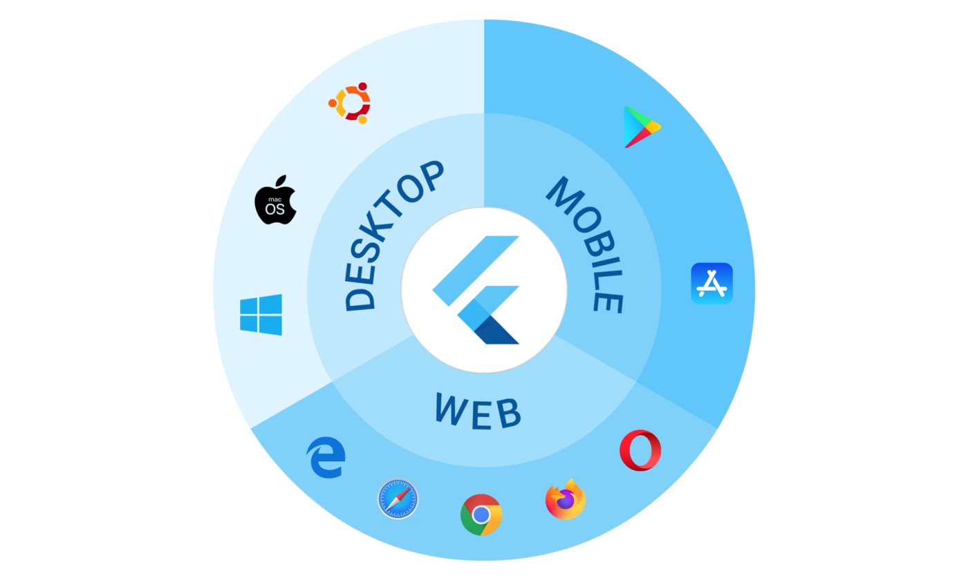
Flutter
Open-source UI software development kit created by Google
Dart - object-oriented, class-based, garbage-collected language with C-style syntax

Slide 4
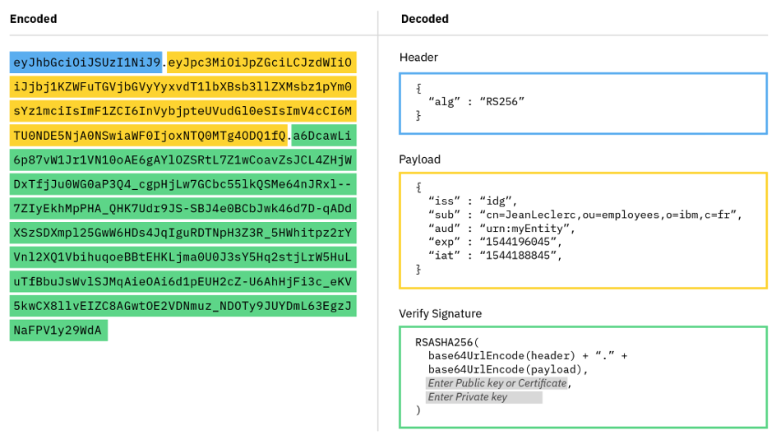
Spring Security
Authentication/Authorization
Password Storage
JWT
Header
Payload
Signature
Notes:
1. What is Spring Security
In simple words, Spring security provides authentication and authorization to our application using simple servlet filters. Web applications are susceptible to security threats and attacks, as they are accessible by anyone uses the internet. There may exist some REST endpoints having restricted access to specific users, for example, updating records or admin related operations.
We can use spring security to secure URLs. Spring Security is a security framework that secures J2EE-based enterprise applications, by providing powerful, customizable security features like authentication and authorization. It is the de facto standard for securing Spring-based applications.
Spring security works on the following three core concepts
Authentication.
Authorization
Password Storage
1.1. Authentication:
Used to verify if a user using an application by providing valid credentials used to verify who you are! Authentication is establishing identity of a principal (user, system, that can perform an action in an application).
1.2. Authorization:
This is besides the authentication. For a simple application, authenticating user might be enough, but let’s think about a big enterprise application.
A normal employee (e.g. Call center agent) may have only limited permission to carry out certain operations.We don’t want to allow this employee to perform other operations
Our back-end product manager allowed to work only on the products. We don’t allow product manager to change customer information or order information.
Ecommerce manager can work on both customer and order information, but they can’t change product information.
System admin can perform all the operations.
With simple authentication, we can’t restrict logged in user as we don’t have information about user privileges or permissions. Authorization helps to provide this information before the user tries to access a resource. It is a process of access control, deciding whether it allows a principal to perform an action (access-control → admin, user, leader, manager, contractor, anonymous etc) or not.
1.3 Password Storage
Making sure that our passwords are secure and difficult to hack is another primary goal of any security framework. Spring Security’s PasswordEncoder interface perform one way transform for the password (We can’t decrypt the password).Spring Security provides several PasswordEncoder, Here is a list for your reference:
BCryptPasswordEncoder.
Argon2PasswordEncoder.
Pbkdf2PasswordEncoder
SCryptPasswordEncoder.
JWT - https://jwt.io/introduction
Signature - The signature helps ensure that the data in the header and payload segments haven't been tampered with, and the JWT can be trusted. However, it's important to note that the cryptographic signature at the end of the JWT is just for validation. It doesn't encrypt any data in the header or payload segments of the token. So you should never send sensitive information like a user's password in a JWT – everything in the header and payload can and should be public.

Slide 5
Demo
DEMO

Slide 6
Thank you!

