Slide 1
Introduction to Futter with Spring Security
By Dobri Tsvetkov and Georgi Sotirov

Slide 2
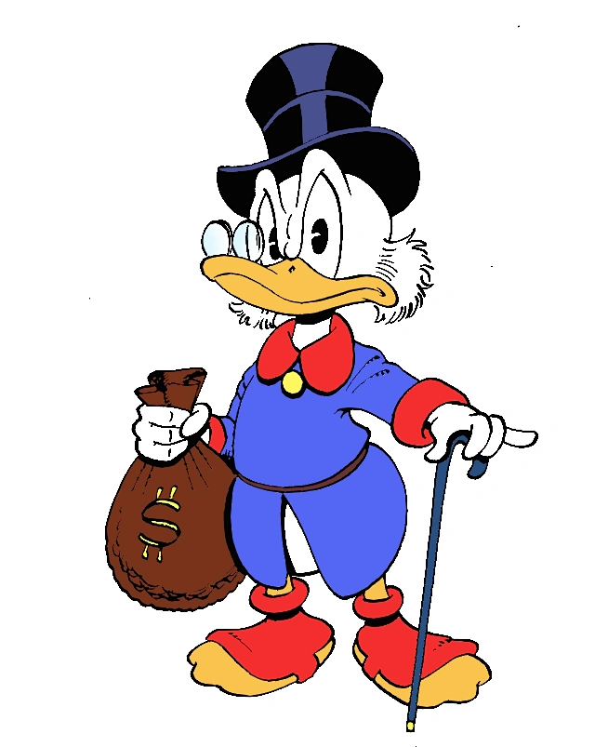
Native app development
1. Numerous platforms and need of different apps
2. Native is expensive!
Slower to code
More difficult to maintain

Slide 3
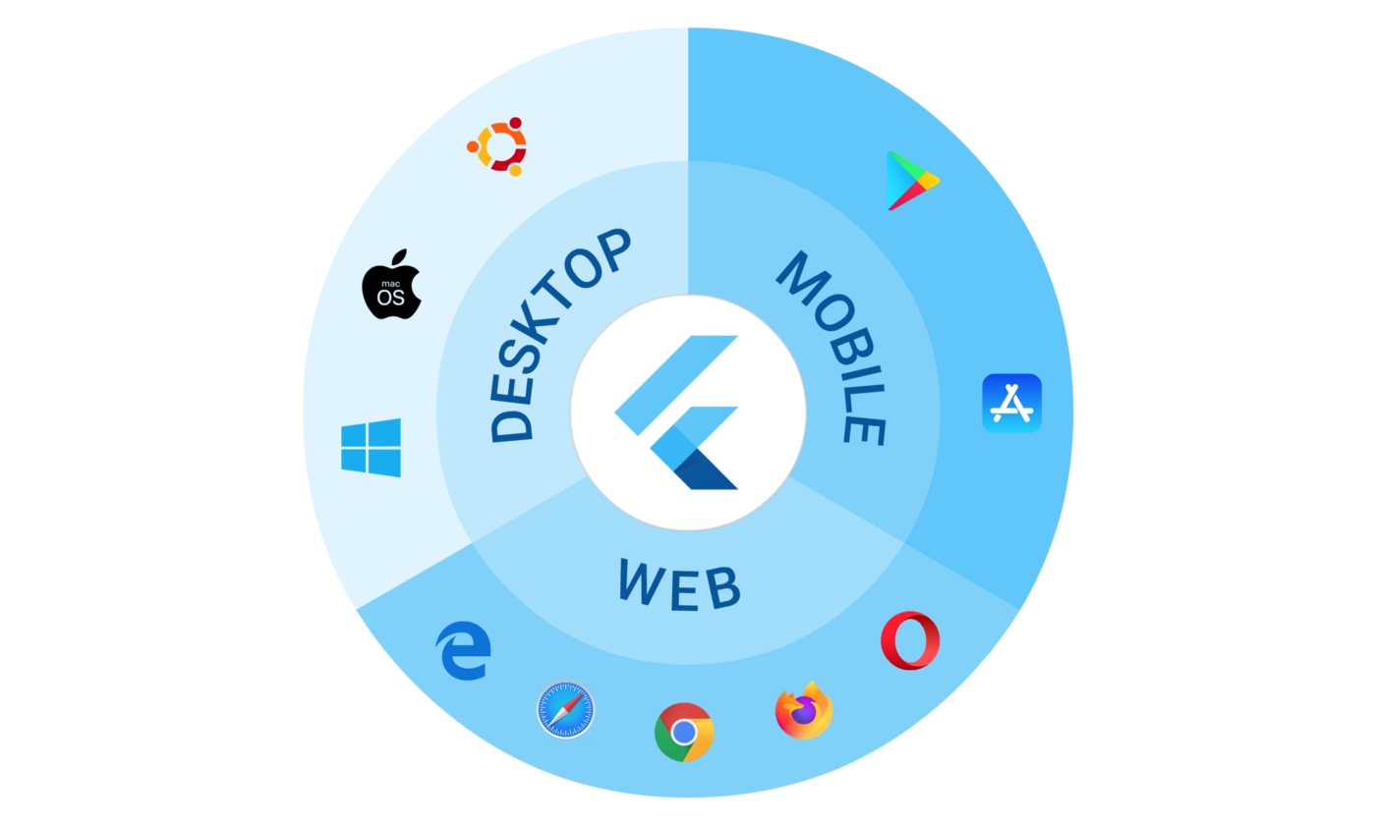
Flutter
Open-source UI software development kit created by Google
Dart - object-oriented, class-based, garbage-collected language with C-style syntax

Slide 4
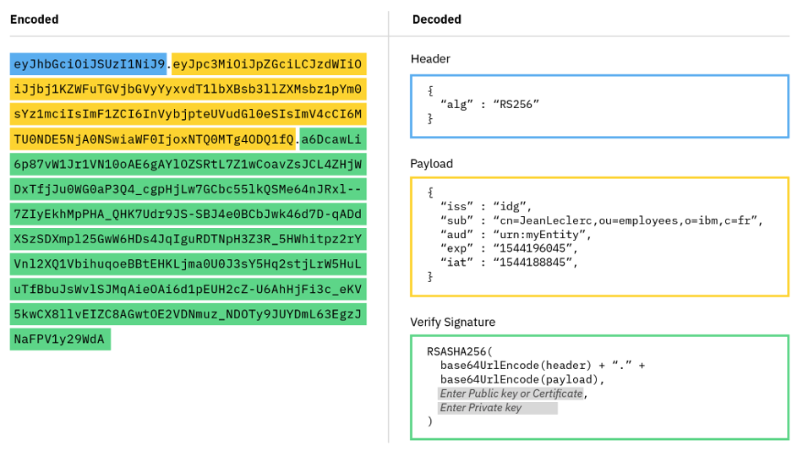
Spring Security
Authentication
Authorization
JWT
Header
Payload
Signature

Slide 5
Demo
DEMO

Slide 6
Thank you!

