Slide 1


HOME MADE AUDIO AMPLIFIER
Jorge Contreras Ortiz
David Grande Gil

Slide 2
Index
Aim of the Project
Amplifier Parts
Design Process
Power Supply
Audio Amplifier
Layout
BOM and Ticket of materials
Testing

Slide 3
Aim of the project
The aim of this project is to design and build a Stereo Audio Amplifier, using Altium Designer and following the next steps:
Schematics and Layout Design.
Selection and purchase of components.
Gerber files generation and PCB fabrication
Assembling the PCB.
Testing the PCB.

Slide 4
Specifications
Power Supply System:
It will regulate from 230 Vac to 9 Vdc.
Current supply: 1 A minimum (calculated from Audio Amplifier specifications).
Audio Amplifier:
Stereo.
Guitar audio amplifier.
Mobile Phone Connection.

Slide 5
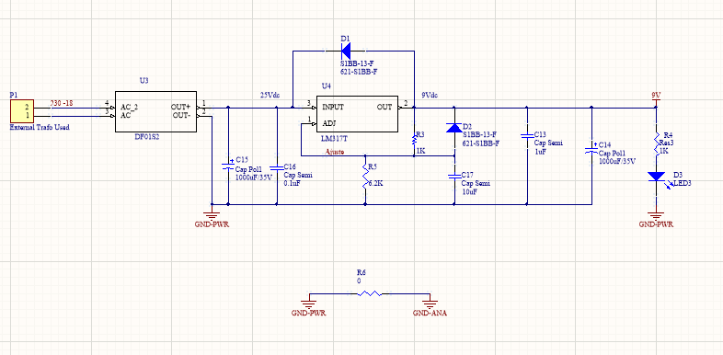
Power Supply

Slide 6
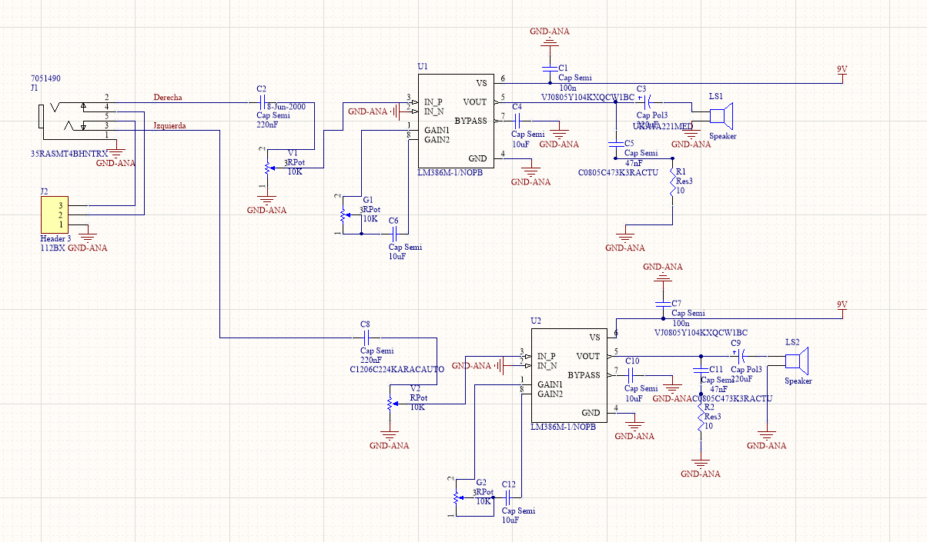
Audio Amplifier

Slide 7
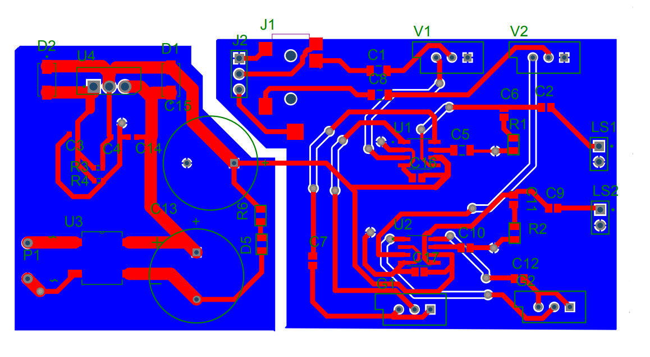
Initial Layout

Slide 8
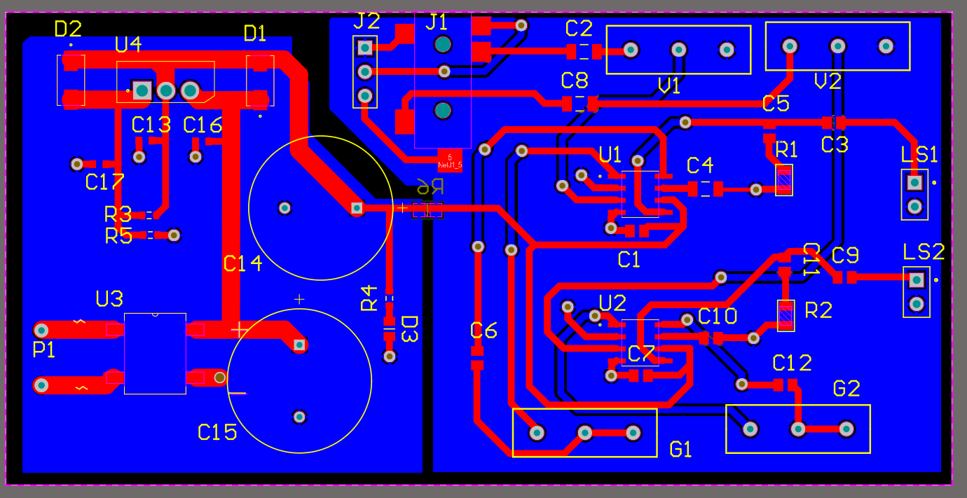
Final Layout

Slide 9
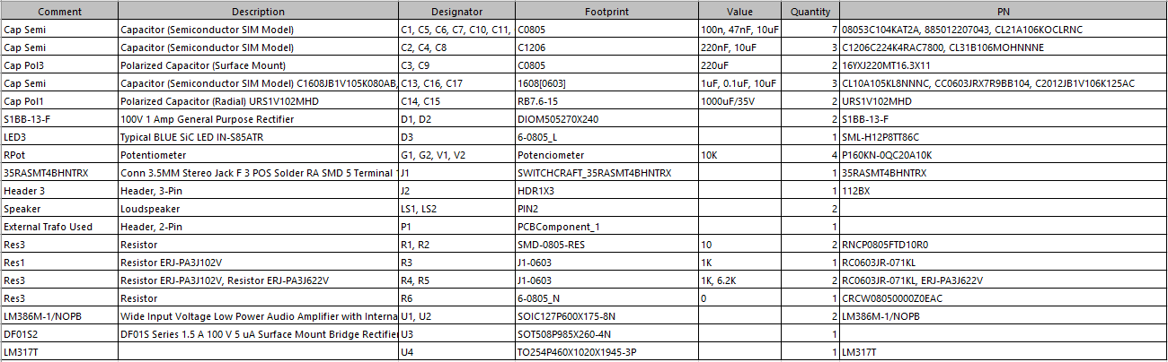
BOM

Slide 10
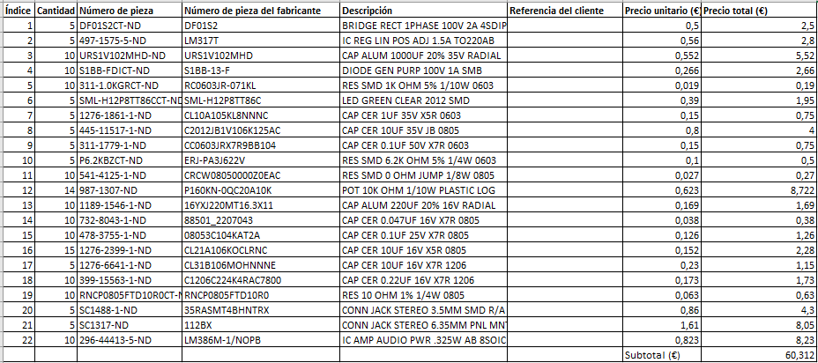
Ticket from Digikey
5 PCB Bought: 8,20 €; Customs: 16,45€; Total = 84,96 € for 5 PCB; Total €/PCB = 16,99€

Slide 11
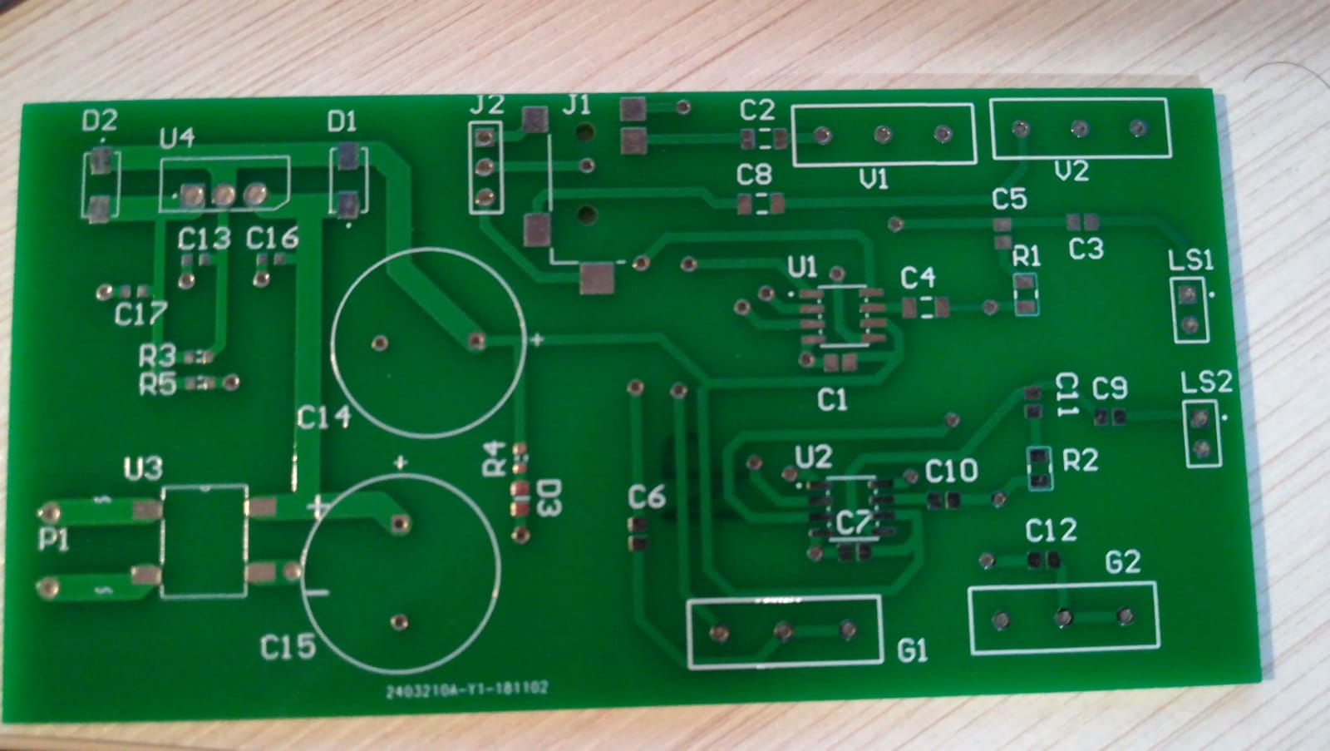
PCB Without Components

Slide 12
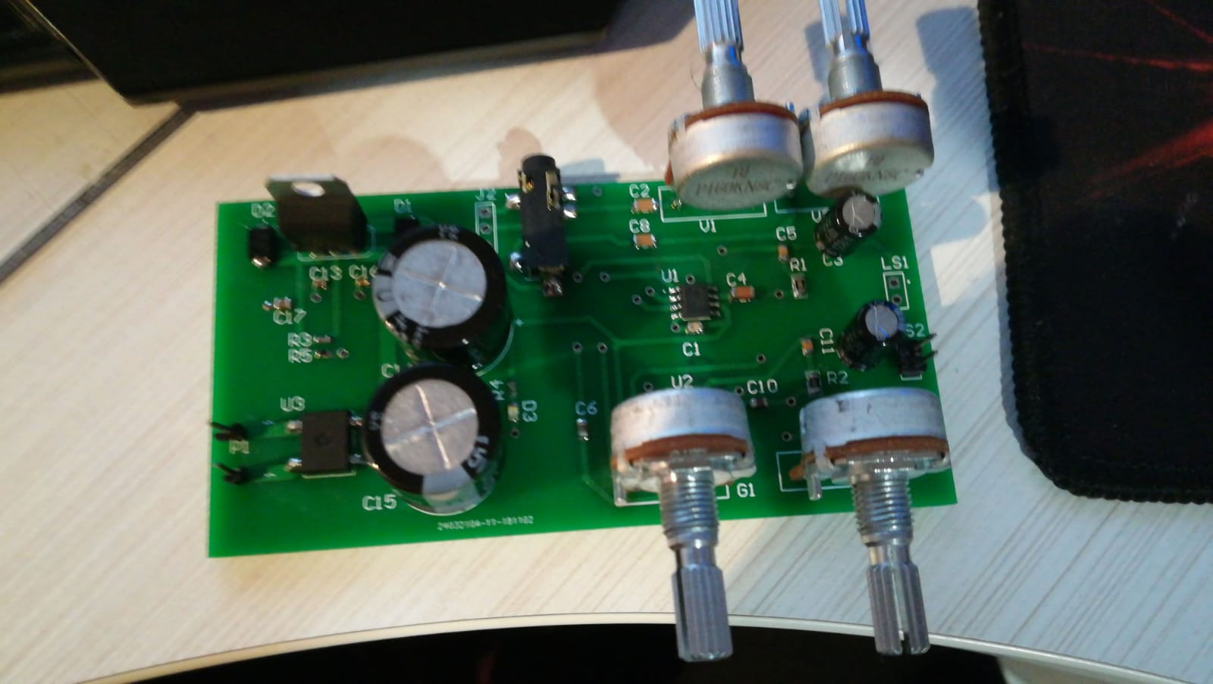
PCB With Components

Slide 13
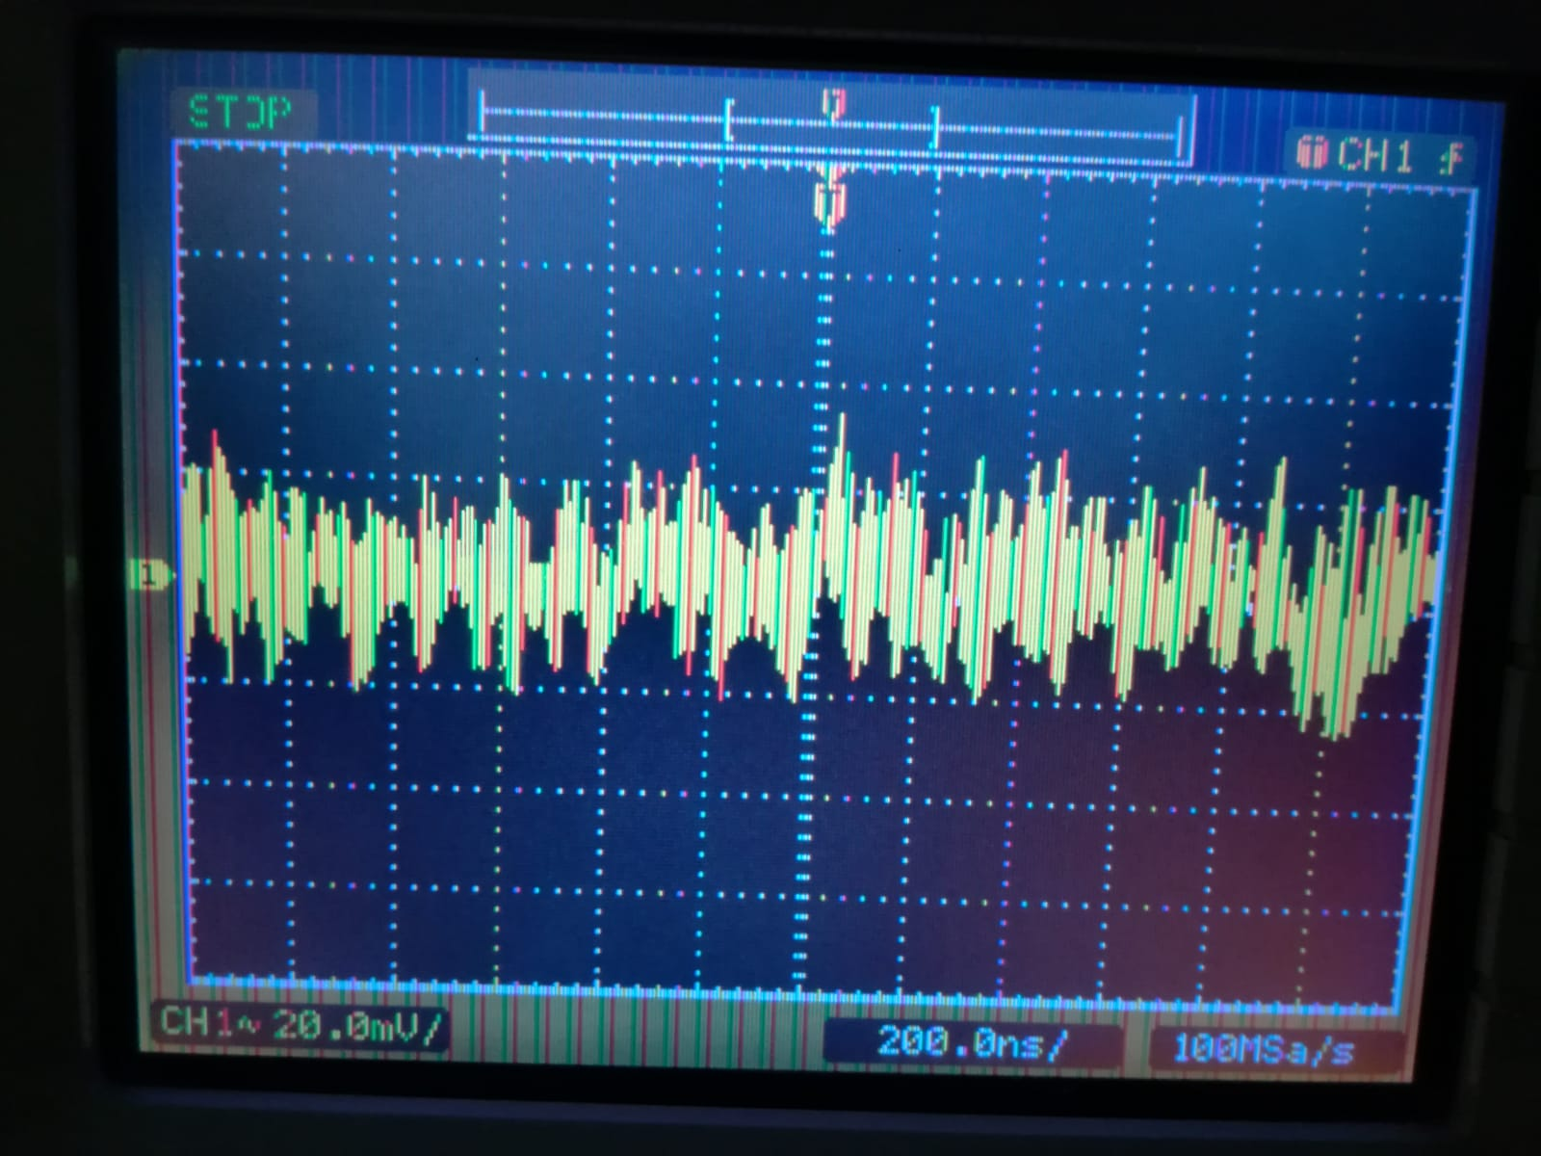
Testing
Power Supply Testing.
Voltage measured at the output of the LDO: 9.2 V.
Ripple Voltage: 20 mV
Audio Amplifier Testing.
Good Quality with Jack 3.5 mm and music from Mobile Phone connected.
A little noise and distortions with Jack 6.35 mm and the Electric Guitar connected.
Checked that when is connected only the guitar and it is connected something to the 3.5 mm Jack, the Jack 6.35 is disconnected from the circuit.

Slide 14
Questions and Comments

