Slide 1


HOME MADE AUDIO AMPLIFIER
Jorge Contreras Ortiz
David Grande Gil

Slide 2
Index
Specifications
Amplifier Parts
Design Process
Power Supply
Audio Amplifier
Layout
BOM and Ticket of materials
Testing

Slide 3
Specifications
Power Supply System:
It will regulate from 230 Vac to 9 Vdc.
Current supply: 1 A minimum (calculated from Audio Amplifier specifications).
Audio Amplifier:
Stereo.
Guitar audio amplifier.
Mobile Phone Connection.

Slide 4
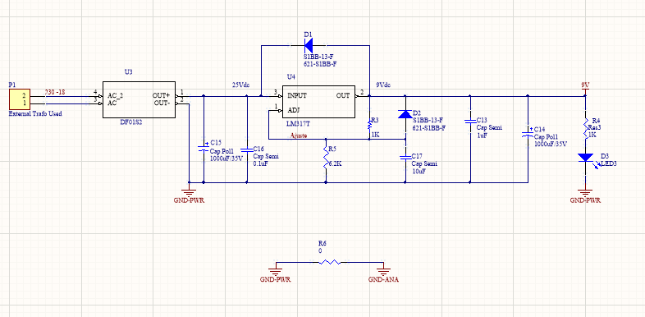
Power Supply

Slide 5
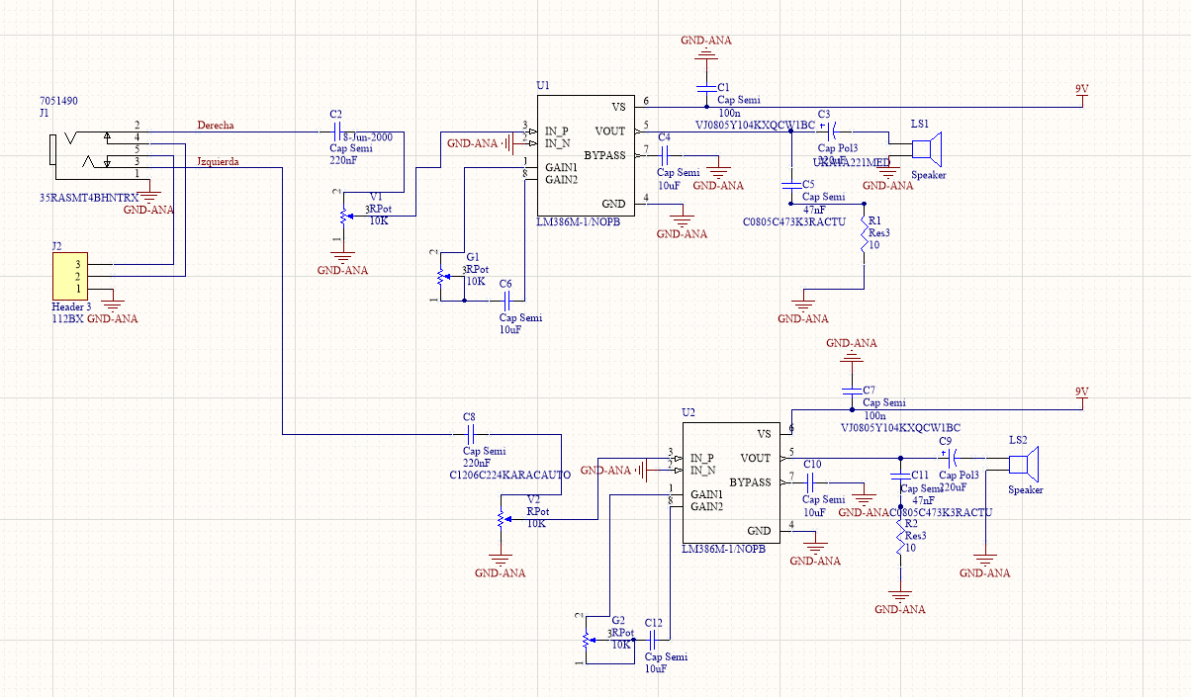
Audio Amplifier

Slide 6
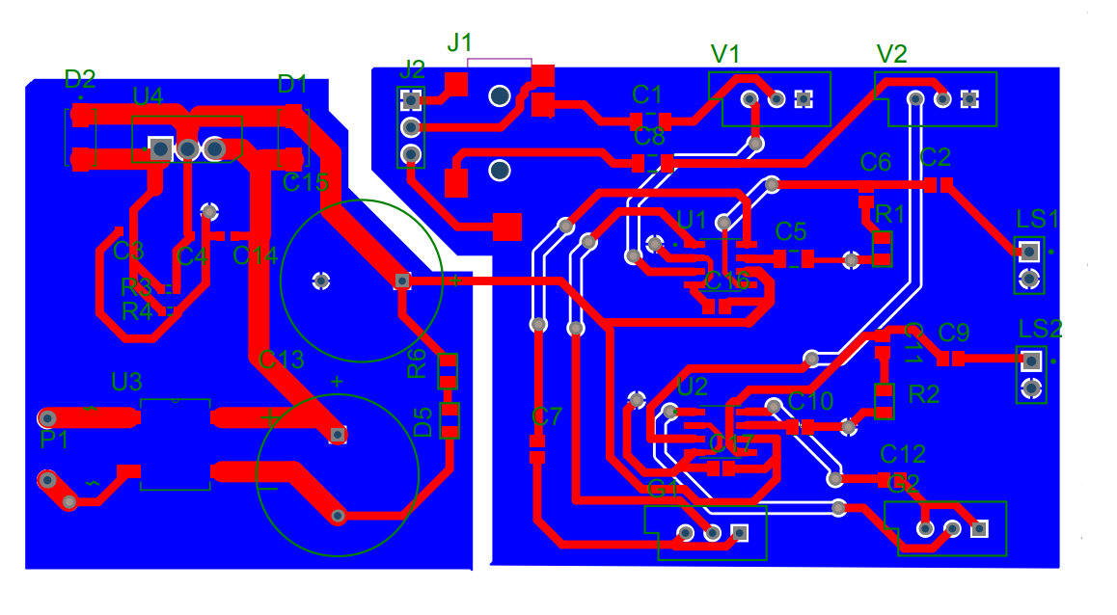
Initial Layout

Slide 7
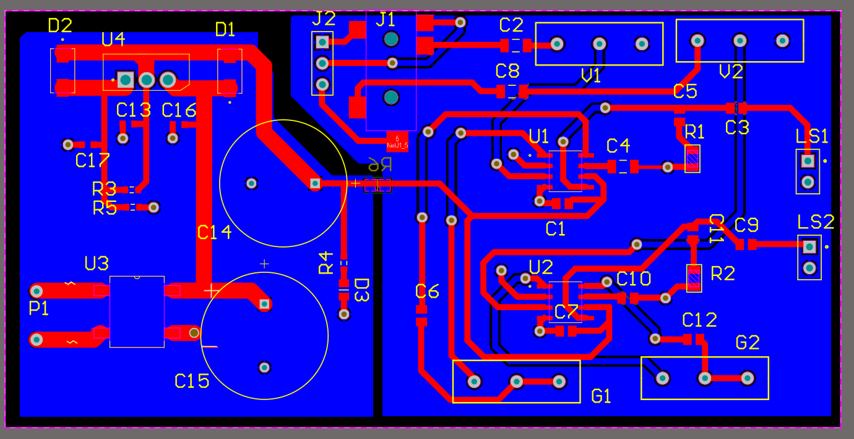
Final Layout

Slide 8
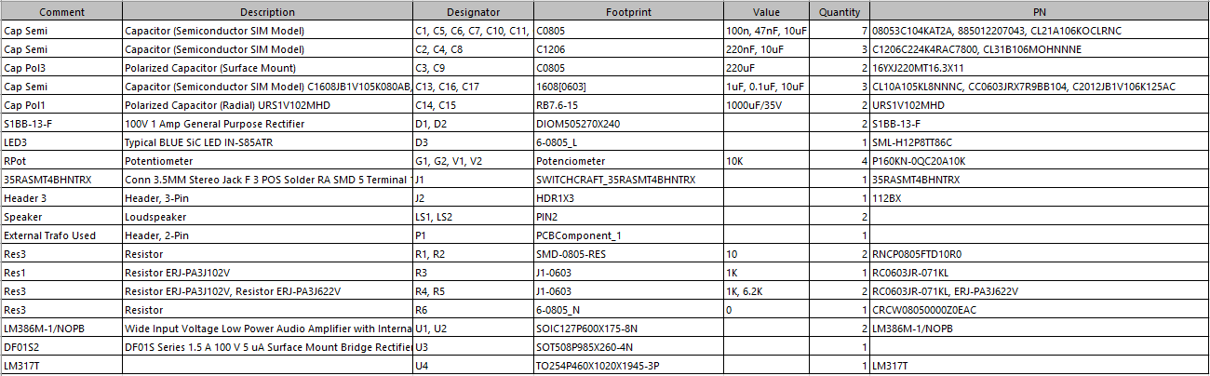
BOM

Slide 9
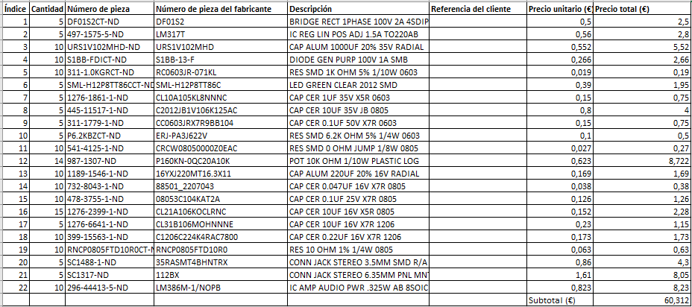
Ticket from Digikey
5 PCB Bought: 8,20 €; Customs: 16,45€; Total = 84,96 € for 5 PCB; Total €/PCB = 16,99€

Slide 10
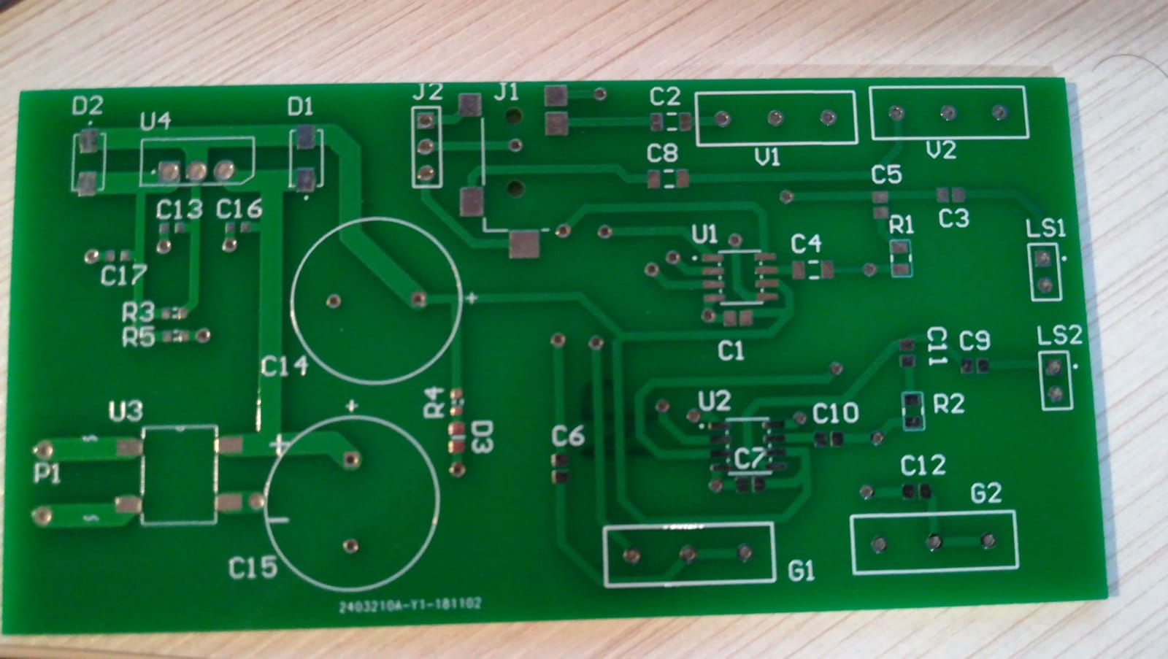
PCB Without Components

Slide 11
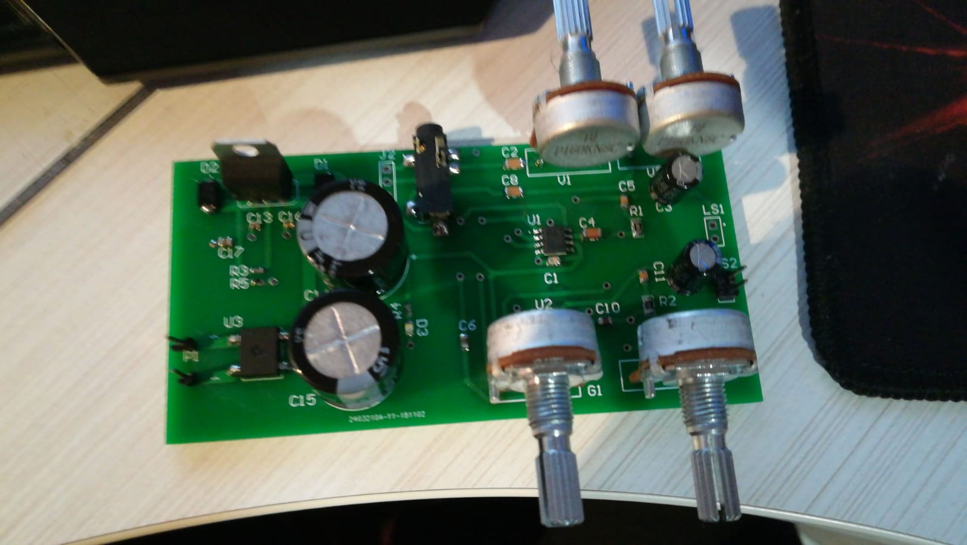
PCB With Components

Slide 12
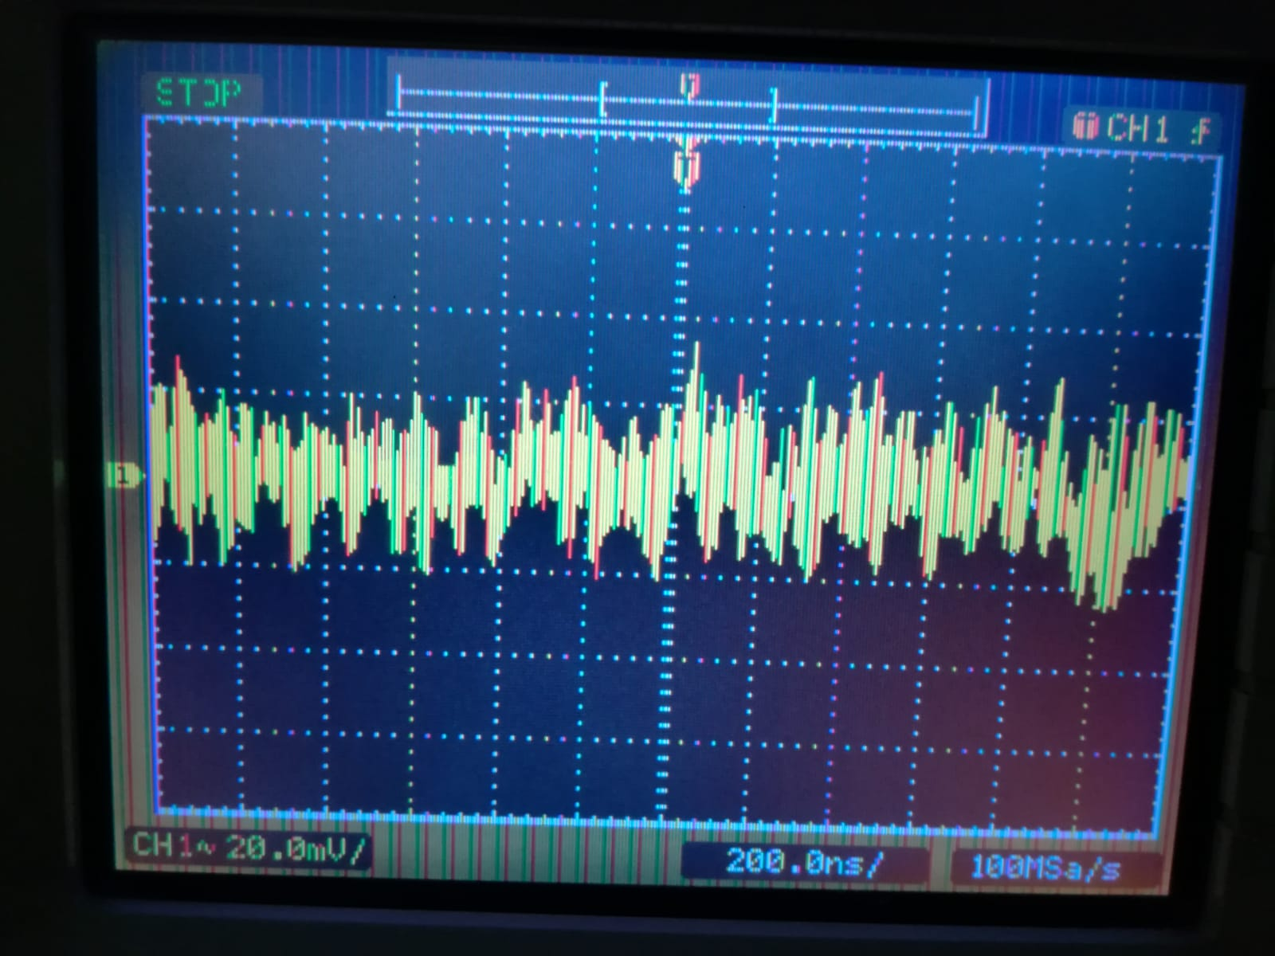
Testing
Power Supply Testing.
Voltage measured at the output of the LDO: 9.2 V.
Ripple Voltage: 20 mV
Audio Amplifier Testing.
Good Quality with Jack 3.5 mm and music from Mobile Phone connected.
A little noise and distortions with Jack 6.35 mm and the Electric Guitar connected.
Checked that when is connected only the guitar and it is connected something to the 3.5 mm Jack, the Jack 6.35 is disconnected from the circuit.

Slide 13
Questions and Comments

