Slide 1
Data visualization

Slide 2
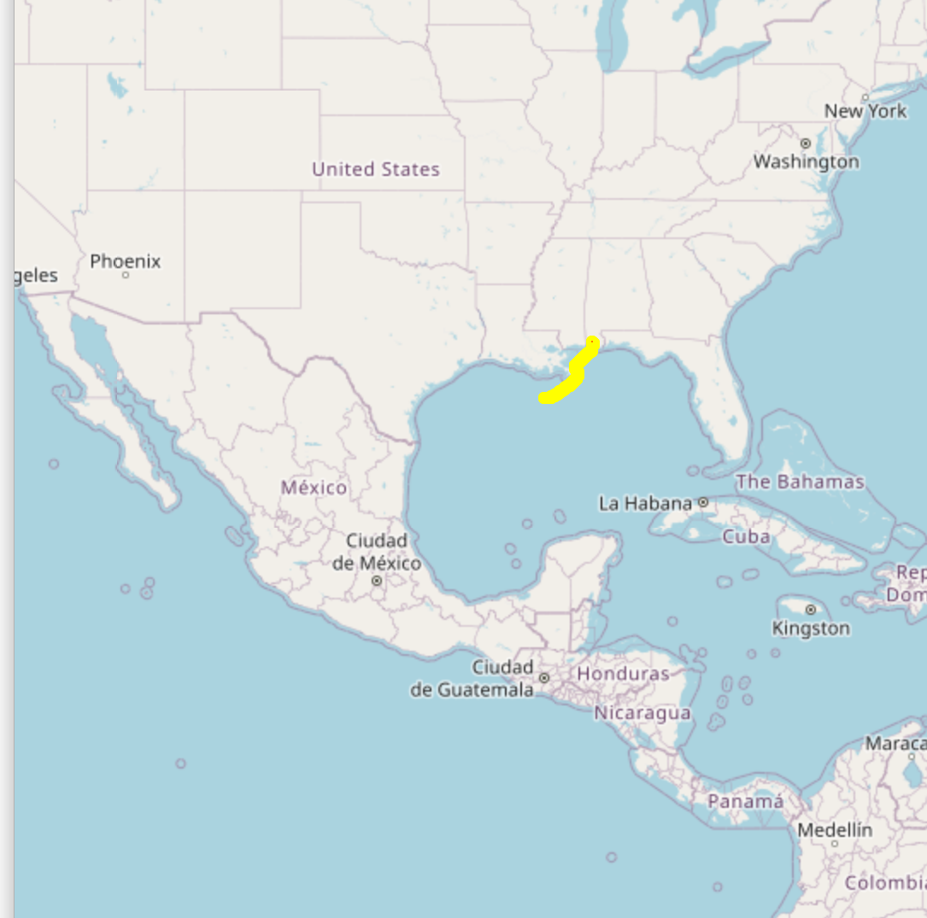
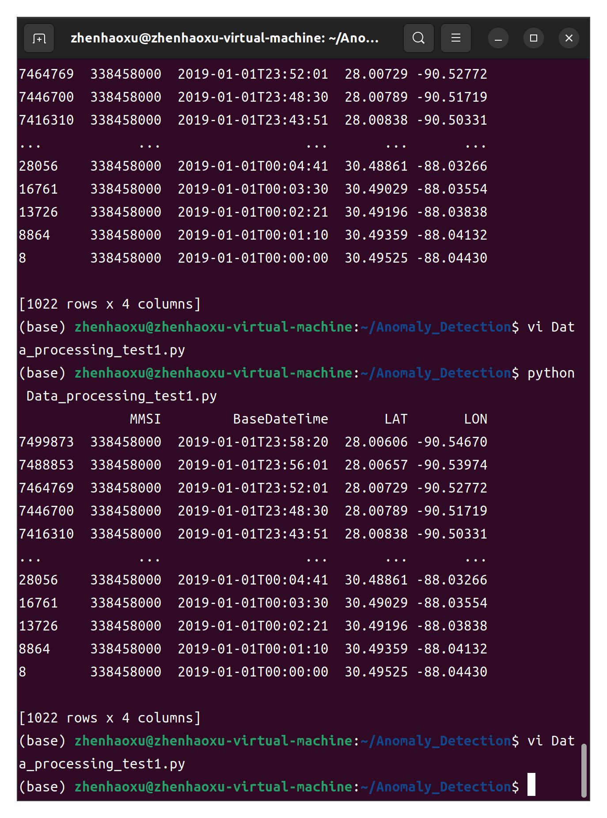
We visualized data of a few ships to check on routing
We try to visualize speed as well to check on anomalous ships

Slide 3
Which data as input？
Choose some important points of one ship in one route and then choose the neighbour points of this important point. We see the features of these points as a sample.
Which data as output?
n-dimensional model?

Slide 4
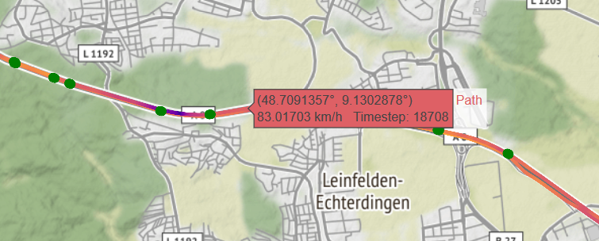
Plan
To use a heatmap in our visualization of a ship
Look at anomalous ship(sunk,whrecked etc) in data set and how its behave
Continue to select useful data, calculate them and represent them as features
Choose a Model and test it with only one feature of the ship as first step
Continue with paper reviews

