Slide 1
LLMs for Ranking-based Solubility Optimization
Using an LLM to find the most water-soluble molecule under a 15-evaluation budget
Anand Karna | MA-INF 4245, Lab AI for Scientific Discovery, University of Bonn

Slide 2
Introduction: the problem and the setup
• Goal: find the molecule with highest aqueous solubility (LogS) using an LLM, budget = 15 evaluations per run
• Oracle: ESOL (Delaney) computes LogS from structure. Cheap, R^2 ~0.69, an estimator not truth
• Dataset: AqSolDB (9,982 molecules). Source of seeds, pools, random baseline. NOT the simulator
• 13 fixed seed molecules give the LLM its only context. Bar to beat = methanol +0.208
• No API budget: every prompt copy-pasted by hand into ChatGPT / Claude / DeepSeek / Gemini
• Three approaches, each asking LESS of the LLM:
– A1 Direct Optimizer: the LLM invents molecules
– A2 BO + Regressor: the LLM predicts a number + confidence
– A3 Preferential BO: the LLM only judges duels, A vs B
Notes:
WHAT: optimize LogS with an LLM under a 15-eval budget. The LLM is the brain; ESOL is the oracle.
WHY runs: an LLM is stochastic, one run could be a fluke. WHY 2 runs: the minimum that shows reproducibility vs path-dependence while staying affordable under hand-typed prompting.
WHY metrics: 'best found' alone is not a result. Three questions: did we find the best (regret), was the LLM good at its job (accuracy, differs per approach), was the search efficient (efficiency, invalid rate, diversity). One shared, unit-tested metrics module measures all three the same way.

Slide 3
Approach 1
LLM as Direct Optimizer

Slide 4
A1: What and Why
• WHAT: the LLM is the inventor. Each round it sees tested molecules + ESOL LogS, proposes one new SMILES
• No math in the loop: the LLM both proposes and decides direction
• WHY: simplest possible LLM optimizer; if it has chemical intuition it shows here with nothing helping it
• HOW: build prompt -> paste -> validate SMILES (RDKit) -> reject mixtures -> ESOL score -> log -> repeat
• Three prompt variants to test how much wording matters:
– A Chain-of-thought: 'analyze features, then design'
– B Pragmatic: A + soft ban on trivial tricks
– C Constrained: hard limits (MW<150, polar group, <=1 ring, single molecule)
• Key decision: show ESOL LogS in prompts (one consistent scoreboard)
Notes:
WHY 2 runs here: Variant A run 2 switched models to prove the behavior is not one model's quirk; B and C run 2 tested reproducibility. That turned a single observation into a statement about reproducibility and path-dependence.

Slide 5
A1: per-run metrics (from analysis.py)
Variant.Run | Best | Improve | Success | Hit-rate | Invalid | Diversity
A.1 | +3.314 | +3.106 | 0.75 | 0.92 | 0.00 | 0.407
A.2 | +2.184 | +1.976 | 0.40 | 1.00 | 0.30 | 0.284
B.1 | +2.751 | +2.543 | 0.27 | 0.89 | 0.18 | 0.200
B.2 | +0.563 | +0.355 | 0.50 | 0.83 | 0.00 | 0.186
C.1 | +1.586 | +1.378 | 0.40 | 1.00 | 0.00 | 0.232
C.2 | +1.258 | +1.050 | 0.50 | 0.90 | 0.00 | 0.243
Notes:
HOW each metric is computed:
Hit-rate = fraction of proposals whose ESOL beat the seed best (A1 makes no prediction, so this is its quality signal).
Success rate = fraction of evals that set a new best.
Invalid rate = 1 - mean(valid) from RDKit. Diversity = mean pairwise Tanimoto of Morgan fingerprints (lower = more diverse).
WHY regret/normalized are N/A for A1: open-ended generation has no fixed pool, so no meaningful ceiling. The AqSolDB ESOL ceiling +17.14 is a degenerate unbounded value, not a real target.
WHY these numbers: A wins on score but repeats one exploit (least diverse). B's two runs disagree (path-dependent). C is most reliable (0% invalid both).

Slide 6
A1: headline finding -- the LLM exploits the oracle
• Unconstrained (Variant A), the LLM found ESOL has no chain-length penalty and no ceiling
• It added -CH(OH)- units forever (polyol chains), +0.28 LogS each, up to dodecitol +3.31 (chemically absurd)
• Replicated across Gemini, DeepSeek, ChatGPT -> a property of ESOL, not one model
• Each prompt closed one exploit, the LLM found the next:
– A chain -> B salt-mixture -> C (hard rules) forced real chemistry
• Takeaway: objective and constraint design matter as much as the LLM
Notes:
The LLM does not cheat maliciously; it optimizes the objective exactly as written. This is the core weakness of a cheap descriptor oracle, and it is a good result to report. Note: word the absurd molecules as 'degenerate' or 'exploited', honestly framed.

Slide 7
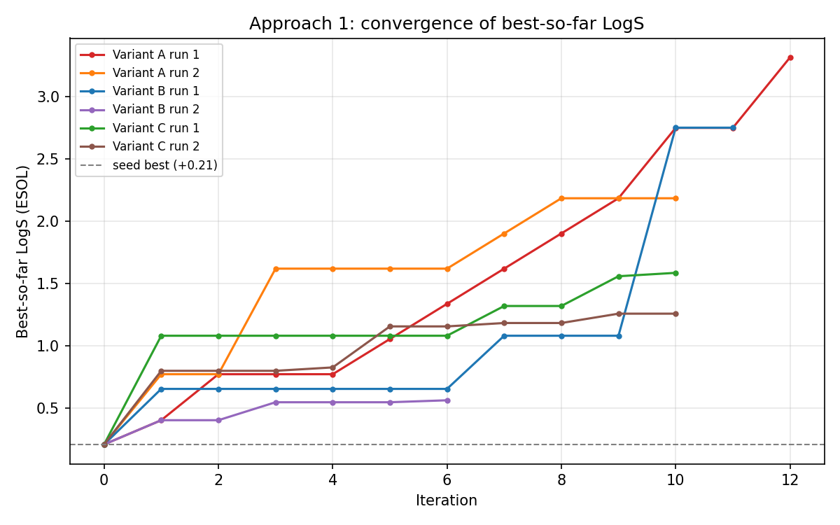
A1 Figure: convergence.png
• Best-so-far LogS vs iteration, 6 runs
– A (red/orange): climbs high via the unbounded polyol exploit
– B (blue/purple): runs DISAGREE, B1 late spike (salt), B2 honest plateau +0.56
– C (green/brown): smooth legit climbs, no spikes
• Take: unconstrained = exploit; soft ban = unreliable; hard rules = consistent
Notes:
Dashed gray line at +0.21 is the seed best (starting point).

Slide 8
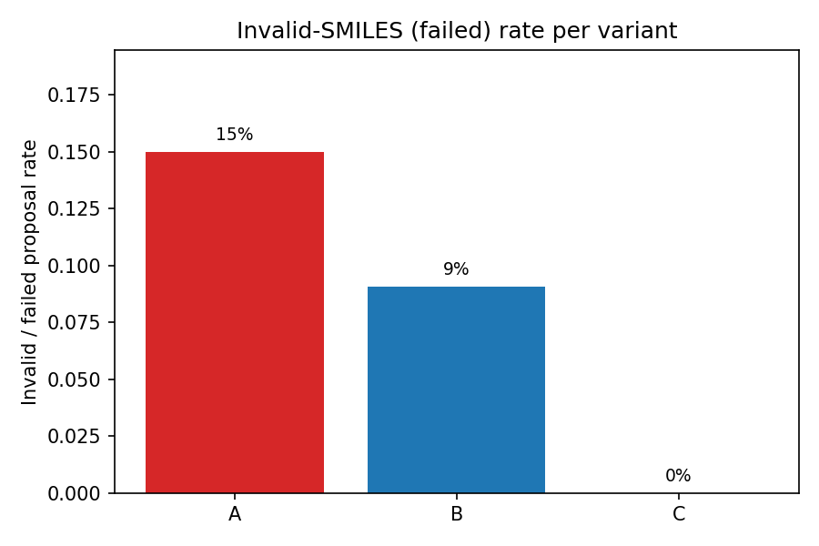
A1 Figures: behavior metrics
• invalid_rate.png (shown): A 15%, B 9.1% (path-dependent), C 0%
– Strict rules also make the LLM more reliable
• diversity.png: A least diverse (0.345, repeats the trick); B/C more diverse
– Removing the easy exploit forces exploration
• comparison.png: all 3 variants beat random (+0.41); the +17.14 ceiling is an ESOL illusion (use +2.14 on the slide)
Notes:
comparison.png and diversity.png also exist in plots/. WHY 2 runs paid off: lets me state A's exploit is reproducible, B is path-dependent, C is reliable. None of that is possible from a single run.

Slide 9
Approach 2
BO with the LLM as a Regressor

Slide 10
A2: What and Why
• WHAT: the LLM is a guesser. Fixed pool of 30 molecules; it predicts LogS (mu) + confidence (1-10) for each
• The LLM does NOT choose what to test. An acquisition function does
• WHY: A1 showed the LLM can invent but exploit. A2 asks a narrower question: can it put a reliable number on solubility?
• HOW the loop:
– LLM predicts all 30 -> confidence mapped to uncertainty sigma
– EI or UCB scores each and picks ONE -> ESOL scores it -> repeat
– EI = expected gain over best + uncertainty bonus; UCB = mu + kappa*sigma
• WHY EI and UCB: the two standard acquisition functions; everything else held fixed
• CRITICAL: the random pool's best was only +0.21; 1 of 30 beat the seed
Notes:
WHY 2 runs each: LLM predictions vary by model and session, so two runs per acquisition function check the result is not a single-session artifact. The pool was a random AqSolDB draw, mostly insoluble molecules, so the best score any method could reach was +0.21. Keep this in mind for every A2 figure.

Slide 11
A2: regression accuracy (from analysis2.py)
Metric | Value | Reading
MAE | 0.82 | Large miss on this scale
RMSE | 1.13 | Big misses present
Bias | +0.73 | Guesses too HIGH (optimist)
Pearson r | +0.46 | Weak-moderate; some signal
R squared | -1.25 | WORSE than guessing the mean
Sign acc vs seed | 0.78 | Direction usually right
Confidence vs error | -0.0007 | Confidence is meaningless
Notes:
HOW: mu = LLM prediction, true = ESOL of the picked molecule. MAE=mean|mu-true|, RMSE=sqrt(mean(err^2)), bias=mean(mu-true), Pearson=corr, R2=1-SSres/SStot, sign-acc=fraction on correct side of the seed, confidence calibration = corr(confidence, |error|).
WHY R^2 is negative: it compares the model's squared error to always guessing the average true value. The LLM is noisy AND biased upward, so it loses to that trivial baseline. Weak positive Pearson means it gets rough order partly right, but ordering is not enough for accurate numbers.
WHY confidence is meaningless: the LLM gives a number because asked; it is not tied to real correctness (known calibration problem). So the sigma fed to EI/UCB carried almost no information.

Slide 12
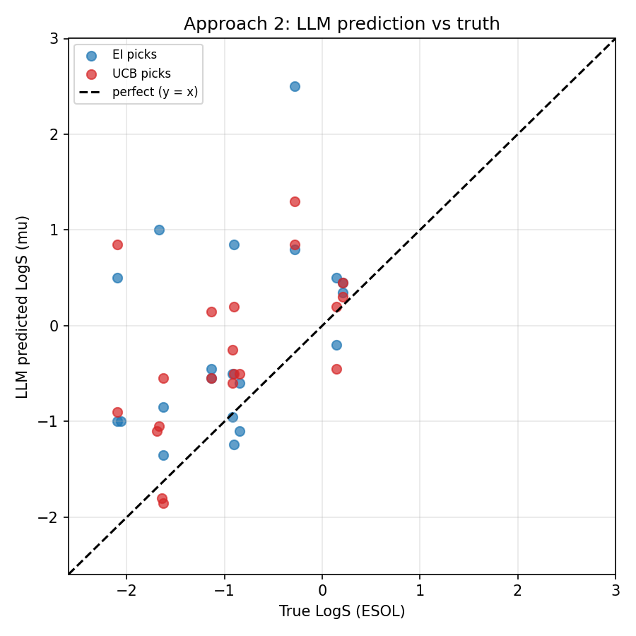
A2 Figure: calibration2.png (key figure)
• LLM prediction mu vs true ESOL LogS; dashed = perfect
– Dots scatter widely, most ABOVE the line (+0.73 bias)
– Loose upward drift = weak +0.46 correlation
– Worst: predicted +2.5 for a true -0.28
• Take: off-the-shelf LLM is a weak, over-optimistic numeric predictor
Notes:
This is the central honest finding of Approach 2.

Slide 13
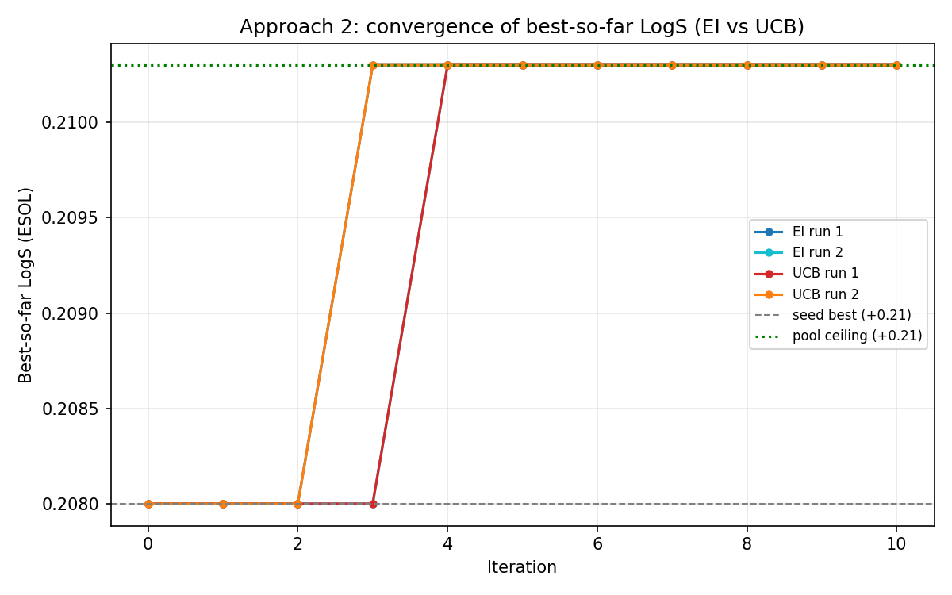
A2 Figures: convergence and confidence
• convergence2.png (shown): y-axis spans only +0.208 to +0.210, a sliver
– All runs hit the pool ceiling in 3-4 iters, then flat (nothing better exists)
• confidence_error2.png: mean-error line is flat, corr -0.0007
– LLM never used confidence below 5, even when wrong
• comparison2.png: random +0.41 'beats' EI/UCB +0.21 ONLY because random draws from all 9,982; unfair
Notes:
The right A2 comparison is EI/UCB vs the pool ceiling (+0.21), which both reach exactly. The bottleneck was the pool, not the math. This lesson shaped A3.

Slide 14
Approach 3
Preferential BO with the LLM as a Ranker

Slide 15
A3: What and Why
• WHAT: the LLM never gives a number. It only judges duels: 'is A or B more soluble?'
• Many duels -> a ranking -> an acquisition picks the next molecule to ESOL-score
• WHY: A2 showed the LLM is a poor regressor, but LLMs compare better than they predict. Test that hypothesis
• HOW the loop:
– Select ~25 informative duels -> LLM answers A/B as JSON
– Bradley-Terry fit: P(i beats j)=sigmoid(u_i-u_j), gives utility + uncertainty
– UCB on utility picks one -> ESOL scores it -> repeat
• Pool STRATIFIED by ESOL -> real ceiling +1.14 (vs A2's dead +0.21)
• Validated with an --auto ESOL oracle + 26 unit tests BEFORE any LLM run
Notes:
WHY stratify by ESOL not experiment: the oracle is ESOL, which disagrees with experiment for salts/sugars, so an experiment-stratified pool was still dead. WHY validate first (anti-hallucination): --auto answers duels by true ESOL (optionally with noise) to prove the loop, the BT fit, the acquisition, and logging are correct without any LLM, and that it responds to ranker quality. Only then the real manual runs.

Slide 16
A3: ranking accuracy + outcome (from analysis3.py)
Run | Best | Regret | Spearman | Kendall | Pairwise acc | Top-1 hit | NDCG@5
1 | +1.1375 | 0.0 | +0.525 | +0.416 | 0.708 | 0 | 0.703
2 | +1.1375 | 0.0 | +0.711 | +0.600 | 0.800 | 0 | 0.856
Notes:
HOW: pred = Bradley-Terry utility, true = ESOL of the whole pool. Spearman/Kendall = rank correlations; pairwise acc = fraction of molecule pairs ordered the same way; top-1 hit = is the utility's #1 the true best; NDCG@5 = top-5 ranking quality vs ideal.
WHY good: 71-80% pairwise accuracy is far above random 50% and far better than A2's negative R^2. Ranking IS easier for the LLM than prediction (the core result).
WHY top-1 hit = 0 yet ceiling reached: the BT #1 was not the single true best, but UCB also explores high-uncertainty candidates, so it tested the true best anyway within budget. A ranker can be imperfect at the very top and still drive a successful optimization.
WHY regret genuinely 0 (unlike A2): the stratified pool had real headroom and the loop reached it.

Slide 17
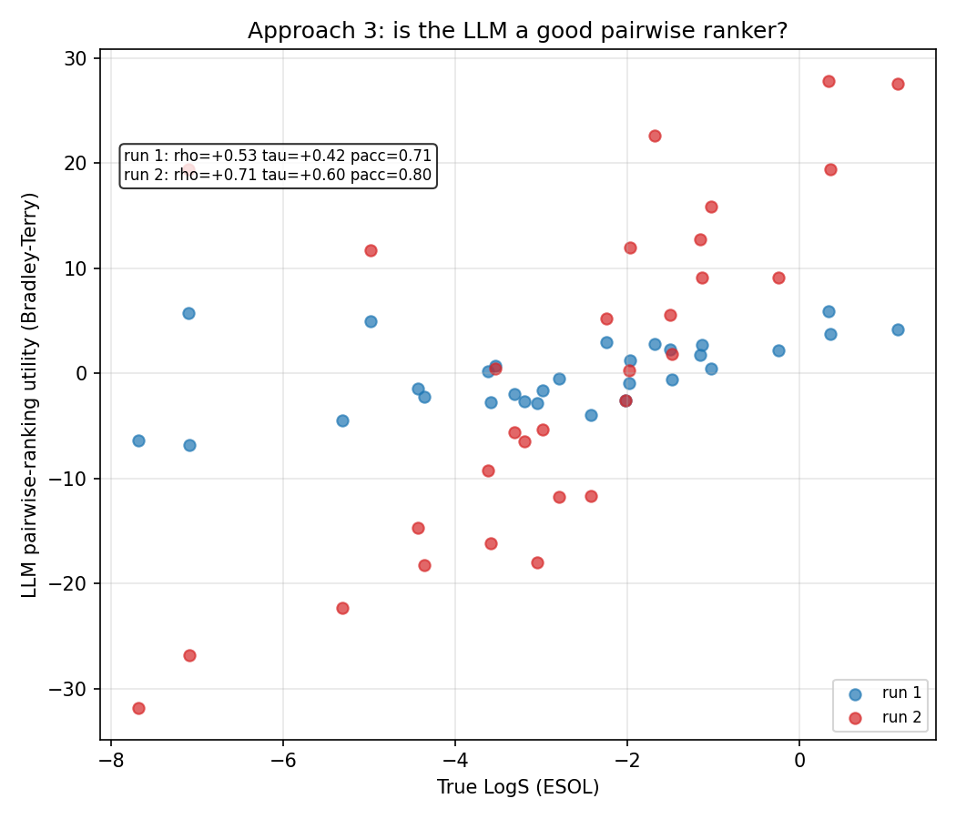
A3 Figure: ranking_quality3.png (headline)
• Bradley-Terry utility vs true ESOL LogS, per run
– Points trend upward, tighter in run 2 (Spearman 0.71) than run 1 (0.53)
– Good but not perfect ranking, matches 0.71-0.80 pairwise accuracy
• Take: YES the LLM is a decent pairwise ranker, and better at ranking than at regression
Notes:
This figure directly justifies the whole approach.

Slide 18
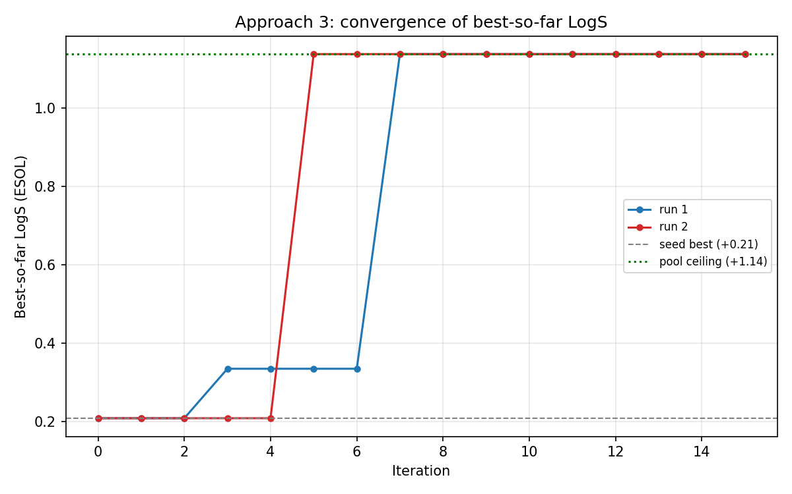
A3 Figure: convergence3.png
• Best-so-far vs iteration; real y-axis range now (stratified pool)
– Both runs climb from +0.21 seed and reach the +1.14 ceiling
– Gain happens in a few jumps (hence low success-rate)
• Take: with a proper pool, the PBO loop genuinely optimizes within budget
• Validation: --auto perfect ranker reaches ceiling fast; 40% noise degrades to Spearman ~0.59
Notes:
comparison3.png also exists: both runs reach the pool ceiling above the seed. The --auto validation shows convergence is caused by ranking quality, not a bug or a lucky pool.

Slide 19
Wrap-up
Observations and Conclusions

Slide 20
Cross-approach comparison (compare_approaches.py)
Approach | Best (mean/max) | Improve | Success | LLM quality (own metric)
A1 direct | 1.94 / 3.31 | +1.73 | 0.47 | hit-rate 0.92
A2 regressor | 0.21 / 0.21 | +0.00 | 0.10 | MAE 0.82, R2 -1.30, sign 0.78
A3 ranker | 1.14 / 1.14 | +0.93 | 0.10 | pairwise 0.75, Spearman +0.62, NDCG 0.78
Notes:
CAVEAT (a required slide): the three are NOT on identical problems. A1 is open-ended (no pool, regret undefined); A2 and A3 use different pools (A2 ceiling +0.21, A3 +1.14). Compare best-LogS and efficiency; use each approach's own quality metric for LLM skill. Figure comparison_all.png shows the best-LogS bars with the random baseline.

Slide 21
Three big findings
• 1. A cheap descriptor oracle is exploitable (A1)
– The LLM optimizes ESOL exactly as written until hard constraints force real chemistry
• 2. The LLM is a poor regressor but a decent ranker (A2 vs A3)
– Regressor: R^2 negative, confidence meaningless. Ranker: 71-80% pairwise correct
– This is the central result: comparison is the strength, exact prediction the weakness
• 3. Search-space design is the real bottleneck (A2 vs A3)
– Same loop: a failure on a dead pool (A2), a success on a stratified pool (A3)
• Plus: one shared, unit-tested metrics module -> every number is validated, none hallucinated
Notes:
WHY the metrics framework is itself a contribution: shared optimization metrics are comparable across approaches; per-approach accuracy judges each LLM role by the metric that fits it. Every reported number has a known-answer test behind it (26 tests total).

Slide 22
Future work
• Fix the oracle's exploitability: cap LogS / penalize MW, or use a stronger solubility predictor
• Fix A2's pool: re-run on an ESOL-stratified pool (proven in A3) for a fair EI-vs-UCB fight
• More runs: with API access, 5-10 seeds per setting + confidence intervals
• Better uncertainty: numeric range, multi-sample spread, or Bradley-Terry std_err instead of self-reported confidence
• Combine approaches: LLM proposes candidates (A1) -> rank by duels (A3) -> evaluate. Use the LLM where it is strong
• Fine-tuning on solubility data; scale A3 duels (more duels -> tighter ranking, likely raises top-1 hit)
Notes:
The natural synthesis combines the LLM's strengths (invention and comparison) and avoids its weakness (exact numeric prediction). Every result here used off-the-shelf models with no fine-tuning.

Slide 23
Thank you
Questions?
Anand Karna | Code, figures and per-run metric CSVs all reproducible from the repo

