Slide 1
Price Scout ™
Justin – steven – Jeffery – Andrew - Tanas

Slide 2
Problems/Improvements
Problems
Enhancements
Currently the login function redirects to a new tab to log in.
We would like to make the login interal and not require a secondary tab

Slide 3

Core Functionality
Searching for desired products
Comparing prices
Displaying trends of prices

Slide 4
UI/UX Design
Show designs/early sketches here
Responsive, user-friendly, minimalistic
How do users interact with the app

Slide 5
Data Flow Diagram (DFD) Steps:
User logs in:
Frontend (Google login) sends authentication data to Supabase Authentication.
Supabase Authentication sends a response back to the Backend API (Django).
Backend API stores the login data in the Login Table.
User searches for products:
Frontend sends a search query to the Backend API.
Backend API queries the Products Table and Store_Product_Data Table to fetch the relevant product data.
The results are sent back to the Frontend for display.
User interacts with products (e.g., adding to history):
Backend API stores user-product interaction in the User_Product_History Table.
External store sync:
Backend API syncs with external stores and stores the API response in the Store_API_Logs and Store_API_Responses Tables.
The Store_Syncs Table keeps track of when syncs occur.

Slide 6
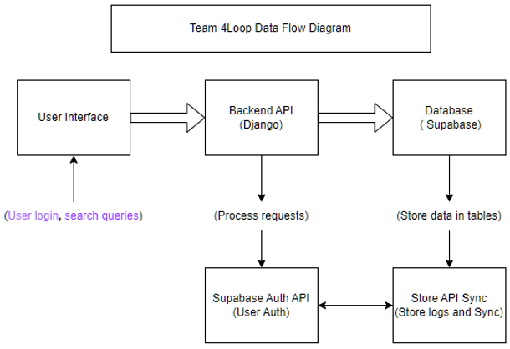
Data Flow Diagram

Slide 7
Demo
Price-Scout ™

