Slide 1

Cross-Website Price Checker
Find the Cheapest Prices with No Fake Reviews
Presented by Team 4

Slide 2

Project Idea
  We threw around a lot of ideas relating to API uses, job posting aggregator, personalized vacation suggester, we had a few others like VR but ultimately decided that the most feasible option would be a Cross-Website Price checker. We all have had experiences being tricked by fake reviewers to find a bad product at our doorstep.
  Our first thought about how to do it was scraping websites, but many websites restrict it. API’s while similarly limited are a safer option to retrieve information from sellers. This is where we had the idea of using AI to check for fake reviewers and was implemented into the plan
  We chose Django for its familiarity and its flexibility with python to interact with 100’s of libraries. This was crucial to interact with both API’s, integrate AI and communicate with our database.

Slide 3



Languages and Frameworks
Front-end Client
Back-end Server
Databases
React.js
  With JSX lang extension
  SSR (server-side rendering)
HTML
CSS
JavaScript
Django Framework
  Admin panel
  Template Pages
  Built in auth
Python
SupaBase Framework
PostgreSQL

Slide 4

Backend
Django will be used for the following:
  Manage API calls
  Process pricing data
  User authentication
  Filter fake reviews
  Schedule routine checks for price changes
The use of Django Templates will help to reduce redundant code and decrease development time

Slide 5
Backend Database Development
For this project, the backend has a couple of components the program itself and the database. I will go over the Database in these next couple slides.
The objectives of this database are as follows:
Store log in information
Store customer search history
Store product price history
Long term goal of this database
Being able to track product interest and price history
Having a system like eBay that will watch for price drops/rises for specific items

Slide 6
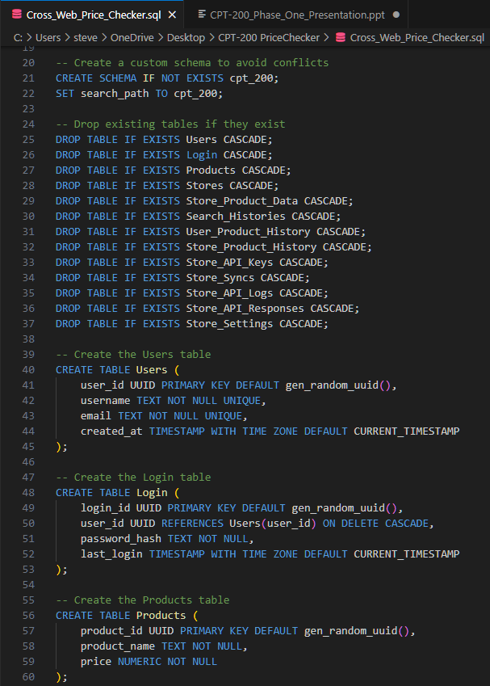
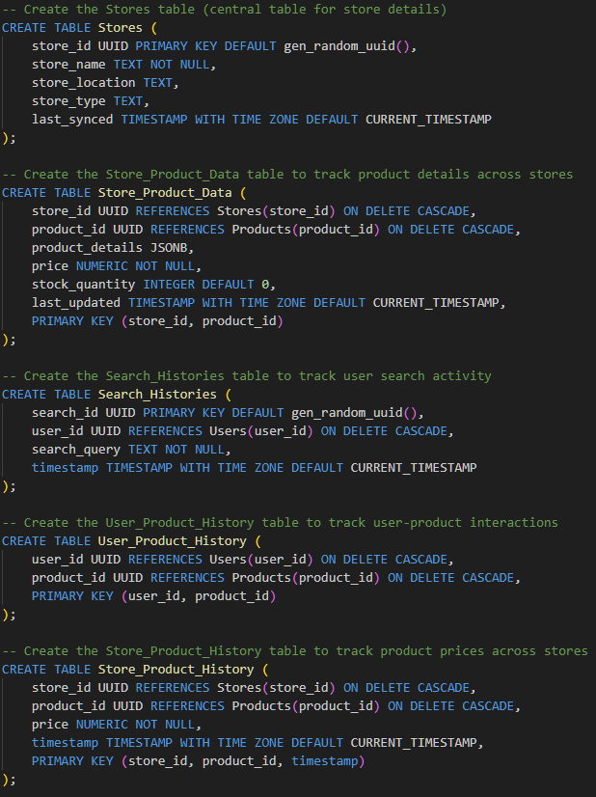
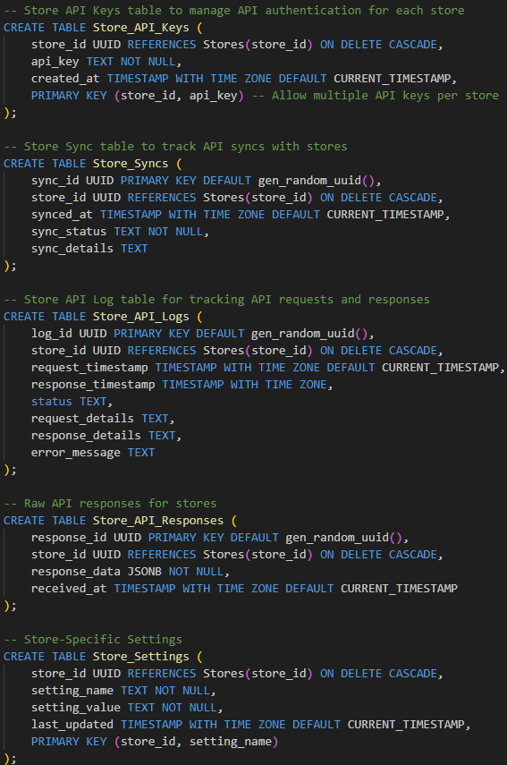
Script for Database
Notes:
Establishing the schema and creating the relationships between the tables

Slide 7
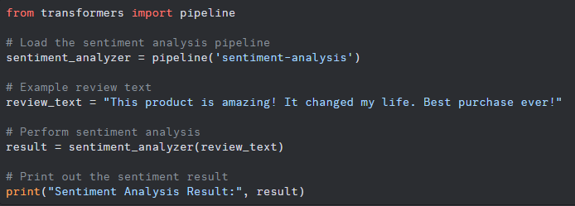
Cutting Edge Technology (AI)
What is it?
Our website is going to use AI to sort through 1000’s of reviews and find which ones are likely authentic or fake. We would use it to advise the user on which products have authentic information in the reviews.
How does it work?
Each review will get a score between 0 and 1 and be flagged as fake positive or negative.
The name of it is HuggingFace
Example
We can give the model a review or several hundred like in a csv file and it will do a sentiment analysis (POS or NEG) and a score:
Python: “label: positive, score: 0.9”

Slide 8
Thanks to You and the Team!
We will be here again March 10th With Updates

