Slide 1

Price Scout Phase Four Presentation
Team 4-Loop

Slide 2
Phase Four Objectives
Finish Frontend
Finish Backend
UI Screenshots
Lessons Learned

Slide 3
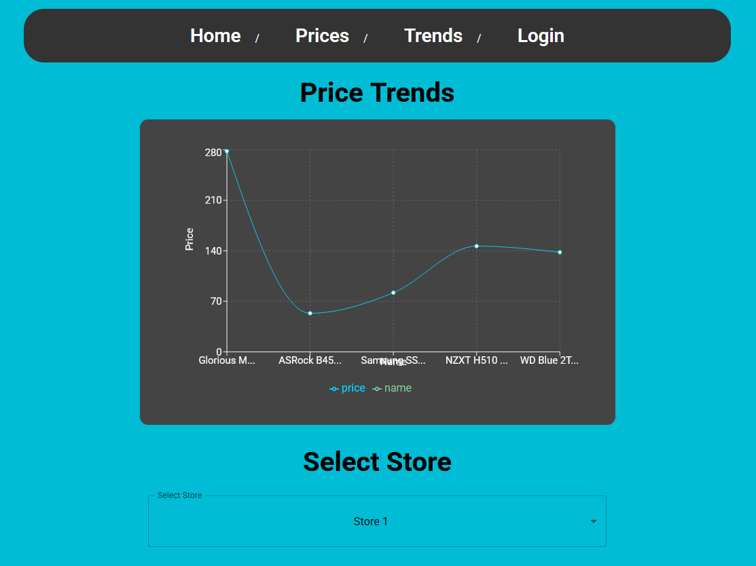
Coding
Completed all code
Frontend
Backend
Data Script

Slide 4

Data Script
Purpose
How it works
Authenticates with Serp API
Fetches product listings in batches to manage rate limits
Inserts/Updates records in supabase to ensure database consistency
Why it matters
Keeps platform pricing accurate and up-to-date
Shows real-time data for a smoother shopper experience
Automates product data ingestion from Serp API into our Supabase database

Slide 5
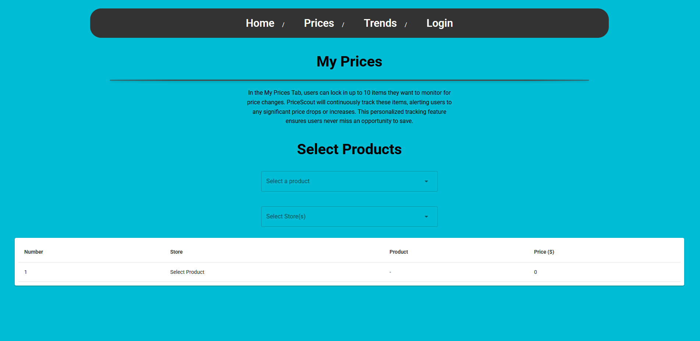
Additional UI Functionality
The user can select both stores and products to filter their desired items.
The table grows to the size of the number of products returned from the API

Slide 6
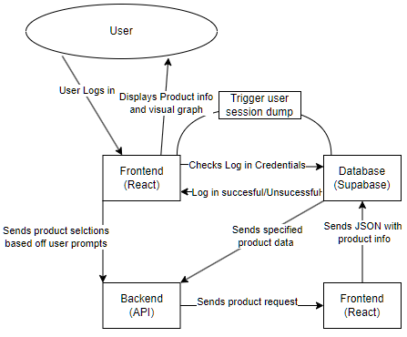
Data Flow Diagram
Through many trials and errors, we have simplified and optimized the process for the user

Slide 7
Lessons Learned: Patrick
The importance of incorporating tasks into a consistent schedule.
Communication is a primary part of teamwork.
How to take setbacks in stride.
How to rely on other’s skillsets when they are better for the job.

Slide 8
Lessons Learned: Steven
This project has tested my ability to work well on a team and on a deadline
Professionally holding someone accountable
Setting reasonable goals for the projects success
Flexibility to work in a different direction than initially we had decided
Setting down your ego and asking for help

Slide 9
Lessons Learned: Justin
Writing tests, even if small is important when integrating complex frameworks to ensure reliable code
Strong error checking eliminates wasted time debugging
Reusable code is valuable, but only when it aligns with project timelines
As the Zen of Python says – “Simple is better than complex. Now is better than never.”

Slide 10

Thank you!

