Slide 1
Price Scout Phase Four Presentation
Team 4-Loop

Slide 2
Phase Four Objectives
Finish Frontend
Finish Backend
UI Screenshots
Lessons Learned

Slide 3
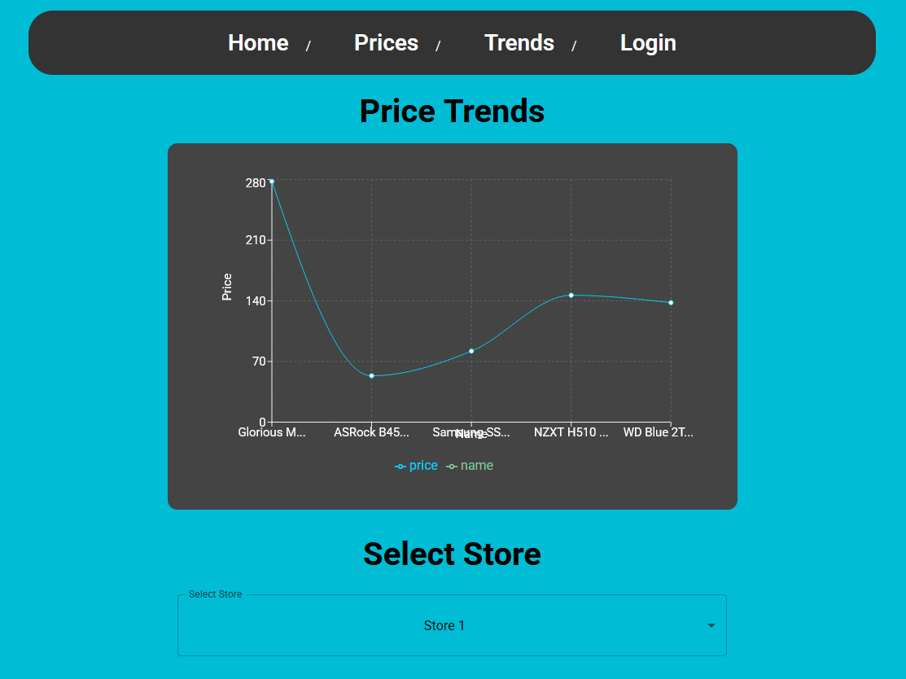
Coding
Completed all code
Frontend
Backend
Data Script

Slide 4
Data Script
Coding focus of Phase Four
TODO Justin fills this out

Slide 5
Additional UI Screenshots

Slide 6
Lessons Learned: Patrick
There are still skills to work on
Communication
Acting in a timely manner
Relying on others has become easier

Slide 7
Thank you!

