Slide 1











Slide 2



Phase 3 Presentation
Team 4 Loop

Slide 3
Changes/Overview
Groceries -> Computer Parts
Desktop, Audio, Peripherals
API Changes
Data being retrieved through single API
Simulated Cloud production environment

Slide 4
Changes to API endpoint(Justin)
New RPC based endpoints
get_stores
Fetches all available stores from the database (used in frontend dropdown)
Includes error handling for db connection failures, timeouts and empty result sets
get_products
Returns a list of products associated with a specific store
Validates store_id input to make sure it isn’t empty or incorrectly formatted
Includes the same error handling as get_stores
All endpoints return Response objects containing standardized json
Status codes are provided with the responses to more accurately reflect errors

Slide 5

Database Script Changes(Steven)
Old schema focused on grocery items (names, UPCs, stores)
New schema accommodates electronics data:
products table: brand, model, specs, category
retailers table added to manage data sources
price_data table: product_id, retailer_id, price, timestamp
Temporary session-based storage (due to data licensing restrictions)

Slide 6

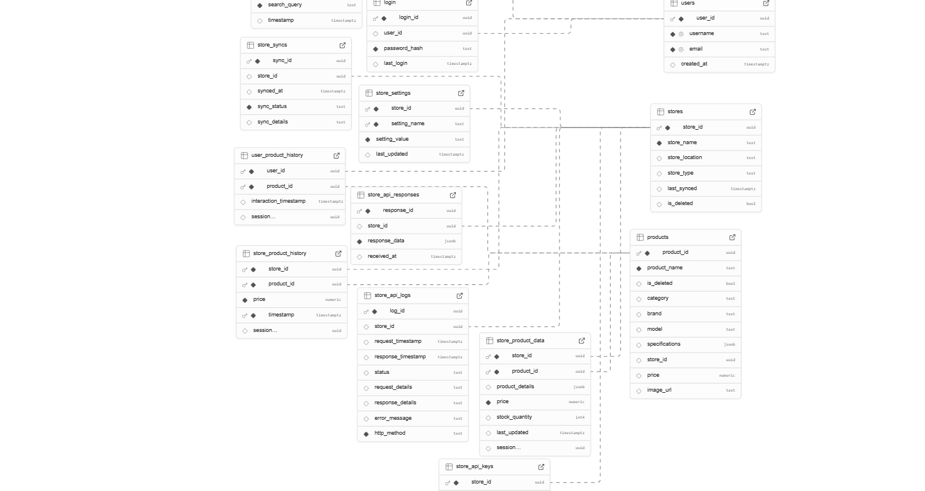
Diagrams ERD(Steven)

Slide 7

Backend SQL Functions(Steven)
FPC
The Functional Project Components (FPC) of PriceScout enable users to log in, track up to 10 tech-related items, and compare real-time prices across major retailers. The app features live data visualization and trending item analysis, all while ensuring session-based data handling to comply with API usage policies.
Fetch script
Product dump Trigger
This ensures that we stay in line with the TOS with the api we are using. We cannot store data for multiple uses, the trigger will set a timer once data has been called and then delete it after the timer goes off.

Slide 8


Data Formatting and Transformation
// Raw data from Store A
{
"name": "AirPods Pro",
"cost": "249.99",
"img": "https://example.com/image.jpg"
}
// Raw data from Store B
{
"product_name": "AirPods Pro",
"price": 249.99,
"image_url": "https://example.com/img.jpg"
}
Unified data field names
API User receives predictable data
Robust code that gracefully handles errors

Slide 9
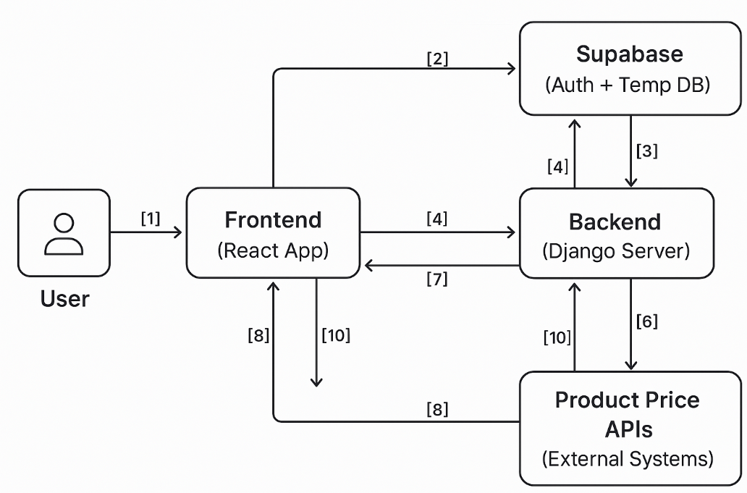
Diagrams DFD(Steven)
[1] User → Frontend: Login request, search query, item tracking
[2] Frontend → Supabase: Auth (Login/Logout via Google)
[3] Supabase → Frontend: Auth response (success/failure)
[4] Frontend → Backend: Search term or tracked item requests
[5] Backend → Product APIs: Fetch price data in real-time
[6] Product APIs → Backend: Return price data (brand, price, link)
[7] Backend → Frontend: Send processed price results & trends
[8] Frontend → Backend: Request to visualize price trends
[9] Backend → Frontend: Return graph/image of visualization
[10] Backend → Supabase: Dump user session after timeout by trigger

Slide 10

Demo

Slide 11

Thank You!

