Slide 1

Cross-Website Price Checker
Find the Cheapest Prices with No Fake Reviews
Presented by Team 4

Slide 2

Project Idea
  We threw around a lot of ideas relating to API uses, job posting aggregator, personalized vacation suggester, we had a few others like VR but ultimately decided that the most feasible option would be a Cross-Website Price checker. We all have had experiences being tricked by fake reviewers to find a bad product at our doorstep.
  Our first thought about how to do it was scraping websites, but many websites restrict it. API’s while similarly limited are a safer option to retrieve information from sellers. This is where we had the idea of using AI to check for fake reviewers and was implemented into the plan
  We chose Django for its familiarity and its flexibility with python to interact with 100’s of libraries. This was crucial to interact with both API’s, integrate AI and communicate with our database.

Slide 3

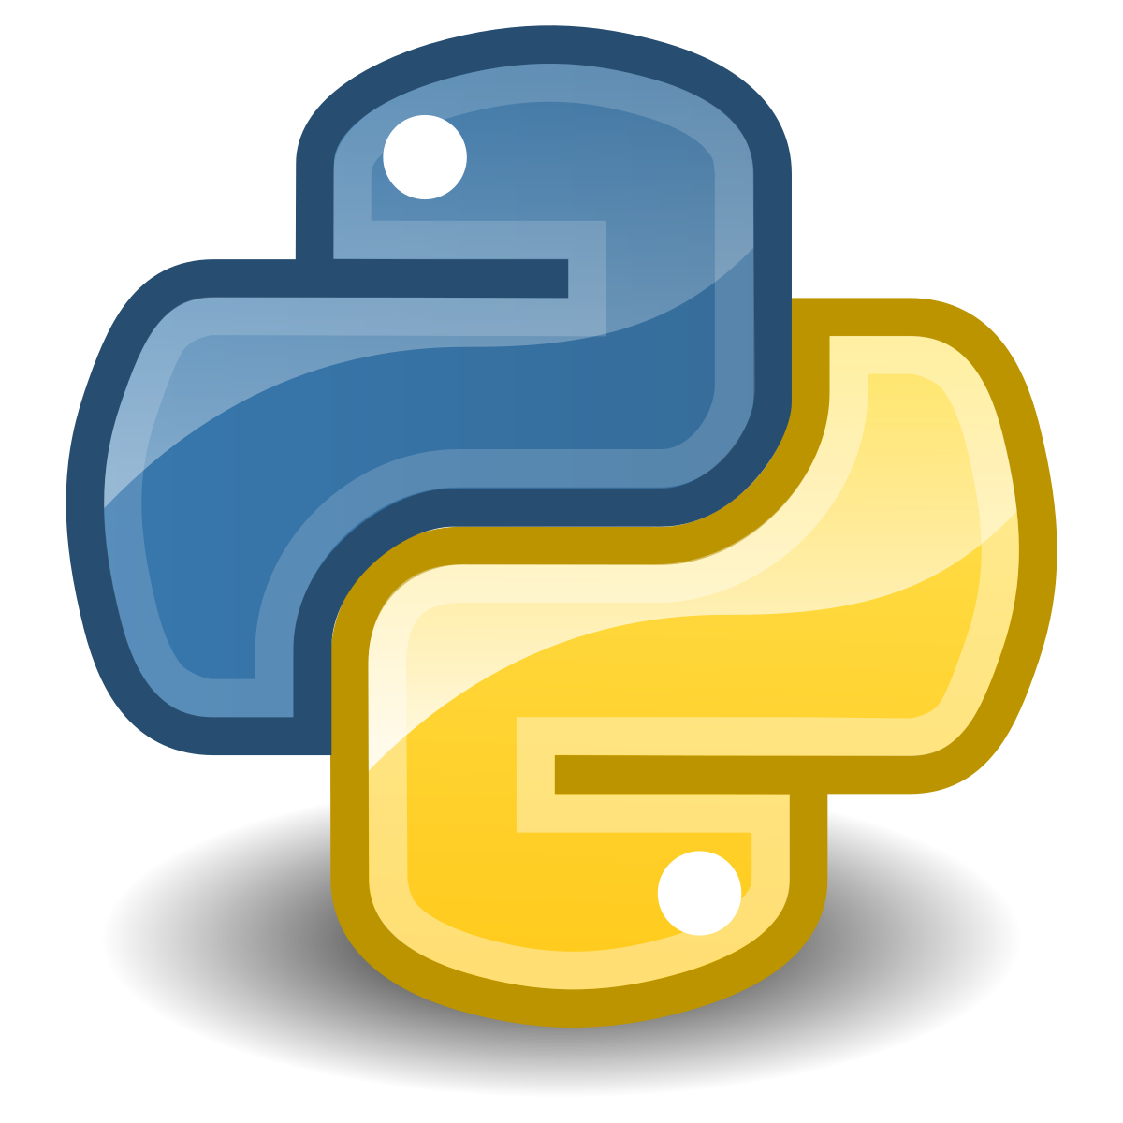

Languages and Frameworks
Front-end Client
Back-end Server
Databases
React.js
  With JSX lang extension
  SSR (server-side rendering)
HTML
CSS
JavaScript
Django Framework
  Admin panel
  Template Pages
  Built in auth
Python
SupaBase Framework
PostgreSQL

Slide 4

APIs
In order to fetch prices on different websites, we need a way to “scrape” those websites
Scraping is the process of extracting data from a website, such as a product’s price, using a program
Though, scraping can sometimes be deemed unethical because it can be used to gather data that is against a website’s Terms of Service

Slide 5

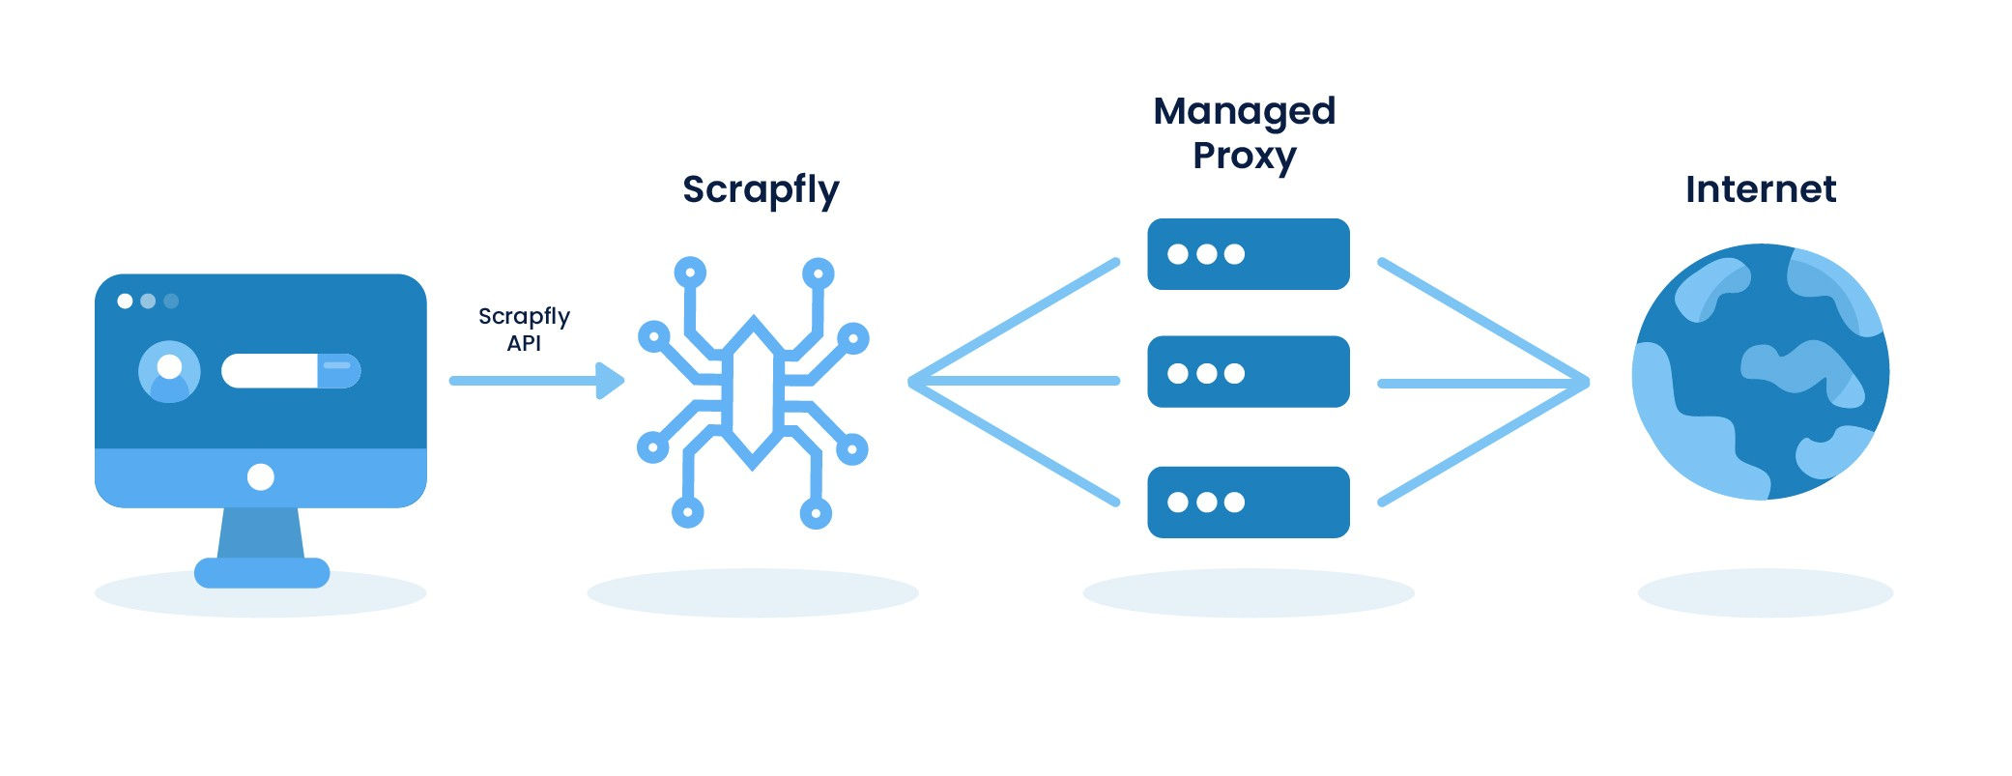
APIs
There’s an an API called ScrapFly that can be used to ethically scrape data and is trusted by over 30,000 developers
ScrapFly outputs data in html, markdown or json formats
ScrapFly has:
A strong Know Your Customer policy that ensures the API is used for legitimate and fair use cases
Continuous updates
Easy integration
Publicly available documentation
Support for all programming languages

Slide 6

Backend Server
Django will be used for the following:
  Manage API calls
  Process pricing data
  User authentication
  Filter fake reviews
  Schedule routine checks for price changes
The use of Django Templates will help to reduce redundant code and decrease development time

Slide 7
Backend Database Development
The backend has a couple of components:
  The program
  The database.
The primary objectives of this database are as follows:
Store log in information
Being able to track product interest and price history
Having a system like eBay that will watch for price drops/rises for specific items

Slide 8
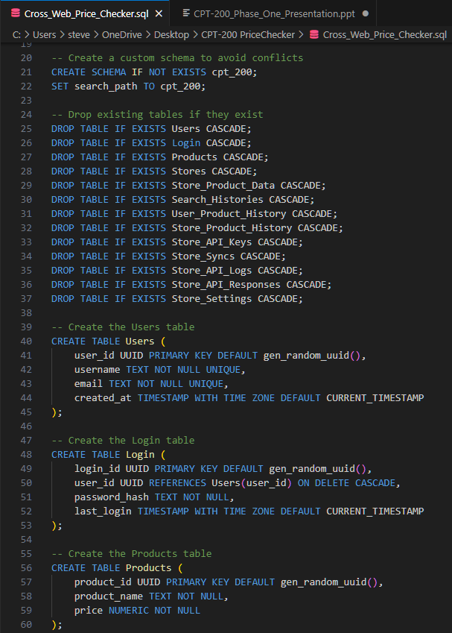
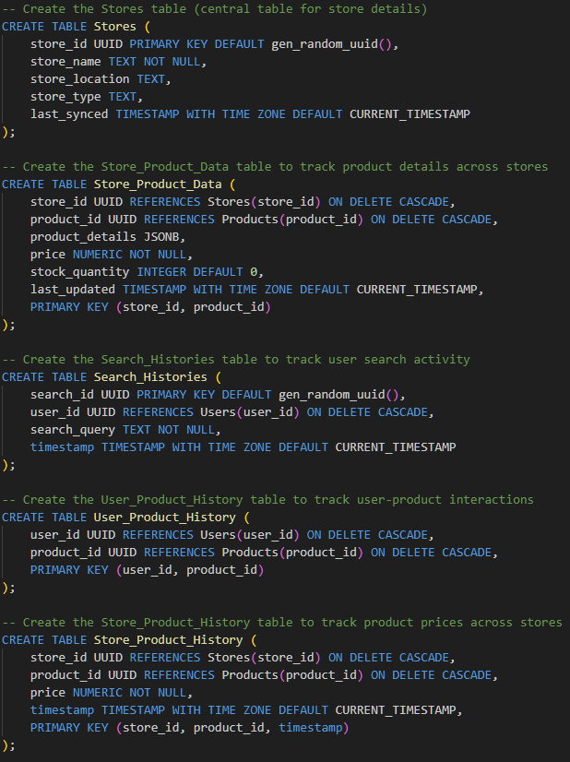
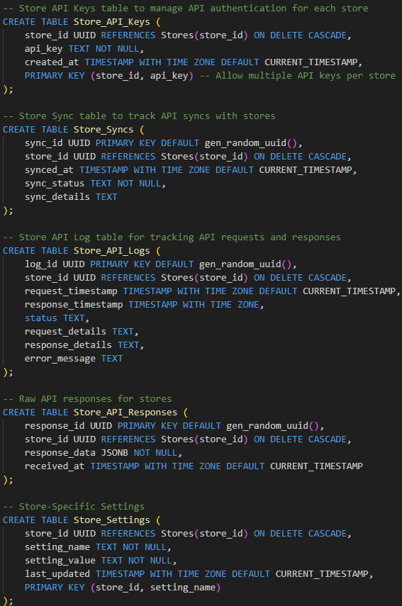
Script for Database
Notes:
Establishing the schema and creating the relationships between the tables

Slide 9
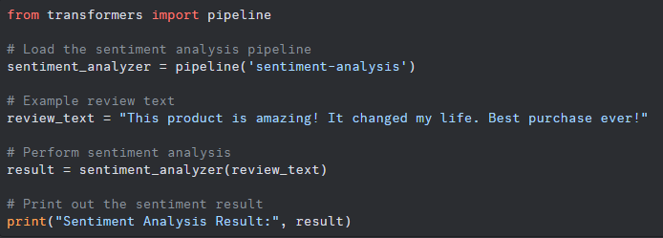
Cutting Edge Technology (AI)
What is it?
Our website is going to use AI to sort through 1000’s of reviews and find which ones are likely authentic or fake. We would use it to advise the user on which products have authentic information in the reviews.
How does it work?
Each review will get a score between 0 and 1 and be flagged as fake positive or negative.
The name of it is HuggingFace
Example
We can give the model a review or several hundred like in a csv file and it will do a sentiment analysis (POS or NEG) and a score:
Python: “label: positive, score: 0.9”

Slide 10
Guiding Documents
Statement of Work
Project Proposal
Other as Required

Slide 11
Thanks to You and the Team!
We will be here again March 10th With Updates

