Slide 1










Notes:
Transition slide (none)

Slide 2



Phase 3 Presentation
Team 4 Loop
Notes:
Patrick

Slide 3
Changes/Overview
Groceries to Computer Parts
Desktop, Audio, Peripherals
API Changes
Data being retrieved through single API
Simulated Cloud production environment
Notes:
Patrick

Slide 4
Changes to API endpoint
New RPC based endpoints
get_stores()
get_products()
All endpoints return Response objects containing standardized json
Status codes are provided with the responses to more accurately reflect errors
Notes:
Justin
get_stores
- Fetches all available stores from the database (used in frontend dropdown.
- Includes error handling for db connection failures, timeouts and empty result sets
get_products
- Returns a list of products associated with a specific store
- Validates store_id input to make sure it isn’t empty or incorrectly formatted
- Includes the same error handling as get_stores

Slide 5

Database Script Changes
Old schema focused on grocery items
New schema accommodates electronics data:
products table changed to reflect computer parts
retailers table added to manage data sources
price_data table cut
Temporary session-based storage (due to data licensing restrictions)
Notes:
Steven
Old schema focused on
- names, UPCs, stores
Tables data:
- products: Brand, model, specs, category
- price_data: product_id, retailer_id, price, timestamp

Slide 6
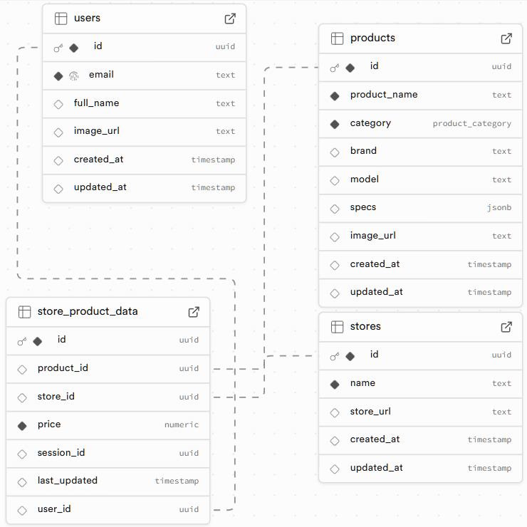

Diagrams ERD
Notes:
Steven

Slide 7

Backend SQL Functions
Functional Project Components (FPC)
log in,
track up to 10 items
compare real-time prices
Fetch script
Product dump Trigger
This ensures that we stay in line with the TOS with the APIs we are using.
Notes:
Steven

Slide 8


Data Formatting and Transformation
// Raw data from Store A
{
"name": "AirPods Pro",
"cost": "249.99",
"img": "https://example.com/image.jpg"
}
// Raw data from Store B
{
"product_name": "AirPods Pro",
"price": 249.99,
"image_url": "https://example.com/img.jpg"
}
Unified data field names
API User receives predictable data
Robust code that gracefully handles errors
Notes:
Justin

Slide 9
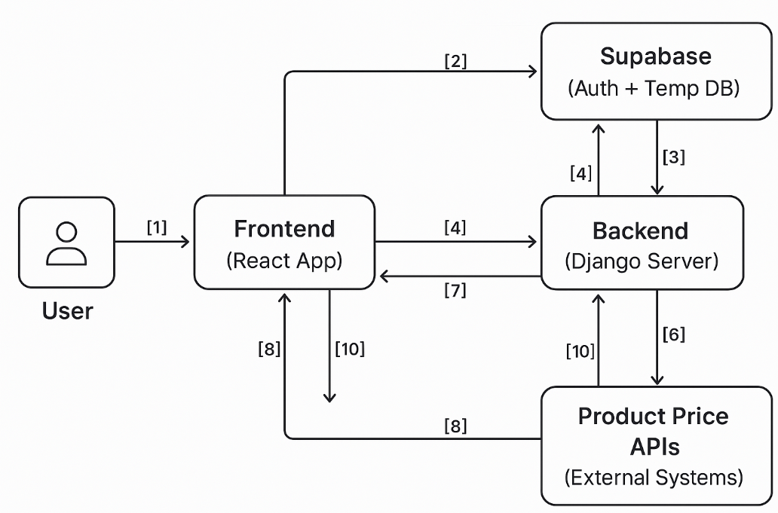
Diagrams DFD
[1] User → Frontend: Login request, search query, item tracking
[2] Frontend → Supabase: Auth (Login/Logout via Google)
[3] Supabase → Frontend: Auth response (success/failure)
[4] Frontend → Backend: Search term or tracked item requests
[5] Backend → Product APIs: Fetch price data in real-time
[6] Product APIs → Backend: Return price data (brand, price, link)
[7] Backend → Frontend: Send processed price results & trends
[8] Frontend → Backend: Request to visualize price trends
[9] Backend → Frontend: Return graph/image of visualization
[10] Backend → Supabase: Dump user session after timeout by trigger
Notes:
Steven

Slide 10

Demo
Notes:
Justin

Slide 11

Thank You!
Notes:
Patrick

