Slide 1
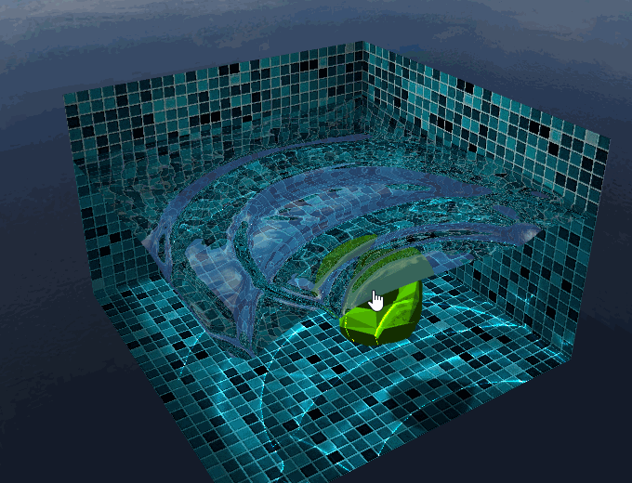
WebGL Interactive Water
Final
Binglu Du, Xinjie Ma

Slide 2
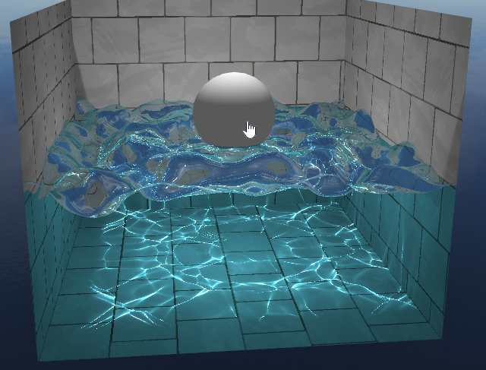
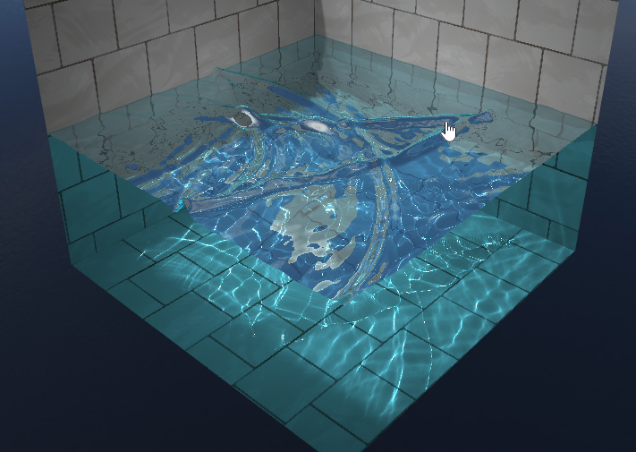
Beta Features
Framework from scratch
Environment - Pool, Sky
Water Shader
Water Simulation
Mouse & sphere interaction
Caustics

Slide 3
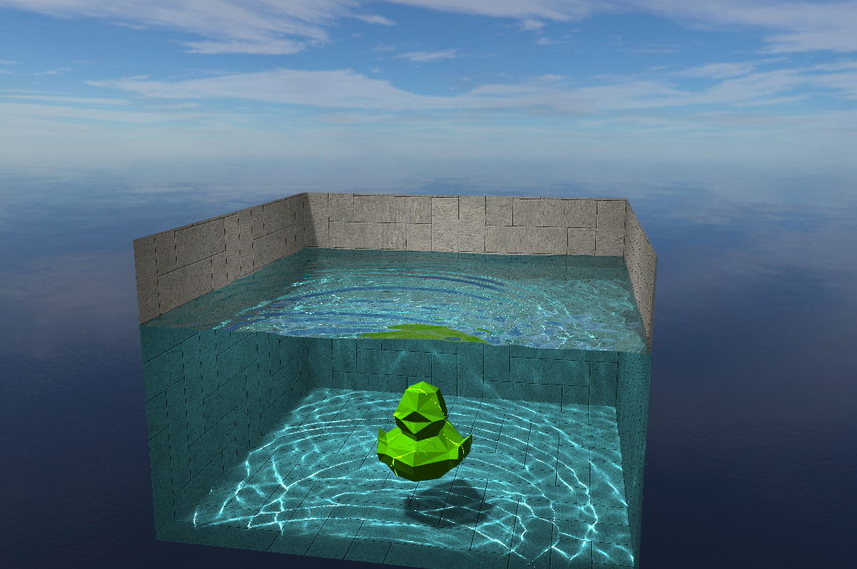
More in Final
More obj interaction
obj shadow & reflection
God rays effect
User input
Wind and rain drop effects

Slide 4

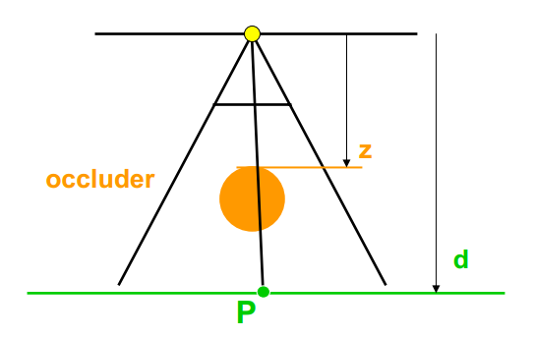
Obj Interaction
Obj loading
Threejs obj loader
Obj Shadow
Shadow Map
render a depth texture from the point of view of light
transform vertex into the light view space
if(position.z > depth) ---> part of shadow
Obj Reflection & Refraction
Reflection Map
render a reflection texture from the point of view of reflection point
Notes:
height += drag (based on dist to click center)
normal = cross (dH/dx, dH/dy)
speed += (averageHeight - Height), averageHeight = (sum of 4 neighbouring Heights)/4
height += volume in water (oldCenter), height -= volume in water(newCenter)

Slide 5
Wind & Rain
Wind
3D Perlin noise as a noise texture
Change water height based on noise
Rain
Pseudo random mouse click

Slide 6
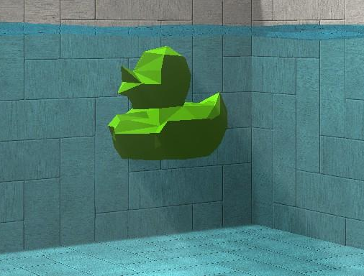



God rays
Volumetric light scattering due to shadows
Depth map -> Godray texture -> Post-process
Godray texture: Blurs a mask generated from the depth map along radial lines emanating from the light source.
3 passes
Notes:
1st pass - take depth map as input, blur along the line from current pixel to light position, and write to 1st ping-pong map
2nd pass - take 1st ping-pong map as input, blur, and write to the 2nd ping-pong map
3rd pass - similar to 2nd pass but switch two ping-pong maps
final pass is in post process, we render the whole scene into a texture and composite god-rays onto colors

Slide 7
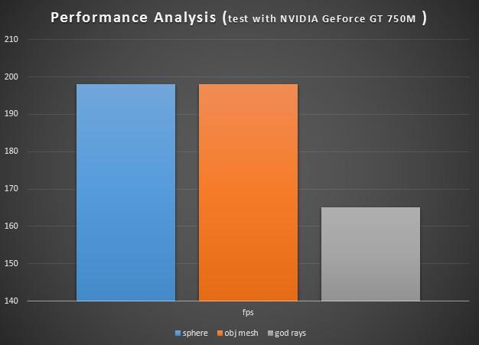
Performance Analysis
Obj mesh interaction: not much influence
-bounding sphere
God rays: Drop down FPS by 30
-3 passes, write to texture
-6 samples each pass

Slide 8
Demo
https://dl.dropboxusercontent.com/u/53181465/aaa/index.html

Slide 9
Future Work
Better obj reflection & refraction
Polish God rays
More Volumetric light scattering effects
(underwater light shaft)

