Slide 1
Deep Learning
Setting the Scene

Slide 2

Lesson Goals
Position the course: Students can understand the place of the Deep Learning course within the overall curriculum, and identify its connections and overlaps with the other courses
Understand the data context:
    Students can identify and explain the 5 Vs of Big Data
    Students can describe the evolution of data paradigms, from an application perspective, and from an analytical perspective
Engineer trustworthy AI: Students can identify key ethical considerations in AI, and outline some of the requirements for trustworthy AI

Slide 3

Deep Learning = (Big) Data Course!

Slide 4
Deep Learning = (not always Big) Data Course!
Train from scratch
Pretrained model
Adapt to the task
Often needs a large, representative task-specific dataset.
Already learned broadly useful representations from large-scale pretraining.
Prompting, retrieval, fine-tuning or transfer learning can work with much less task data.
More data helps only when it is relevant, lawful, representative and usable.
Notes:
[Sources]
- https://arxiv.org/abs/2108.07258
- https://fontawesome.com/license/free

Slide 5
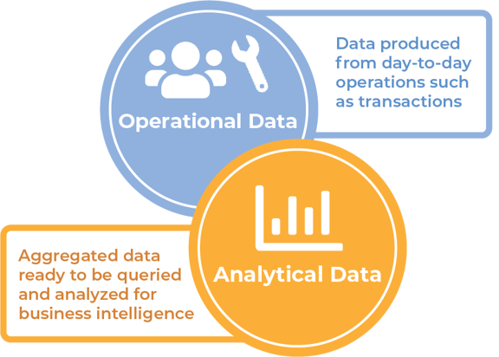
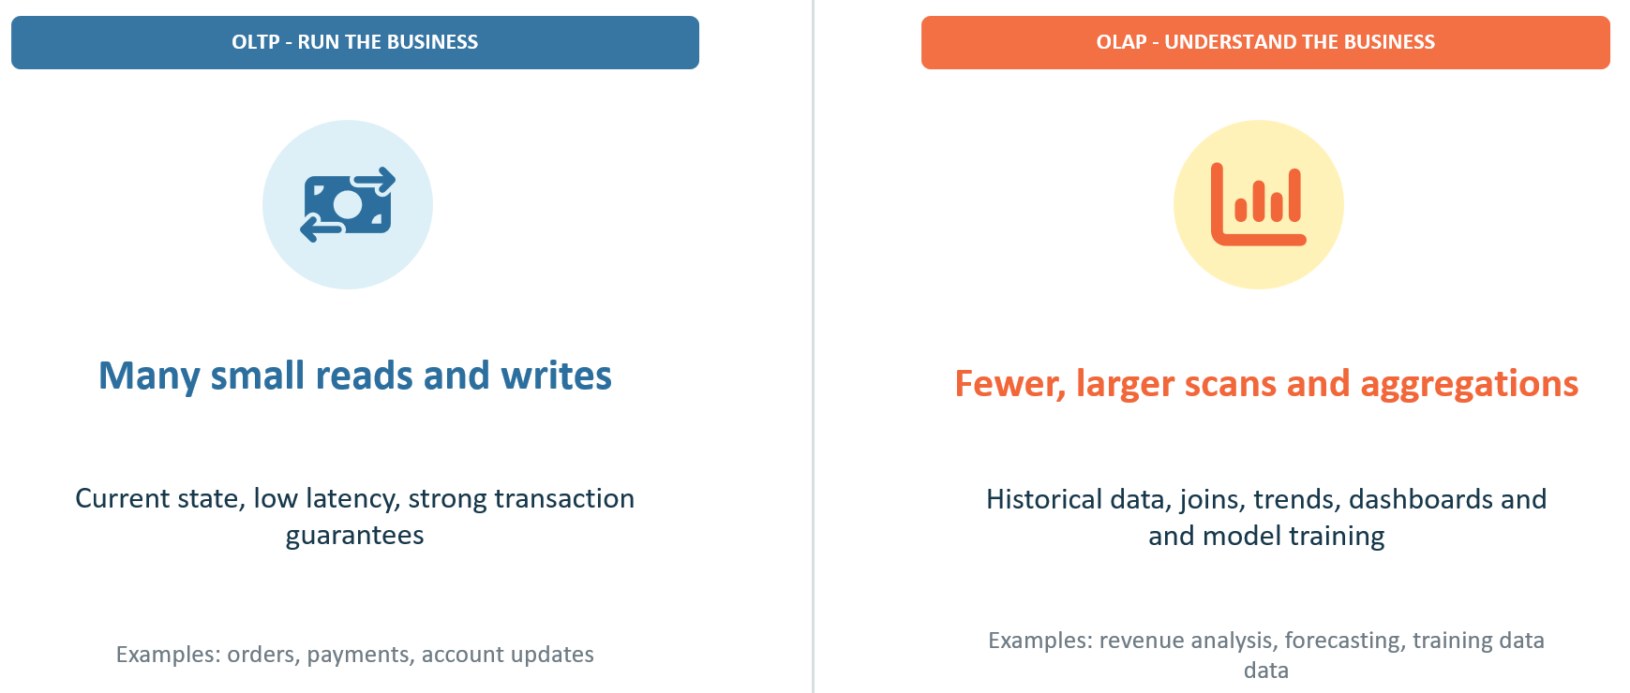
Deep Learning for Analytics
Deep Learning for Operational use (focus of this course)

Slide 6
Deep Learning for analytics and for operational use
ANALYTICS / DECISION SUPPORT
OPERATIONAL / EMBEDDED AI
Batch or exploratory
Real-time or automated
A person interprets predictions, patterns or generated content before acting.
The model is part of a running application and may trigger actions directly.
Examples: churn analysis, image review, forecasting
Examples: fraud blocking, recommendations, agents
Operational AI requires software engineering, monitoring and safeguards around the model.

Slide 7
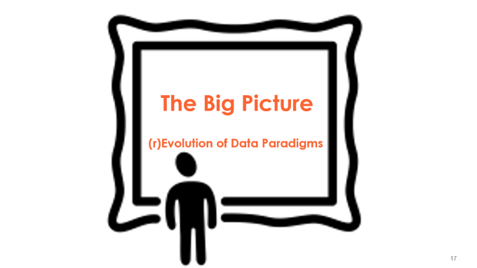
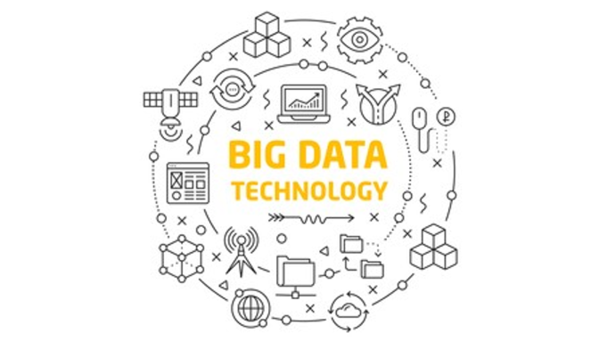
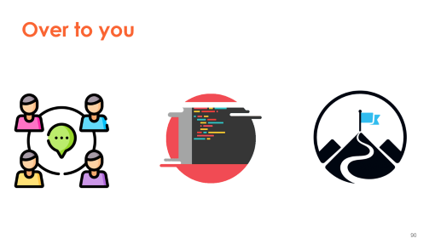
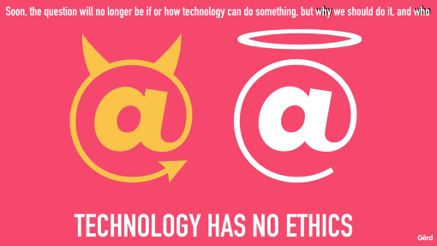


Slide 8


Slide 9
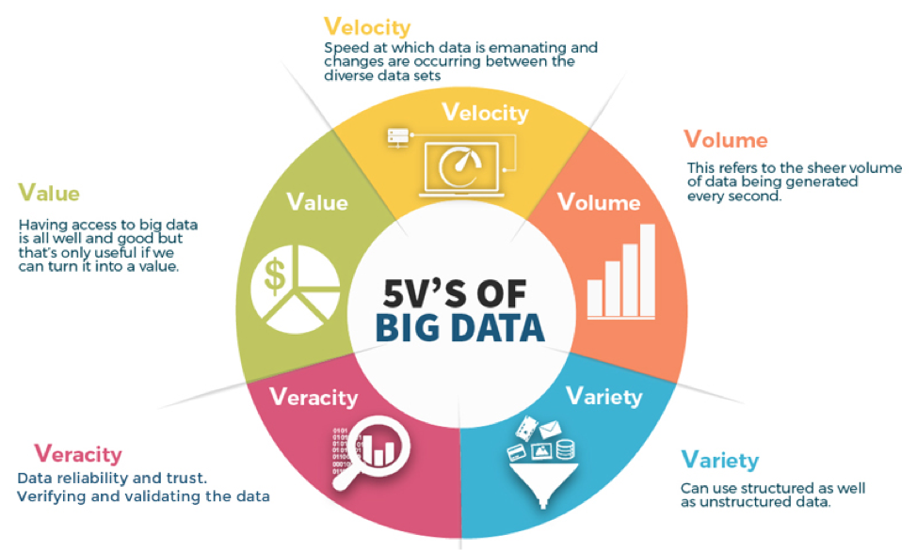
5 V’s of Big Data – The Challenges!
Notes:
1. Volume:
The name ‘Big Data’ itself is related to a size which is enormous.
Volume is a huge amount of data.
To determine the value of data, size of data plays a very crucial role. If the volume of data is very large then it is actually considered as a ‘Big Data’. This means whether a particular data can actually be considered as a Big Data or not, is dependent upon the volume of data.
Hence while dealing with Big Data it is necessary to consider a characteristic ‘Volume’.
Example: In the year 2016, the estimated global mobile traffic was 6.2 Exabytes(6.2 billion GB) per month. Also, by the year 2020 we will have almost 40000 ExaBytes of data.
2. Velocity:
Velocity refers to the high speed of accumulation of data.
In Big Data velocity data flows in from sources like machines, networks, social media, mobile phones etc.
There is a massive and continuous flow of data. This determines the potential of data that how fast the data is generated and processed to meet the demands.
Sampling data can help in dealing with the issue like ‘velocity’.
Example: There are more than 3.5 billion searches per day are made on Google. Also, FaceBook users are increasing by 22%(Approx.) year by year.
3. Variety:
It refers to nature of data that is structured, semi-structured and unstructured data.
It also refers to heterogeneous sources.
Variety is basically the arrival of data from new sources that are both inside and outside of an enterprise. It can be structured, semi-structured and unstructured.
Structured data: This data is basically an organized data. It generally refers to data that has defined the length and format of data.
Semi- Structured data: This data is basically a semi-organised data. It is generally a form of data that do not conform to the formal structure of data. Log files are the examples of this type of data.
Unstructured data: This data basically refers to unorganized data. It generally refers to data that doesn’t fit neatly into the traditional row and column structure of the relational database. Texts, pictures, videos etc. are the examples of unstructured data which can’t be stored in the form of rows and columns.
4. Veracity:
It refers to inconsistencies and uncertainty in data, that is data which is available can sometimes get messy and quality and accuracy are difficult to control. When it comes to the accuracy of big data, it’s not just the quality of the data itself but how trustworthy the data source, type, and processing of it is. Removing things like bias, abnormalities or inconsistencies, duplication, and volatility are just a few aspects that factor into improving the accuracy of big data.
Big Data is also variable because of the multitude of data dimensions resulting from multiple disparate data types and sources.
Example: Data in bulk could create confusion whereas less amount of data could convey half or Incomplete Information.
5. Value:
After having the 4 V’s into account there comes one more V which stands for Value!. The bulk of Data having no Value is of no good to the company, unless you turn it into something useful.
Data in itself is of no use or importance but it needs to be converted into something valuable to extract Information. Hence, you can state that Value! is the most important V of all the 5V’s.

Slide 10
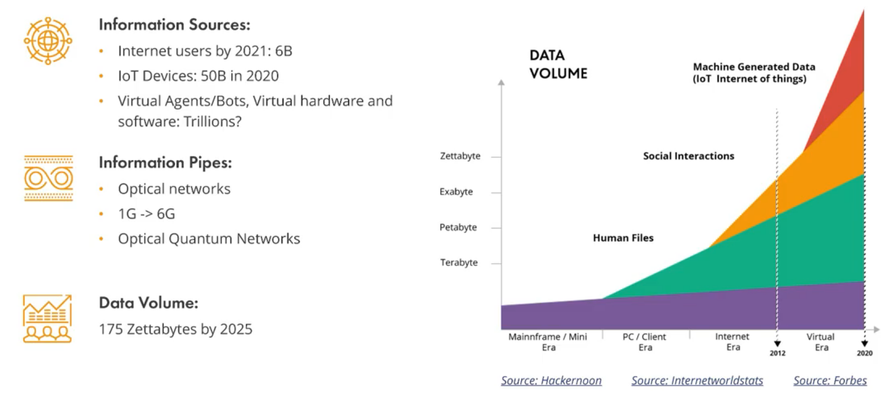
Volume
‘The Explosion of Data’

Slide 11
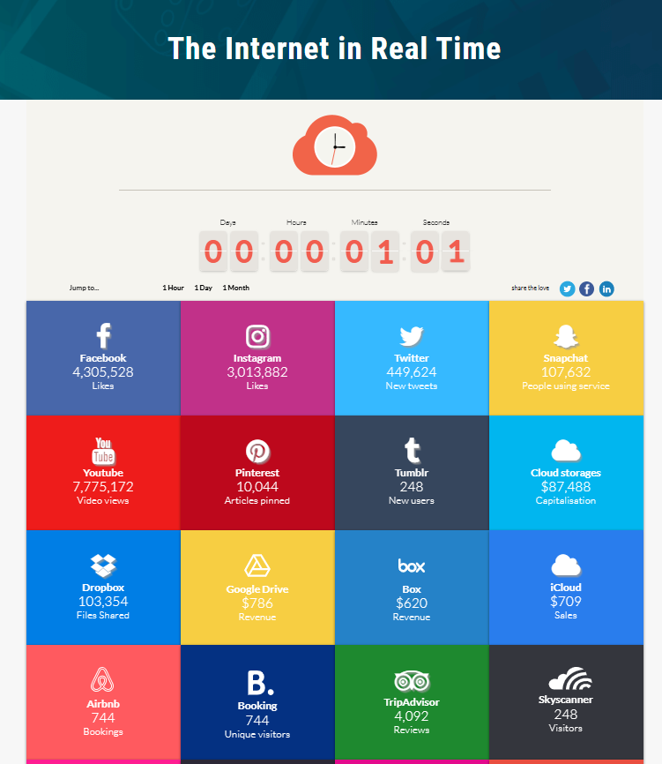
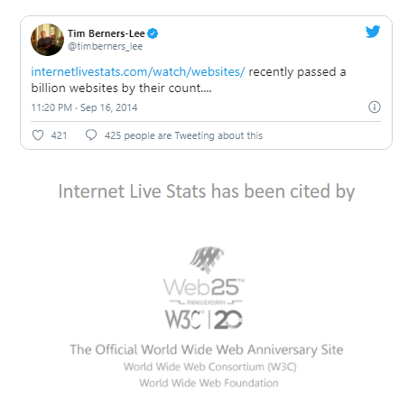
Velocity https://betfy.co.uk/internet-realtime/

Slide 12
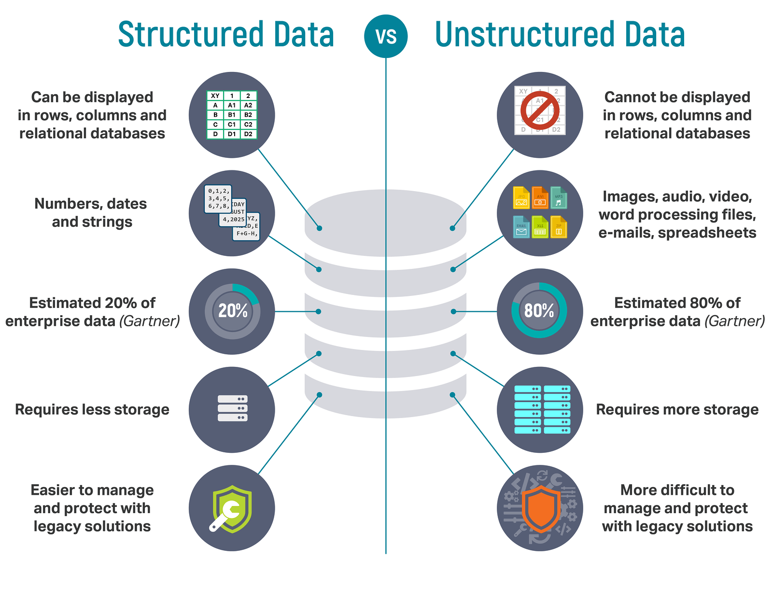
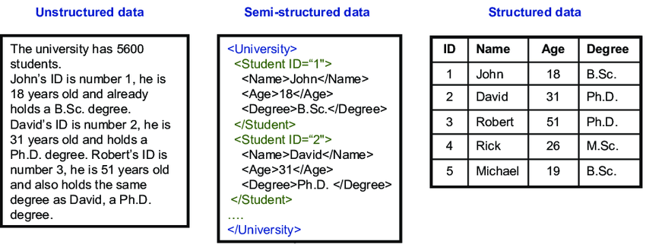
Variety
Unstructured – Semi – Structured Data

Slide 13
Variety
Structured Semi-structured Unstructured Multimodal Data
Structured
Semi-structured
Unstructured
Multimodal
Rows, columns, types
JSON, logs, events
Text, images, audio, video
Several modalities together
Modern deep learning often learns directly from raw modalities - but metadata and structure still matter.
Notes:
[Sources]
- https://fontawesome.com/license/free

Slide 14
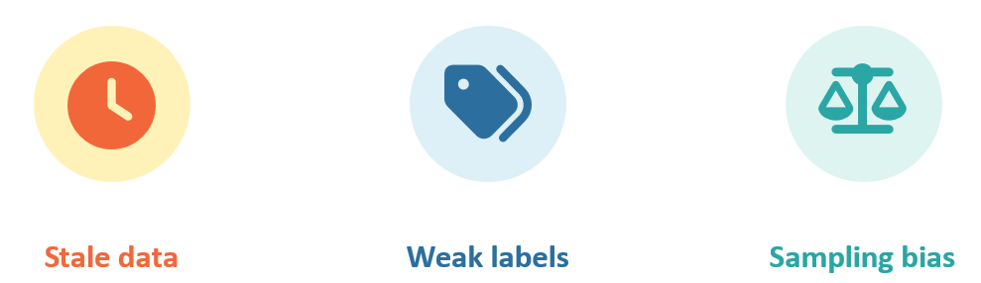
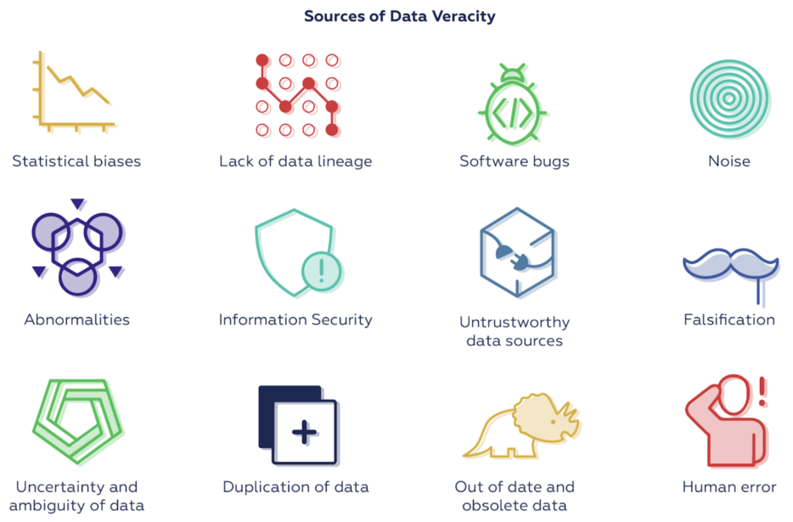
Veracity
‘Trustworthyness of Data’

Slide 15
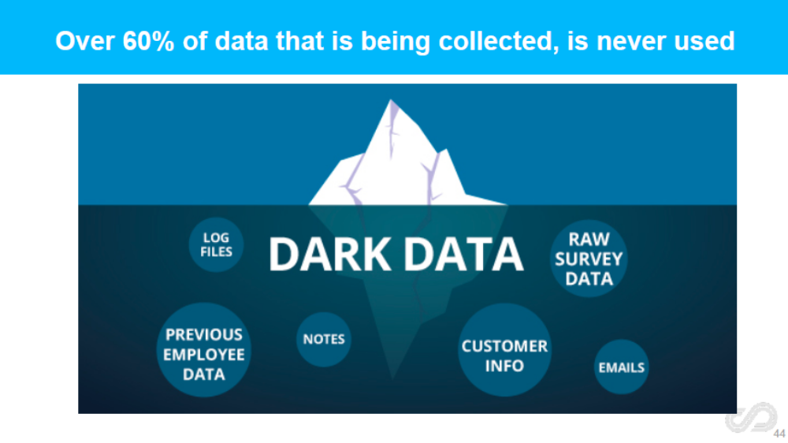
Value
Usefulness or worth of data, what with Dark Data?

Slide 16
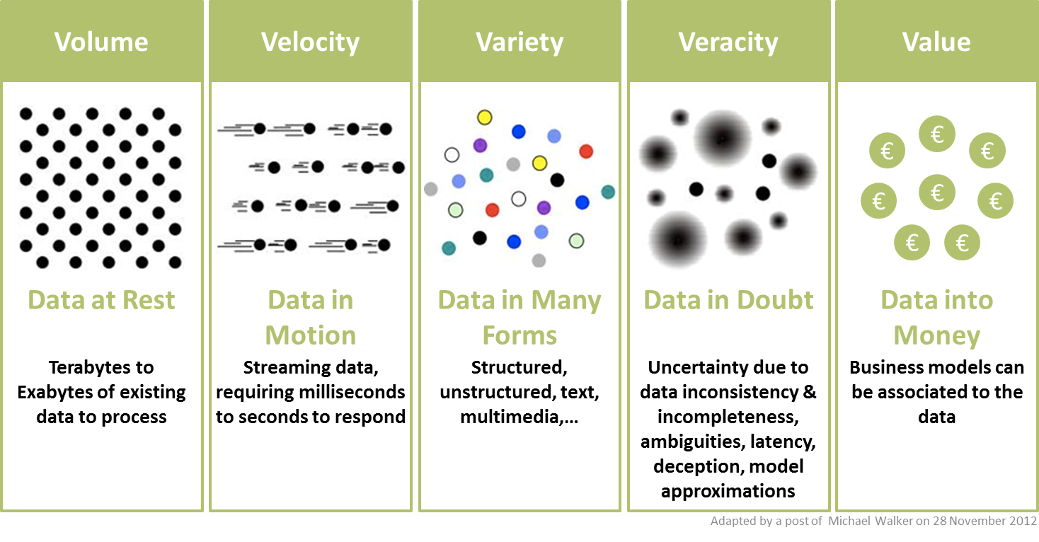
Recap

Slide 17

The Big Picture
(r)Evolution of Data Paradigms

Slide 18
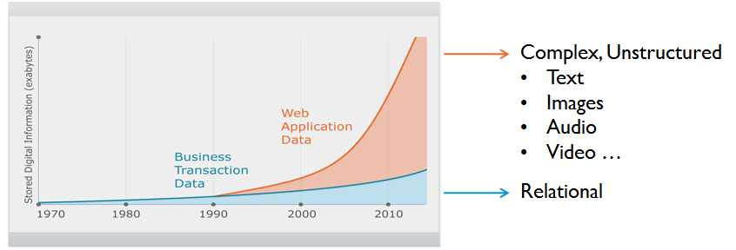
Evolution: Powered by User Data

Slide 19

The story of data…
From an application standpoint

Slide 20
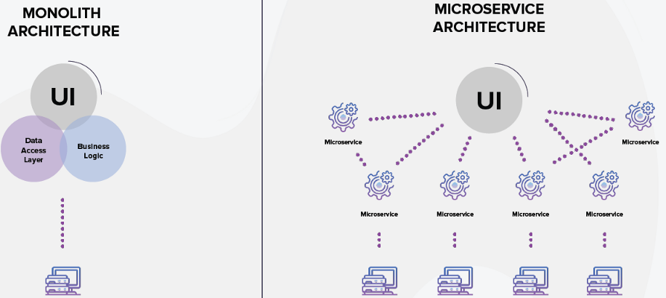
Evolution of Application Architecture
Move from single-server monolith to microservices
At the same time, move from on-premise to cloud

Slide 21
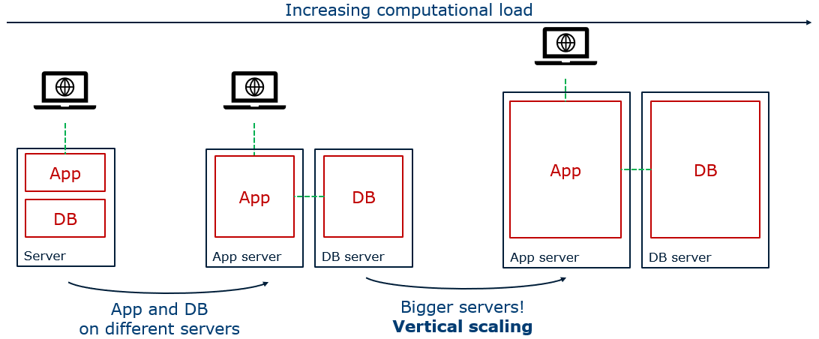
Evolution of Application Architecture

Slide 22
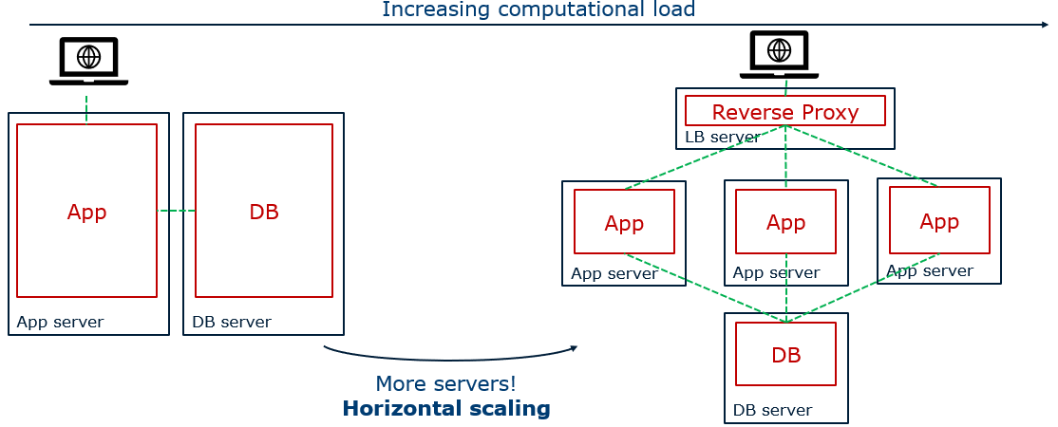
Evolution of Application Architecture

Slide 23
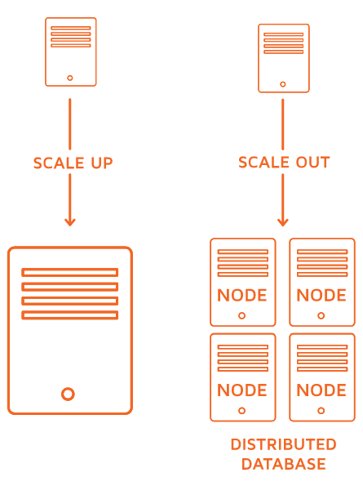
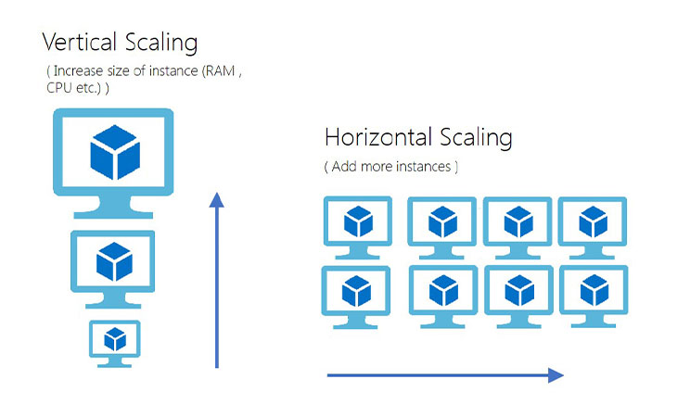
Horizontal (Out) – Vertical (Up) Scaling

Slide 24
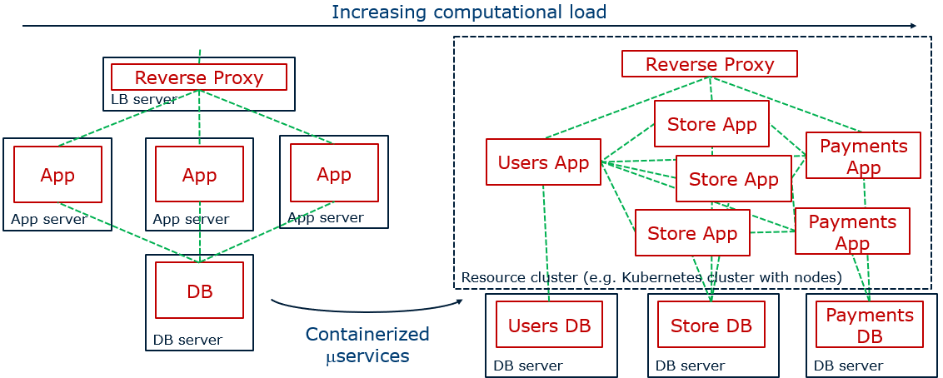
Evolution of Application Architecture
API’s
API’s
API’s
API’s

Slide 25
The story of data…
From a database and analytics standpoint

Slide 26
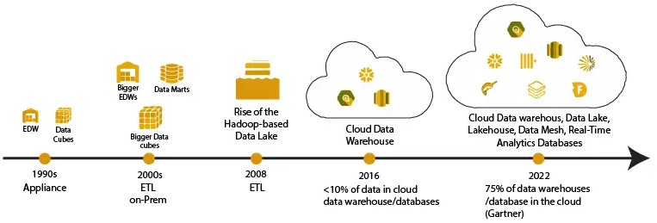
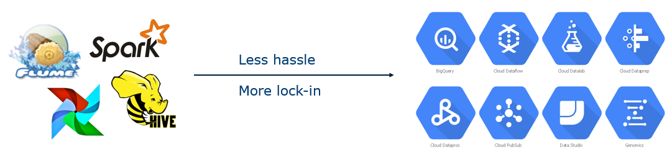
Evolution of Data Analytics Architecture
Move from monolith to:
  Clustered databases for OLTP
  From Data Warehouse → Data Lake → Data Lakehouse → Data Mesh
Move from self-managed on-prem to managed cloud solutions

Slide 27
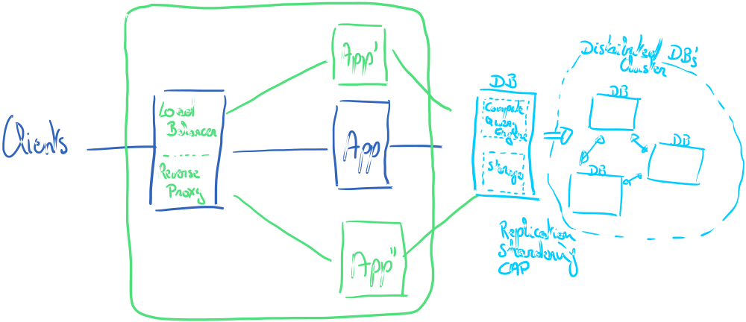
Evolution of Database Architecture
From Monolith to Cluster

Slide 28
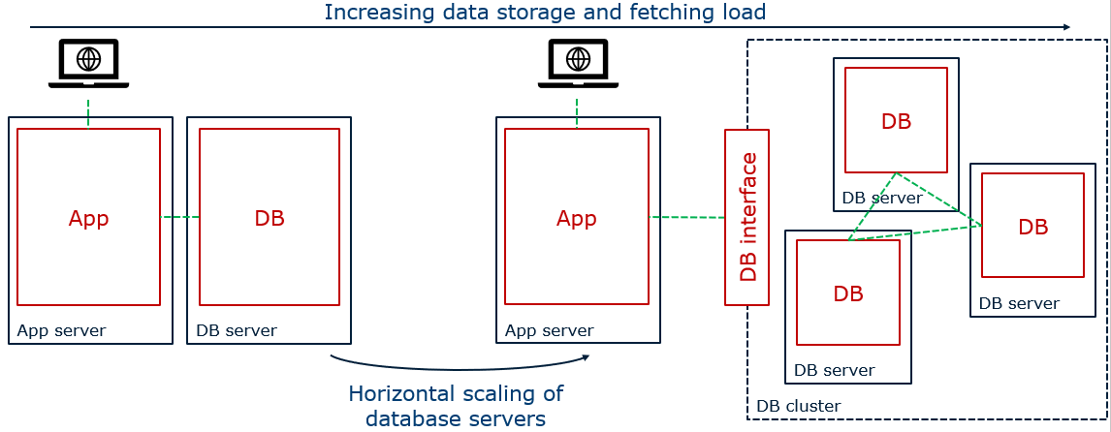
Evolution of Database Architecture

Slide 29
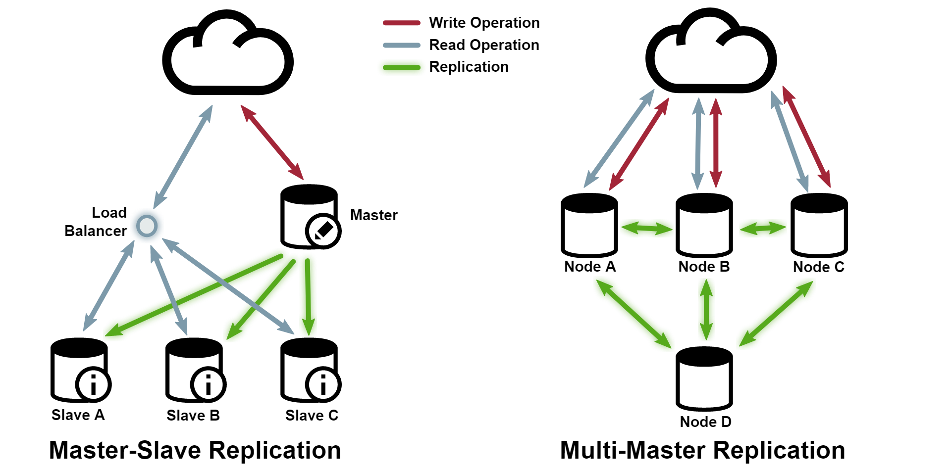
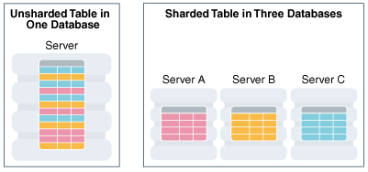
Strategies for Splitting-up the DB
Sharding Replication

Slide 30
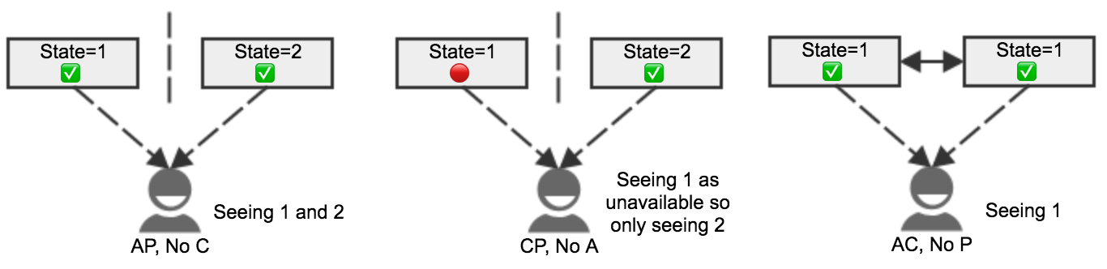
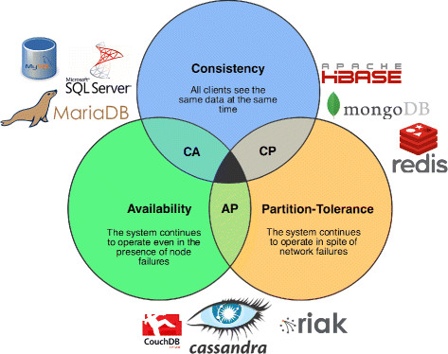
Distributed Systems: CAP theorem

Slide 31

CAP Theorem https://www.youtube.com/watch?v=k-Yaq8AHlFA&t=3s&ab_channel=DistributedSystemsCourse

Slide 32
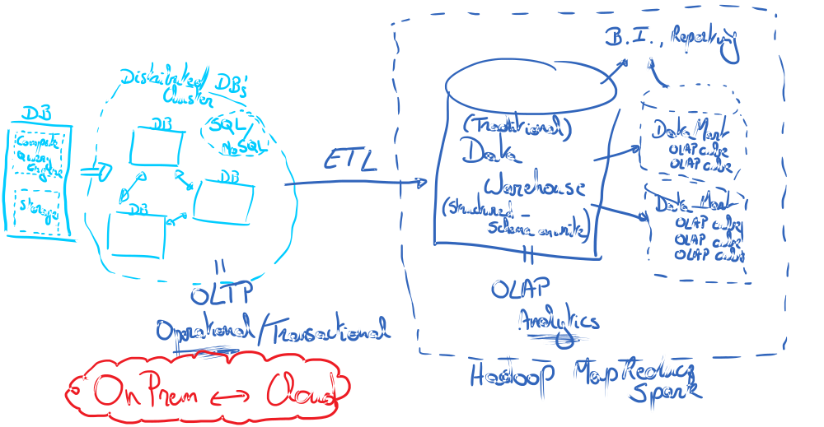
Evolution of Database Architecture
Supporting Analysis

Slide 33
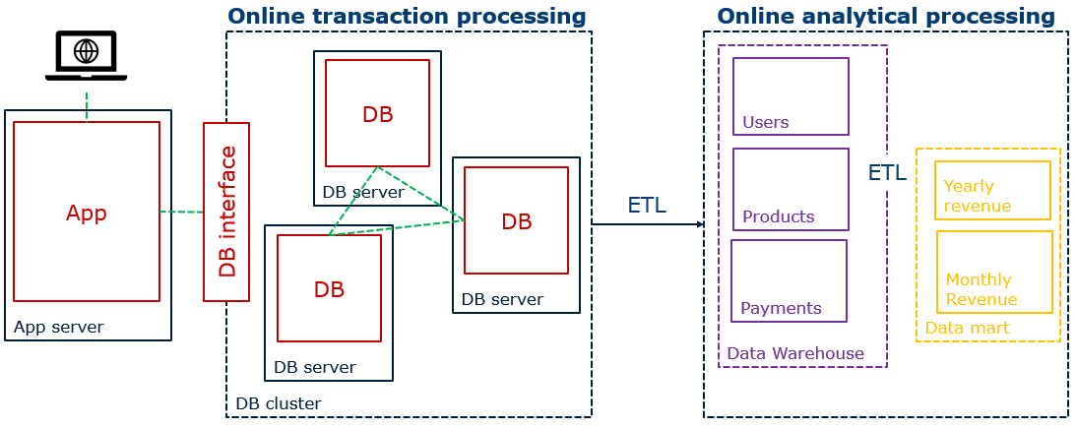


Evolution of Database Architecture
Supporting Analysis: Data Warehouse

Slide 34
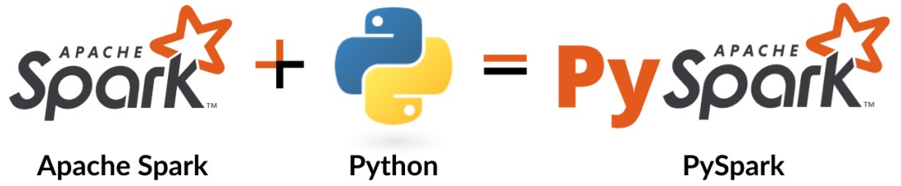
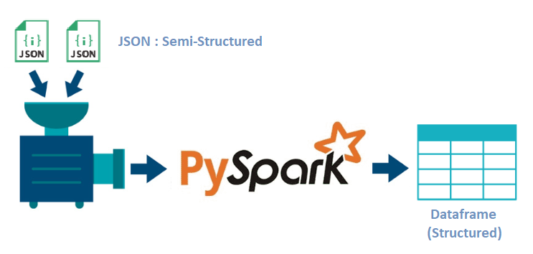
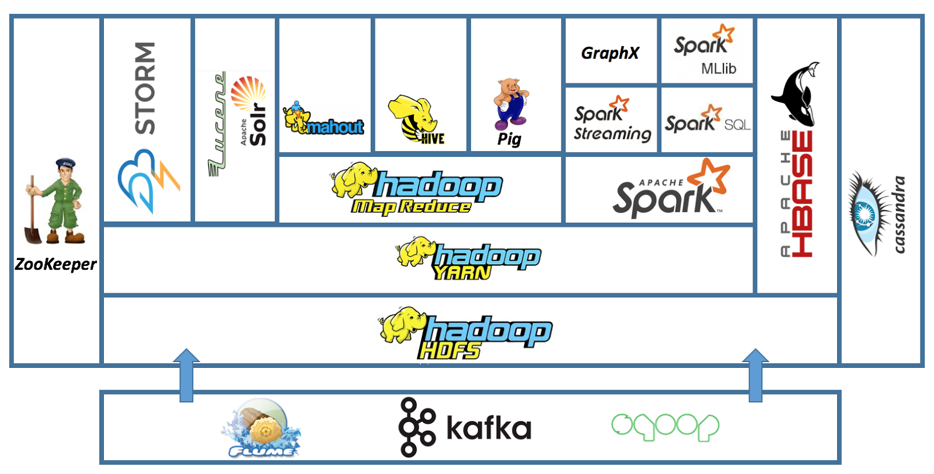
Hadoop & Spark Eco-system
Focus is on semi- or structured data!

Slide 35
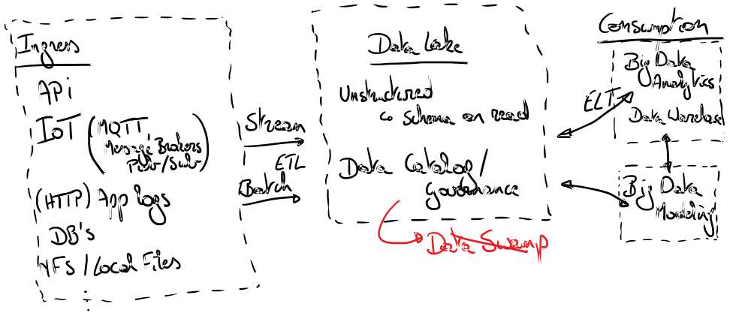
Evolution of Database Architecture
Supporting Variety & Velocity: Data Lake

Slide 36
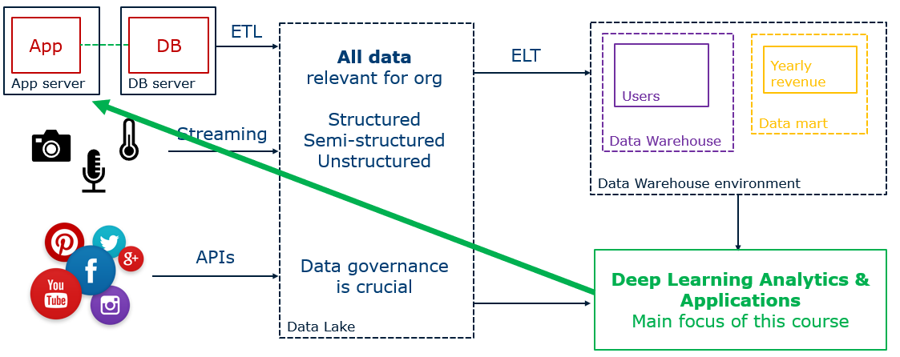
Evolution of Database Architecture
Supporting Variety & Velocity

Slide 37
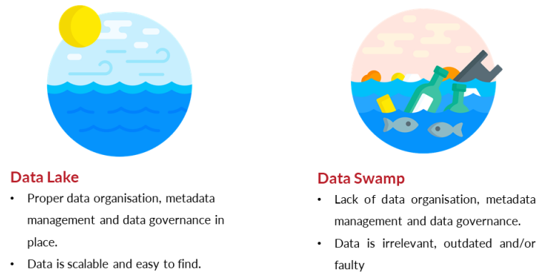
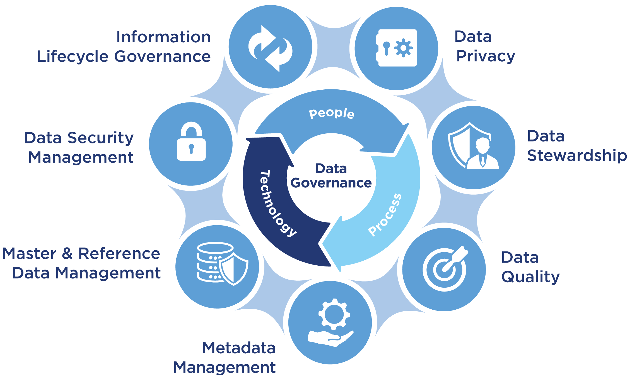
Data Swamp – Data Governance
By emphasizing the data governance, and metadata layer in a datalake, we can enhance data accessibility and usability by also adding an API layer…
Enter the Data Lakehouse!
Notes:
✅ Abstracts Complexity
APIs hide the complexity of raw file formats (e.g., Parquet, ORC) and storage systems (e.g., S3, ADLS).
Consumers interact with data through clean, consistent endpoints (e.g., /sales/summary, /users/active).
✅ Enforces Governance
APIs can enforce access control, auditing, and data masking at the interface level.
This ensures that governance policies defined in the metadata layer are respected in every data interaction.
✅ Enables Real-Time & Interactive Access
Unlike batch-oriented data lakes, APIs can expose real-time or on-demand data access.
This is crucial for dashboards, apps, or ML inference pipelines.
✅ Supports Interoperability
APIs allow integration with external tools (e.g., Power BI, Tableau, Jupyter, LangChain agents) without tight coupling to the storage layer.
This aligns with data mesh and data product thinking.

Slide 38
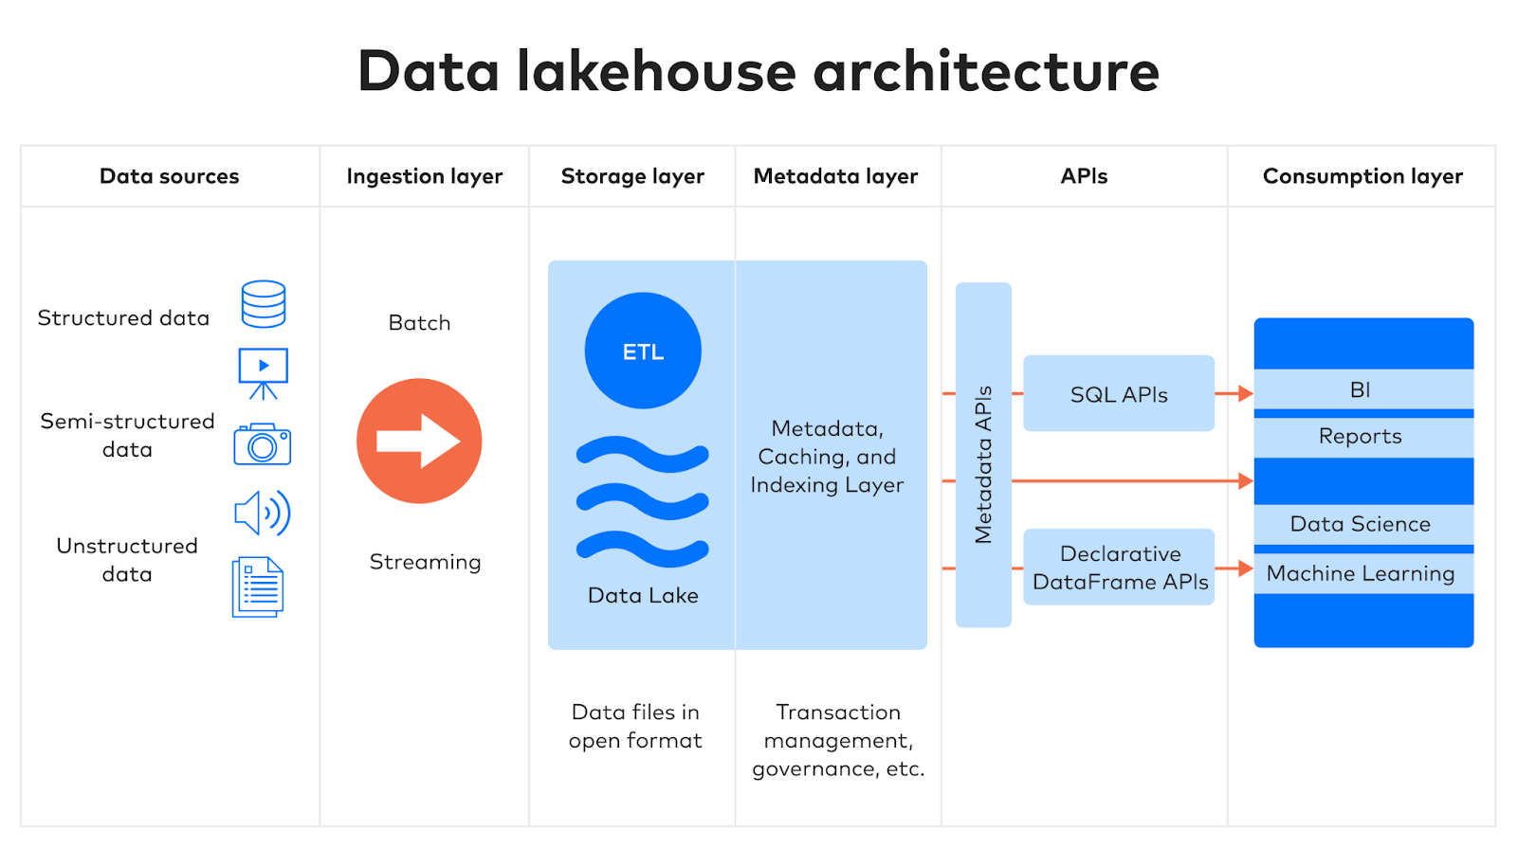
Notes:
A data lakehouse combines the scalability of a data lake with the structure and performance of a data warehouse. The API layer helps complete this transition by:
Making structured access to governed data possible
Supporting SQL-like or RESTful interfaces
Enabling data-as-a-service models

Slide 39
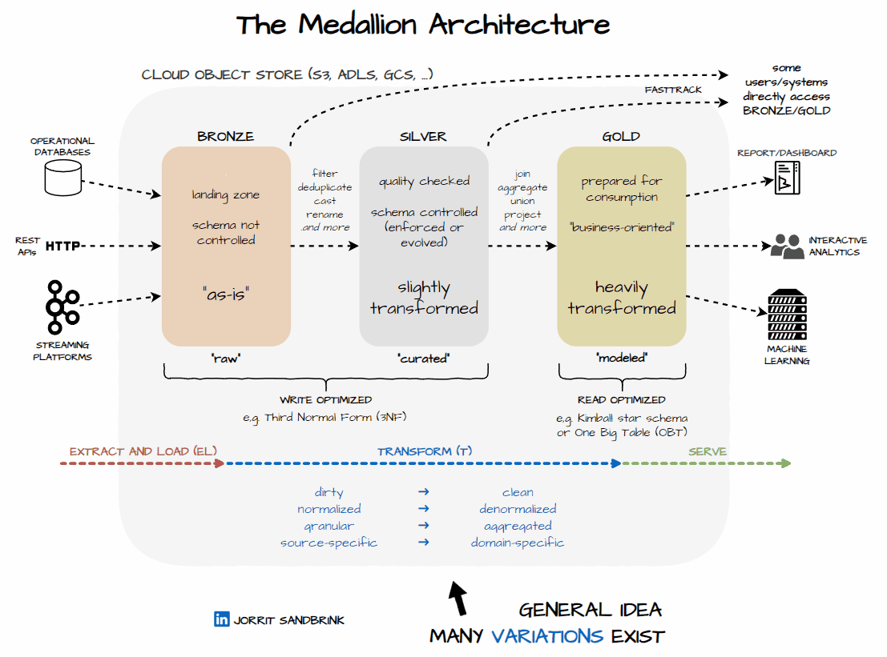
Microsoft Fabric = Data Lakehouse
Notes:
Bronze Layer: This is where raw data is ingested. The data in this layer is typically in its original, unprocessed form, which means it can be messy and contain duplicates or errors. The structure of the data here is often denormalized, meaning it might not follow strict database normalization rules and can include redundant information.
Silver Layer: In this layer, the data is cleaned, validated, and possibly transformed into a more structured format. This often involves normalizing the data, which means organizing it into tables and relationships that reduce redundancy and improve data integrity. The silver layer aims to create a reliable dataset that can be used for more detailed analysis.
Gold Layer: The gold layer contains the most refined and aggregated data. Here, the data is often denormalized again to optimize it for specific analytical queries and performance. Denormalization in this context means combining tables and flattening the data structure to make it easier and faster to query, especially for reporting and machine learning purposes

Slide 40
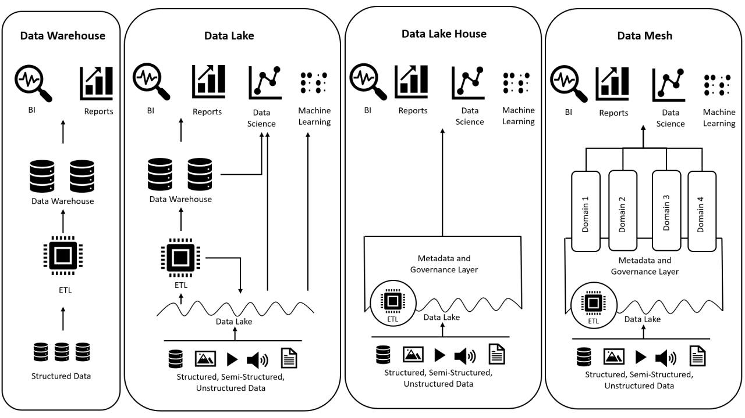
And, finally, into a Data Mesh…?
Decentralize data ownership into domains
Notes:
data mesh reintroduces some "siloing", but it's intentional and strategic—focused on domain ownership, privacy, and scalability, not isolation. It’s about federated governance rather than central control.

Slide 41


Slide 42
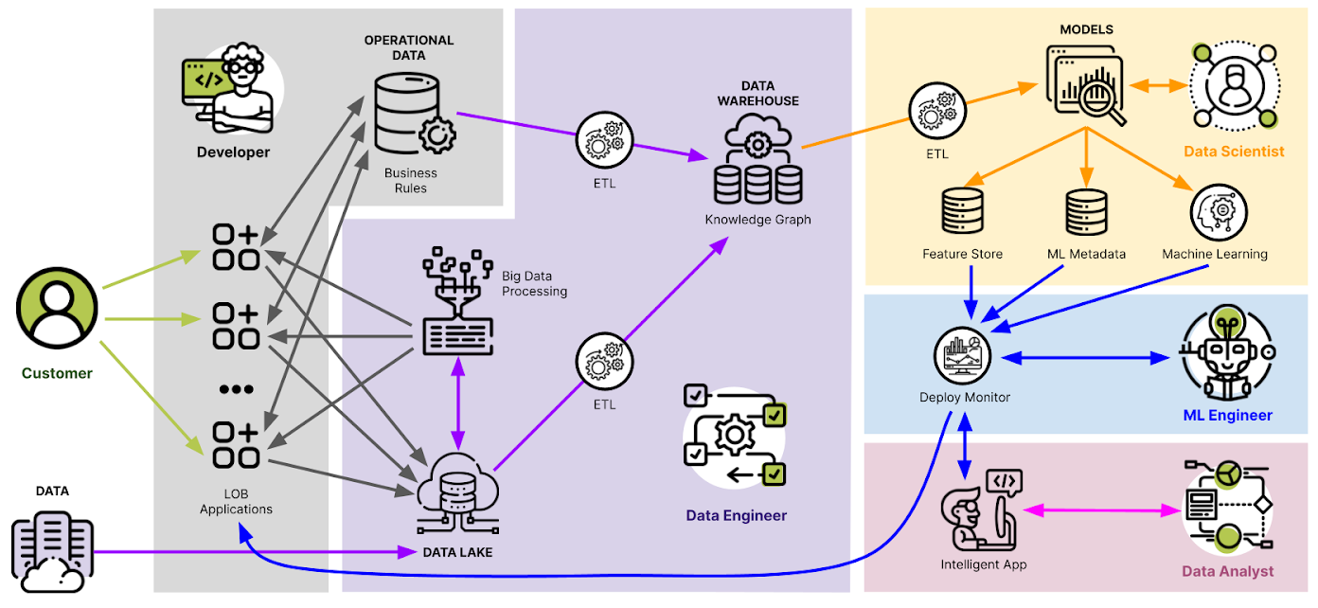
Data Engineering - Cloud AI - Deep Learning - Business Intelligence

Slide 43
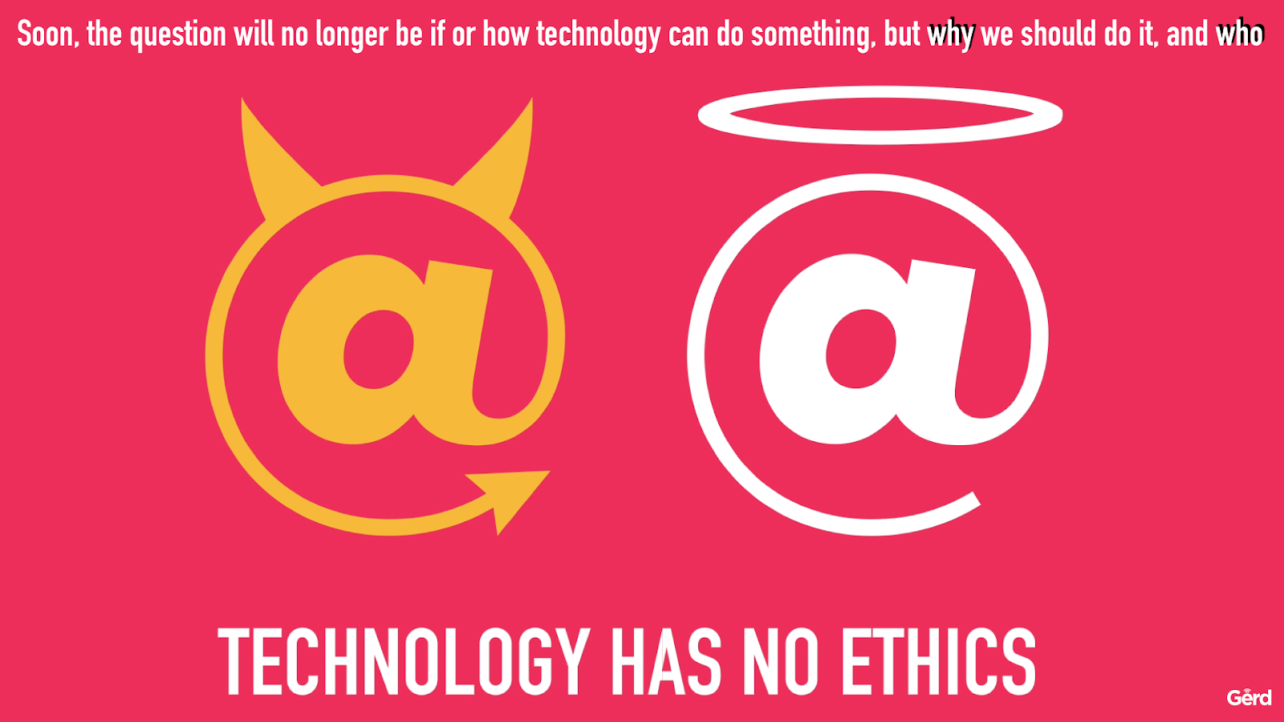

Slide 44
Machine Learning
Ethics & Trustworthy AI

Slide 45
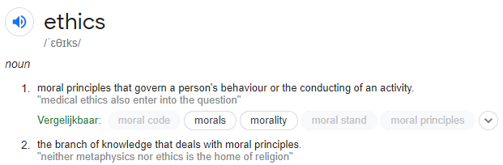


Why Ethics?

Slide 46
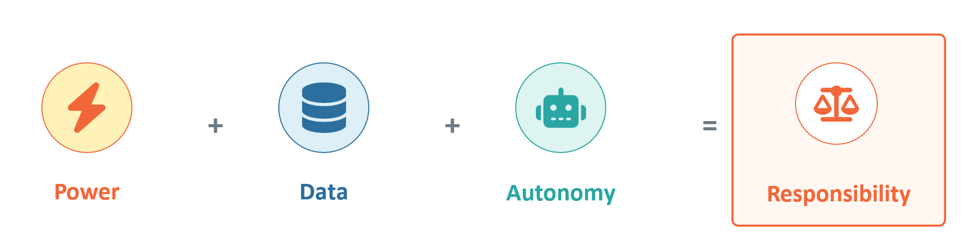
Why Ethics?
Capability changes responsibility

Slide 47

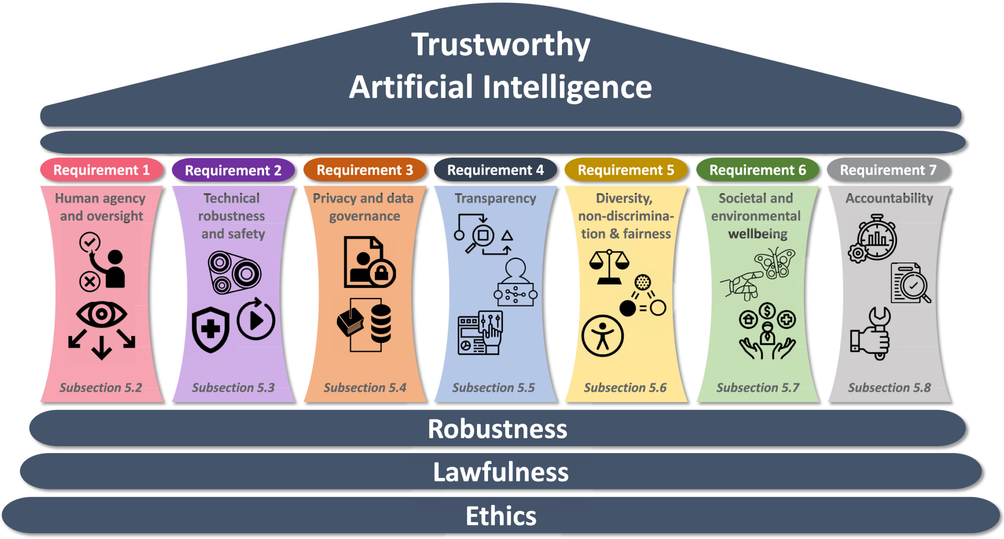
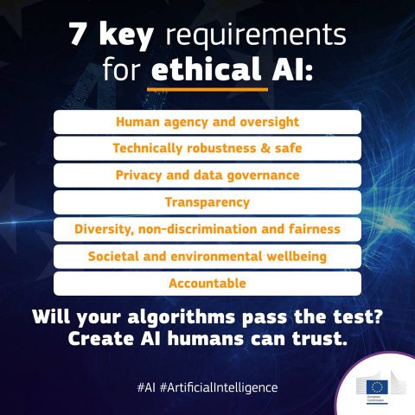
EU & Ethical AI

Slide 49
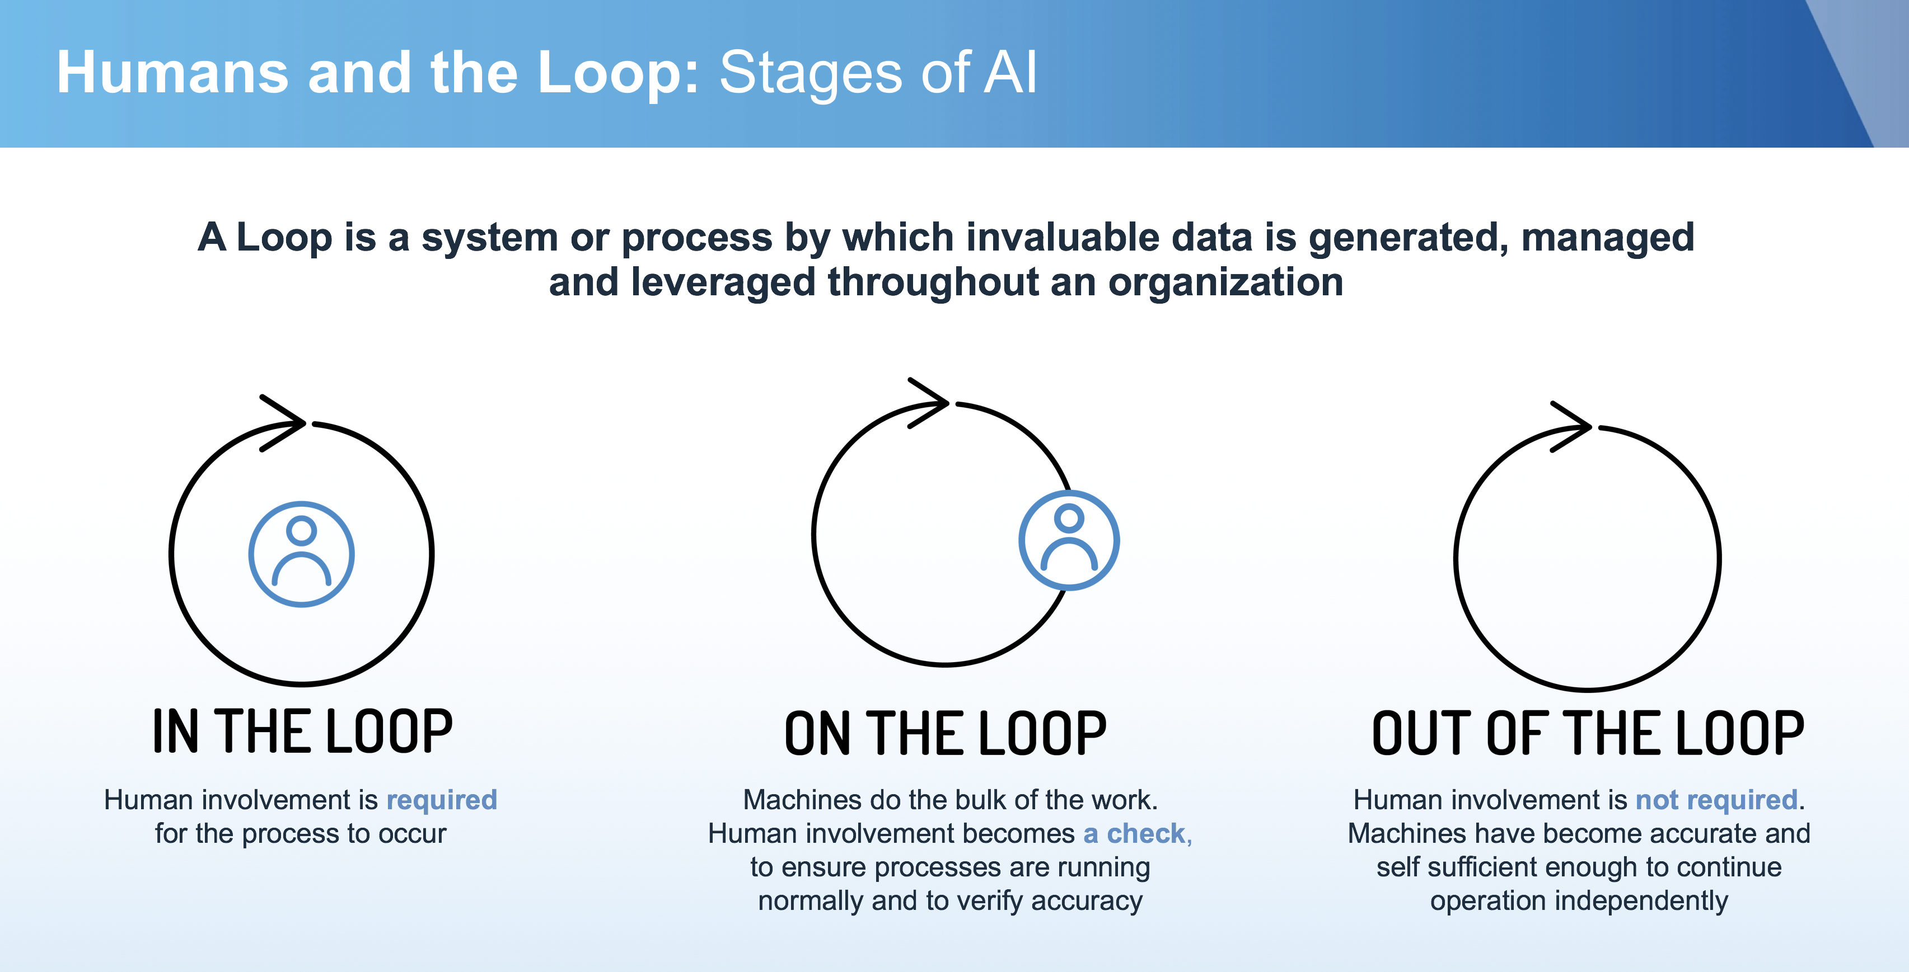
Human-in-, on-, out-the-loop
Notes:
https://www.datacenterdynamics.com/en/opinions/path-ai-connected-government/
Human-in-the-Loop (HITL): This approach involves humans actively participating in the AI decision-making process. They provide input, validate models, monitor for bias, and make final decisions based on AI recommendations. This ensures accountability and transparency, as humans can intervene and correct the AI’s actions in real-time.
Human-on-the-Loop (HOTL): Here, humans take on a supervisory role. They oversee the AI’s actions and intervene only when necessary. This allows for a balance between automation and human oversight, ensuring that the AI operates within acceptable parameters while still having human control available if needed.
Human-out-of-the-Loop (HOOTL): In this scenario, AI systems operate fully autonomously without human intervention. While this can increase efficiency, it also raises concerns about accountability, transparency, and bias, as there is no human oversight to address potential issues.

Slide 50






Robotics / Drones & AI

Slide 52


Confusion Matrix
Accuracy doesn’t tell the whole story! Get a more nuanced view with a confusion matrix

Slide 53


Robustness requires more than accuracy

Slide 54



Adversarial Attack (breaking the CNN)

Slide 56





Fake News
Deep Fakes

Slide 57


StyleGAN2 (www.thispersondoesnotexist.com)

Slide 58

Generative Adversarial Networks
(GANs)

Slide 59



GANs: Why Discriminator Network?
‘Conceptual Loss vs MSE Loss’
Same MSE loss, different perceptual ‘quality’:

Slide 60



Surveillance capitalism
Notes:
https://mediareset.com/2015/11/04/big-media-sales-opportunity-take-big-data-to-main-street/
https://www.vpro.nl/programmas/tegenlicht/kijk/afleveringen/2021-2022/handel-in-voorkennis.html

Slide 61



Who sells what data?
Notes:
https://www.techtarget.com/whatis/definition/surveillance-capitalism
https://www.vpro.nl/programmas/tegenlicht/kijk/afleveringen/2021-2022/handel-in-voorkennis.html
https://usercentrics.com/knowledge-hub/data-is-the-new-gold-how-and-why-it-is-collected-and-sold/

Slide 63


Explanainable AI (XAI)

Slide 64

XAI – Computer Vision
‘Activation (from CNN) Maps’

Slide 65

XAI – Natural Language Processing
‘Attention (from Transformer) Maps’

Slide 67


Deep Learning = Data Driven

Slide 68


Bias (in Dutch: vooroordeel, vooringenomenheid)

Slide 69


Balanced dataset to learn from?

Slide 70


Gender Bias

Slide 71

Racial & Gender Bias

Slide 72


Racial Twitter Conversational Bot

Slide 73


Fairness? Non-discrimination?

Slide 75

China: ‘Social Score’ (Skynet)?

Slide 76

Filter Bubbles
(Automatic Recommendations)

Slide 77





Green AI versus Red AI
(Efficiency versus Accuracy)

Slide 78



Slide 79


Slide 80

Massive Compute / Energy

Slide 81


Amount of connections / synapses
Animals versus AI models

Slide 82

Artificial Brain versus Human Brain
100x more synapses
Chemical connections
Exchange of info between networks is slow: humans need words / sentences
‘Limited’ connections
Electrical connections
All cells are alike in structure, so can exchange information at very high speed, and we can apply transfer learning / pre-trained networks
Notes:
https://www.youtube.com/watch?v=Y6Sgp7y178k&ab_channel=AmanpourandCompany
Human brain still has 100x more synapses
But…can’t process information that efficiently
So, ANN is way more effective in learning, and because ANN all work alike, they can exchange information at a very high speed…Humans needs words and sentences…
But… ANN need way more information than a human brain to train…

Slide 83


‘Smaller Models’: Model Distillation
Notes:
Model distillation is a technique where a smaller, "student" model learns to mimic the behavior and performance of a larger, more complex "teacher" model, transferring knowledge to achieve comparable accuracy with fewer computational resources. The process involves generating "soft targets" (probability distributions over possible outputs) from the teacher model's predictions on a dataset, which the student model then uses to fine-tune its own parameters. This allows the student model to capture complex patterns and relationships from the teacher's outputs, resulting in more efficient, faster, and cost-effective models for deployment

Slide 84

Mixture of Experts (MoE) LLMs
Notes:
https://www.dailydoseofds.com/p/transformer-vs-mixture-of-experts-in-llms/

Slide 86


Autonomous vehicle needs to make decisions…
https://www.moralmachine.net/

Slide 87



Notes:
https://winterkongress.ch/2025/talks/uncovering_discrimination_in_public_fraud_detection_systems/
The Dutch childcare benefits scandal—known locally as the "toeslagenaffaire"—was a major political and social crisis caused by the misuse of AI algorithms by the Dutch tax authorities.
🔍 What happened?
Between 2013 and 2019, the Dutch tax office used a self-learning algorithm to detect fraud in childcare benefit applications. The algorithm flagged thousands of families—over 26,000—as potential fraudsters, often based on discriminatory factors like:
Dual nationality
Ethnicity
Address
Income level
These families were then:
Forced to repay thousands of euros they had legally received
Denied access to other benefits
Faced bankruptcy, mental health issues, and family breakdowns
In some cases, children were taken into foster care
⚠️ Why was it a scandal?
The algorithm operated as a black box, with no transparency or human oversight.
It discriminated against people of color and immigrants.
The tax office assumed guilt based on flawed logic (e.g., applying the Pareto principle—assuming 80% of flagged cases were guilty).
Victims had no recourse or appeal options.
🧠 Key lessons:
AI systems must be explainable and accountable.
Human oversight is essential in automated decision-making.
Bias in data and design leads to real-world harm.
Transparency in public sector algorithms is critical.
The scandal led to the resignation of the entire Dutch cabinet in early 2021 and remains a cautionary tale about the dangers of unregulated algorithmic governance

Slide 88

Amazon ‘Just Walk Out’

Slide 89

AI in Healthcare

Slide 90



Over to you

