Slide 1

Last Lesson:
Data Realm

Slide 2
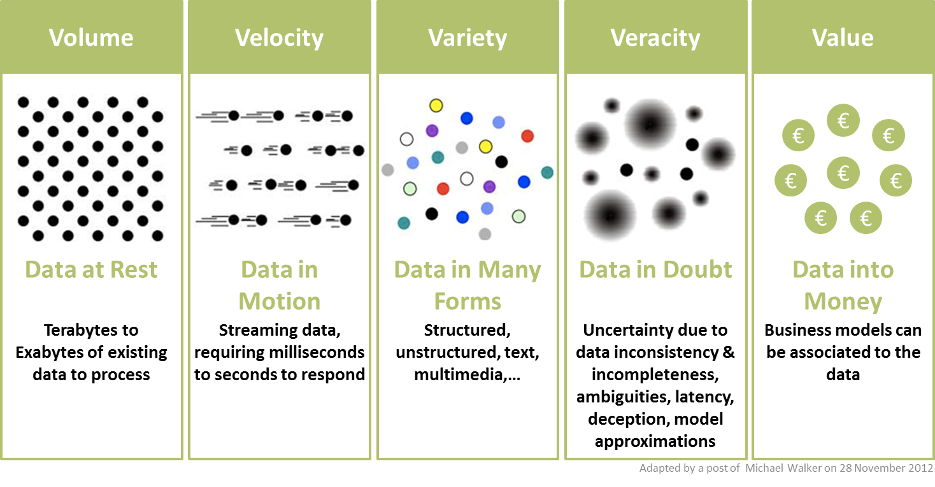
5 V’s of Big Data

Slide 3
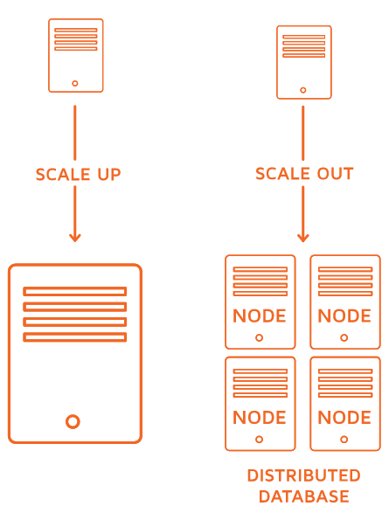
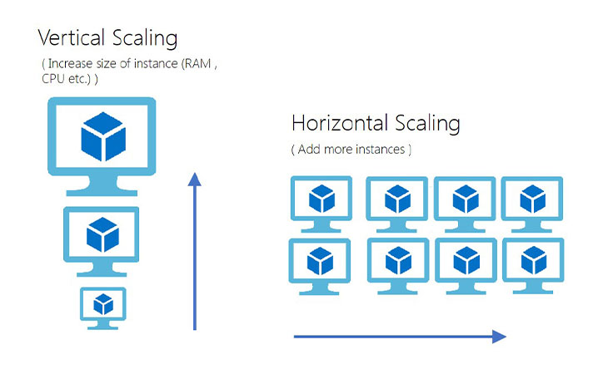
Horizontal (Out) – Vertical (Up) Scaling

Slide 4
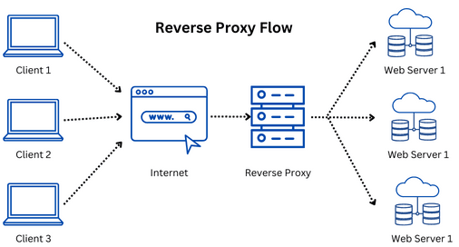
Distributed Resources: ‘Manager’ needed
Reverse Proxy

Slide 5
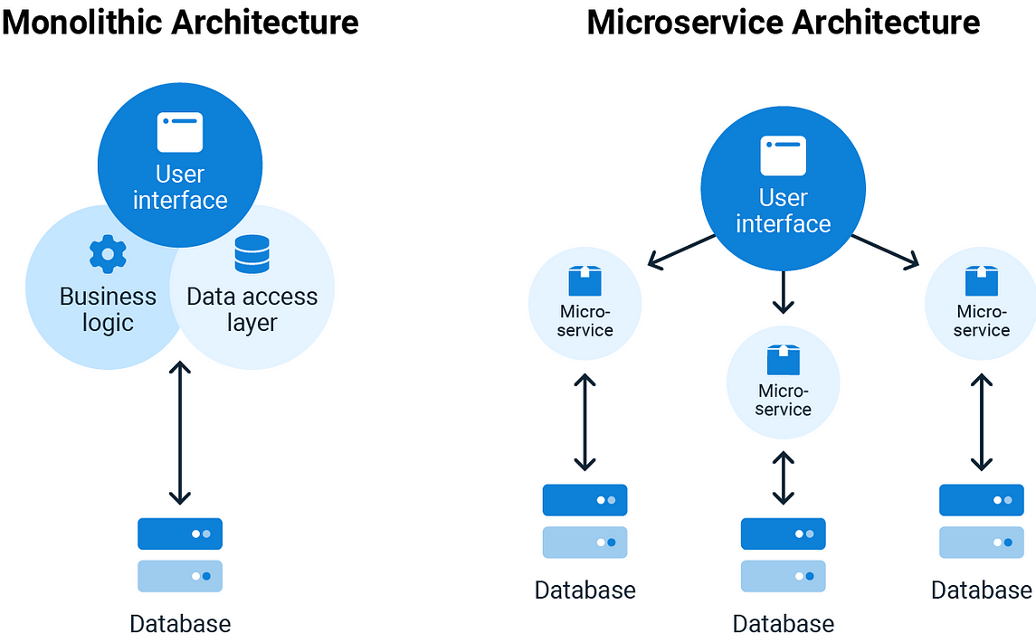
Evolution of Application Architectures

Slide 6
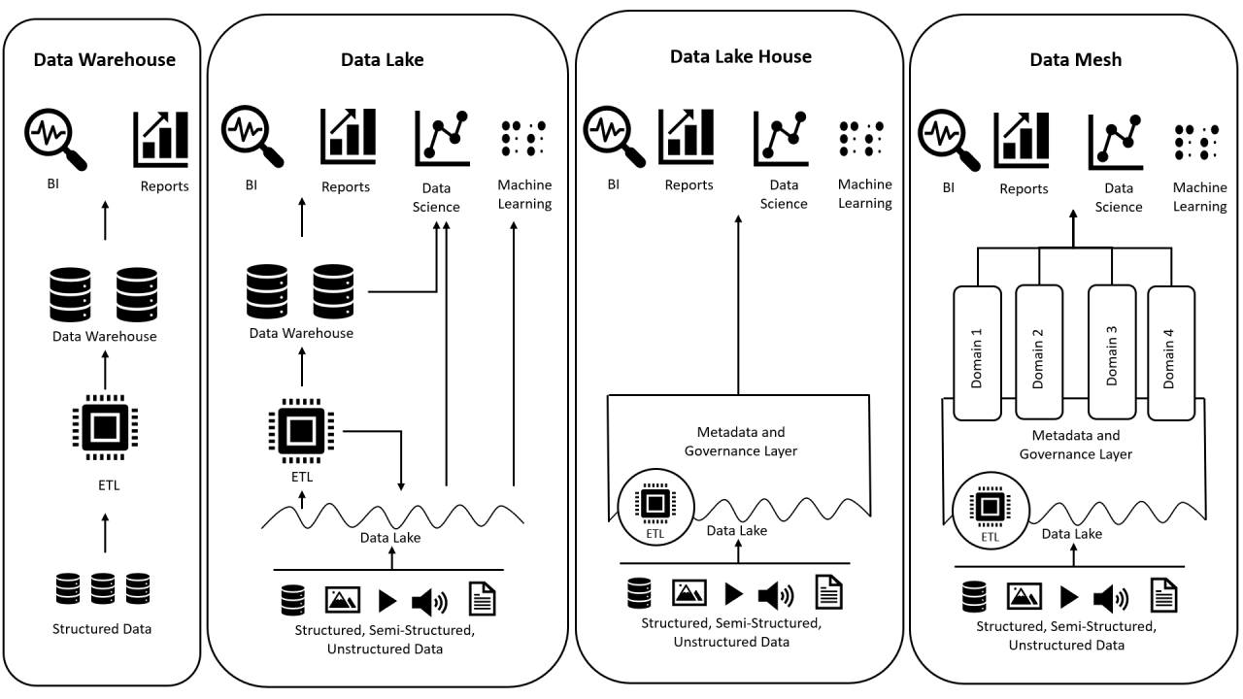



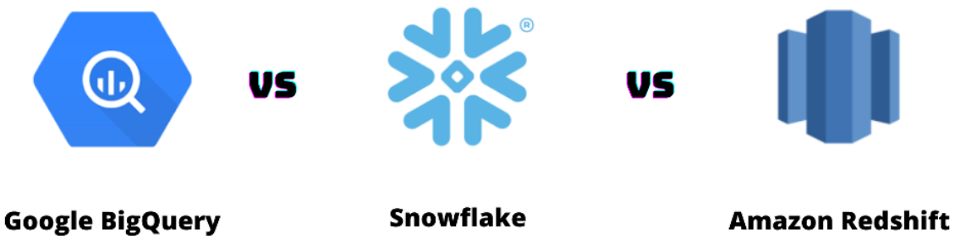

Evolution of Data Architectures
Hadoop and Spark
On-prem or cloud, open-source, large-scale data processing and analytics.
Google BigQuery, Snowflake, and AWS Redshift
Ideal for cloud-based data warehousing and high-performance analytics
Microsoft Fabric and AWS Lake Formation
Comprehensive platforms for end-to-end data management and analytics.

Slide 7
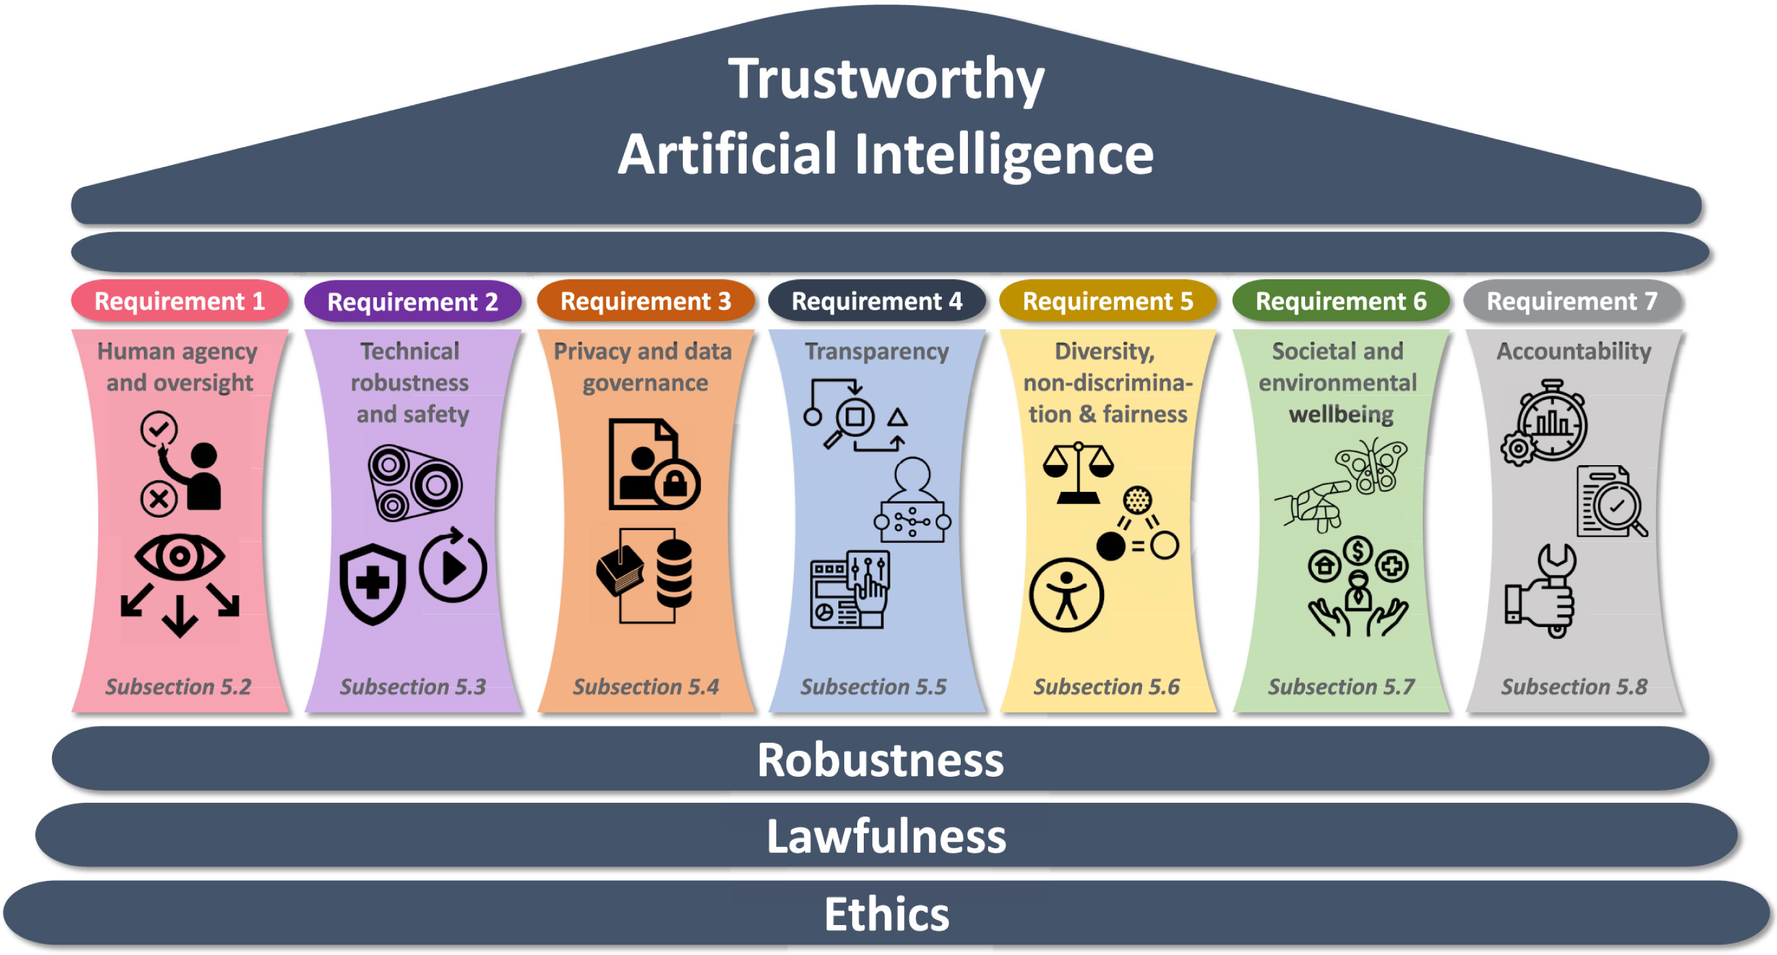
Trustworthy AI & Ethics

Slide 8
Deep Learning
Advanced Deep Learning

Slide 9

Lesson Goals
Students can explain the general components and working principles of a neural network
Students gain a deeper understanding of the DL learning process, by grasping
    The role of the learning rate and activation functions
    The difficulties of complex loss landscapes, and how to mitigate them
    The role of regularization techniques (early stopping, weight decay, dropout, ensemble models, data augmentation, batch normalization)
Students can explain the purpose, and core architecture, of several different major neural network types

Slide 10
Neural Networks

Slide 11
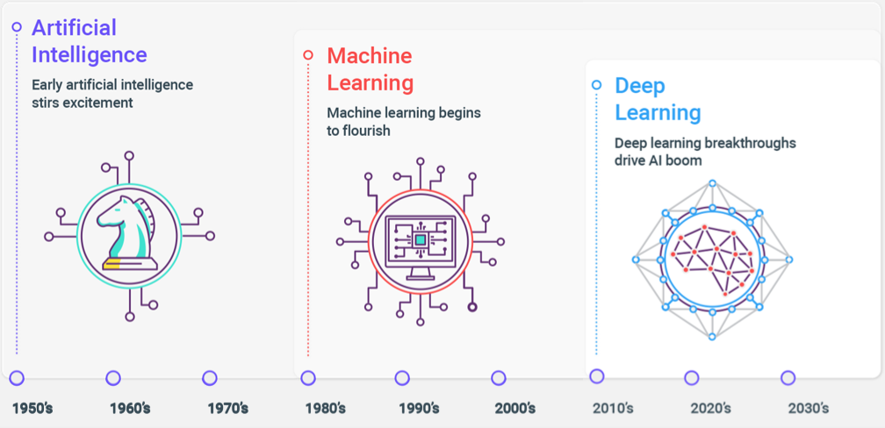
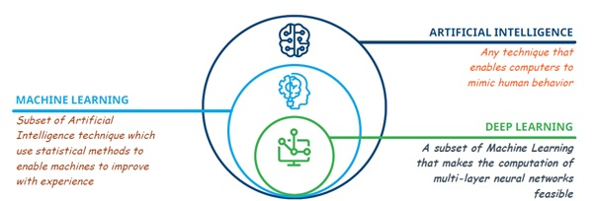
AI > ML > DL

Slide 12
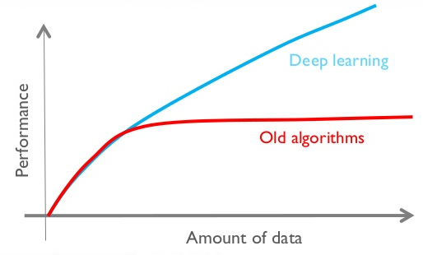
Deep Learning better with Big Data

Slide 13
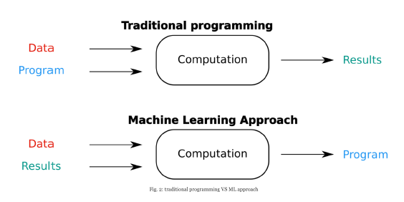
Machine Learning = Data Driven

Slide 14
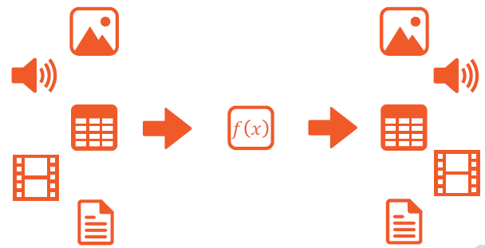


(High Level) ML Pipeline versus DL Pipeline
Notes:
Traditional ML pipeline: from tabular data to tabular data (classification/regression)
DL pipeline: data is ‘high densitiy, information heavy, high throughput’ → classical ML techniques are not equipped to deal with such data heavy information. In the old days, we used feature engineering techniques to extract useful information out of the data = we transformed it into tabular data. Now we use deep neural nets to decide for themselves what ‘features’ it should extract, given input and output data…

Slide 15
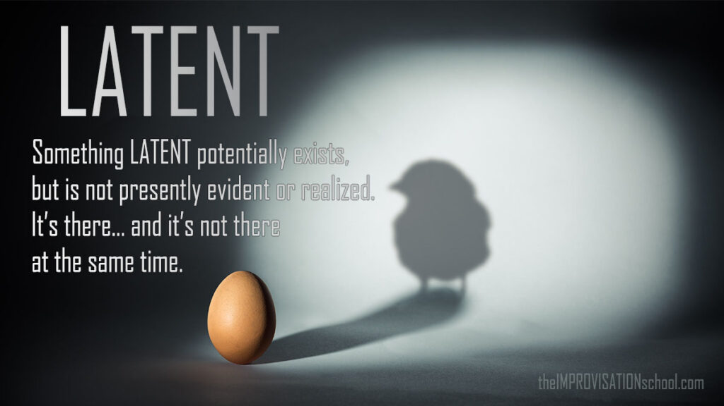

Slide 16
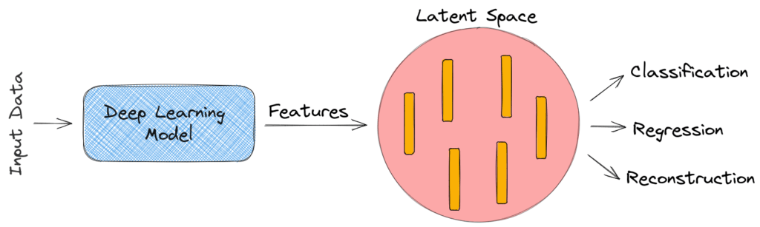
Latent Space
Latent:
something hidden. Present, but not directly observable.
Latent space:
compressed encoding (representation) of data in multi-dimensional space

Slide 17
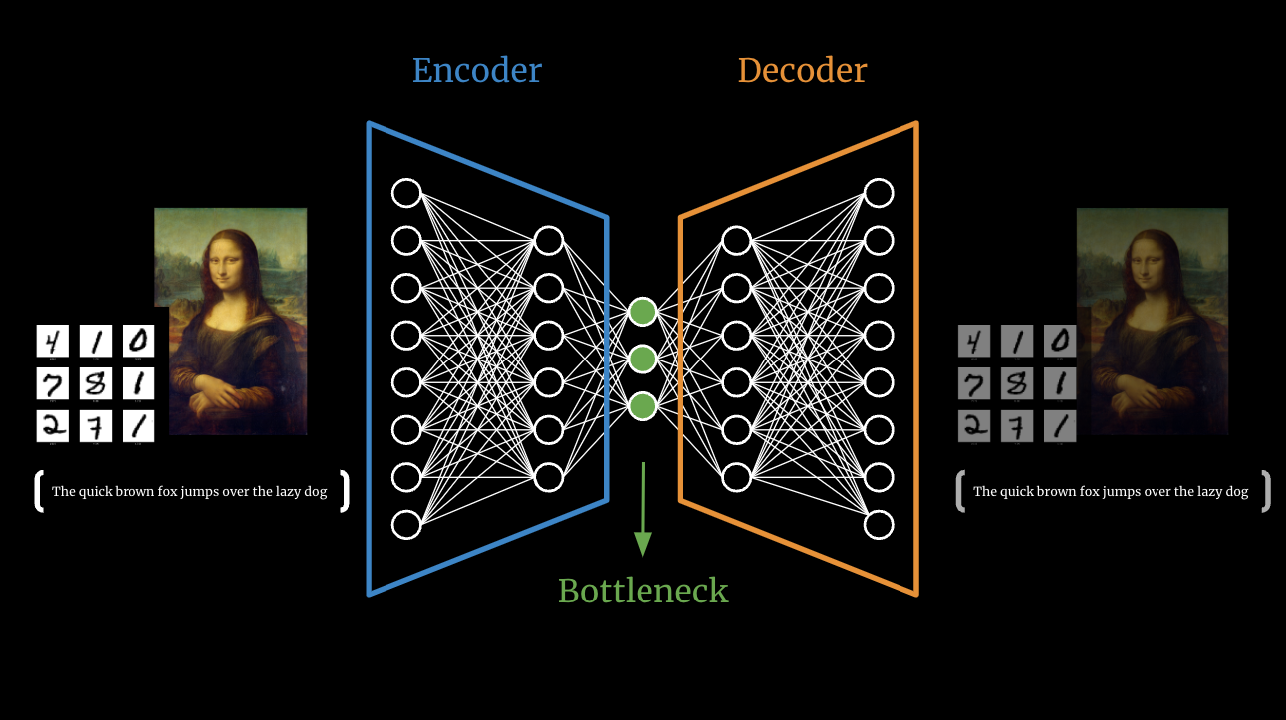
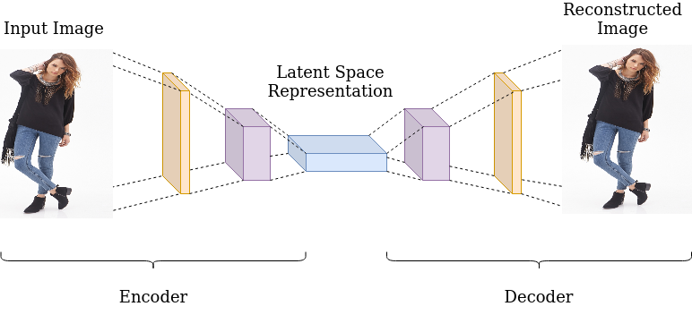
Encoding / Decoding
Encoding:
Learn how to compress data to most important latent features
Decoding:
Learn how to decompress (or generate) from latent features to output data

Slide 18
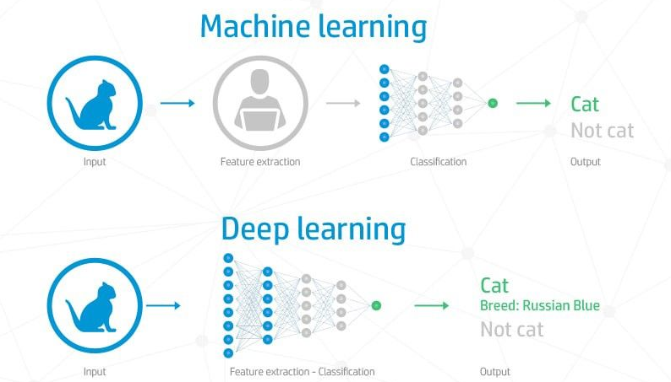
Difference ML versus DL

Slide 19
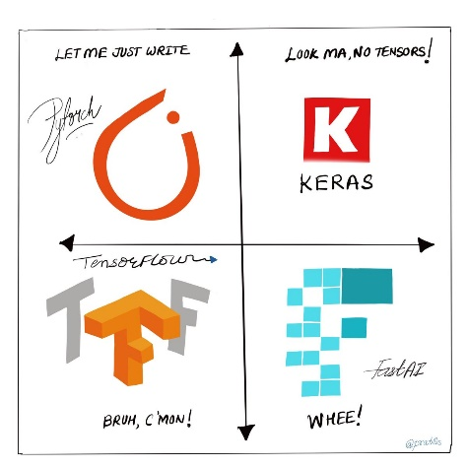
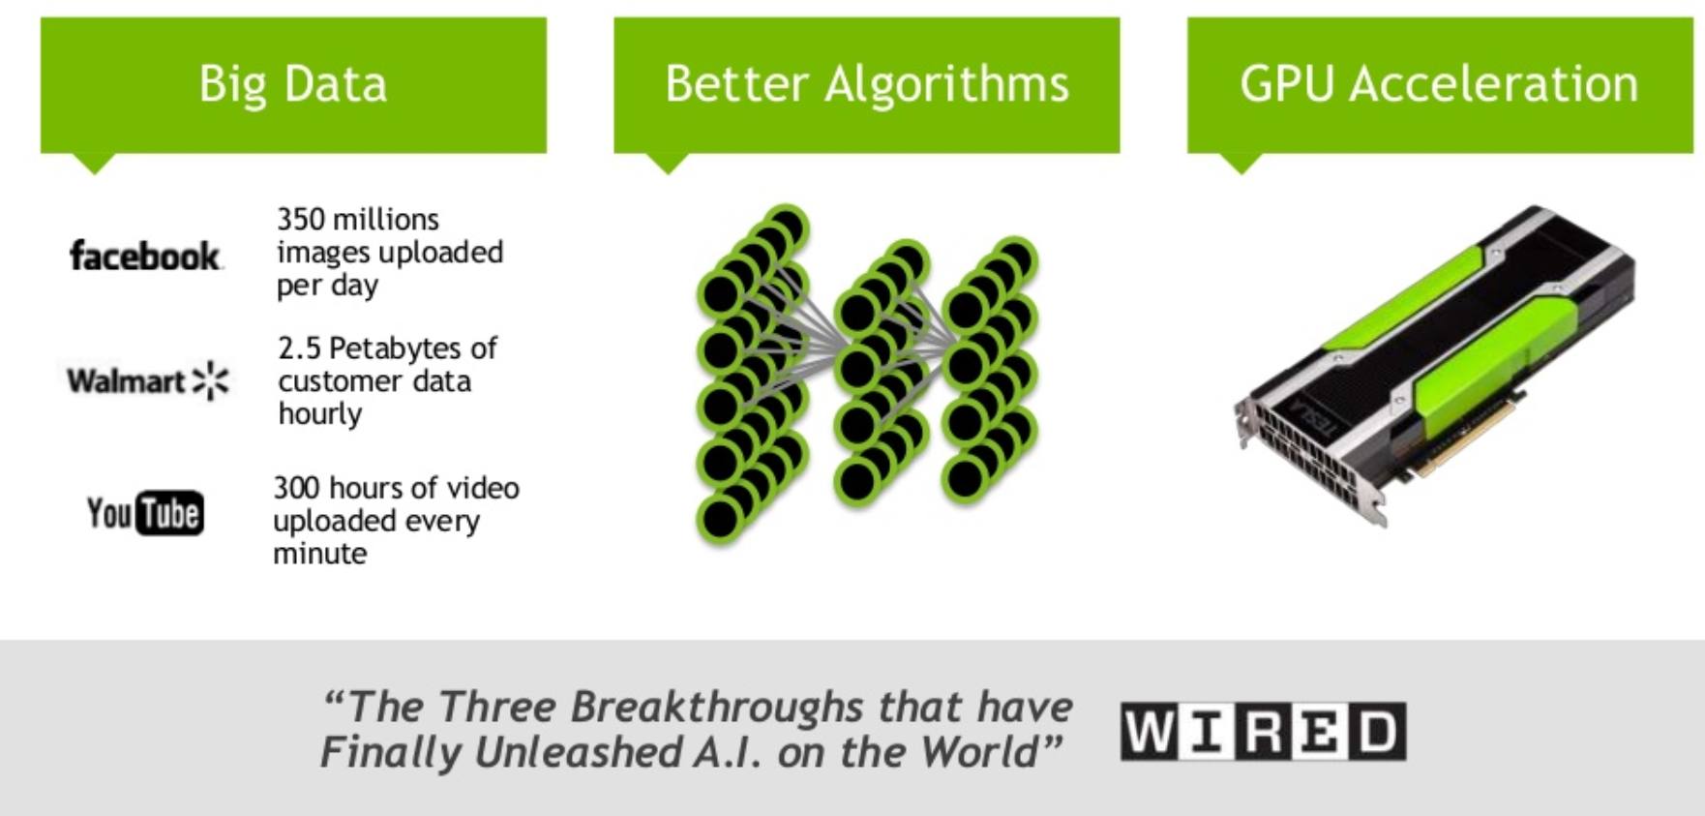

What made Deep Learning feasible?

Slide 20
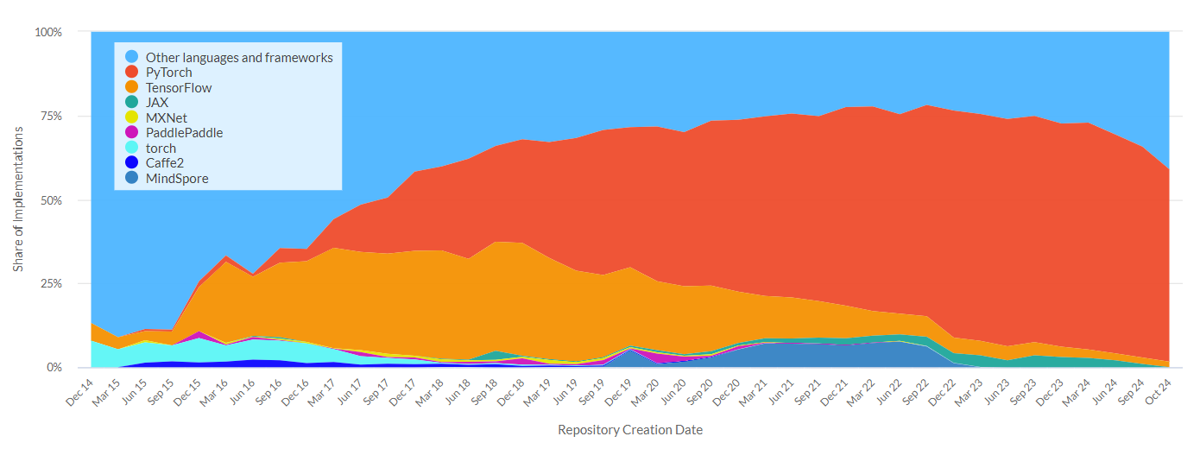
Why Fastai / Pytorch
Notes:
https://gonzoml.substack.com/p/deep-learning-frameworks

Slide 21
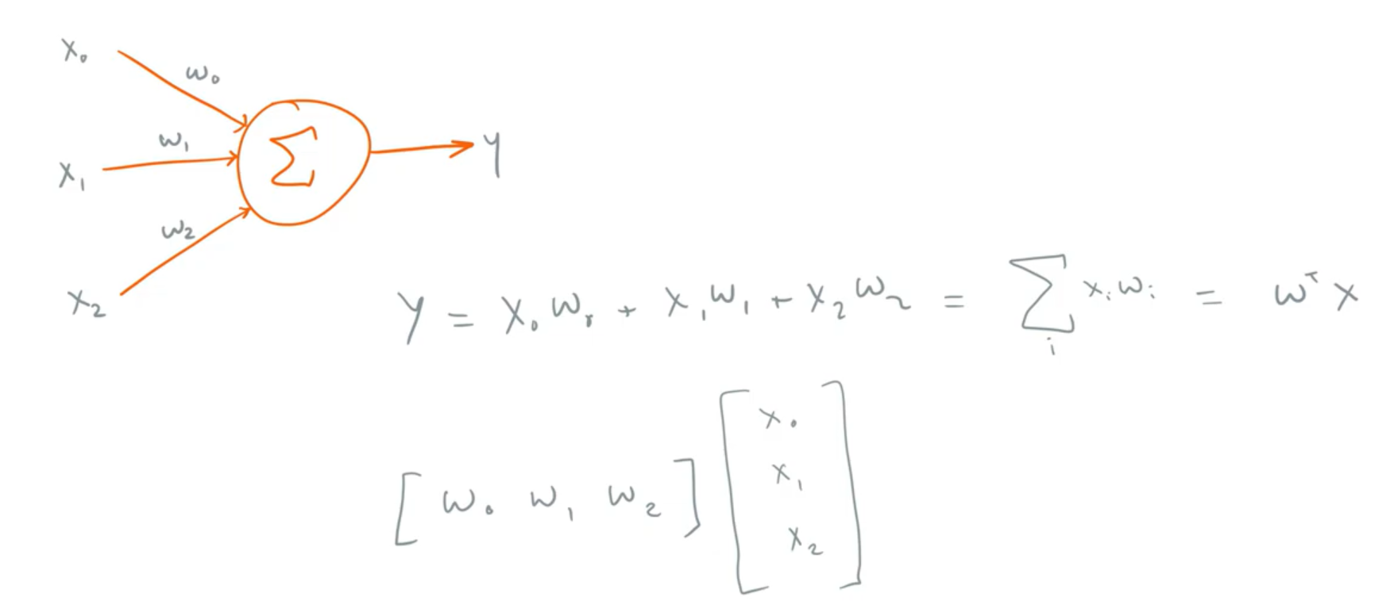
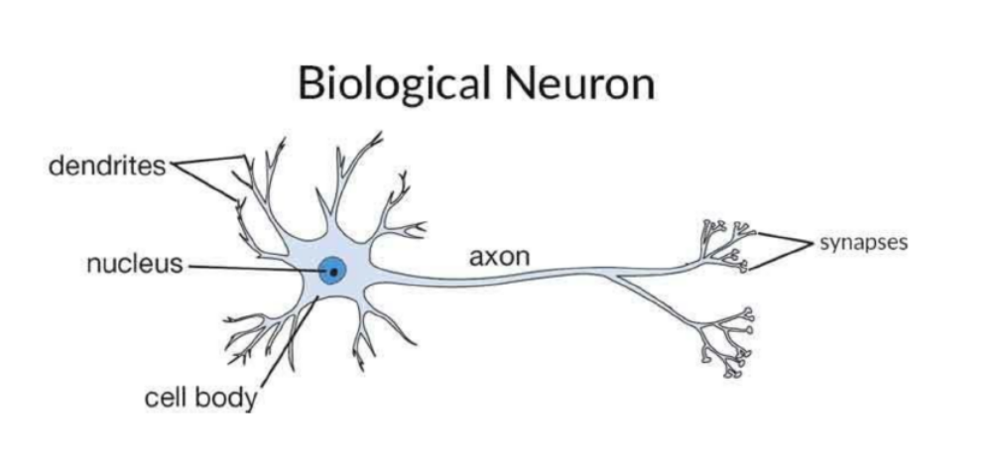
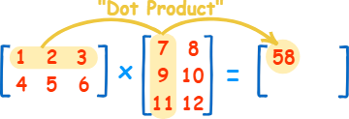
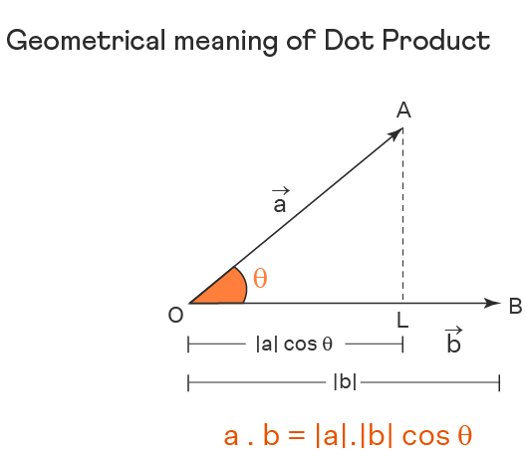
Neuron / (Linear) Perceptron
Notes:
Neuron in the human brain on the left
Dendrites capture signals from previous synapses (some weak, some strong), send them to the nucleus, which combines them. If a certain threshold is reached, the neuron ‘fires’ a signal down its axon, for other downstream connected synapses/dendrites can capture
Abstraction of neuron on the right = perceptron.
Every input has a certain weight (importance), all the weighted inputs are summed together (including a bias) → effective way to calculate the result is via matrix calculations → if you calculate with matrices of different dimensions, they are called ‘tensors’ (hence TensorFlow)

Slide 22
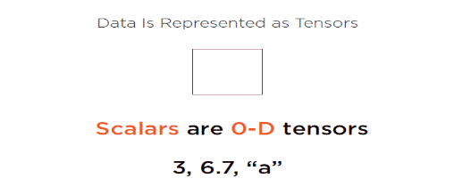
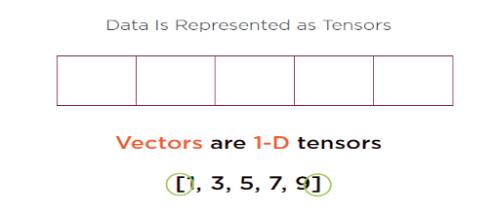
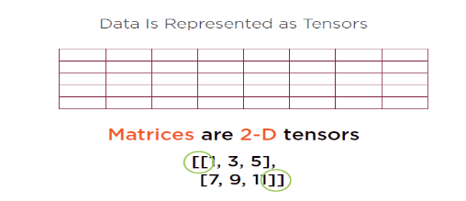
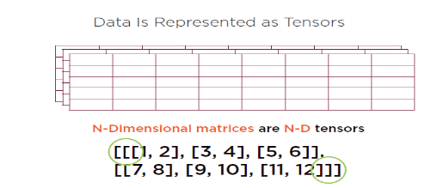
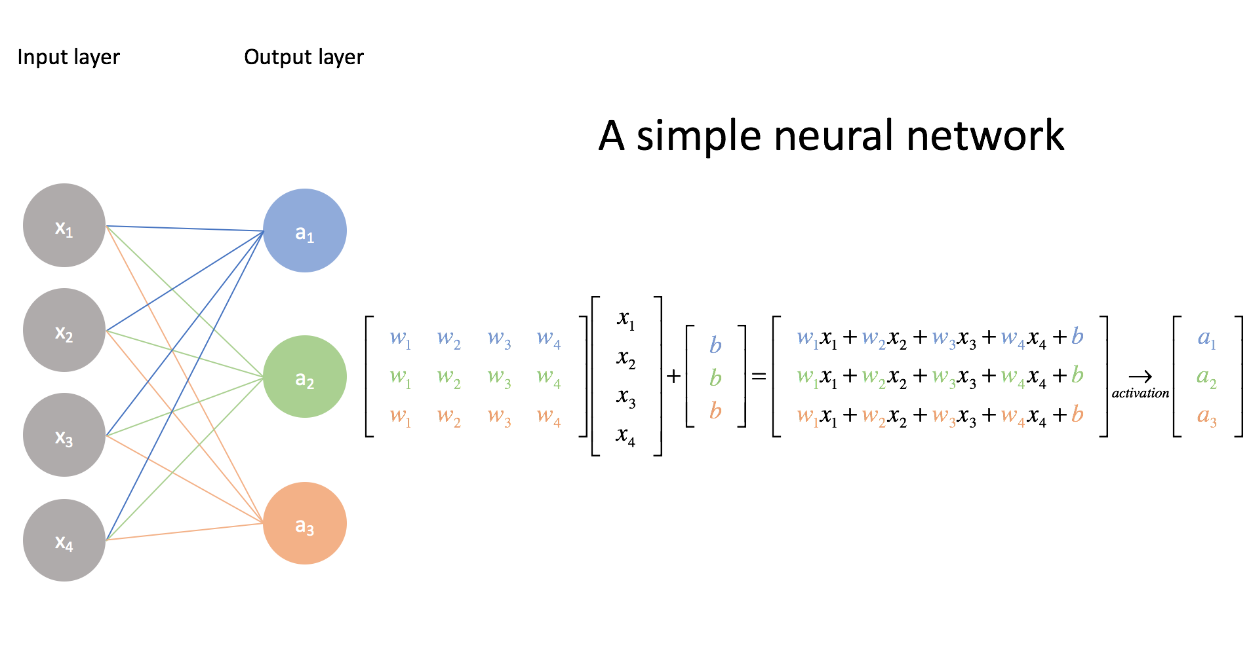
Tensor Calculations

Slide 23
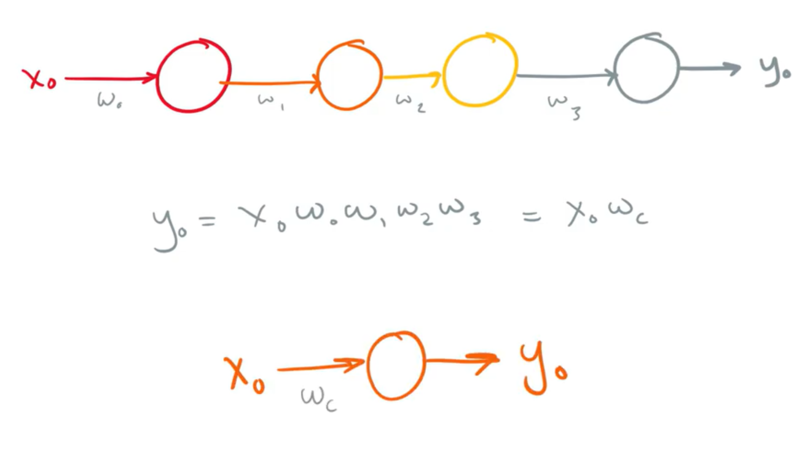
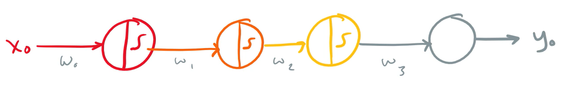
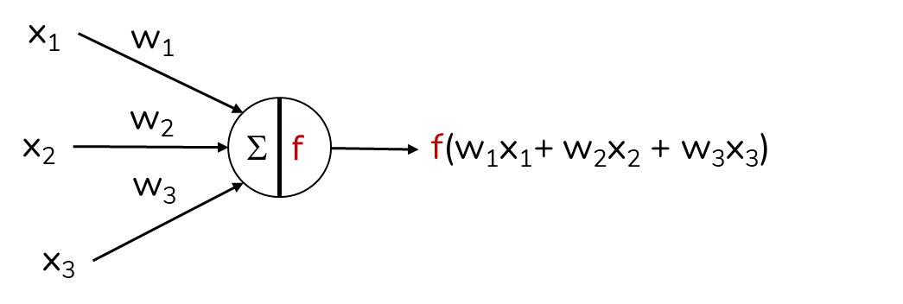
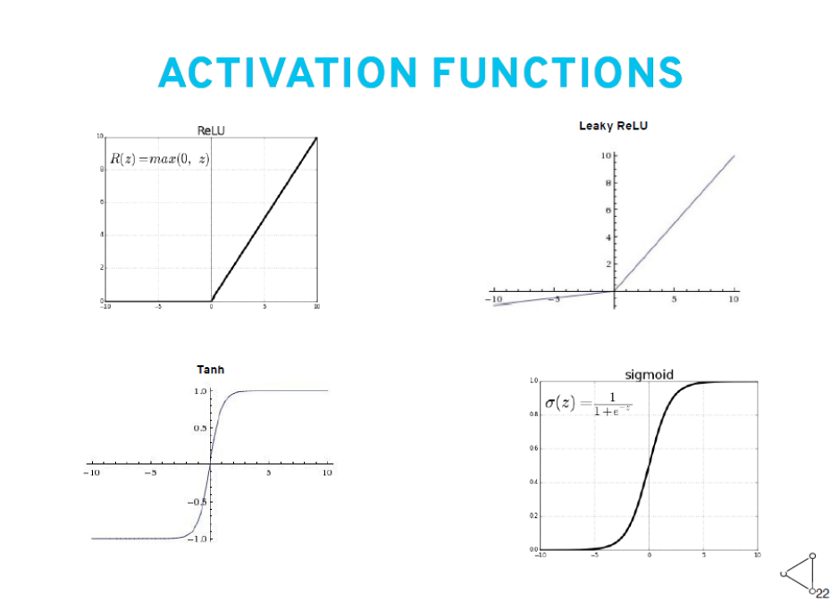
Activation Functions: adding non-linearity
Notes:
Chaining together multiple linear calculations, will just result in one big linear equation. Now there is no option to map non-linearity in the data
Add a non-linear activation function to each neuron, ‘a fire when above threshold’-non-linear-mechanism
Add the weighted outputs together (= x-axis), and map it to the activation function to see how much output is generated by the neuron (the y-axis) → this mapping is non-linear
Typical activation functions in the past: sigmoid, or tanh. Now mostly (leaky) ReLU is used
Notice the ‘sweet spot’ of the activation functions around the center (the ‘null’): in this part the non-linearity is most effective, especially if we want to calculate the gradient (‘richtingscoefficient’ in Dutch)
That’s why we don’t often use sigmoid-type activation functions anymore: if the weighted sum of the inputs is really low, or really high: output is the same as an extremely high (or low) sum. The ReLU fixes this problem: if the sum is really high (Fire, Fire, Fire!), the result will also be very very high.

Slide 24
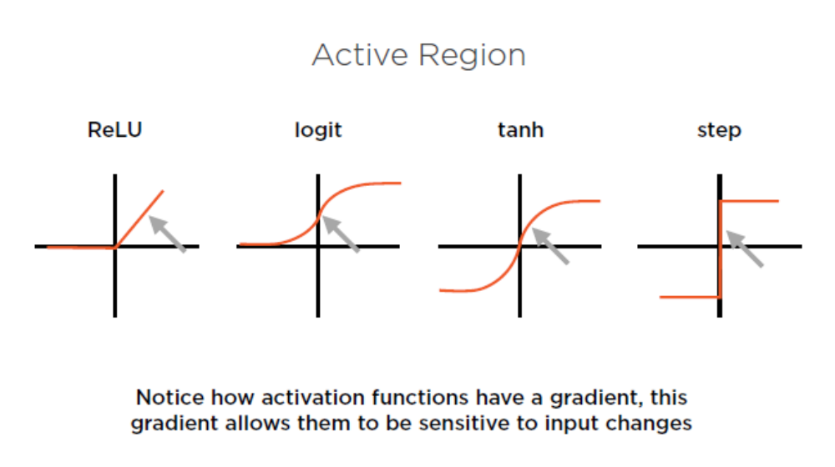
Activation Function: Active Region

Slide 25
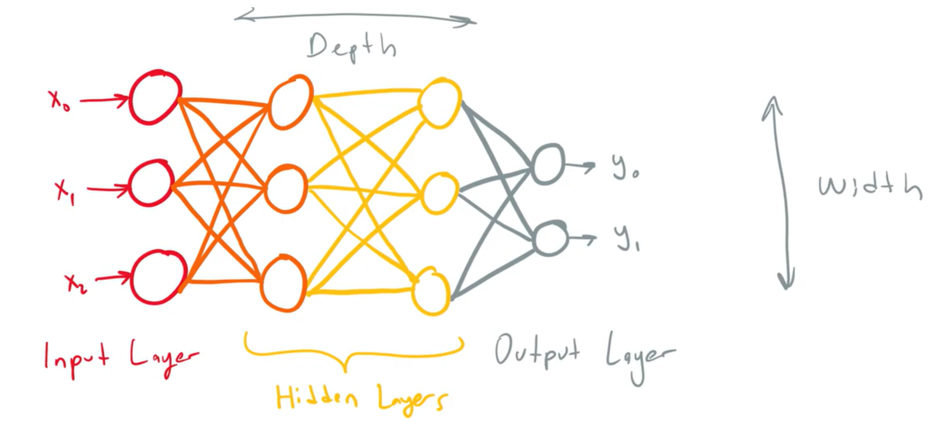
Naïve, Fully Connected (FCN), Dense, Feedforward Network, aka Multi-Layer Perceptron
Notes:
Combining it all together to form:
a fully connected (FCN), aka naïve, aka feed-forward network. Aka a multi-layer perceptron (oldskool).
Usually the first hidden layer has more neurons than the second layer: the latter one ‘compresses’ the information in a denser format, and the output layer is the ultimate compressor to whatever amount of output nodes you need

Slide 26
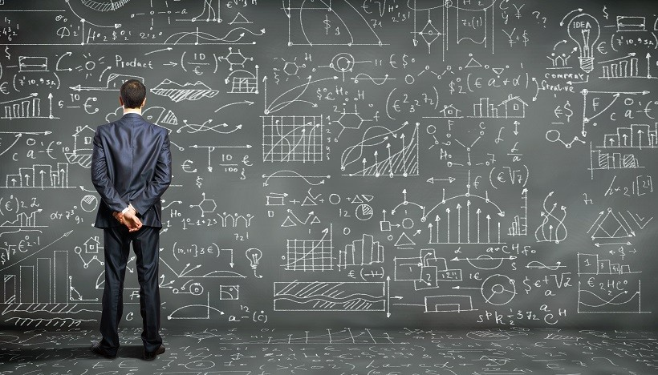
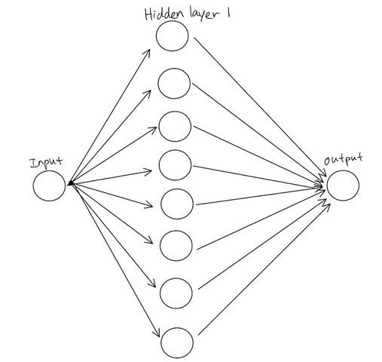
Universal Approximator
(one hidden layer is theoretically enough)
Theory: 1 hidden (very wide) layer
with non-linear activations is enough to solve any problem.
Practice:
Computationally very hard
Does not generalize well to unseen data
Enter deep learning = many hidden layers.
Made feasible by GPUs and better techniques.

Slide 27
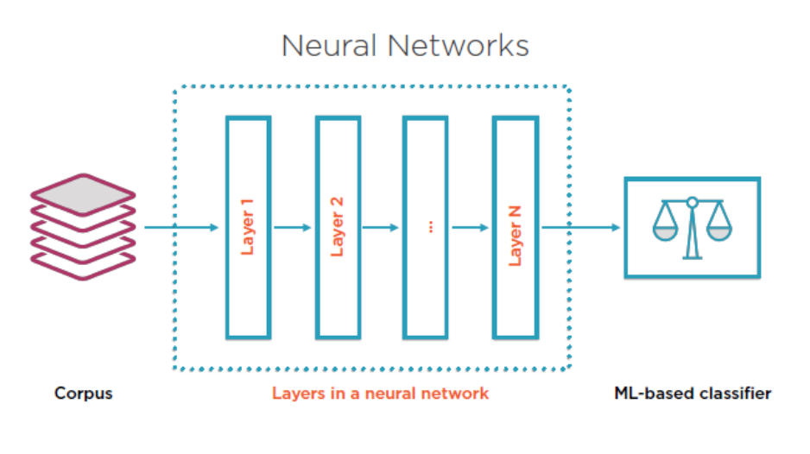
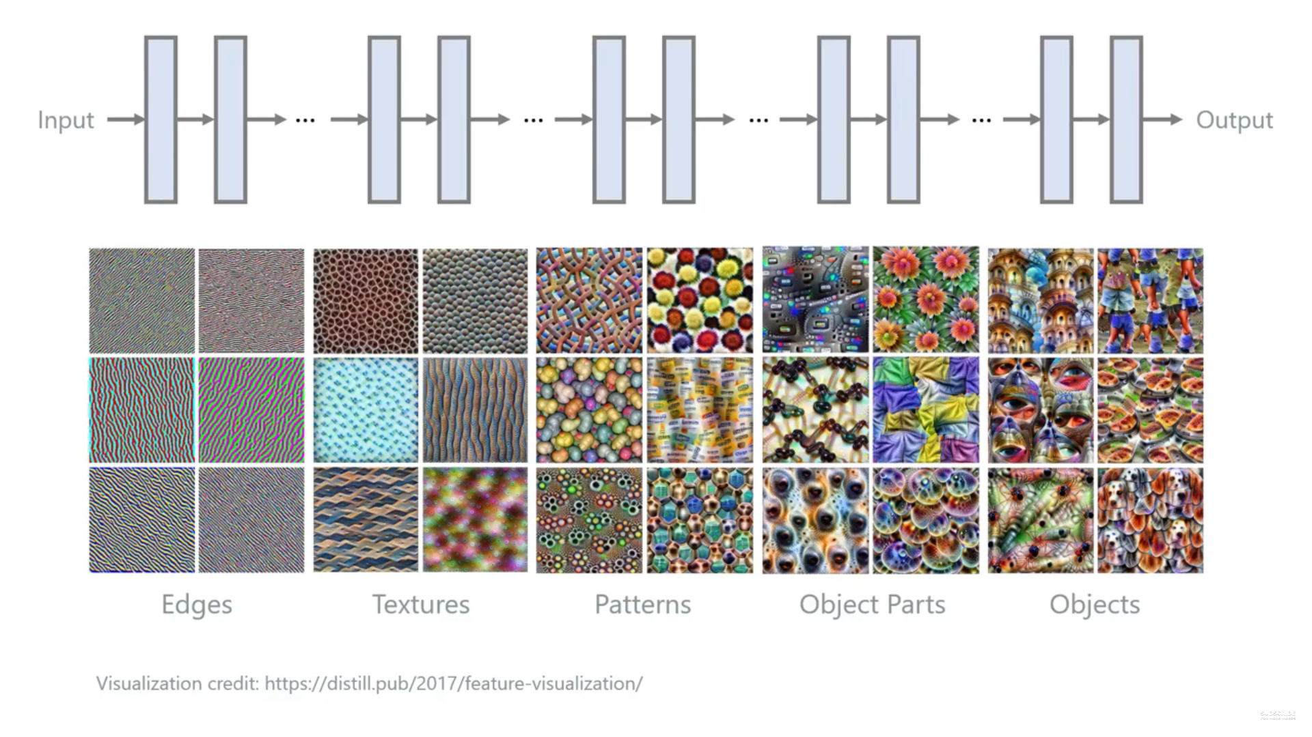
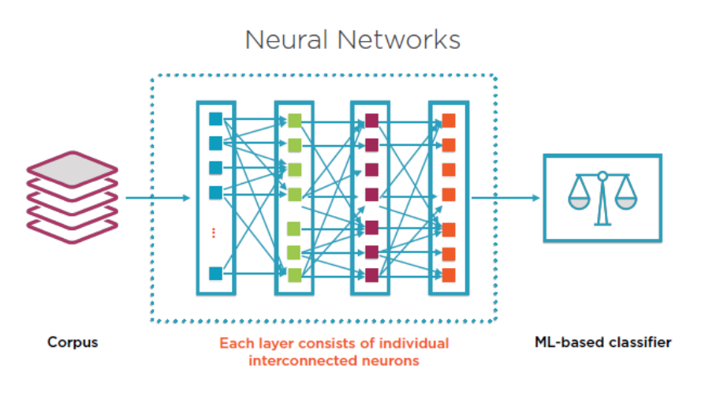
Layers of a Deep Learning Network

Slide 28
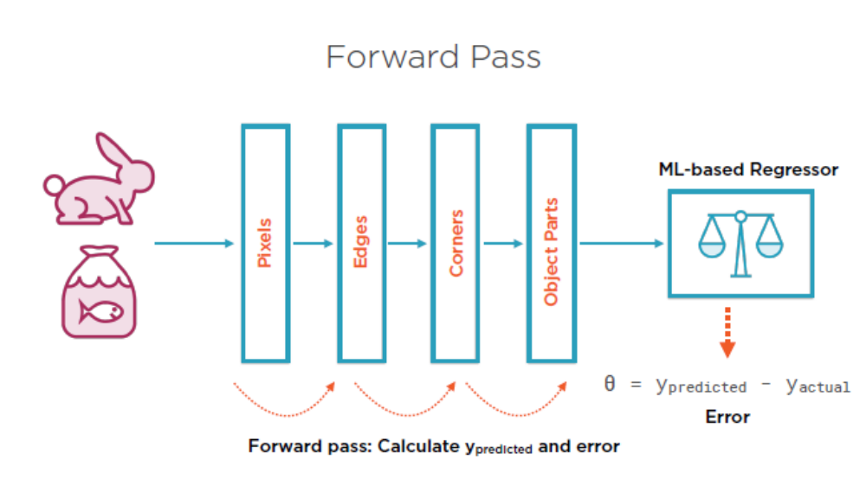
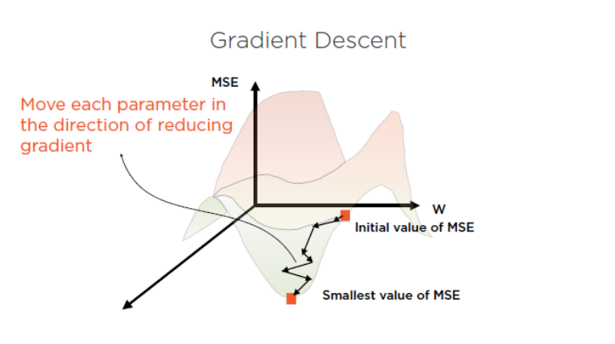
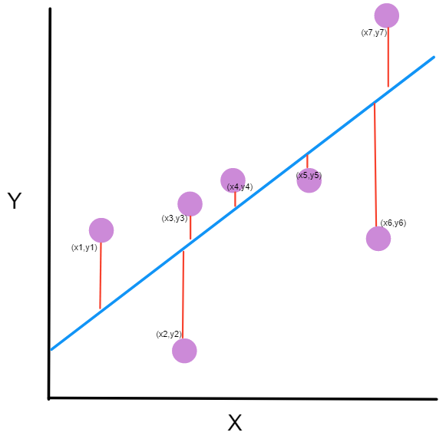
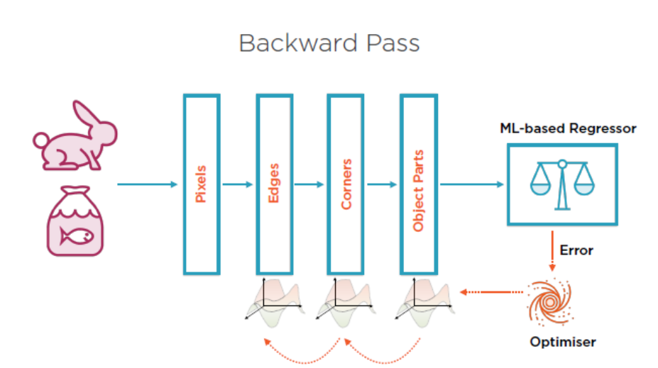
Learning Cycle
Step1 Forward Pass
Step2 Loss Function
Step3 Optimize weights
Step4 Back-propagate

Slide 29
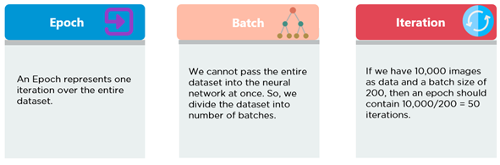
Epoch – Batch - Iteration

Slide 30
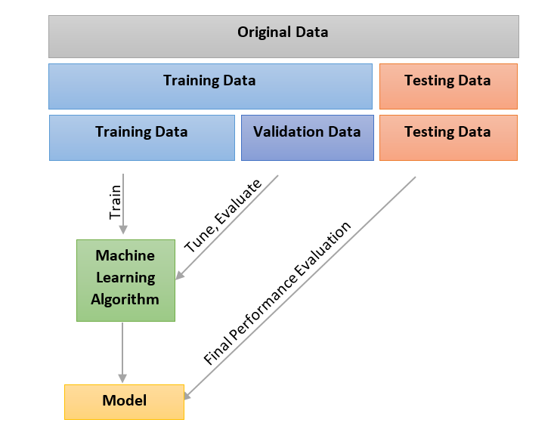
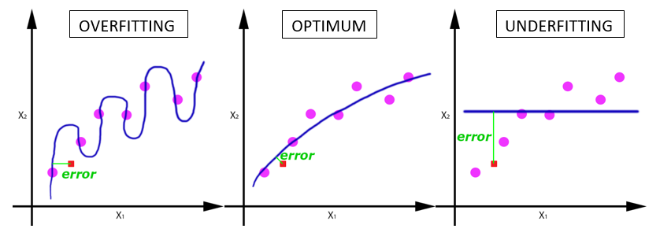
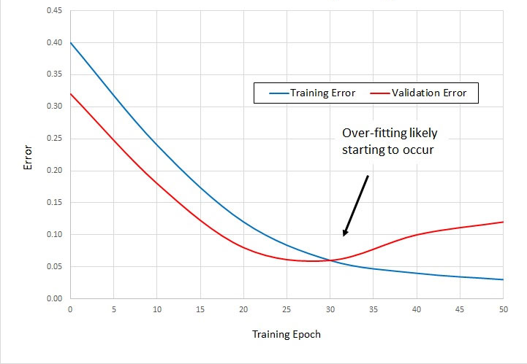
Underfit – Overfit: use of validation set

Slide 31
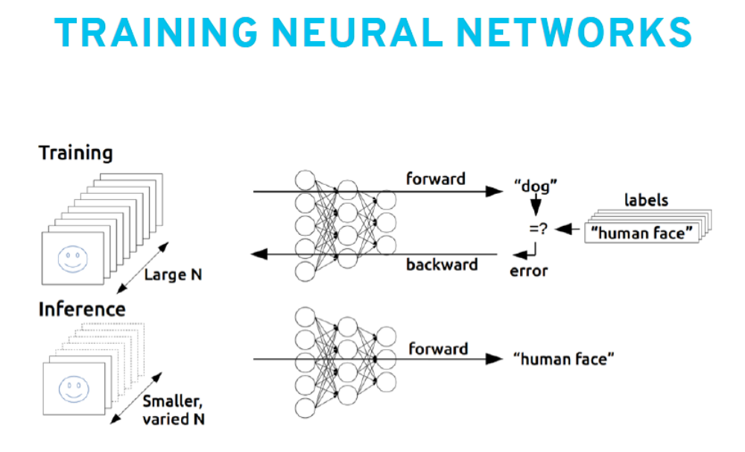
After training: inference (predict)

Slide 32

Advanced Topics

Slide 33

Data Preprocessing

Slide 34





Data Preprocessing

Slide 35





Normalize - Standardize

Slide 36
Forward Pass & Loss calculation & Backward pass

Slide 37





Loss calculation

Slide 38


Backwards Pass

Slide 39


Update Weights (simplification)
Step size

Slide 40



Learning Rate

Slide 41

Challenge
Local Minima
‘I’m stuck!’

Slide 42

Getting Stuck in Local Minima
(of the loss function)

Slide 43


Loss Landscapes: theory versus reality

Slide 44


Local Minima & Saddle Points
Notes:
https://www.khanacademy.org/math/multivariable-calculus/applications-of-multivariable-derivatives/optimizing-multivariable-functions-videos/v/saddle-points

Slide 45



Solution 1:
Randomness by Batch Size
Notes:
On one end of the spectrum: (Batch) Gradient Descent: take all training samples, run them through your network, calculate errors, and use an average of the gradient to update our parameters. Advantage: takes all samples, so calculation is optimal. We have a complete overview of the loss landscape at that point, with those settings, and we calculate the best way down. But it needs lots of memory. And main disadvantage: getting stuck in the local minima!
Other side of the spectrum: take one training sample at a time, run it through the network, calculate error and gradient, update parameters, take nextt sample,…
Mini-batch approach: in between the two.

Slide 46





Solution 2:
Randomness by Learning Rate
Annealing Cycling LR
One Cycle →

Slide 47

One Cycle Learning Rate Scheme

Slide 48



Solution 3:
Momentum Optimizer (adam)

Slide 49

Challenge
Vanishing Gradients

Slide 50



Vanishing Gradient

Slide 51



Solution:
Use ReLu activations

Slide 52

Variants: Leaky ReLU, ELU, …
Fixing the ‘dying’ ReLU: stuck in negative side, always outputting zero

Slide 53

Challenge
Co-variate shift
Notes:
Internal covariate shift refers to the phenomenon where the distribution of inputs to a layer changes during training because the parameters of previous layers are being updated. This forces each layer to continuously adapt to new input distributions, which can slow down training.
Batch Normalization addresses this by normalizing the activations of each layer to have zero mean and unit variance within a mini-batch, then applying learnable scale and shift parameters. This keeps the input distribution to each layer more stable, allowing for faster and more reliable training.

Slide 54



Internal Covariate Shift

Slide 55

Solution:
Batch Normalization

Slide 56


Challenge
Overfitting

Slide 57

General Solution:
Regularize the training process

Slide 58



Regularization 1: Early Stopping
Notes:
When validation error no longer improves, stop training. Because every training cycle has the potential to make a certain weight bigger and bigger, and thus more focussed on certain aspects, so more prone to overfitting, stopping the training cycles is a regularization technique

Slide 59


Regularization 2: L2 regularization
(L2: using squares to get rid of the sign)

Slide 60


Regularization 3: Dropout
Notes:
By turning random selected neurons off during training (and only during training, not during inference), we force all neurons to contribute to the end result. They cannot afford a neuron specialize in a certain aspects, because if it’s turned off, they network doesn’t catch that aspect. So all neurons do a little detection, no one neuron does all detection of a feature

Slide 61

Regularization 3: Ensemble Methods

Slide 62


Regularization 3: Data Augmentation

Slide 63


Data Augmentation: even multiclass

Slide 64

Python Library: Albumentations.ai

Slide 65

Common Neural Network Architectures
‘Neural Network Zoo’
Notes:
https://www.asimovinstitute.org/neural-network-zoo/

Slide 66

Convolutional Neural Network (CNN)
Purpose:
Designed for spatial data (images). CNNs excel at capturing local patterns like edges, textures, and shapes.
Architecture:
Composed of layers like:
  Convolutional layers (feature extraction)
  Pooling layers (downsampling)
  Fully connected layers (classification) Often ends with a softmax or sigmoid layer for prediction.
Output:
a class label or probability distribution over classes (e.g., cat vs. dog), or a feature map if used in intermediate stages.

Slide 67





(Denoising / Variational) Auto-encoder
Purpose:
Learns to compress and reconstruct data. It consists of:
  Encoder: Compresses input into a latent representation.
  Decoder: Reconstructs the input from the latent representation.
Architecture:
Built using fully connected layers, convolutional layers, or a mix.
Output:
Typically reconstructs the entire input, not a per-pixel classification.
Notes:
https://www.jeremyjordan.me/autoencoders/
🔍 Latent Space in VAEs: Distributions, Not Just Vectors
In a standard autoencoder, the encoder compresses the input into a fixed latent vector — a deterministic representation.
In a VAE, the encoder instead learns a probability distribution for each dimension of the latent space:
Each feature is represented by a mean and variance.
So instead of a sharp value like z = 3.2, you get something like z ∼ N(3.2, 0.1²).
This means:
Sharp distributions (low variance) indicate the model is confident about that feature.
Broad distributions (high variance) suggest uncertainty or variability in that feature.
🎲 Sampling and Decoding
During training:
You sample from these distributions to get a latent vector.
This sampled vector is passed to the decoder, which tries to reconstruct the original input.
This sampling introduces stochasticity, which:
Forces the model to learn robust representations.
Makes the latent space smooth and continuous, ideal for generating new data.
🧪 Why This Matters
Because the latent space is probabilistic:
You can interpolate between points and still get meaningful outputs.
You can generate new samples by sampling from the latent space (e.g., from a standard normal distribution).
This is why VAEs are popular in generative tasks like:
Image synthesis
Style transfer
Anomaly detection

Slide 68

Fully Convolutional Network (FCN)
Purpose:
Designed for dense prediction tasks like semantic segmentation.
Architecture:
Uses only convolutional layers (no fully connected layers), often with upsampling to maintain spatial resolution.
Output:
Produces a spatial map of predictions (e.g., class labels for each pixel).

Slide 69


RNN / LSTM
(Recurrent Neural Network / Long Short-Term Memory)
Purpose:
Designed for sequential data like text, time series, or speech. LSTMs improve upon vanilla RNNs by handling long-term dependencies better.
Architecture:
  RNNs: Have loops allowing information to persist across time steps.
  LSTMs: Include gates (input, forget, output) to control the flow of information. Can be stacked or bidirectional for more power.
Output:
  A sequence of predictions (e.g., next word in a sentence)
  Or a single prediction after processing the entire sequence (e.g., sentiment classification)

Slide 70

Transformer (!)
Purpose:
Built for sequence modeling without recurrence. Transformers excel at capturing global dependencies using attention mechanisms.
Architecture:
  Self-attention layers to weigh relationships between all tokens
  Positional encoding to retain order
  Encoder-decoder structure in models like BERT (encoder-only) or GPT (decoder-only)
Output:
  Can be a sequence (e.g., translated sentence)
  Or a single value (e.g., classification score)
  Extremely flexible: used in NLP, vision (ViT), audio, and more

Slide 71

Generative Adversarial Network (GAN)
Purpose:
Designed for generative tasks — creating realistic data (images, audio, etc.) from noise or latent representations.
Architecture:
  Generator: Learns to produce realistic data
  Discriminator: Learns to distinguish real from fake
  Trained in a min-max game where both networks improve iteratively
Output:
  Synthetic data (e.g., images, videos, music)
  Often indistinguishable from real data when trained well

Slide 72



Over to you

