Slide 1

CMS. 611 PRoject 4
Nayeon K, giulio g, jorrie b, forrest m, randi c, eric s

Slide 2
Spectator-friendly
eSports
Notes:
Our focus was compelling esport game. This meant we had to design not just with the player in mind, but also with a

Slide 3
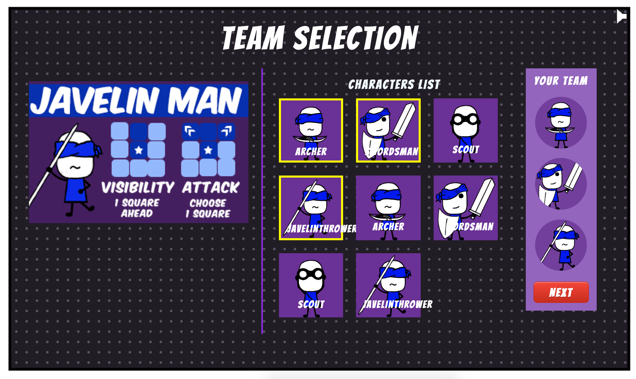
The Game: player
Two Players
Choose your characters
Notes:
Before we dive too deeply into what makes our game E-sport worthy, we’d like to give you a little bit of context - to give you a feel for how the player actually plays the game.

Slide 4
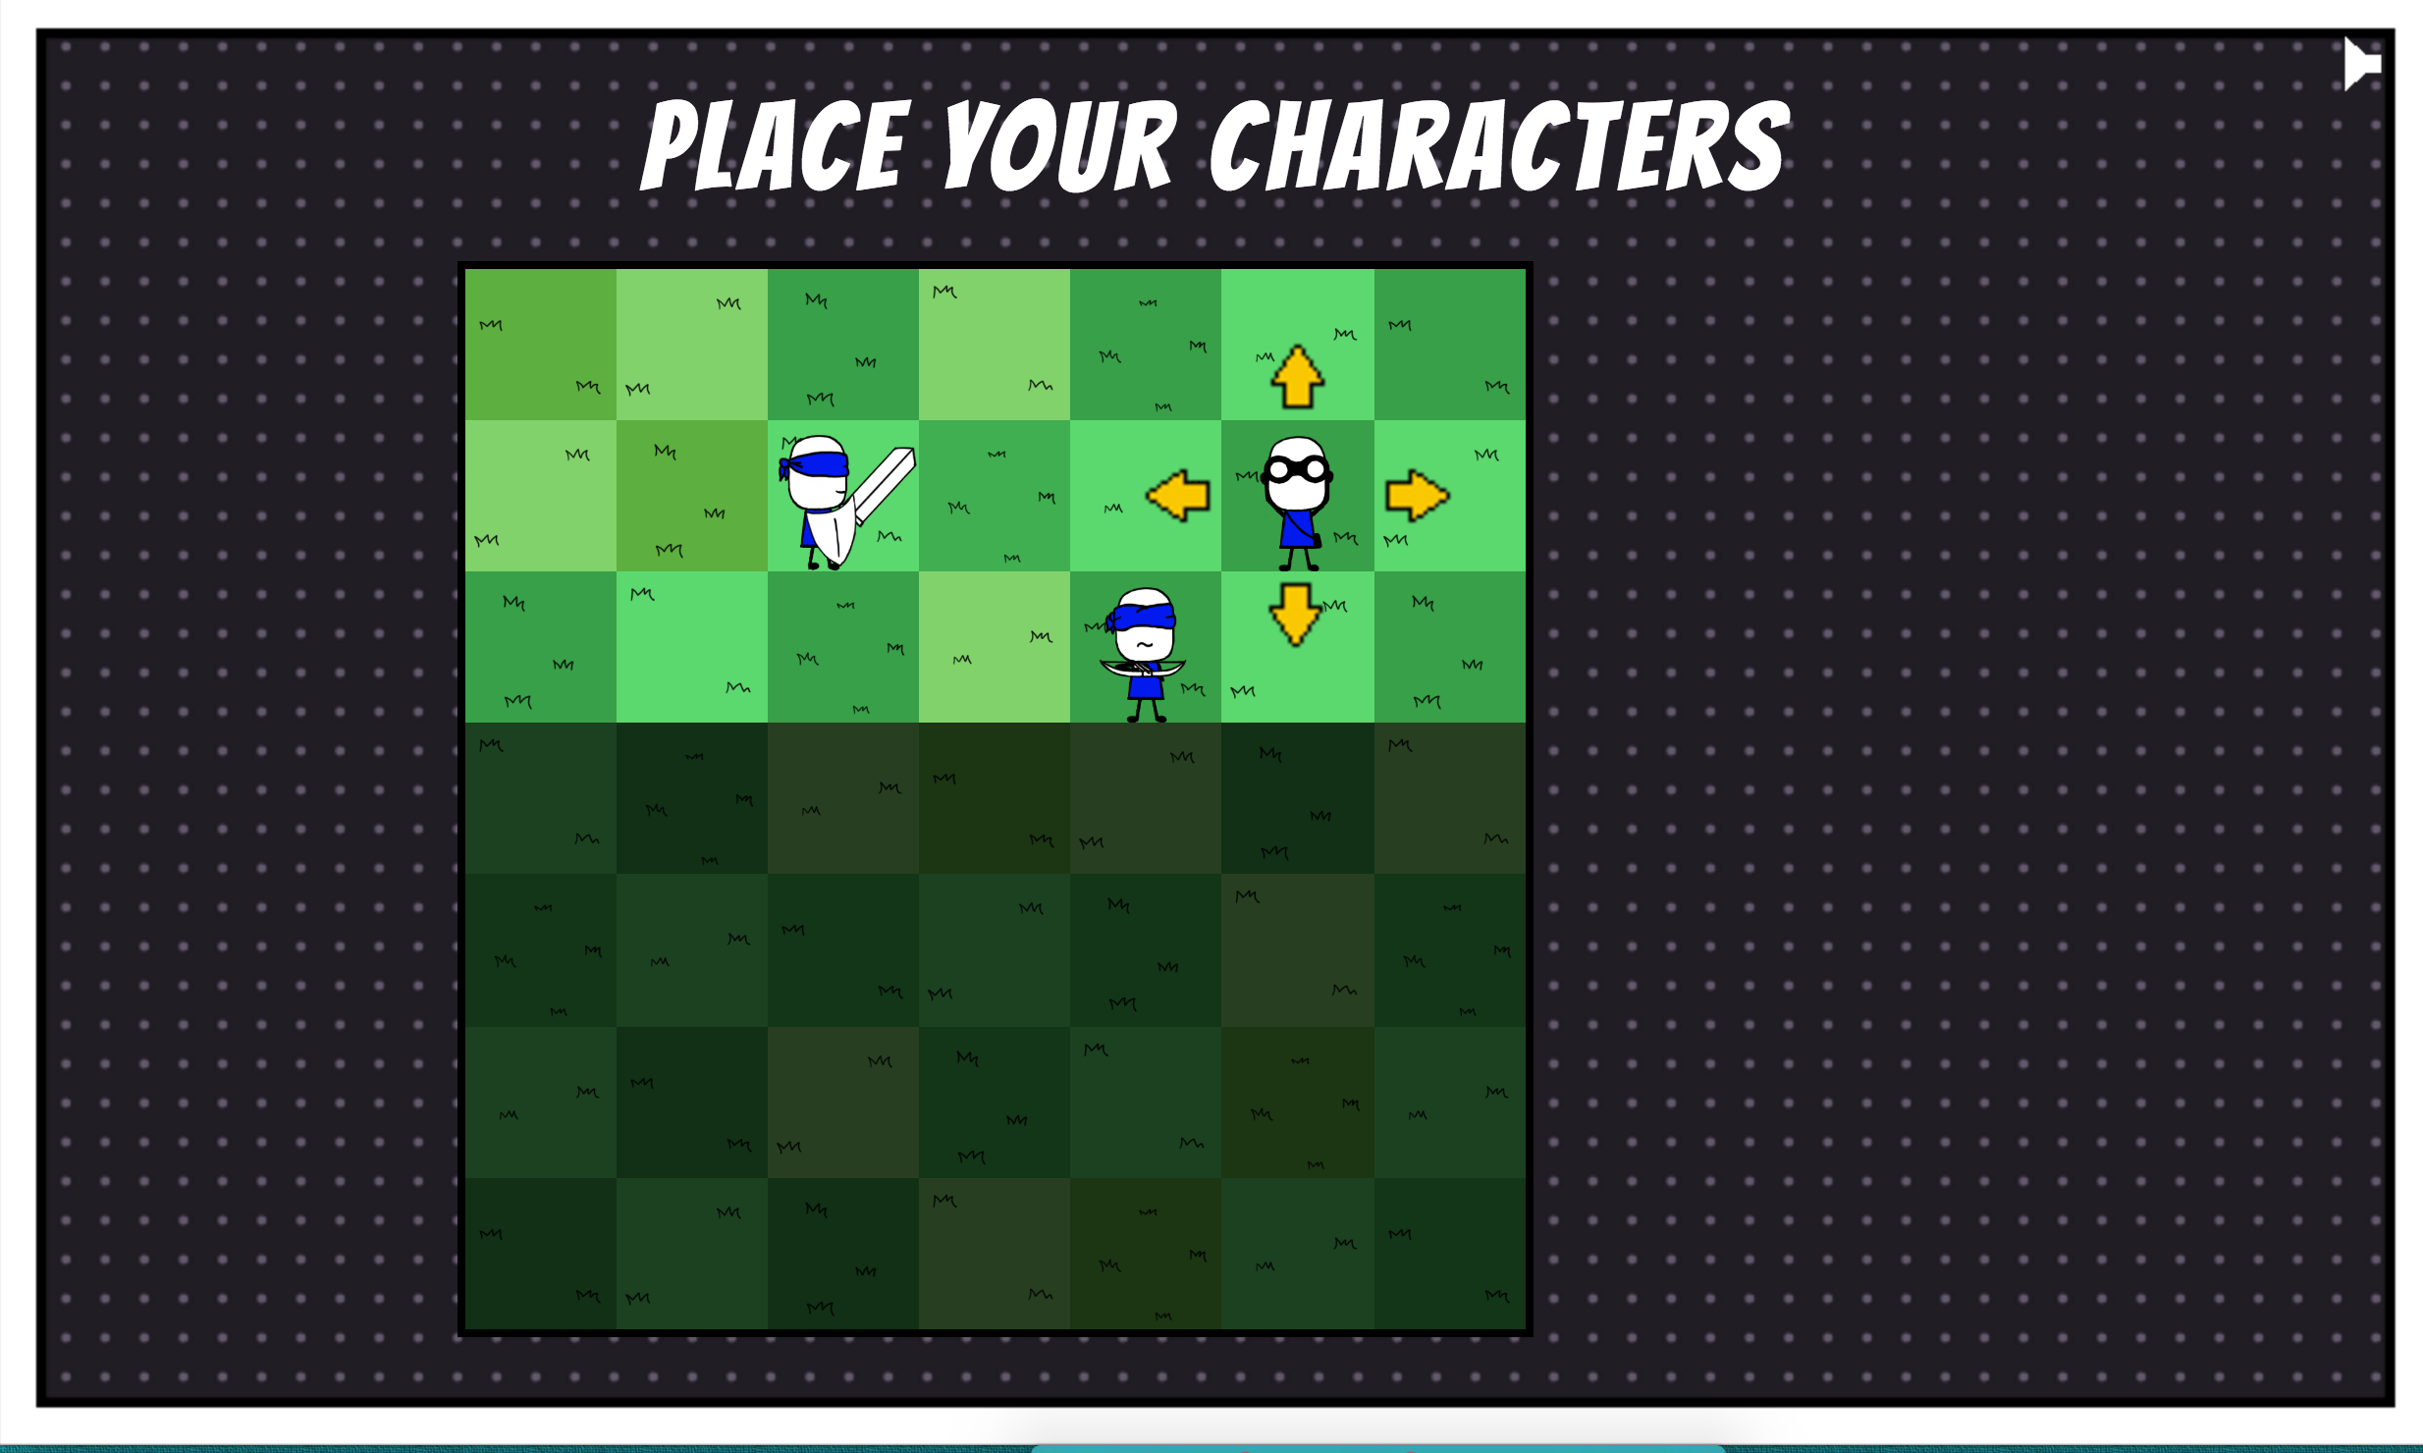
The Game: player
Place them on your side of the board

Slide 5
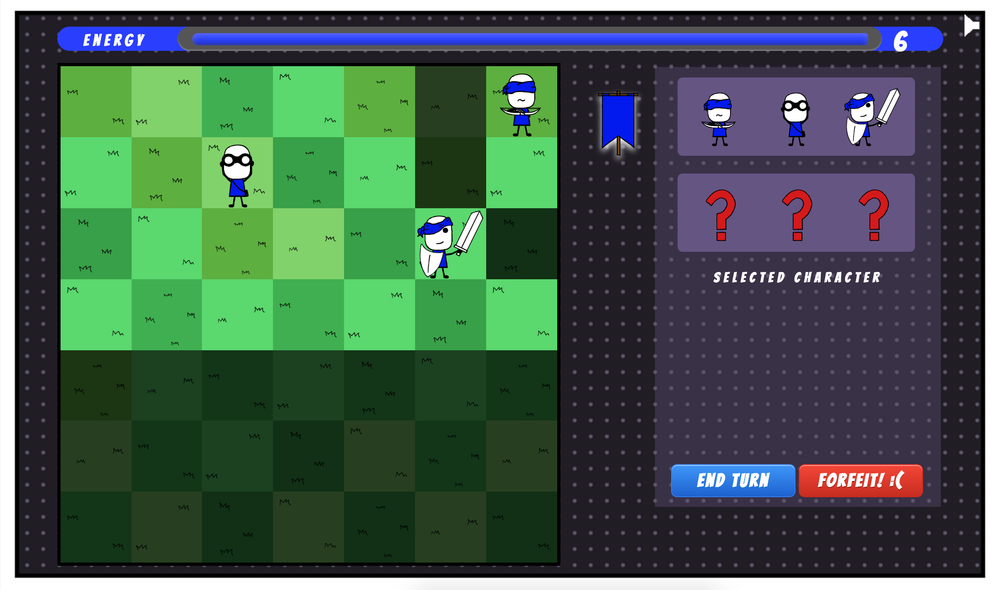
The Game: player
Each turn you can make a certain number of actions.
Battle until only one team left!
Notes:
Talk more about hidden

Slide 6
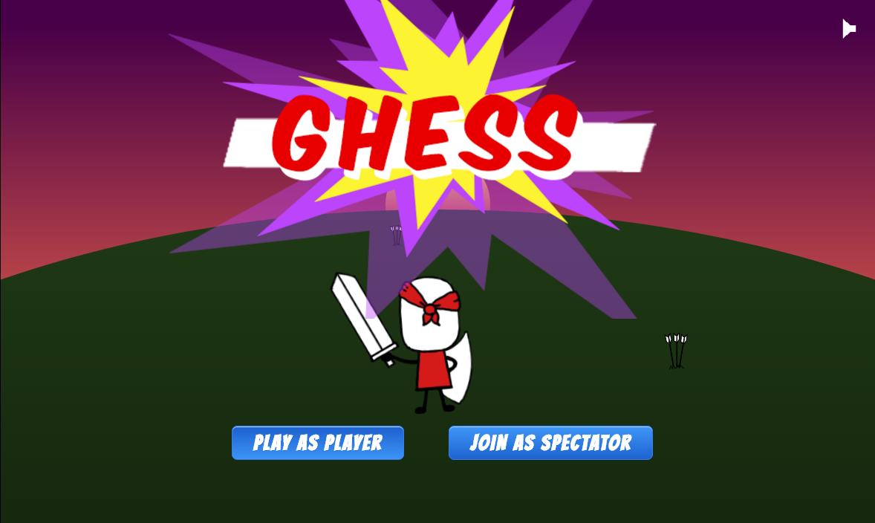
The Game: spectator
Notes:
But rather than tell you, let’s show you!

Slide 7
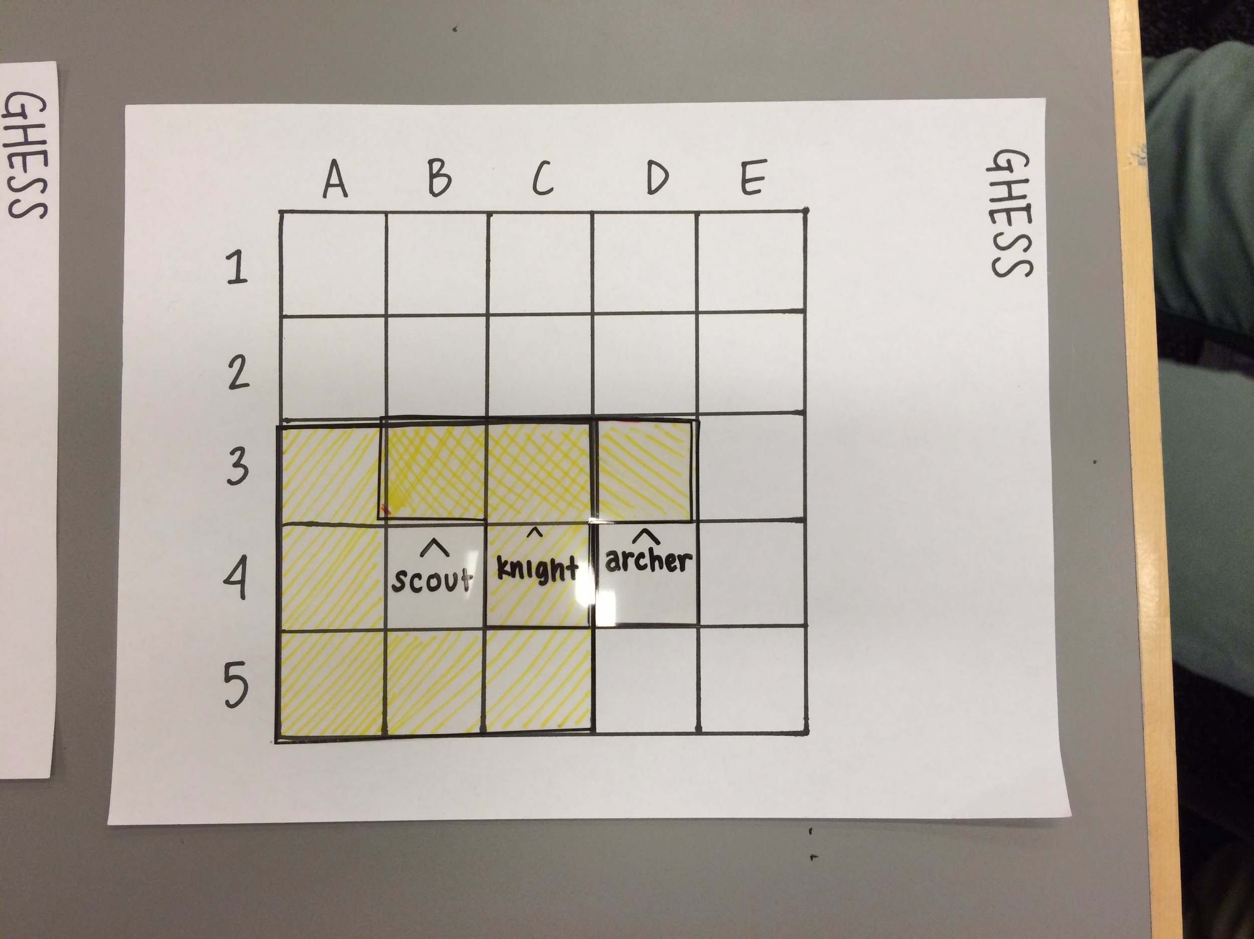
The PRocess: Prototyping
Project 1 = Success!
… but there was so much more to do!
Notes:
TMI - each one of these is a slide, call up more interesting anecdotes (talk more about transition from project 1), character design (why did you choose them and how did we make paper digital), bring back feature list - how did we hit up networking,
Paper prototype was a success - had a lot of interested people early on, many spectators, people were getting very into it.
...even with its limitations
Paper prototype was very clunky. We took turns being the computer which was extremely prone to error, very slow, etc.

Slide 8
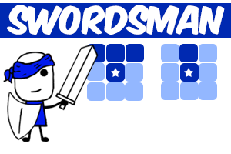
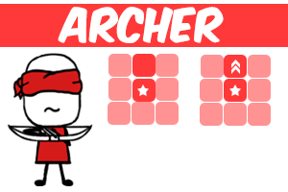
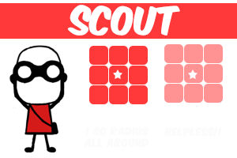
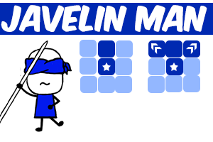
The PRocess: Character Design
Notes:
Started out with very simple characters for a purpose:
Easier to build up from basics than to cut features

Slide 9
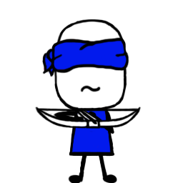
The PRocess: Building from the ground up
A game without an engine
Lesson from project 3: focus on our strengths

Slide 10
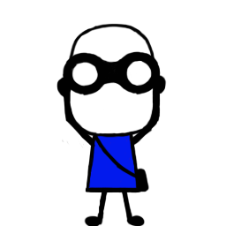
The PRocess: Networking
No cheating!
Complete freedom = full customization
Notes:
Security

Slide 11
Reflection: WINS
We got a networked game to work.
Controls are easy to understand (Single Input, Mouse).
Able to focus on balancing the feel between existing characters at the end of the project.
A fundamentally good game with lots of room for growth.
Notes:
Cut down bullets - way too long, more images, animated gifs/stills, each of thse could be a slid, what about complementary skills was a win (work divided well? Do we work together? Blah blah)

Slide 12
Reflection: What went wrong
Scope - We shot for the stars and reached the moon
Illnesses (Unforeseen complications)
Communication was harder in this group than in previous groups.
Notes:
Feature and character scope (competitive game requires balancing

Slide 13
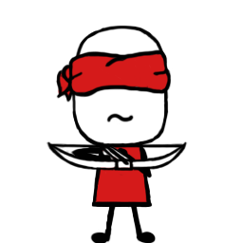
Reflection: Potential Future Work
Port to Mobile
More characters!
Enhanced spectator view UI
Choose your own color, character specialization
Choose your name, choose your opponent
More animations
Notes:
Interesting - focus more on port to mobile, start with that. Optional slide.

Slide 14
Questions?
Notes:
Our focus was compelling esport game. This meant we had to design not just with the player in mind, but also with a

